Slide 1
MILESTONE 6 PROGRESS
Group:
Nicolas Rincon-Speranza
Lawson Darrow
Nikiraj Konwar
Christian Stevens
Advisor:
Dr. Zahra Nematzadeh

Slide 2
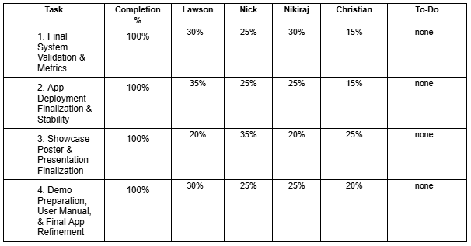
Milestone 6 Task Matrix

Slide 3
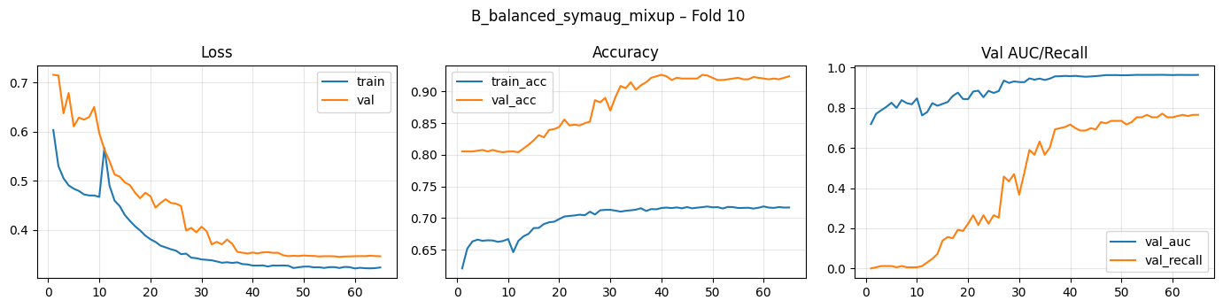
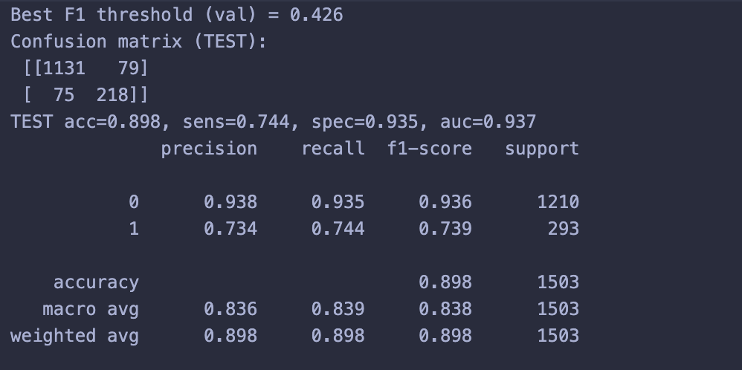
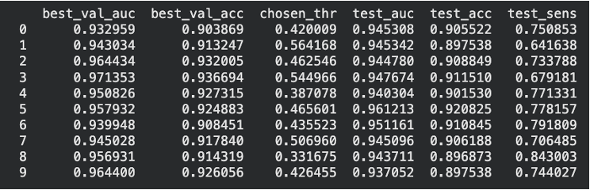
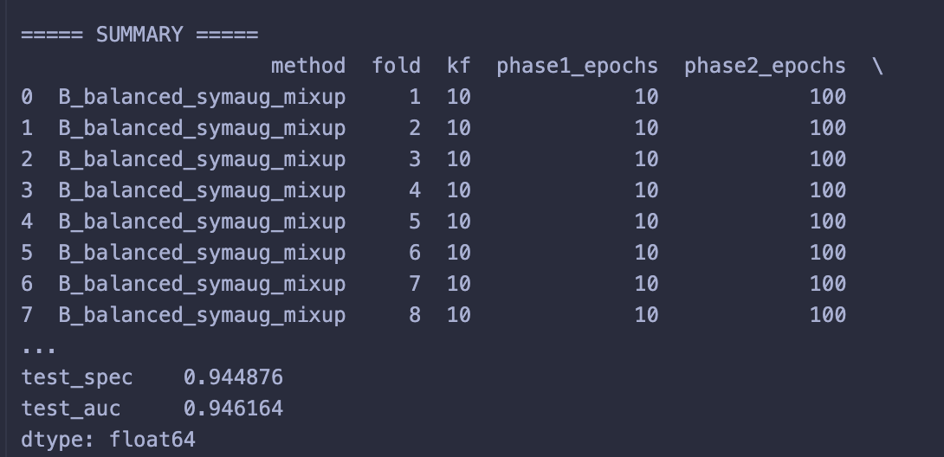
Final Metrics

Slide 4
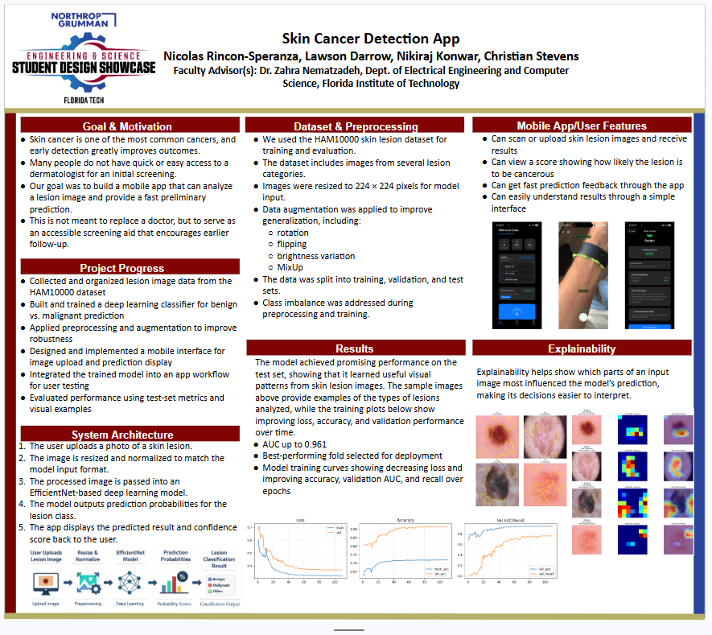
Final Poster

Slide 5
User Manual
Explains how to use SkinCheck from start to finish, including installation, first-time setup, scanning lesions, viewing results, saving history, exporting PDFs, and managing reminders.
Shows the app’s main user-facing features, such as on-device AI classification, scan history, insights/dashboard views, notifications, educational content, and privacy/security settings.
Walks through real usage scenarios, showing how different people—such as everyday users, caregivers, wellness users, and admins—might use the app in practice.
Provides help and reference information, including troubleshooting steps, FAQs, privacy/security details, and a developer section describing the system architecture, backend, code structure, testing, deployment, and how to extend the app.

Slide 6
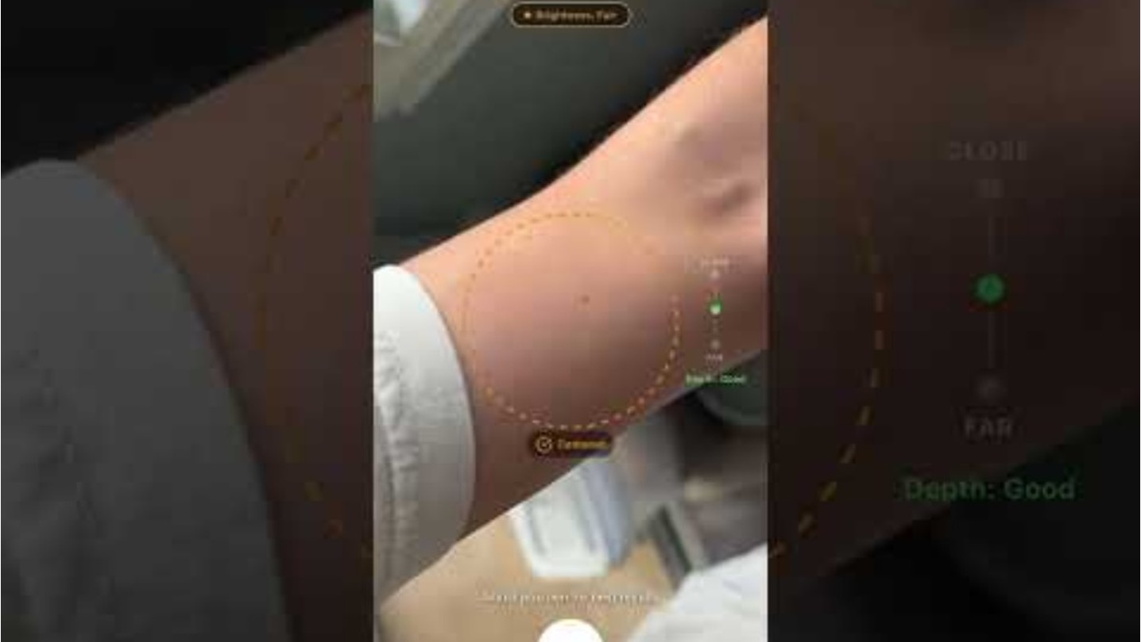
Demo Video
Demo Video

Slide 7
Milestone 6 Lessons Learned
Strong models need strong evaluation
Good performance is not enough without stable results, validation, and error analysis.
Deployment is harder than training
A model that works in development still needs extra work to function reliably in a mobile app.
Explainability improves trust
Visualization tools helped confirm the model focused on meaningful lesion features.
Clear communication matters
Posters, presentations, and demos are important for showing the purpose and value of the project.
Iteration leads to improvement
Repeated testing, feedback, and refinement strengthened both the model and the app.
Teamwork is essential
Dividing responsibilities and working together made it possible to complete the full system.

Slide 8
THANK YOU!
Any Questions

