Slide 1
MILESTONE 4 PROGRESS
Group:
Nicolas Rincon-Speranza
Lawson Darrow
Nikiraj Konwar
Christian Stevens
Advisor:
Dr. Zahra Nematzadeh

Slide 2
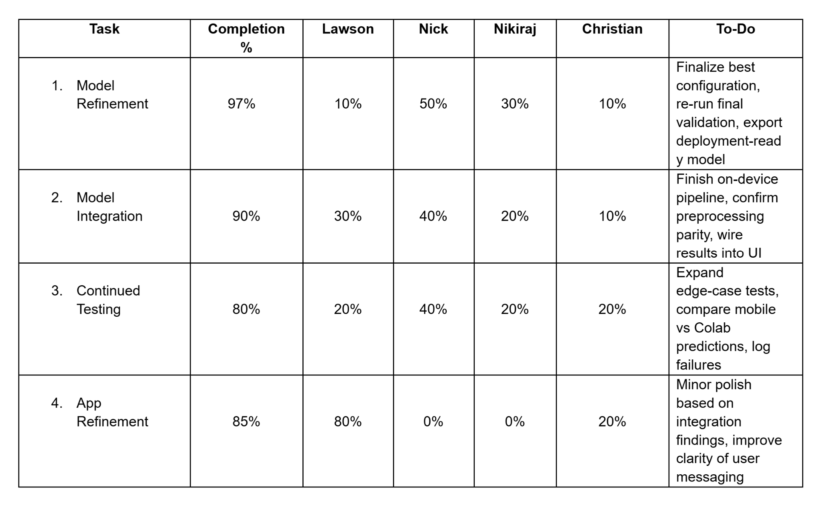
Milestone 4 Task Matrix

Slide 3
Model Logic & Data Strategy
Dataset & Experimental Design
Binary classification: Benign (0) vs Malignant (1)
Stratified 80/20 split to preserve class distribution
Stratified 10-Fold Cross Validation on training set for robust evaluation
Class Imbalance Handling
Two data streams (benign / malignant)
Weighted sampling to oversample malignant class
Improves minority-class sensitivity
Augmentation & Regularization
Mild photometric augmentation (class-conditional)
No unrealistic geometric distortions
Optional MixUp for smoother decision boundary and better generalization

Slide 4
Architecture & Training Strategy
Model Architecture
EfficientNetB0 (ImageNet pretrained)
Global Average Pooling
Dense(512) + BatchNorm + Dropout(0.3)
Sigmoid output (binary probability)
Two-Phase Transfer Learning
Phase 1: Frozen backbone (LR = 1e-3)
Phase 2: Fine-tuning (LR = 1e-4)
Optimization & Evaluation
AdamW + weight decay
Label smoothing (0.1)
ReduceLROnPlateau + EarlyStopping
Threshold selected via best F1 (validation)
Test metrics: Accuracy, Sensitivity, Specificity, AUC

Slide 5
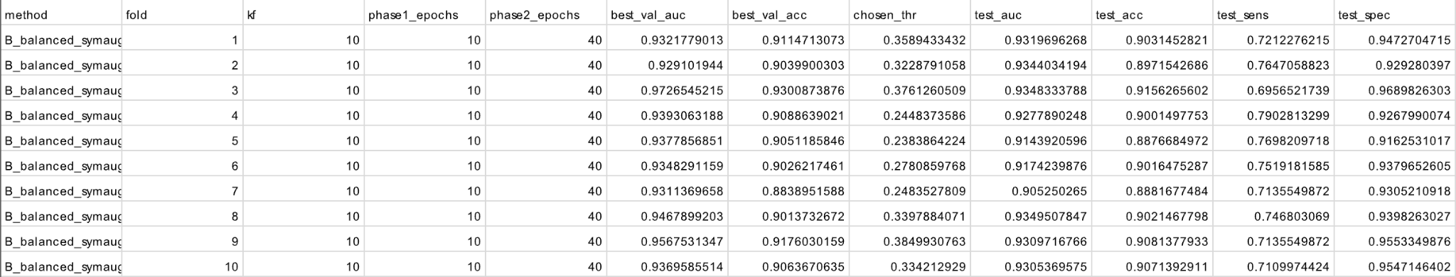
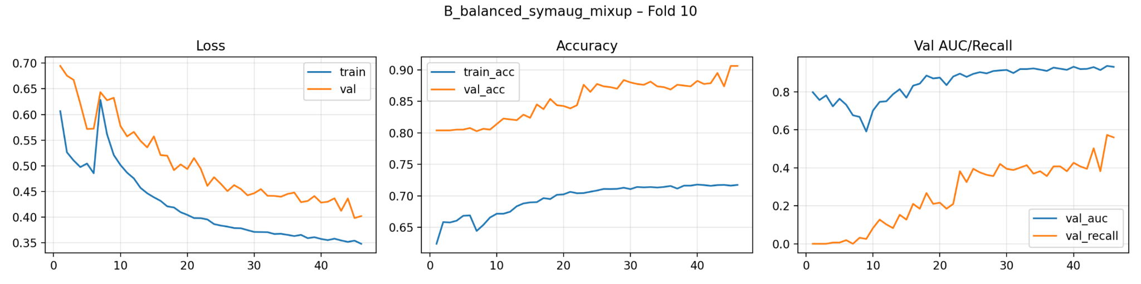
Before Longer Phase

Slide 6
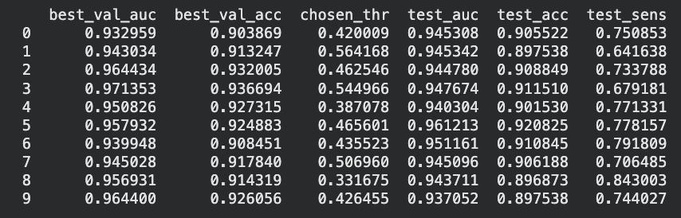
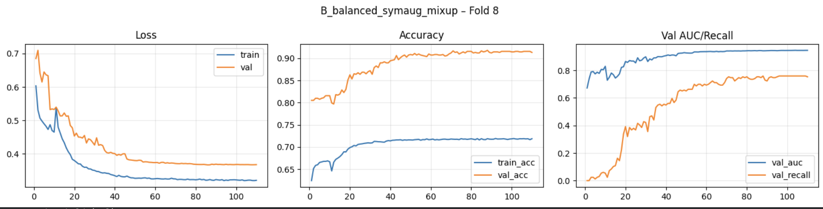

After Longer Phase

Slide 7
Mobile App Refinements
Inference workflow
Run preprocessing + inference off the UI thread to prevent freezes
Load the model once and reuse the interpreter and buffers each scan
Eliminate redundant image conversions and repeated allocations
Avoid unnecessary disk I/O by keeping capture data in memory
Streamlined preprocessing
Resize/crop a single time to the model input size
Normalize in one pass while building the input tensor
Keep preprocessing consistent with training to avoid extra fix-up steps

Slide 8
Mobile App Refinements Cont.
Efficient UI + state handling
Use a clear state flow (idle → processing → result) to prevent duplicate runs
Disable/debounce scan actions during processing
Minimize re-renders and update UI only when loading starts and results arrive

Slide 9
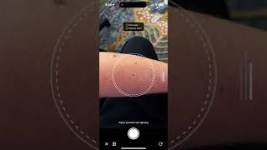
Mobile App Demo

Slide 10
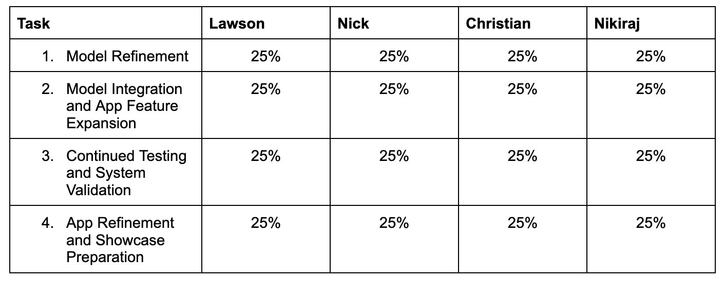
Milestone 5 Task Matrix

Slide 11
THANK YOU!
Any Questions

