Slide 1


Skin Cancer Detection Milestone 1
Nikiraj Konwar, Nicolas Rincon-Speranza, Lawson Darrow, Christian Stevens
Faculty Advisor: Zahra Nematzadeh

Slide 2
Milestone 1 Completion Matrix
Task | Completion % | Lawson | Nick | Christain | Nikiraj | To do
1. Investigate tools | 100% | 25% | 25% | 25% | 25% | none
2. Hello World demos | 100% | 70% | 10% | 10% | 10% | none
3. Requirement Document | 100% | 0% | 100% | 0% | 0% | none
4. Design Document | 100% | 0% | 0% | 0% | 100% | none
5. Test Plan | 100% | 0% | 0% | 100% | 0% | none
6. Implement, test & demo | 100% | 70% | 10% | 10% | 10% | none

Slide 3
Requirements
Functional
Capture & upload images with framing
Classify lesion (benign/malignant) + confidence
Show disclaimers & educational resources
Offline operation; no external storage
Non-Functional
Predictions ≤ 5s
On-device processing (privacy)
Simple & accessible UI
Ethical compliance: not a diagnostic tool

Slide 4




Collaboration Tools
Discord
Communication and scheduling
Channels for files, datasets, links, references
Google Docs
Documentation and real-time collaboration
GitHub
Code management
Useful for version control and branching

Slide 5
Test Plan
Test Case Scenarios for Functional Requirements
Capture lesion with camera
Upload from gallery
Navigate with guidance overlays
Data preprocessing
Image classification
Confidence display
Disclaimers

Slide 6
Test Plan
Test Case Scenarios for Non-Functional Requirements
Latency <5s
Local processing
Accessibility support
Error handling

Slide 7
Test Plan Sample Test Case
Test Case: Capture image under valid conditions.
Objective: Verify ability to capture lesion photo in real-time.
Inputs: User taps camera icon. User takes photo of lesion.
Expected Outcome: Image is stored in memory and passed to preprocessing.
Unusual Input: Extremely low light, camera covered, blurred motion.
Dependencies: Camera permission granted.
Procedure: Open app, grant permission, capture image in varied lighting.

Slide 8
Test Plan Sample Test Case
Test Case: Select existing image.
Objective: Verify gallery import functions.
Inputs: User selects lesion photo from gallery.
Expected Outcome: Imported image is accepted and processed.
Unusual Input: Invalid format (BMP), corrupted file, non-lesion images.
Dependencies: Gallery access permission.
Procedure: Upload valid PNG, invalid BMP, corrupted image, and selfie.

Slide 9
Compare & Select Tools
A. Mobile Development Framework
Flutter
B. Machine Learning Framework
TensorFlow
C. Image Preprocessing Library

Slide 10
Compare & Select Tools
Python
TensorFlow
NumPy, Pandas, Matplotlib, Pillow, Keras
Flutter
Platform macOS

Slide 11
Resolve Technical Challenges
TensorFlow Lite conversion for system compatibility
Required to enable mobile deployment pipeline
CNN integration

Slide 12
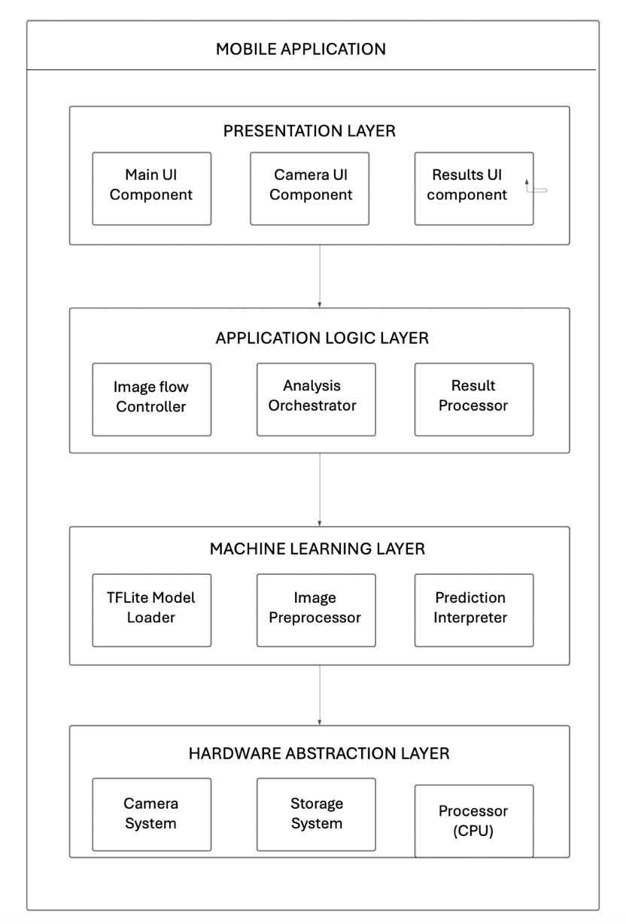
Design
SYSTEM OVERVIEW
The Skin Cancer Detection Mobile Application comprises four major subsystems that
work collaboratively to deliver the complete user experience.
Image Capture Module
Machine Learning Inference Engine
Results Processing and Display
Data Management System

Slide 13
Image Processing Pipeline
BEGIN Image Processing Algorithm
1. CAPTURE raw image from camera hardware
2. VALIDATE image quality metrics:
- Check focus clarity using Laplacian variance
- Assess lighting conditions via histogram analysis
- Verify lesion visibility through region detection
3. IF quality inadequate THEN REQUEST recapture
4. RESIZE image to 224x224 pixels maintaining aspect ratio
5. NORMALIZE pixel values to range [0, 1]
6. APPLY color correction and contrast enhancement
7. RETURN processed image tensor
END Algorithm

Slide 14
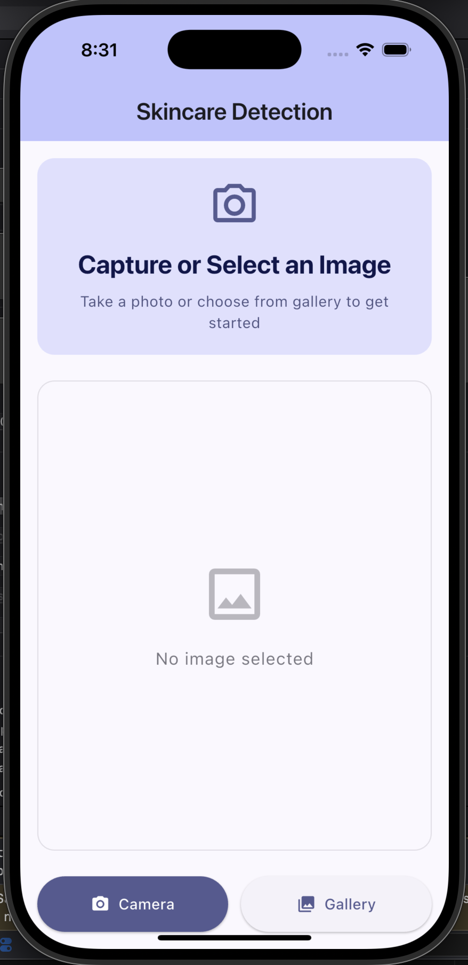
Demo
Flutter app interface
Camera button
Gallery access

Slide 15
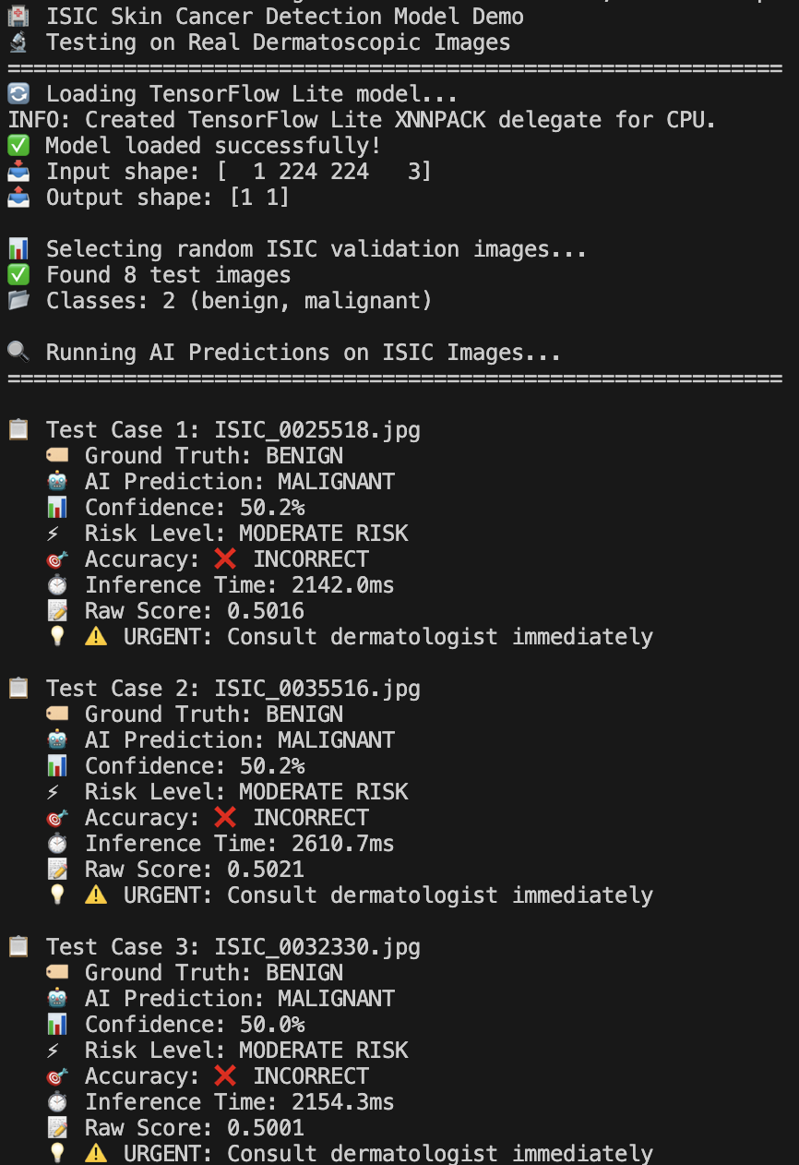
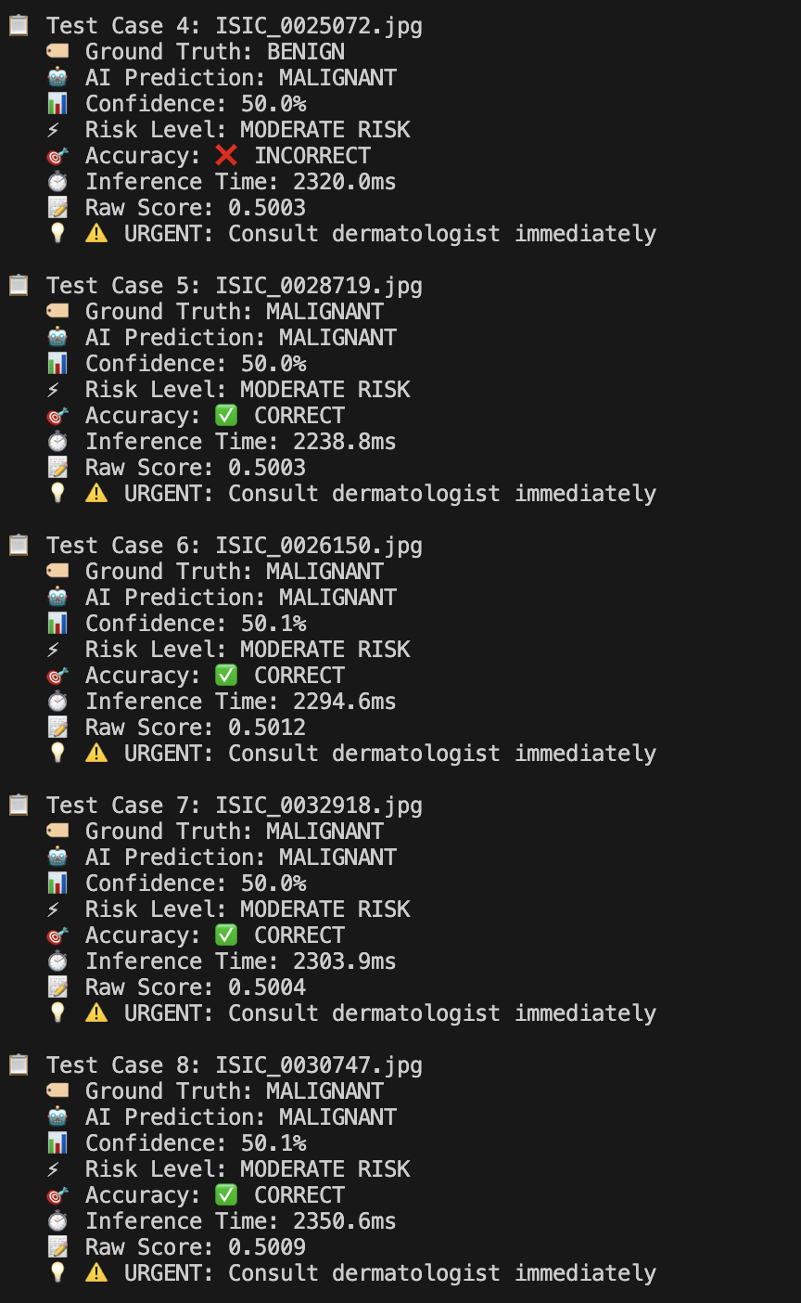
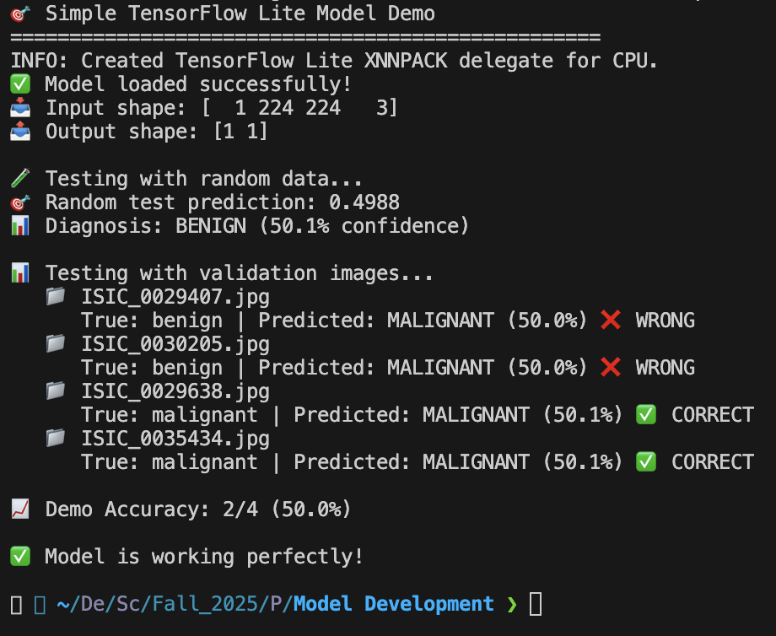

Slide 16
Milestone 2 Task Matrix
Task | Lawson | Nick | Christain | Nikiraj
1. Implement, test, and demo image capture and upload feature with UI framing assistance | Lead development of capture and overlay module | Support testing with different image types | Validate consistency of captured images and report bugs | Document capture workflow and assist with debugging
2. Implement, test, and demo real-time AI-powered prediction feature (integrated TensorFlow Lite CNN model) | Lead integration of TFLite CNN into iPhone app | Assist with connecting preprocessing pipeline | Run performance tests on phone hardware (speed, memory usage) | Verify prediction outputs, confidence display, and error handling
3. Implement, test, and demo disclaimer and educational resource integration (user guidance, preventive info, professional links) | Support UI layout for disclaimers on phone screens | Draft and refine disclaimer wording and educational text | Lead integration of disclaimers and resource links into the iOS app | Test readability, accessibility features
4. Validate prototype with test images and document early usability findings | Run live demos on iPhones and gather user impressions | Lead writing of usability report with structured findings | Conduct systematic testing with edge-case images | Lead analysis of feedback and propose refinements for next milestone

