Slide 1
Dashboard improvement

Slide 2
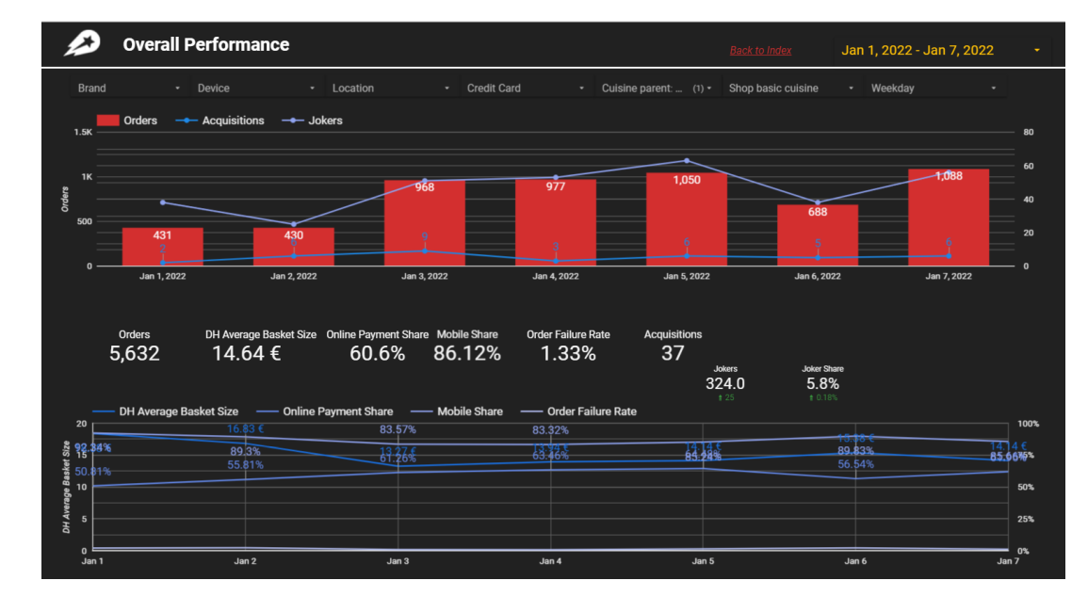
Overall performance
In the filter, the cuisine selected is not obvious
Remove gridlines from both charts
Change color of lines in the charts (e.g. cannot differentiate between acquisition and jokers).
Different charts based on the different kpis (different scales)
Failure rate: different chart as the scale is very small
One chart with share (online, mobile)
The wild cards need to be on top of each charts with the relevant KPIs

Slide 3
Summary of Charts
Key points Overall Performance
January 1st and 2nd had the lowest number of total orders, generating only 15% of the total orders.
January 5 and 7 generated the highest number of orders (38% of total orders).
Mobile has a share of 80%
The average basket size is 14.64 €. On January 2nd, the average basket size increased by 15%
Key points Geographical Performance
Athens is the best performing city in terms of numbers of orders (74% out of the 5,6 K orders)
Rodos exhibits the highest increase since the previous week (26.7% increase)
Serres and Larisa have the highest average basket size.
Kozani and Ioannina have the buiggest decrease in basket size.

