Slide 1

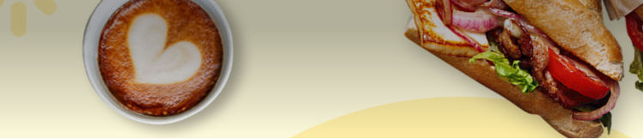
Breakfast Boost

Slide 2
Agenda
Background
Method
Results
Recommendations

Slide 3




Background
Objective
Method
Timeframe
Data
Identify best target group for Breakfast cuisine
Grow customer loyalty
RFM-Behavioral Customer segmentation based on total order value and number of orders
(K means clustering)
January 2022
122 K distinct users
534 K orders
4,5 M € Total Order value
4,38 € Average order value
RFM segmentation: recency, Frequency, Monetary value: We focus on Frequency and Monetary value

Slide 4
Metrics
Order value
Frequency
Order value (i.e. total basket value)
Order Count (i.e. total number of orders)

Slide 5
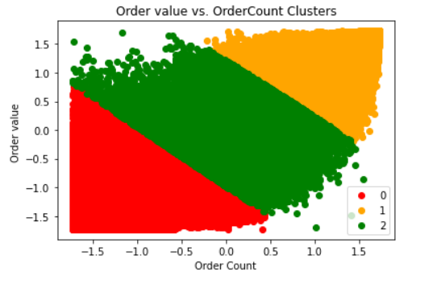
Orange is the cluster with the highest opportunity
Method
Use K-means clustering in order to segment customers based on Order value and Number of orders.
3 segments of customers were identified.
Orange is the cluster where the customers have the highest order amount and highest frequency
High Value High Frequency
Medium Value
Medium
Frequency
Low Value
Low
Frequency
Notes:
In K-means, we specify the number of clusters. The Elbow method indicates the optimal number of clusters. For simplicity, we chose 3 clusters.

Slide 6

Targeting strategies
Campaigns
Objective: Cross Selling
Segment: High Value
Target high value segment in order to promote breakfast cuisine and increase ROI.
High value customers have higher lifetime value, purchase more frequently and are more likely to stay loyal and have a positive response to the targeting campaign.
Objective: Change behavior: Frequency and loyalty Increase
Segment: Medium Value
Target medium value segment in order to promote breakfast cuisine ,increase their value and loyalty.
Objective: Up Selling
Segment: High Value
Target the customers with the highest order value in order to increase their order value. E.g. offer a coupon or discount code
΄΄Μήπως ξέχασες το πρωινό σου σήμερα;¨
Πολλοί επιλέγουν και μπάρα δημητριακών

Slide 7
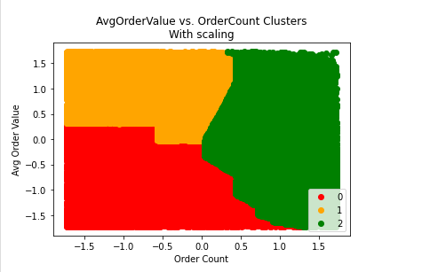
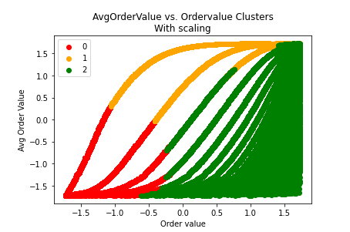
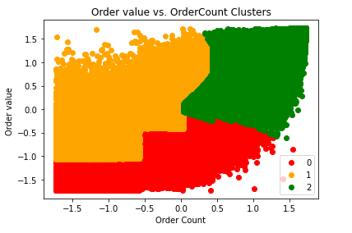
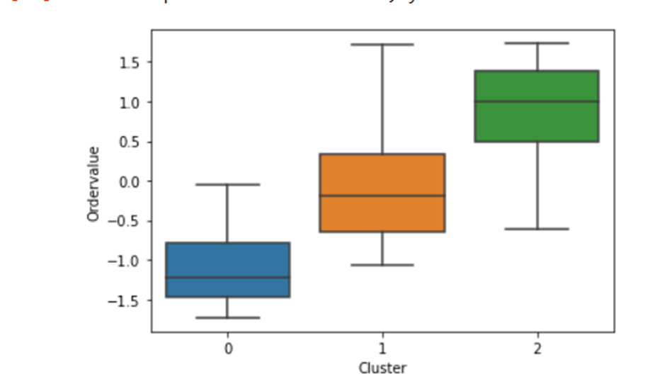
Appendix
Segmentation based on Order Value, Average order value and Frequency

