Slide 1

Analyzing 911 calls
Understanding the Emergency Response System
Daniel P, Nikifor S

Slide 2
Presentation Overview
Project Goals
Data Sources
Solution Architecture
ERD
Demo
Lessons learned
Business Process

Slide 3

Project Goals
Answer business questions related to understanding the emergency response system
Utilize what we’ve learned in the last weeks
Data modeling
ELT pattern
Semantic layer
Deploy and schedule the pipeline in the cloud

Slide 4
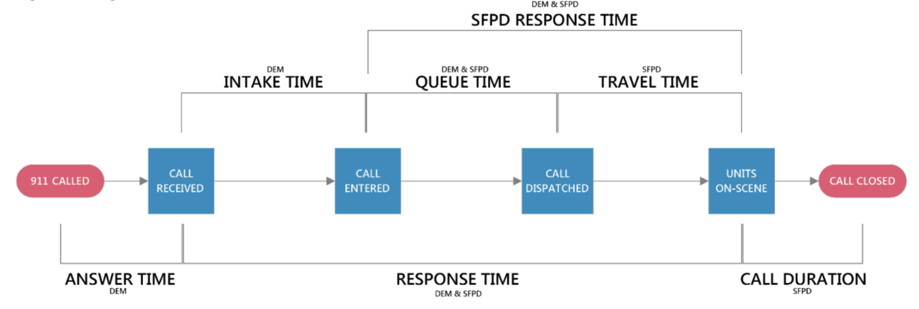
What we are analyzing

Slide 5

Data Sources
Live API – San Francisco open data
Calls
Call types
Districts
Neighborhoods
Static CSV data for enrichment
Calls disposition
Stats about neighborhoods (US Census)

Slide 6
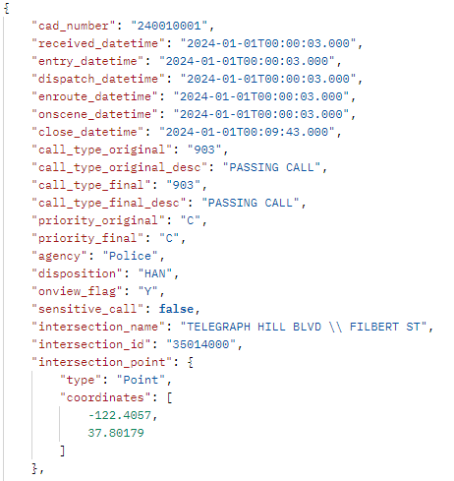
Data Sources
Live API – San Francisco open data
Calls
Call types
Districts
Neighborhoods
Static CSV data for enrichment
Calls disposition
Stats about neighborhoods (US Census)

Slide 7
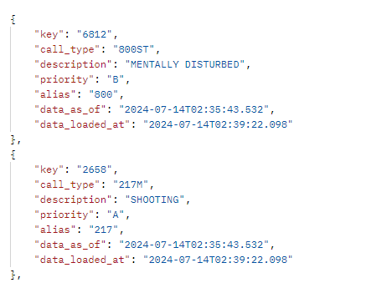
Data Sources
Live API – San Francisco open data
Calls
Call types
Districts
Neighborhoods
Static CSV data for enrichment
Calls disposition
Stats about neighborhoods (US Census)

Slide 8
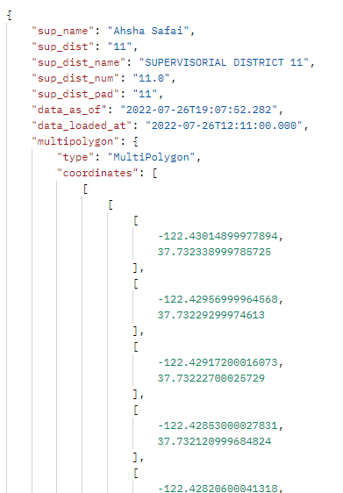
Data Sources
Live API – San Francisco open data
Calls
Call types
Districts
Neighborhoods
Static CSV data for enrichment
Calls disposition
Stats about neighborhoods (US Census)

Slide 9
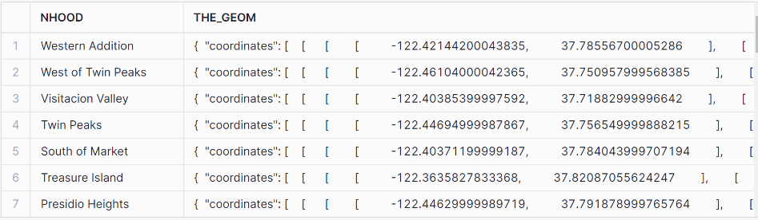
Data Sources
Live API – San Francisco open data
Calls
Call types
Districts
Neighborhoods
Static CSV data for enrichment
Calls disposition
Stats about neighborhoods (US Census)

Slide 10
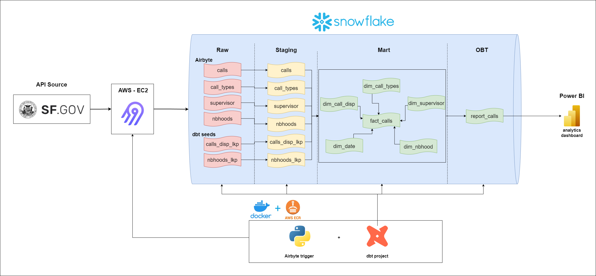
Solution Architecture

Slide 11
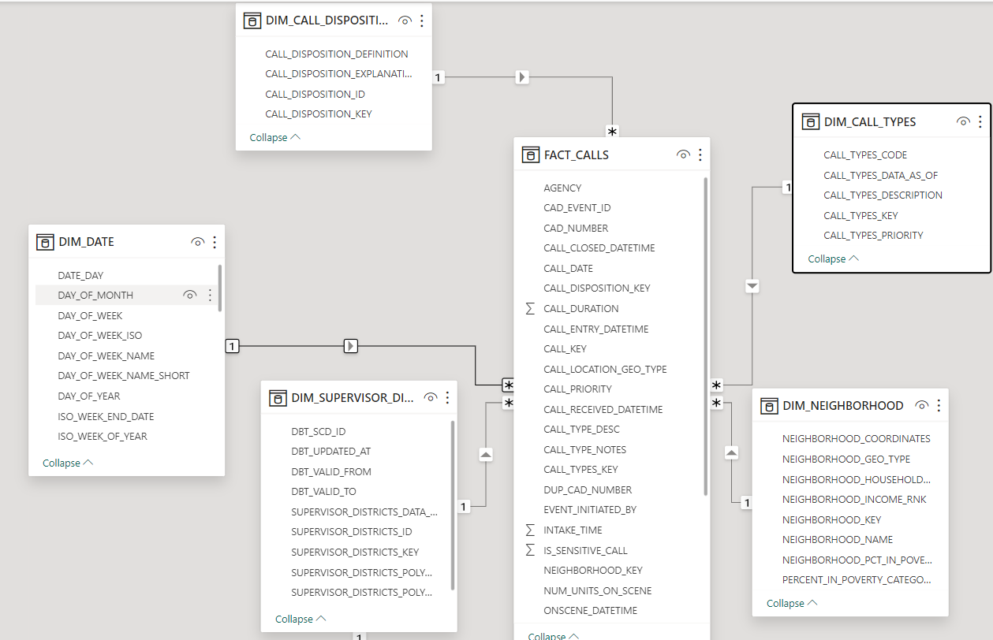
Start Schema ERD

Slide 12


Slide 13

Conclusion and lessons learned
Don’t over complicate
Analyze the metadata and make sanity tests to your crucial components
SCD in DBT is tricky
Small EC2 is not guaranteed to work with DBT

