Slide 1

Analyzing 911 calls
Understanding the Emergency Response System
Daniel P, Nikifor S
Notes:
In this presentation, we will explore the history, types and technologies of 911 calls.

Slide 2
Presentation Overview
Project Goals
Data Sources
Solution Architecture
ERD
Demo
Lessons learned
Business Process

Slide 3

Project Goals
Answer business questions related to understanding the emergency response system
Utilize what we learned in the last weeks
Data modeling
ELT pattern
Semantic layer
Deploy and schedule the pipeline in the cloud
Notes:
The goals of a project define the scope of work and the expected outcomes. Identifying primary and secondary goals is important to ensure that the project aligns with the mission of the organization, while also providing added value. Primary goals are the most important, and they should be the main focus of the project. Secondary goals are less critical, but they still contribute to the overall success of the project. When setting goals, it is important to consider the resources available and the constraints that may affect the project.

Slide 4
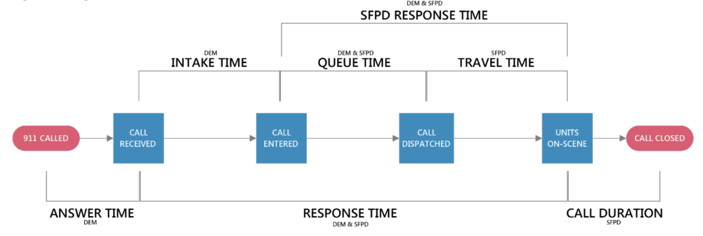
What we are analyzing

Slide 5

Data Sources
Live API – San Francisco open data
Calls
Call types
Districts
Neighborhoods
Static CSV data for enrichment
Calls disposition
Stats about neighborhoods (US Census)
Notes:
One of the key components of any data project is identifying the right data sources to use. Data sources may include databases, APIs, spreadsheets, and more. It's important to carefully consider the quality, quantity, and viability of each potential data source before deciding which ones to use. This will help ensure that the data project is successful and meets its objectives.

Slide 6
Notes:
One of the key components of any data project is identifying the right data sources to use. Data sources may include databases, APIs, spreadsheets, and more. It's important to carefully consider the quality, quantity, and viability of each potential data source before deciding which ones to use. This will help ensure that the data project is successful and meets its objectives.

Slide 7
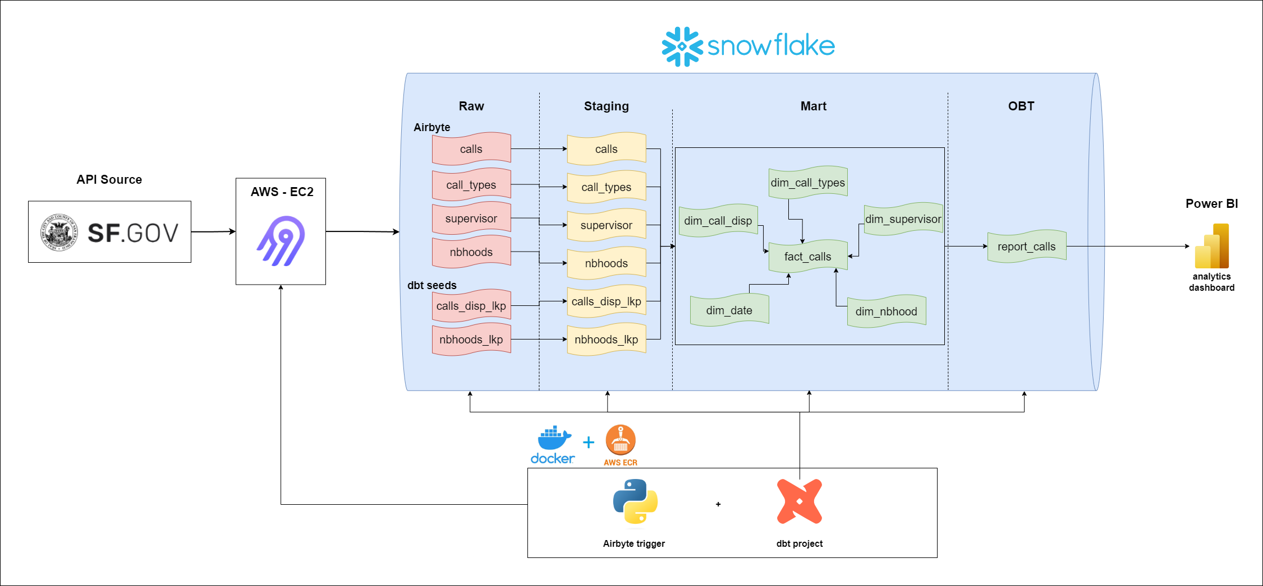
Solution Architecture

Slide 8
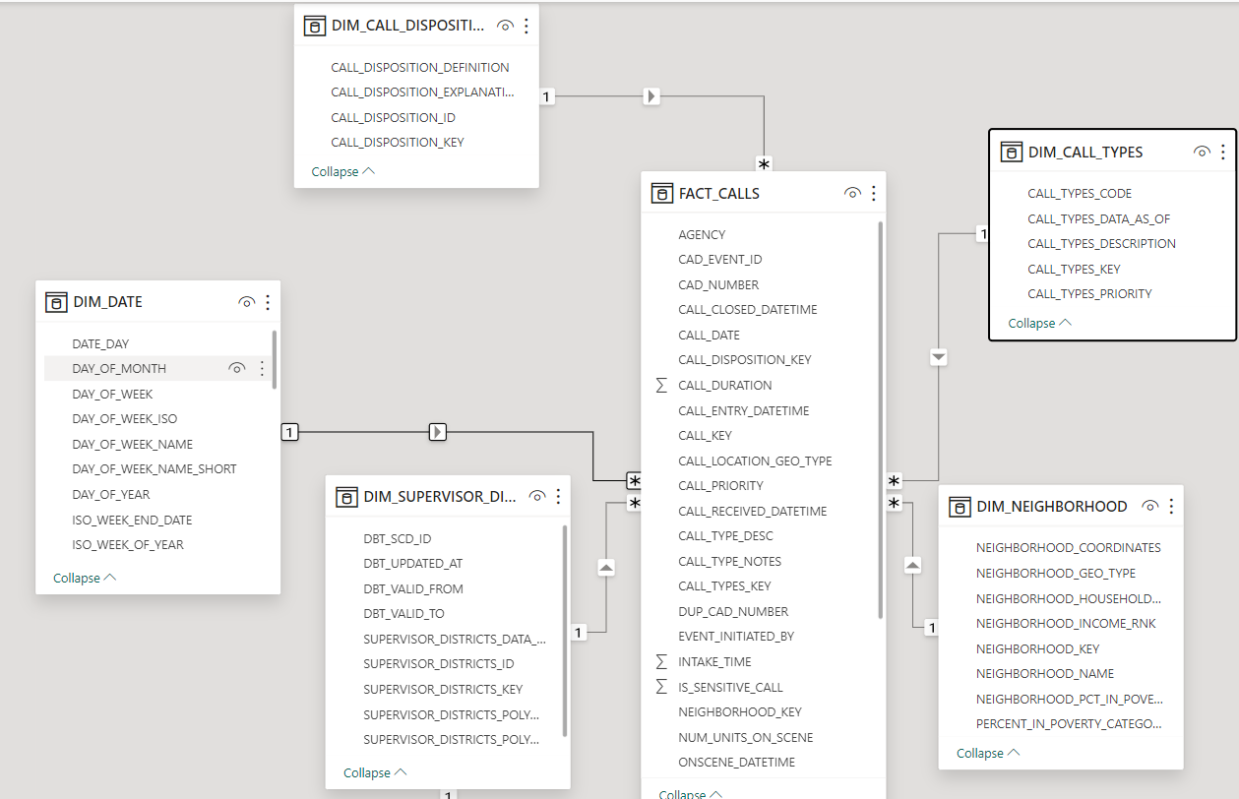
Start Schema ERD

Slide 9

Notes:
This slide should focus on the technical demo that we will be running. It is important to show off the product in action and emphasize its key features. Be sure to clearly explain what the demo is for and what users can expect to see. You might also want to highlight the benefits of the product and why it is worth using.

Slide 10

Conclusion and lessons learned
Don’t over complicate
Analyze the metadata and make sanity tests to your crucial components
SCD in DBT is tricky
Small EC2 is not guaranteed to work with DBT
Notes:
911 calls are an essential public service that provide lifesaving assistance to millions of people every year. As technology advancements continue to transform the way 911 calls are made and managed, it is important to remember the critical role that 911 calls play in public safety.

