Slide 1
Creating and Using HTTP Client SDKs
Oleksii Nikiforov
Software Engineer at EPAM

Slide 2
TABLE OF CONTENTS.
01
02
03
04
05
06
Why would I need it?
How to write manually?
How to extend?
How to test?
How to write declarative clients?
How to generate clients?

Slide 3
WHY?
01
<p> To provide a consistent and manageable way of integrating with a service in the form of a distributable package </p>

Slide 4
WHYs
Demand
Meaningful abstraction
Distributable
Distributed systems are quite popular
Pack it as NuGet package
Speed-up itegration process
Consistent
Versioning
A unified approach for all consumers
Easy to release and version

Slide 5
How to write client SDKs manually
02

Slide 6
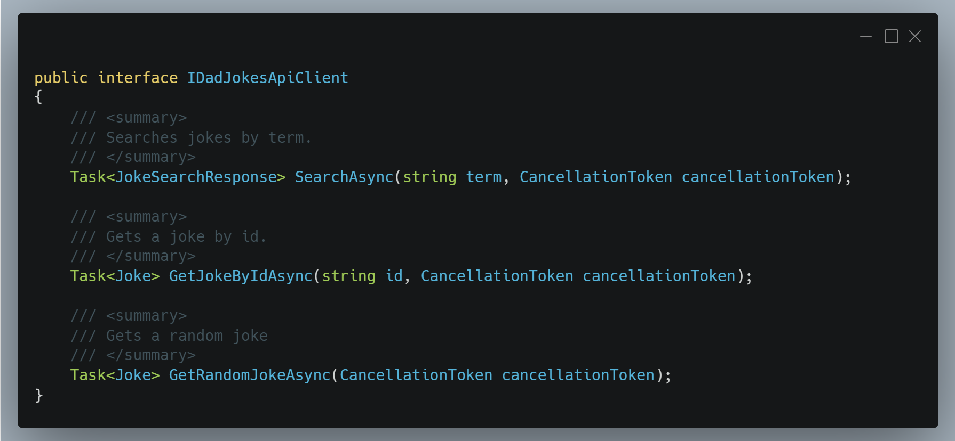
It is a good idea to start from the contract

Slide 7
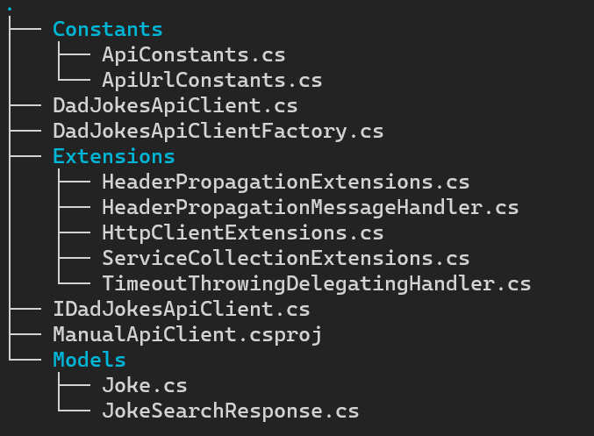
DEMO
The bread and butter of HTTP-based integrations is the HttpClient. It contains everything you need to work with HTTP abstractions successfully
Notes:
Review client;
Client Lifetime
dotnet example –l Review examples

Slide 8
Pros and Cons
✅ Full control over behavior and data contracts. Throw custom exceptions, transform payload, etc
✅Easy to debug and troubleshoot. Simple stack trace
❌ Need to write a lot of repetitive code
❌ Someone should maintain a codebase in case of API changes and bugs

Slide 9
Extension points
03
<p>A wide variety of problems could be expressed as cross-cutting concerns. A message handler receives an HTTP request and returns an HTTP response</p>

Slide 10
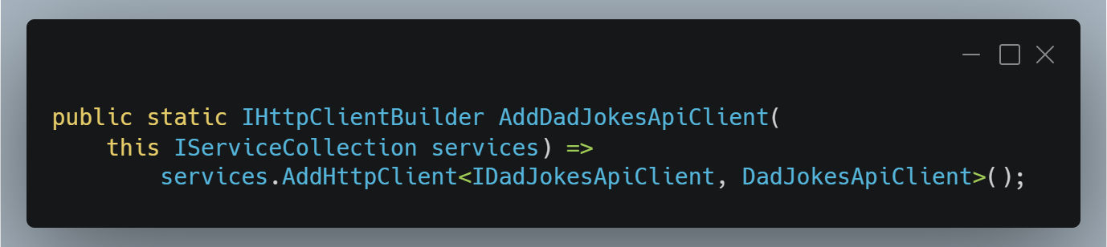
DEMO

Slide 11
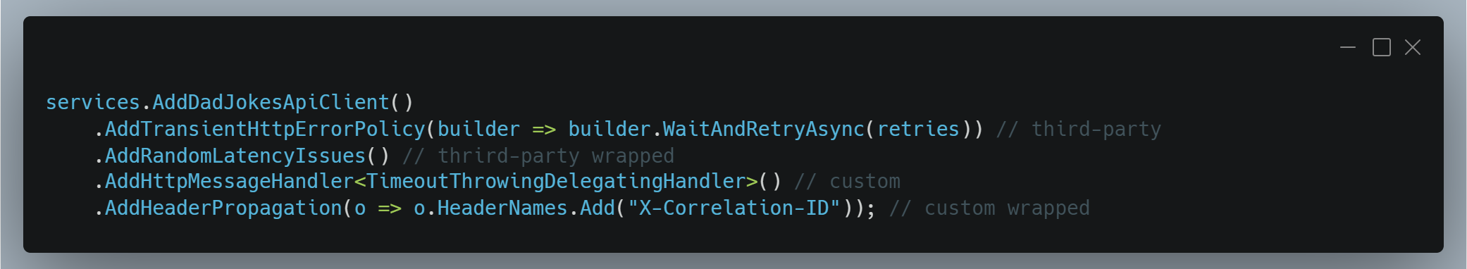
IHttpClientBuilder is a DI-friendly way to add message handlers.

Slide 12
Test
04
<p> Add a brief introduction of your section here: Let’s dive in and get to know some interesting facts about animals! </p>

Slide 13
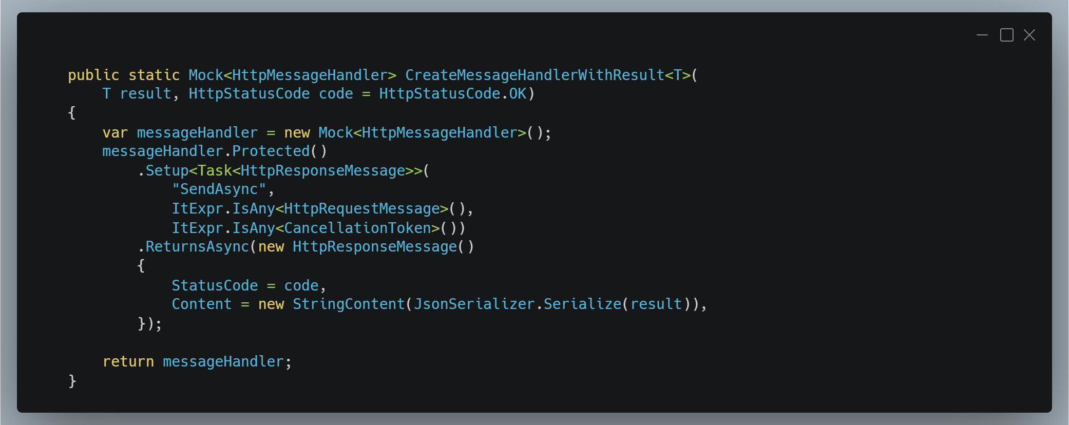

Slide 14
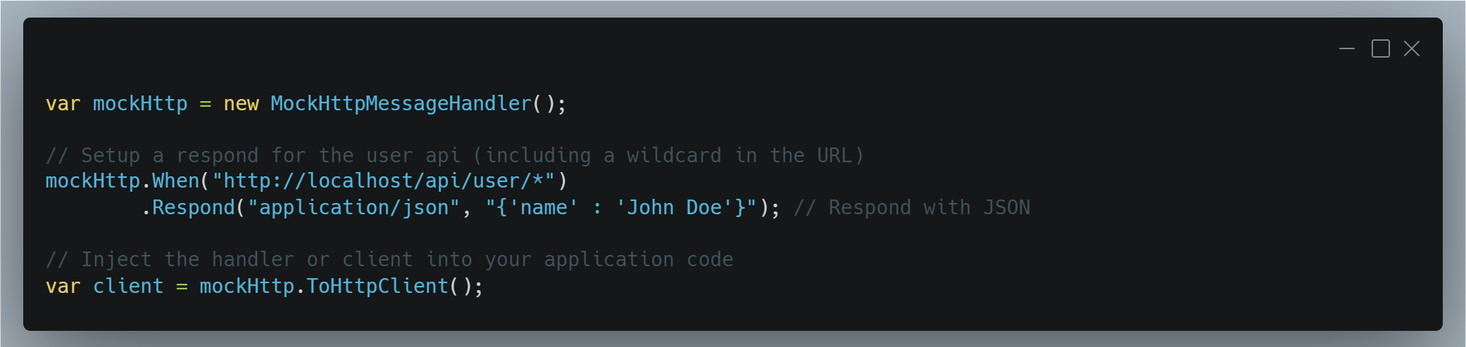
https://github.com/richardszalay/mockhttp

Slide 15
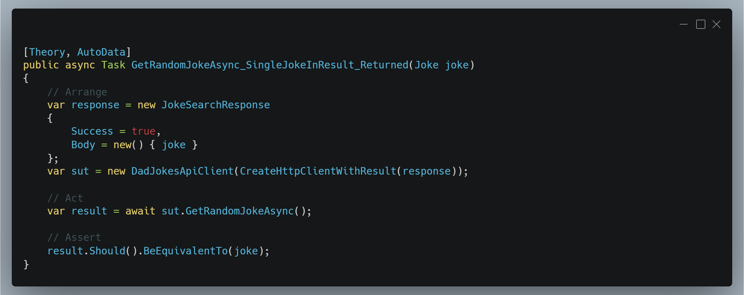

Slide 16
How to write declarative clients
05
<p>Refit is an automatic type-safe REST library for .NET. It turns your REST API into a live interface. </p>

Slide 17
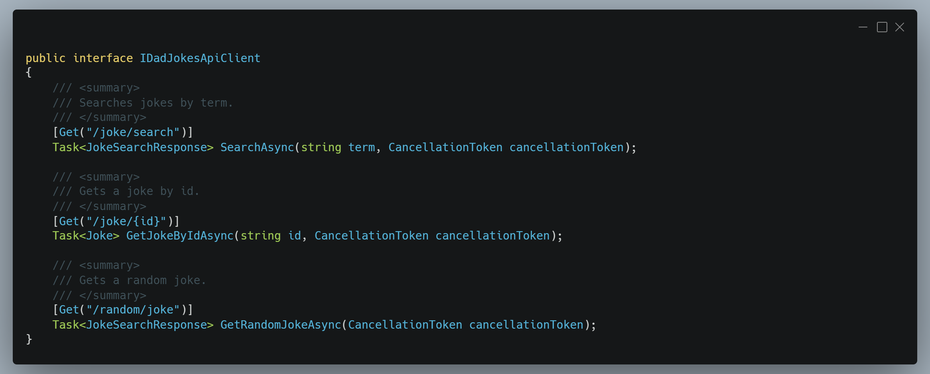
It is a good idea to start from the contract

Slide 18
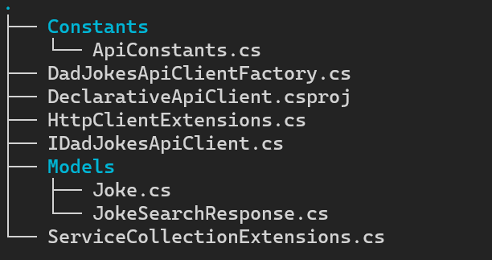
DEMO
The code is automatically generated based on attribute-based configuration. This concept is known as metaprogramming.
Notes:
Review client;
Client Lifetime
dotnet example –l Review examples

Slide 19
Pros and Cons
✅ Easy to use and develop API clients
✅ Highly configurable. Flexible enough to get things done
✅ No need for additional unit testing
❌ Hard to troubleshoot
❌ Requires other team members to understand the tool.
❌ Still consumes some time for medium/large APIs.

Slide 20
How to generate clients?
06
<p> There is a way to automate HTTP Client SDKs fully. The OpenAPI/Swagger specification uses JSON and JSON Schema to describe an API </p>

Slide 21
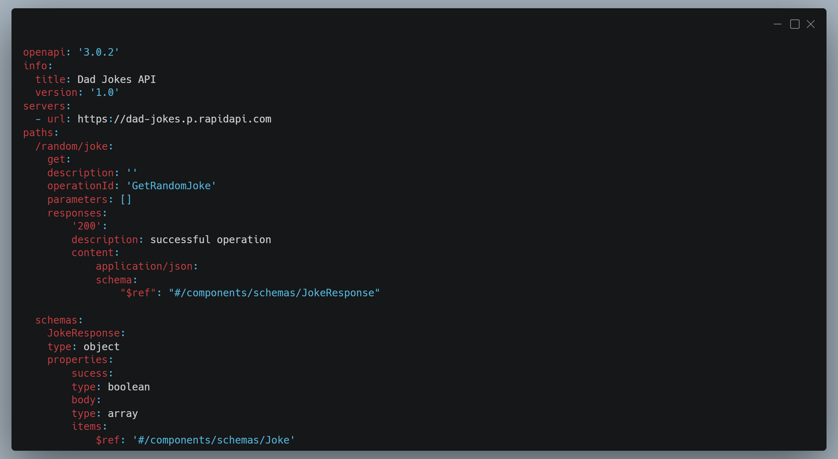

Slide 22
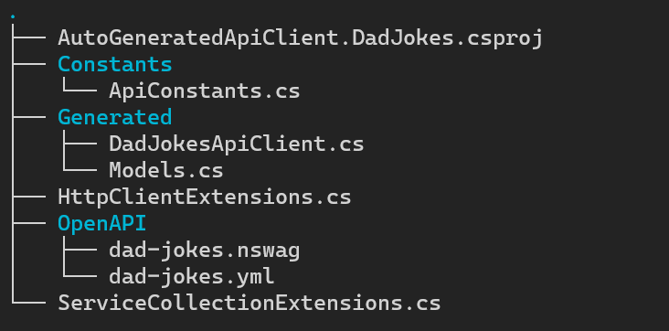
DEMO
The NSwag project provides tools to generate client code from these OpenAPI specifications.
Notes:
Review client;
Client Lifetime
dotnet example –l Review examples

Slide 23
Pros and Cons
✅ Based on the well-known specification
✅ May be integrated into CI/CD process
✅ Multi-language support
✅ Relatively easy to troubleshoot
❌ Hard to customize and control the contract of generated API Client
❌ Can't be applied without proper OpenAPI specification

Slide 24
THANK YOU!
@nikiforovall
https://nikiforovall.github.io/
Do you have any questions?

