Slide 1

<<Electric Motor Temperature>>
<Group 1 R language>
<Varun and Byom>
<14/02/2020>

Slide 2
Business Problem:
The main purpose of the data set's recording is to be able to model the stator and rotor temperatures of a PMSM in real-time. Due to the intricate structure of an electric traction drive, direct measurement with thermal sensors is not possible for rotor temperatures, and even in case of the stator temperatures, sensor outage or even just deterioration can't be administered properly without redundant modeling. In addition, precise thermal modeling gets more and more important with the rising relevance of functional safety.
Objective:
Predict Motor temperature (“PM”) based on other attributes available are like ambient, coolant, torque, current d_q components, voltage d_q components, stator yoke, stator tooth, stator winding, permanent magnet and profile_id.

Slide 3
Project Architecture / Project Flow
Data cleansing
Duplicate values removal
Missing values treatment
EDA
Outlier treatment
Feature Engineering
Data pre processing
Data type conversion
Normalising/ standardising the data
Data visualisation
Model building
Regression model
Tree model
Model evaluation
Evaluating using RMSE metric
Model deployment
Deploying using Shiny

Slide 4
Data cleansing
There are 6,98,649 rows and 14 columns in the training dataset
there are no NA and duplicate values in the given data set.
Check all the business moments.
Majority of the variables are right skewed and has long tail in the end.
While others are left skewed and has long tail in the beginning.
We will remove the 1st variable because it’s a serial number.
When we check the structure of the data set except profile_id others are numeric. Now we have to convert profile_id into factor.
Exploratory Data Analysis (EDA)
After converting into factor we will get 52 levels.
Now find the correlation ship between the variables. There is a collinearity also.
Now we have to make the profile_id into unique, by doing this we will come to know how many levels are there.
The data set will follow normality.
When we used scatterplot we came to know about linearity. Data set follows positive linearity.
Histogram and bar plot will help us to find the variation in the data set.

Slide 5
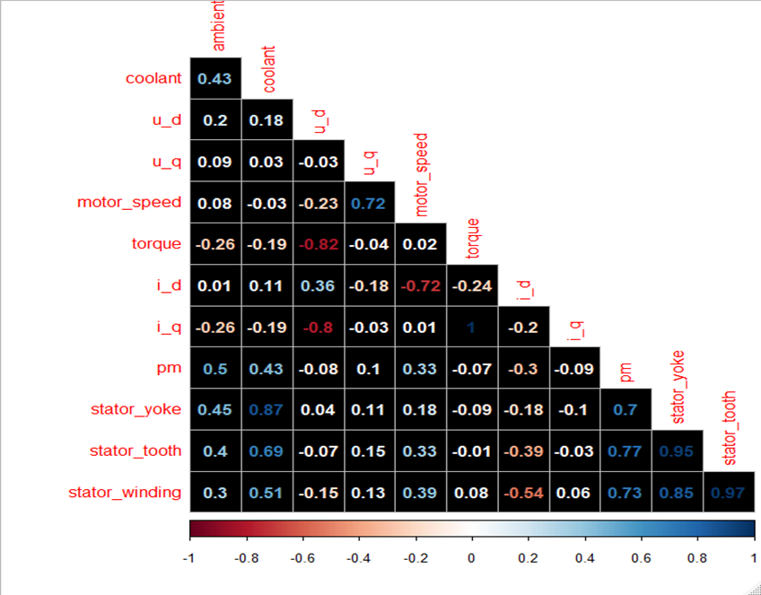
Heat plot will tell us whether there are any NA values and correlation of the variables.
There are outliers in the data set. Before performing model building we have to treat the outliers..

Slide 6
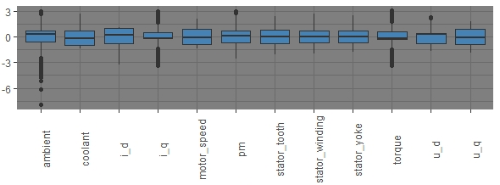
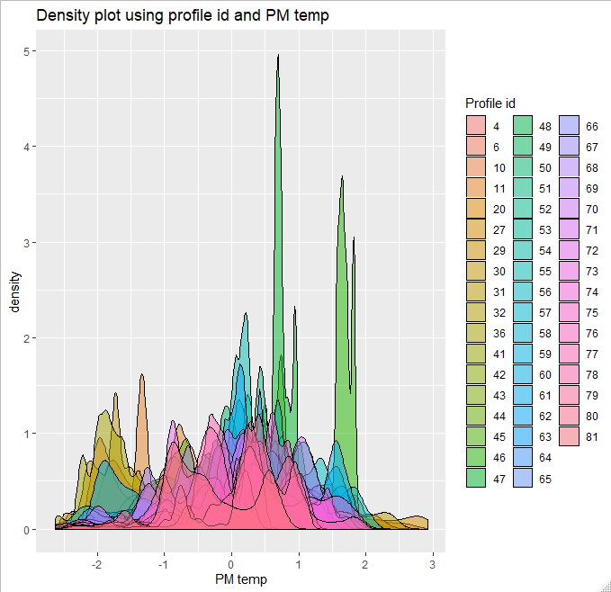
Outliers:
Ambient
i_q
Torque
Outliers are removed Using capping technique of outlier treatment.

Slide 7
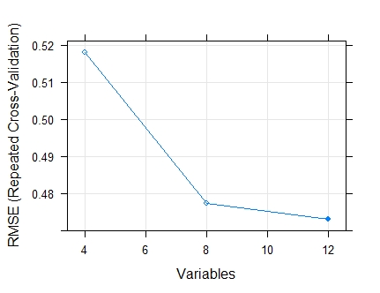
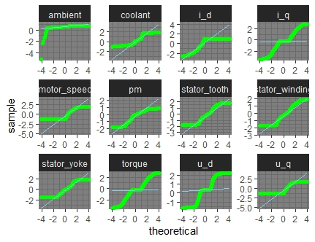
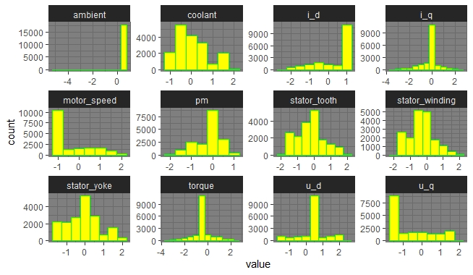
Feature Engineering
For better RMSE all the variables must be considered
Data visualisation

Slide 8
Model Building
Data Set Details
998070 rows X 14 Columns-Continuous Data
Data Partition
Train = 698649 rows X 13 Columns
Test = 299421 rows X 13 Columns
Data is divided into 70:30 of train and test.
Based on this data we are going to perform model building.
Algorithms
Multiple Linear Regression
Ridge Regression
Lasso Regression
Elastic net regression
Decision tree Regressor
Xgboost Regressor
GBM model
Random Forest Regression
Earth-Multivariate Adaptive Regression Splines
H2O.ai models:
Neural network
Random forest
Auto ML
GBM

Slide 9
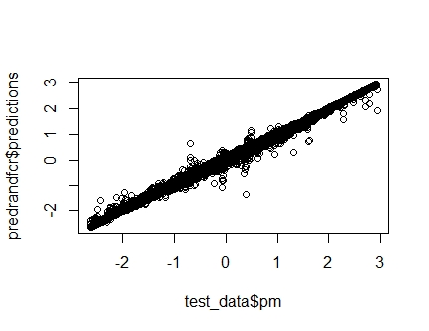
Model evaluation
Model – Random Forest
set.seed(100)
randfor <- ranger(pm~.,data = train_data, num.trees = 100,mtry = 4,importance = 'none')
predrandfor <- predict(randfor,test_data)
cor(predrandfor$predictions,test_data$pm)
rmse(test_data$pm,predrandfor$predictions)
plot(test_data$pm,predrandfor$predictions)
Accuracy: 98.8%
RMSE value: 0.024681
Type: Regression
Number of trees: 100
Sample size: 523989
Number of independent variables: 12
Mtry: 3
Target node size: 5
Variable importance mode: none
Splitrule: variance
OOB prediction error (MSE): 0.001179009
R squared (OOB): 0.9888195

Slide 10
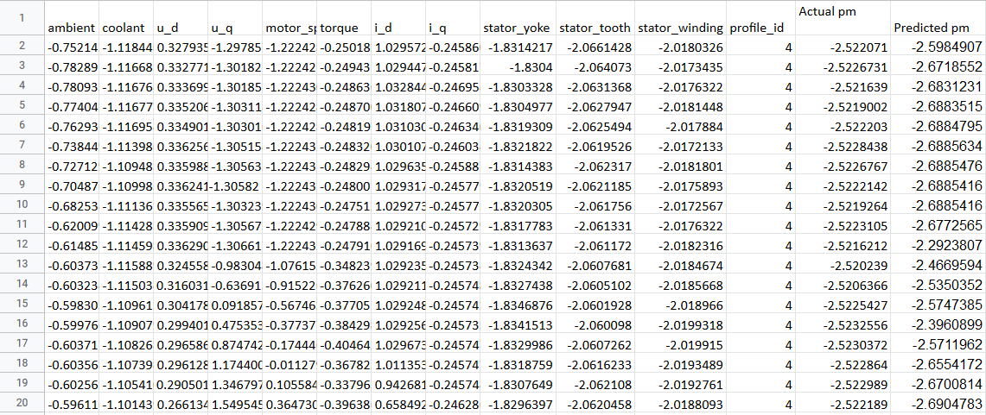
Model Predictions
Electric motor data fed to the model
Predicted probabilities for each pm value
Example

Slide 11
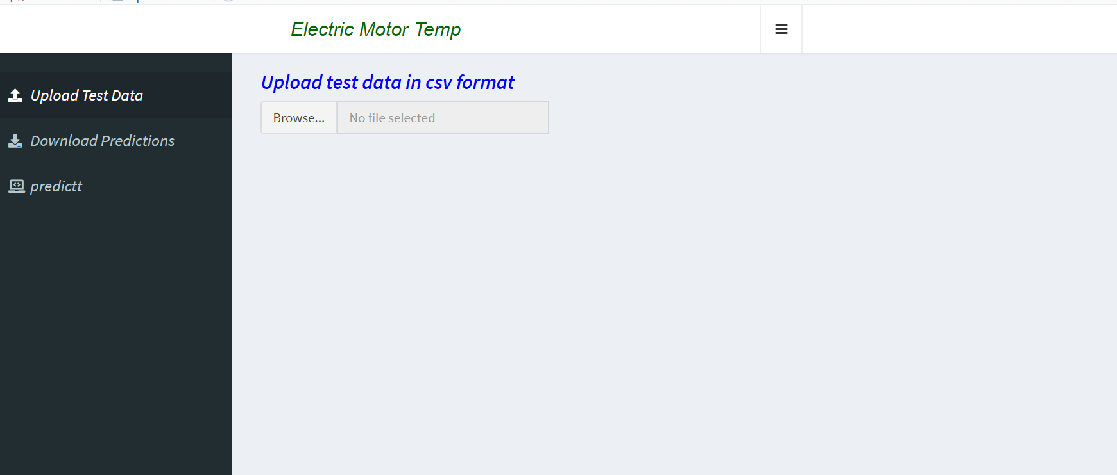
Model Deployment using R shiny
We will upload the test data here in .csv format
Upload test Data : for uploading Test file in .csv format.
Download predictions : for downloading predictions of “PM” from the uploaded file.
Predictt : for prediction of “PM” using slidebar panel (i.e. without uploading file)

Slide 12
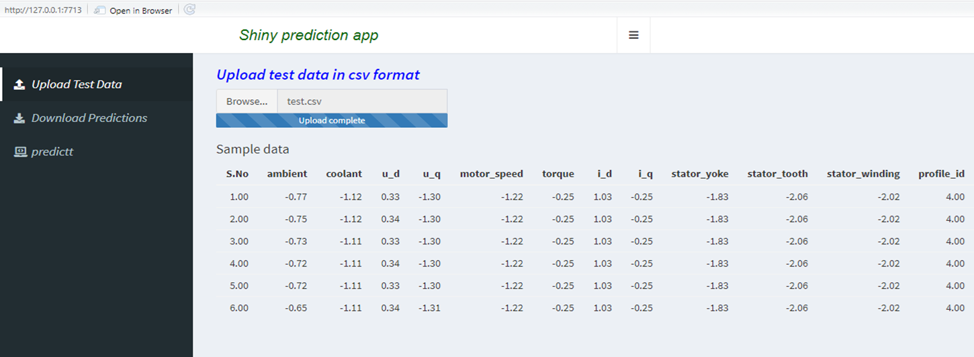
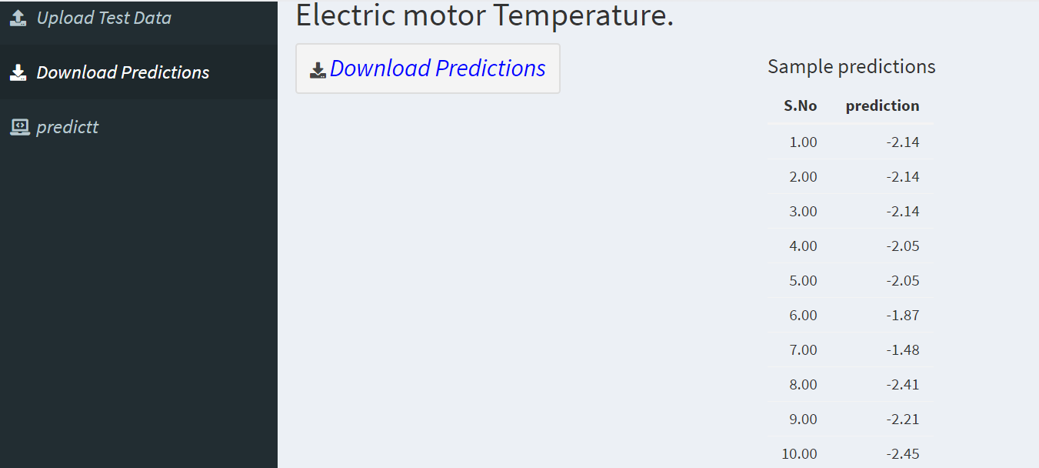
Upload data :
Predict data :

Slide 13
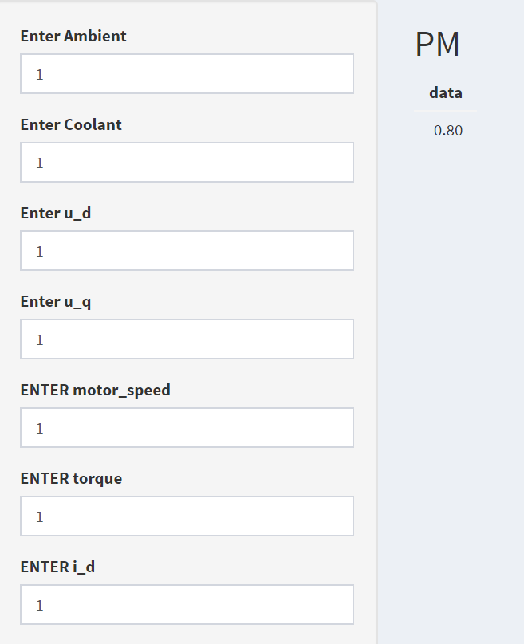
sdowefk0oekf0
Predicting “PM” without uploading :

Slide 14
Challenges faced?
Data visualisation took more time for plotting data.
The dataset contained with large amount of outliers.
Feature selection doesn’t improve the model evaluation metrics.
Model building was more complicated since, size of data set is very large.
model deployment was complicated
How did you overcome?
Data visualisation was done for unique profile_id instead of whole dataset.
Outliers are treated using capping technique of outlier treatment.
From Feature selection profile_id also part of training dataset.
H2o package made model building easier and faster.
model deployment was done using shiny app

Slide 15
Thank you

