Slide 1

Touchless token generation system
Internal Guide
PROF.JASMINE M R
DEPARTMENT OF MCA
TKM COLLEGE OF ENGINEERING
Submitted by
NIKILA MANOJ
TKM21MCA-2030

Slide 2

INTRODUCTION
RELATED WORK
1
2
GAP IDENTIFIED
3
4
PROBLEM STATEMENT
OBJECTIVES
5
CONTENTs
METHODOLOGY
6
7
RESULT
CONCLUSION
8
9
REFERENCES

Slide 3
1. INTRODUCTION
Touchless token generation is a solution designed to facilitate the generation of tokens for walk-in customers without the need for physical contact with screens or objects.
The system uses hand gestures as input to initiate the token generation process by capturing the specific hand attributes and assigning tokens to the users.
This touchless approach enhances user convenience, reduces the risk of spreading diseases, and reduces wait time.

Slide 4
The system is developed using advanced computer vision technologies and machine learning classification algorithms.
The system utilizes the hand detection pipeline of the Mediapipe framework to identify and track hand landmarks, resulting in the detection of 21 distinct key points for each detected hand.
These extracted data points are utilized to train the model using various classification algorithms, including Random Forest (RF), Decision Tree (DT), Naïve Bayes, Support Vector Machine (SVM), and K-nearest neighbors (KNN).

Slide 5
1.1Existing system
The existing token generation system can be categorized into two main approaches:
Manual Handwritten Token
Generated by the receptionist, who physically writes or prints on a paper.
The details of the person may be included.
Token Dispenser
An automated device used to generate and distribute tokens.
Can be used in stand-alone mode to print token slips by pressing a button.

Slide 6
1.1.1 Limitations of the existing system
The process of manually writing tokens is a stressful and time-consuming process leading to customer dissatisfaction.
The existing system of token generation has the highest possibility to cause infectious disease due to unsanitary touch.
The existing system may not always be easily accessible to people with disability or older age people.

Slide 7
1.2 proposed system
Developing a system that can generate tokens that helps in preventing the spread of contagious diseases in places where people gathering is unavoidable and maintaining adherence to social distancing guidelines is important.
A touchless token generation system is highly advantageous for this purpose.
The system employs a webcam or a built-in camera for capturing hand gestures to generate tokens.

Slide 8
2
Related work

Slide 9
Sl. No | Title of the paper, Journal name, Publisher, Year | Algorithm used | Pros | Cons
1. | Hand Gesture Recognition using Image Processing and Feature Extraction Techniques. International Conference on Smart Sustainable Intelligent Computing and Applications under ICITETM2020 Publisher: Elsevier Year:2020 | Random Forests, Support Vector Machines, Naïve Bayes, Logistic Regression, K-Nearest Neighbours . | Feature extraction through ORB technique | No real-time Implementation

Slide 10
Sl. No | Title of the paper, Journal name, Publisher, Year | Algorithm used | Pros | Cons
2. | Cricket Shot Image Classification Using Random Forest. 8th International Conference on Advanced Computing and Communication Systems (ICACCS). Publisher: IEEE Year: 2022 | Random Forests | Feature extraction Using Mediapipe | Lack of Comparative Analysis. Limitations in handling video data.

Slide 11
Sl. No | Title of the paper, Journal name, Publisher, Year | Algorithm used | Pros | Cons
3. | Indian Sign Language recognition system using SVM and CNN. Array Open Access Journal Publisher: Elsevier Year: 2022 | SVM and CNN | Provide both Text and Speech Output. | Inability to distinguish between similar signs with slight differences.

Slide 12
3. Gap identified
The system is effective in recognizing static gestures only and focuses more on improving accuracy rather than interpretability.

Slide 13
4. Problem statement
The system employs advanced computer vision and machine learning technologies to develop a token generation platform that generates tokens by interpreting hand gestures captured in real-time video feeds.

Slide 14
5. objectives
To develop a reliable and efficient system for generating tokens without physical contact, and ensure public health protection.
To develop a machine learning model to accurately recognize and classify hand gestures in real time.
To train the system to accurately recognize a wide range of hand gestures.
To design a system that can handle high-traffic areas and queues, increasing efficiency and reducing wait times.

Slide 15
6
methodology

Slide 16
Steps include:
Dataset
Processing of images
Building and Training the model
Testing and deployment
Reading frames from the live feed using OpenCV
Tracking and drawing landmarks using Mediapipe
Count Increment

Slide 17
6.1 system architecture
ISL
dataset
Processing of images using MediaPipe
Webcam opens using OpenCV
Loading the trained model
Drawing hand landmarks
Capturing hand gestures
Performance Evaluation of the Model
Building and Training the model
Token generation
Token count increasing
Saving the best model

Slide 18
6.1.1 Dataset
1. Dataset
Indian-sign- language dataset is used.
It contains a total of 20,700 images.
The dataset is classified into different classes with different alphabets starting from A to Z and 0-9.

Slide 19
6.1.2 Image processing
The image in the dataset is read using the OpenCV library's imread function and converted to RGB.
Processing on the image is done using the MediPipe Hands solution.
Using the ‘MediaPipe Hands solution’ module the landmarks are detected
The Mediapipe parameters is initialized with the static image mode=True, max num hands=2, and min detection confidence=0.7.

Slide 20
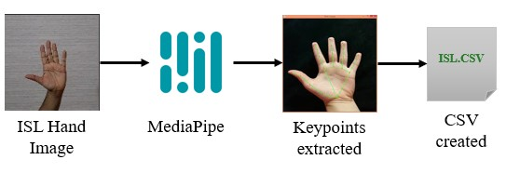
The landmarks are successfully extracted, and a function loops through each feature value and writes it to the CSV file, separated by commas.
The CSV file is used to train machine learning models for hand gesture recognition.

Slide 21
6.1.3 Building and Training the model
The system trains several machine learning models such as Random Forest, Decision Tree, Naïve Bayes, KNN, and SVM on the dataset containing ISL images' landmark coordinates.
The data is split into training and testing sets using train_test_split.
In each case, the model is trained on a training dataset and evaluated on a test dataset.
Each model is implemented using a different class from sklearn.

Slide 22
1. Random Forest
A type of decision tree algorithm that builds multiple decision trees and combines their results to obtain a final prediction.
The RandomForestClassifier object is created with criterion='entropy’.
The random forest classifier is trained using the training data and then evaluating its performance on the test data.

Slide 23
2. Decision Tree
The decision tree algorithm recursively partitions the data into subsets based
on the values of the features, and at each node, it selects the feature that maximizes the separation between the classes or minimizes the variance of the target variable.
A new instance of the DecisionTreeClassifier class is created, specifying the criterion to 'entropy’ to determine the best splits.
The random_state is set to ‘zero’ to ensure the reproducibility of the results.
The decision tree classifier is trained using the training data and then evaluating its performance on the test data.

Slide 24
3. Naive Bayes
The Naive Bayes classifier is based on the Bayes theorem, which describes the probability of an event occurring based on prior knowledge of conditions that might be related to the event.
A new instance of the GaussianNB class is created.
The Gaussian Naive Bayes classifier is trained using the training data and then evaluating its performance on the test data.

Slide 25
4. SVM
Support Vector Machine (SVM) is a supervised machine learning algorithm that can be used for both classification and regression tasks. Here,
A SVM classifier is trained on the training set using the SVC class.
It is configured with a radial basis function (RBF) kernel and the hyperparameters C and gamma are set to 50 and 0.1, respectively.
The classifier is then trained and evaluated.

Slide 26
5. KNN
K-Nearest Neighbors (KNN) classifier is trained on the training data and evaluated its performance on the testing data.
The number of neighbors (n_neighbors) parameter to consider the prediction is set to 5.
‘Minkowski’ metric is used and its power is set to 2.
The classifier is then trained and evaluated.

Slide 27
6.1.4 Testing and Deployment
1. Reading frames from the live feed
Capturing live video frames from the webcam using OpenCV's VideoCapture function from the default system webcam.
Image manipulation and processing such as converting the color of the image from RGB to BGR, flipping the image horizontally.

Slide 28
2. Tracking and drawing landmarks using Mediapipe
Using Mediapipe landmarks are traced and stored on a variable.
The extracted data is processed and cleaned in the same method used for training the model.
The pre-trained model is loaded using ‘joblib. load()’.
The model is used to predict the gesture label for the cleaned hand landmarks data.

Slide 29
3. Count Increment
A count is set such that the number increases for the given time period, for example, 3-4 seconds.
If the model has predicted the same gesture for 40 consecutive frames, a ticket is generated and displayed.

Slide 30
7. result
The following table shows the training score, testing score, and f1 score of the different machine learning classifiers used in the respective study.
SL.NO | Model | Training_accuracy | Testing_accuracy | F1_score
1 | Random Forest | 0.926638 | 0.922572 | 0.922572
2 | Decision Tree | 0.921056 | 0.908043 | 0.908043
3 | Naïve Bayes | 0.851193 | 0.840007 | 0.840007
4 | SVM | 0.986355 | 0.984762 | 0.984762
5 | KNN | 0.980684 | 0.979447 | 0.979447

Slide 31
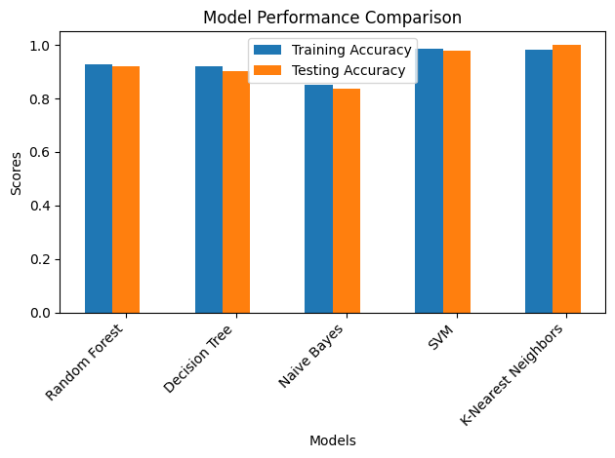
7.1 Training and Testing Accuracy Graphs

Slide 32
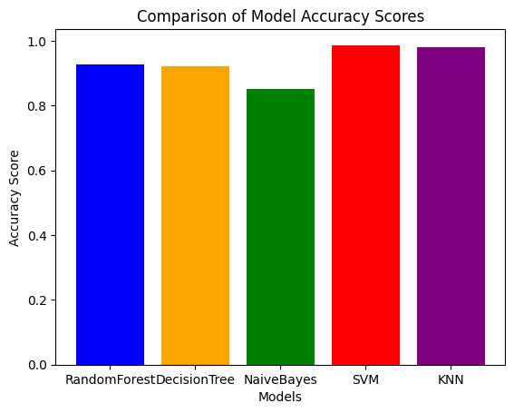
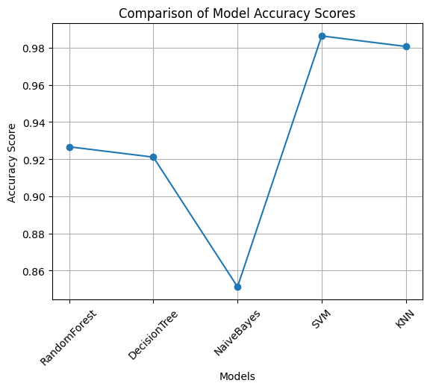
Using bar plot
Using line plot

Slide 33
7. Future enhancements
In the future, it may be possible to incorporate audio feedback for the generated token. Implementing sound effects to indicate when a token is generated can enhance the overall user experience of the system.
Another potential future enhancement for a touchless token generation system using hand gestures could involve incorporating the ability to detect fluctuating hand gestures, such as waving hands.

Slide 34
8. conclusion
A touchless token generation system generates tokens using hand gestures. The system classifies hand gestures using classification models trained on a hand gesture dataset. It imports the necessary libraries, reads in the image data, processes it using the MediaPipe solution, and then stored which is used to train the model. Classification models like RandomForest, DecisionTree, Naive Bayes, and Support Vector Machine (SVM) are trained on the training data and evaluated on the testing data. Real-time data is captured using a computer vision library, preprocessed, and then classified. A ticket shall be generated when a hand gesture is captured.

Slide 35
9. references
M. Nawaz, R. W. Chan, A. Malik, T. Khan, and P. Cao, ”Hand Gestures Classification Using Electrical Impedance Tomography Images,” in IEEE Sensors Journal, vol. 22, no. 19, pp. 12923-12931, Oct. 2022.
C. M. Jin, Z. Omar, and M. H. Jaward, ”A mobile application of American sign language translation via image processing algorithms,” in IEEE Region 10 Symposium (TENSYMP), pp. 104-109, May.2016
G. Jia, H.-K. Lam, S. Ma, Z. Yang, Y. Xu, and B. Xiao, ”Classification of Electromyographic Hand Gesture Signals using Modified Fuzzy C-means Clustering and Two-Step Machine Learning Approach,” in IEEE Transactions on Neural Systems and Rehabilitation Engineering, vol. 28, no. 6, pp. 1428 - 1435, June. 2020.

Slide 36
M. F. Wahid, R. Tafreshi, and R. Langari, ”A Multi-Window Majority Voting Strategy to Improve Hand Gesture Recognition Accuracies Using Electromyography Signal,” in IEEE Transactions on Neural Systems and Rehabilitation Engineering, vol. 27,no. 2, pp. 427 - 436, February.2020.
U. Sairam, D. K. Reddy Gowra, and S. C. Kopparapu, ”Virtual Mouse using Machine Learning and GUI Automation,” in 8th International Conference on Advanced Computing and Communication Systems (ICACCS), Vol. 1, pp. 1112-1117, March.2022.
Devanandan, M., Rasaratnam, V., Anbalagan, M. K., Asokan, N., Panchendrarajan, R., Tharmaseelan, J.”Cricket Shot Image Classification Using Random Forest” in 3rd International Conference on Advancements in Computing (ICAC), pp. 425-430, December.2021

Slide 37
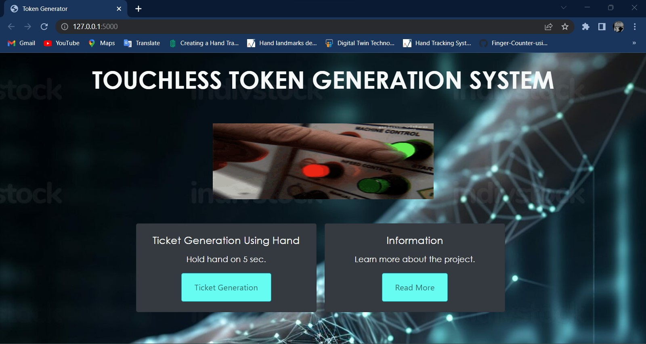
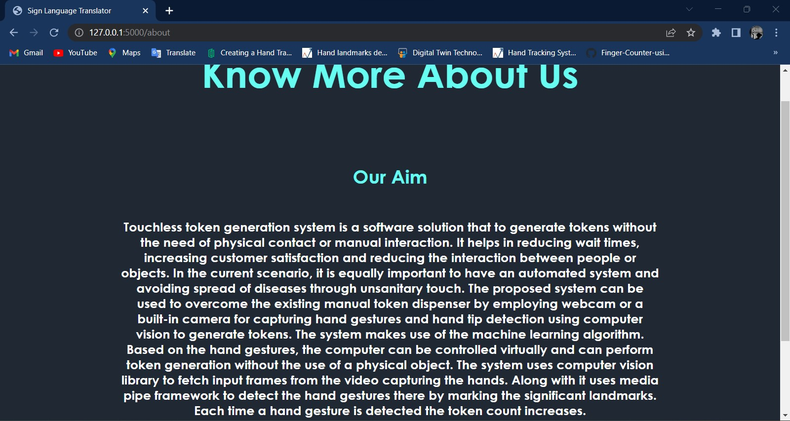
screenshots

Slide 38
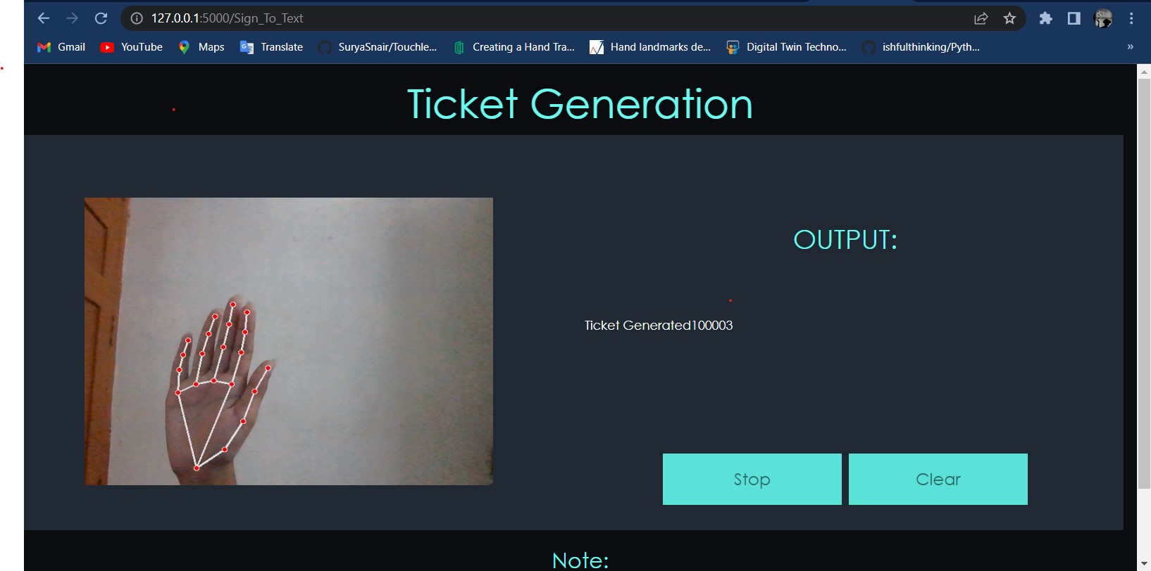

Slide 39
THANKYOU!!…

