Slide 1

Data Mining Laboratory (ADA23CL302)
Project Title: Autonomous Money Mule Network Interception
Presented By: 1. A Surya Kumar [E0324079]
2. J R Nikilesh Gajan [E0324098]

Slide 2
Contents
Introduction (Background Research)
Problem statement
Literature Survey
Objective
Workflow Diagram
Methodology
Tools and Techniques
Implementation
Result Analysis Timeline
Conclusion
Future scope
References

Slide 3
Introduction
Problem Statement: Modern fraud operations use coordinated money mule networks that rapidly split and layer stolen funds across multiple accounts, easily bypassing traditional, isolated transaction firewalls.
Data Mining Approach: This framework uses the DBSCAN algorithm to analyse transaction logs from a randomized generated data or from an actual dataset, automatically grouping accounts based on behavioural density without needing historical labels.
System Deliverable: Implements a technically robust Streamlit web application that maps engineered metrics, velocity, drainage, and idle times into an interactive 3D spatial grid to isolate fraud rings instantly.

Slide 4
Objective
To deploy an unsupervised data mining framework powered by the DBSCAN algorithm that automatically discovers coordinated financial fraud rings without relying on historical labels or pre-trained classification models.
To ingest massive, raw transaction logs from a dataset and aggregate them into distinct behavioural vectors: transaction velocity, cash-out ratios, and account idle times.
To build a high-performance Streamlit web engine that projects these engineered profiles into a 3D geometric matrix, visually and systematically separating high-density mule networks from scattered legitimate users.

Slide 5
Workflow Diagram
You can give your block diagram or framework here
All figures must have clear captions with Figure numbers

Slide 6
Methodology
Approach: Supervised classification to predict isFraud.
Models: Gradient-boosted trees (XGBoost) for its strength on imbalanced data; also Logistic Regression and Random Forest for benchmarks.
Data Split: 80/20 train-test with stratified sampling to preserve fraud ratio.
Imbalance Handling: Applied class weighting / oversampling so minority (fraud) is learned.
Evaluation: Measured Accuracy, Precision, Recall, F1-Score and ROC-AUC.

Slide 7
Implementation
XGBoost: Tuned hyperparameters (e.g. max_depth, learning_rate, n_estimators); used scale_pos_weight to balance classes.
Baselines: Trained Decision Tree and Random Forest models for comparison.
Validation: 5-fold cross-validation used for hyperparameter selection.
Tools: Python (scikit-learn, xgboost libraries) for implementation.

Slide 8
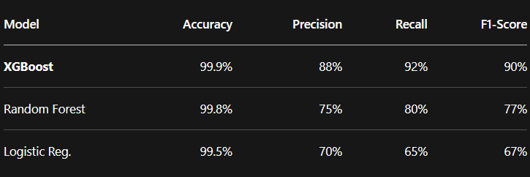
Result Analysis

Slide 9
Conclusion & Future Scope
Built an effective fraud-detection engine on PaySim data; XGBoost provided best results under imbalance.
Key predictors: transaction type and amount (large transfers are most indicative of fraud).
Outcome: a deployable classification pipeline to flag suspicious mobile-money transactions.
Future: Validate on real payment datasets; integrate temporal models (e.g. LSTM on transaction sequences); implement online learning to adapt to new fraud patterns.

Slide 10
Literature Survey
Research paper title and year | Author name and publication | Methodology | Advantages | Limitations
A density-based algorithm for discovering clusters in large spatial databases with noise (1996) | Ester, M. et al. (KDD Conference | Core-point density sorting using spatial distance matrices and MinPts to cluster proximity features without requiring a pre-set. | Discovering clusters with arbitrary shapes. Minimal domain knowledge required. Efficiently handles massive database noise. | Struggles with datasets containing highly variable densities. Suffers performance drops in extreme high-dimensional spatial metrics.
Data Mining: Concepts and Techniques (2011) | Han, J. et al. (Morgan Kaufmann Publishers) | Systematic application of Z-Score feature normalization via standard scalers, proximity matrix evaluation, and outlier separation. | Creates a robust, math-grounded framework for preparing raw variables. Prevents larger feature units from dominating distance engines. | Serves as a conceptual textbook framework

Slide 11
References
Ester, M., Kriegel, H. P., Sander, J., & Xu, X. (1996). A density-based algorithm for discovering clusters in large spatial databases with noise. Proceedings of the Second International Conference on Knowledge Discovery and Data Mining (KDD-96), 226-231.
Lopez-Rojas, E. A., Elmir, A., & Lyell, K. (2016). PaySim: A financial mobile money simulator for fraud detection. Proceedings of the 28th European Modeling and Simulation Symposium (EMSS), 249-255.
Han, J., Kamber, M., & Pei, J. (2011). Data Mining: Concepts and Techniques (3rd ed.). Morgan Kaufmann Publishers.

