Slide 1

Computer Networks Laboratory (CSE23CL301)
Project Title: NETWORK TRACKING ANALYSIS USING A PCAP NETWORK TRAFFIC ANALYZER
Presented By: 1. A Surya Kumar (E0324079)
2. M Kishore Kumar (E0324081)
3. J R Nikilesh Gajan (E0324098)

Slide 2
Contents
Introduction (Background Research)
Problem statement
Literature Survey
Objective
Workflow Diagram
Methodology
Tools and Techniques
Implementation (Dataset description/ environment setup)
Result Analysis (Graphs, Output Screenshots)
Conclusion
Future scope
References

Slide 3
Introduction
Every message on a network travels in packets; a packet capture (PCAP) records them with headers and timestamps.
Tools such as Wireshark show individual packets, leaving the analyst to spot patterns and attacks by hand.
Three common patterns are the SYN flood, the port scan and DNS tunnelling; they appear only when packets are grouped by host, flow and time.

Slide 4
Rule-based detectors catch known patterns but miss behaviour that no rule describes.
Isolation Forest, an unsupervised model, ranks hosts by how unusual they are without labelled attacks.
This project combines both in a browser-based PCAP Network Traffic Analyzer built with Streamlit and FastAPI.
It is a teaching and laboratory tool for saved captures, covering the TCP handshake, DNS, HTTP, LAN/NAT and QoS lab topics.

Slide 5
Problem Statement
Reading a capture packet by packet is slow, so attacks such as SYN floods, port scans and DNS tunnelling can be overlooked.
Proposed solution: a browser-based analyzer that turns a PCAP / PCAPNG capture into summaries, protocol views and explained alerts.
Each source IP receives a severity, a risk score and an Isolation Forest anomaly score.

Slide 6
Literature Survey
Research paper title and year | Author name and publication | Methodology | Advantages | Limitations
Isolation Forest, 2008 | Liu et al., IEEE ICDM | Random trees isolate anomalies in fewer splits | Needs no labelled attacks; fast and simple | Scores are uncalibrated; depend on the data seen
TCP SYN Flooding Attacks and Common Mitigations, 2007 | Eddy, IETF RFC 4987 | Explains SYN floods and defences such as SYN cookies | Clear description of the attack and its defences | Describes defences, not detection from captures
A Mathematical Theory of Communication, 1948 | Shannon, Bell System Technical Journal | Entropy measures how random a string is | General, simple measure of randomness | Short strings give noisy values; needs a threshold
Domain Names – Implementation and Specification, 1987 | Mockapetris, IETF RFC 1035 | Defines DNS messages, names and labels | Standard basis for parsing DNS queries | Does not address misuse such as tunnelling

Slide 7
Objective
To build a web application that parses PCAP / PCAPNG captures and summarises packets, duration, protocol mix and packet rate.
To analyse TCP handshakes, retransmissions and duplicate ACKs, with DNS, HTTP, LAN and QoS pages.
To detect SYN floods, port scans and DNS tunnelling with explained rules, and score each source IP with an Isolation Forest.
To test the application on a synthetic capture with one example of each attack.

Slide 8
Workflow Diagram
1. Capture input
PCAP or PCAPNG upload, or a built-in sample capture
2. Streamlit frontend
Home page and TCP, DNS, HTTP, LAN, QoS and Alerts pages
3. FastAPI backend
POST /upload; GET /summary, /tcp, /dns, /http, /lan, /qos, /anomalies; POST /baseline
4. Packet parser
Scapy PcapReader reads the packet fields (bounded size)
8. Dashboard
Charts, tables and alerts with severity, risk score and reason
7. Detectors
Rules (SYN flood, port scan, DNS tunnelling) and Isolation Forest
6. Feature builder
One feature row per source IP and 10-second window
5. Protocol analyzers
TCP flows and handshakes, DNS, HTTP, LAN and QoS
Figure 1: Workflow of the PCAP Network Traffic Analyzer

Slide 9
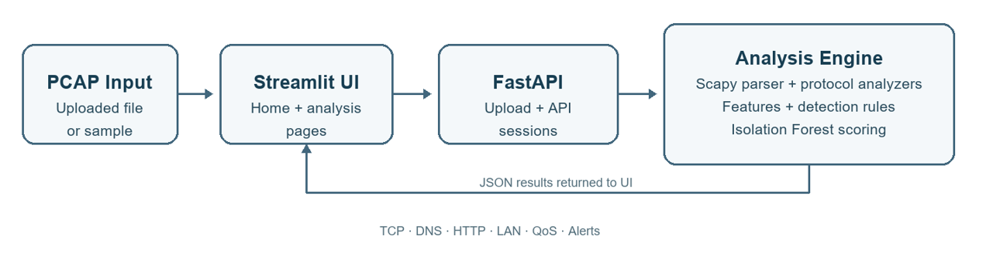
System Architecture

Slide 10
Methodology
Parse every packet with Scapy: timestamp, length, IP addresses, ports, TCP flags and DNS query names.
Label each packet with its highest recognised protocol and count packets in 1-second bins.
Build bidirectional TCP flows and mark each as complete or half-open from its SYN, SYN-ACK and ACK steps.
Build one feature row per source IP and 10-second window: SYN counts, destination ports, DNS label length and entropy.

Slide 11
Methodology (contd.)
Detector | Signal in a 10-second window | Output
SYN flood | Many SYNs from one source with a low SYN-ACK ratio, r = SYN-ACK / SYN | 70 points
DNS tunnelling | Long or random-looking DNS labels (Shannon entropy) | 55 points
Port scan | Many distinct destination ports from one source | 45 points
Isolation Forest | StandardScaler and forest on per-source features | Score 0–100
Table 1: Detection rules and anomaly scoring. Each source IP gets a risk score (0–100) and a severity: High, Medium or Low.

Slide 12
Tools and Techniques
Streamlit multipage dashboard with Plotly interactive charts.
FastAPI and Uvicorn backend; Requests connects the dashboard to the API.
Scapy PcapReader for bounded PCAP / PCAPNG parsing; pandas and NumPy for tables and features.
scikit-learn: StandardScaler and Isolation Forest for anomaly scores.
Techniques: threshold rules over 10-second windows, TCP handshake reconstruction and Shannon entropy of DNS labels.

Slide 13
Implementation
Dataset: two deterministic synthetic captures, normal_sample.pcap and synthetic_attacks.pcap (Table 2).
Environment: Python 3.10+ on Windows; setup.bat installs the packages and run_project.bat starts FastAPI and Streamlit (localhost:8501).
Metrics: detection rate DR = TP / (TP + FN) × 100 %; a false alert names the wrong attack for a host; per-protocol counts must sum to the total packets.

Slide 14
Implementation (contd.)
Property | normal_sample.pcap | synthetic_attacks.pcap
Packets | 16 | 170
Duration | 25.0 s | 4.70 s
Protocols | TCP 12, DNS 3, ARP 1 | TCP 162, DNS 8
TCP handshakes | 3 complete (RTT 60 ms) | 0 complete; 162 half-open
Injected attacks | None | 10.0.0.5 SYN flood; 10.0.0.9 port scan; 10.0.0.7 DNS tunnelling
Rule alerts | None | SYN flood, DNS tunnelling, port scan
Table 2: Deterministic synthetic captures, written offline; no traffic is transmitted.

Slide 15
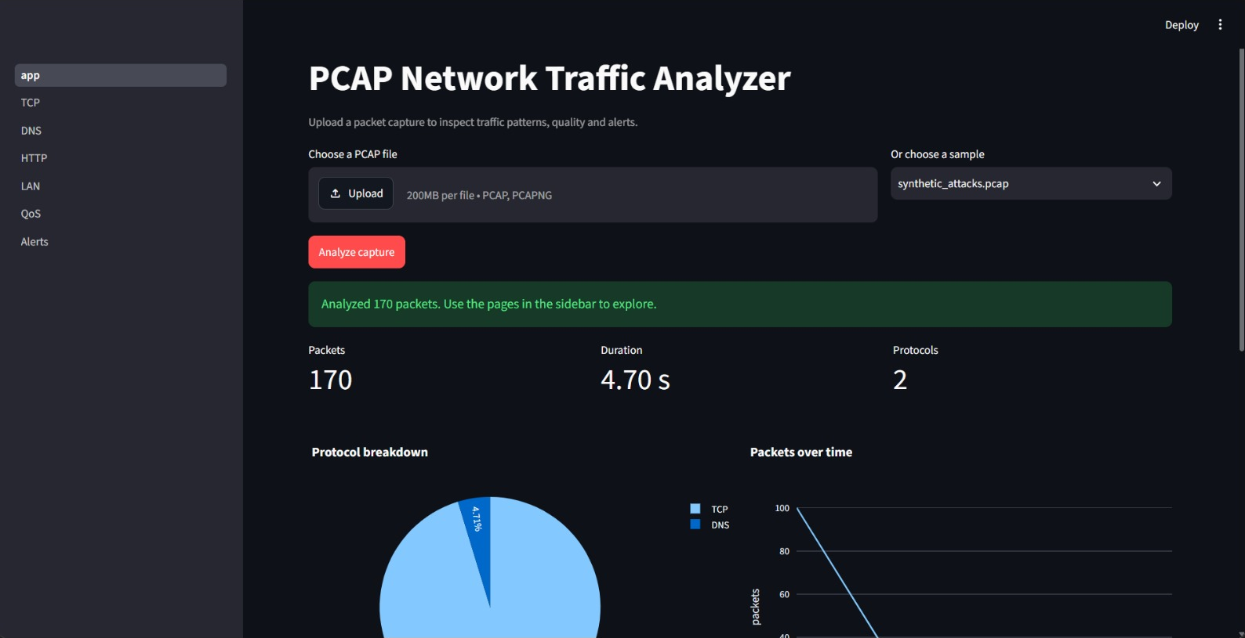
Results
170 packets analysed over 4.70 s; 2 protocols found (TCP and DNS).
Figure 2: Home page after analysing synthetic_attacks.pcap

Slide 16
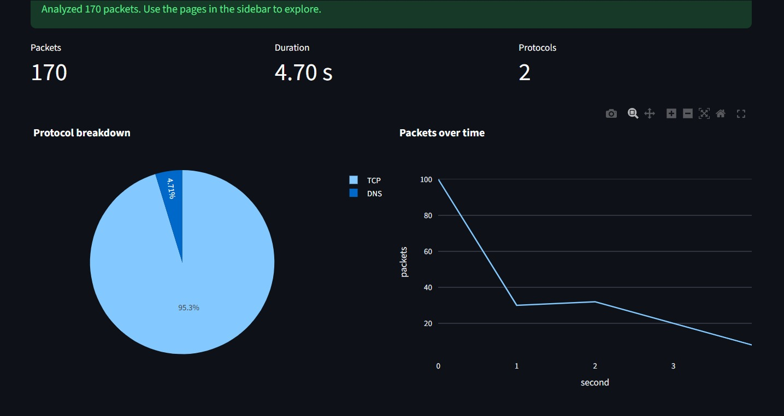
TCP 95.3 %, DNS 4.71 %; about 100 packets arrive in the first second.
Figure 3: Protocol breakdown and packets over time

Slide 17
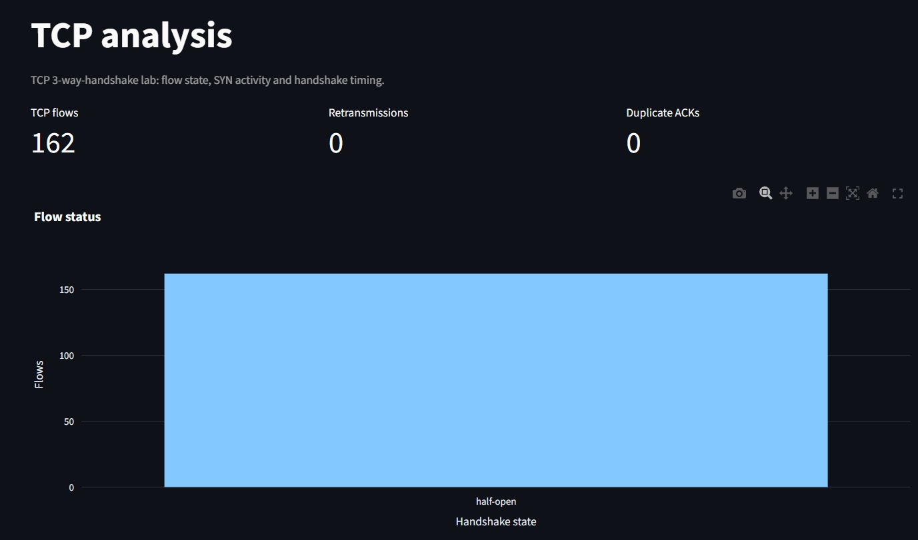
162 TCP flows, all half-open; 0 retransmissions and 0 duplicate ACKs.
Figure 4: TCP analysis page: flow status by handshake state

Slide 18
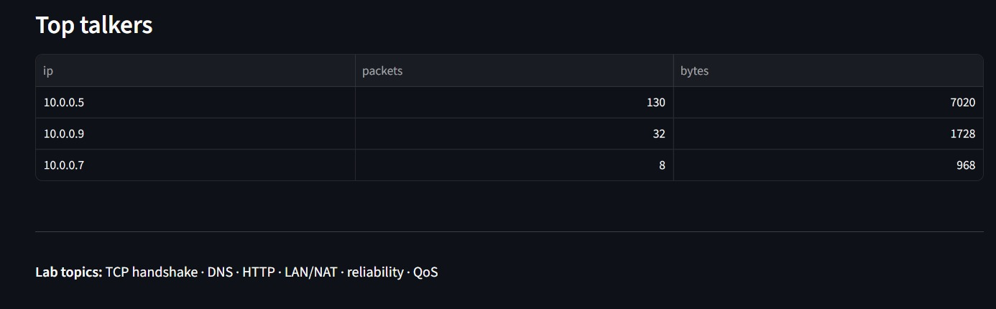
10.0.0.5 sent 130 of the 170 packets.
54 bytes per packet is a bare SYN: 14 + 20 + 20 bytes of headers.
Figure 5: Top talkers table on the home page

Slide 19
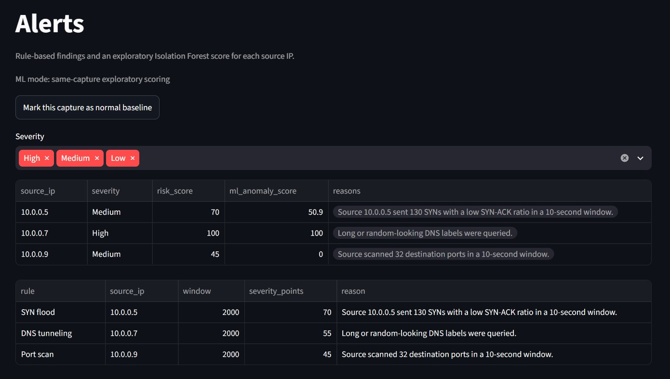
All 3 attacking hosts flagged; 10.0.0.7 High, the others Medium.
Figure 6: Alerts page: severity, risk score, Isolation Forest score and reason

Slide 20
Result Analysis
Source IP | Attack (rule) | Packets | Bytes | Severity | Risk score | IF score
10.0.0.5 | SYN flood | 130 | 7,020 | Medium | 70 | 50.9
10.0.0.7 | DNS tunnelling | 8 | 968 | High | 100 | 100
10.0.0.9 | Port scan | 32 | 1,728 | Medium | 45 | 0
Table 3: Rules versus Isolation Forest (IF) on synthetic_attacks.pcap. The rules flagged all 3 attackers (detection rate 100 %, no false alerts); the forest scored the port scanner 0, so the rules should drive the alerts. These results come from one small synthetic capture.

Slide 21
Conclusion
Built a browser-based PCAP Network Traffic Analyzer with overview, TCP, DNS, HTTP, LAN and QoS views and explained alerts.
On the 170-packet synthetic capture, all 162 TCP flows were half-open and all 3 attacks were flagged correctly.
Isolation Forest scored the port scanner 0, so unsupervised scores need normal traffic as a baseline.
Limits: one small synthetic capture and hand-set thresholds; testing on real labelled traffic is next.

Slide 22
Future Scope
Test on public labelled captures and normal campus traffic; report precision and recall for each rule.
Train the Isolation Forest on a normal baseline and compare it with same-capture scoring.
Tune the thresholds and add rules for ARP spoofing, ICMP floods and slow scans.
Add live capture, alert export, persistent sessions, IPv6 analysis and feature importance.

Slide 23
References
Tanenbaum, AS & Wetherall, DJ, Computer Networks, Pearson Education.
Kurose, JF & Ross, KW, Computer Networking: A Top-Down Approach, Pearson Education.
The Tcpdump Group, ‘Tcpdump and libpcap’, https://www.tcpdump.org/.
Eddy, W (ed.) 2022, ‘Transmission Control Protocol (TCP)’, IETF RFC 9293.
Eddy, W 2007, ‘TCP SYN Flooding Attacks and Common Mitigations’, IETF RFC 4987.

Slide 24
References (contd.)
Mockapetris, P 1987, ‘Domain Names – Implementation and Specification’, IETF RFC 1035.
Liu, FT, Ting, KM & Zhou, Z-H 2008, ‘Isolation Forest’, Proc. IEEE ICDM, pp. 413–422.
Streamlit, ‘Streamlit documentation’, https://docs.streamlit.io/.
Plotly, ‘Plotly Python graphing library’, https://plotly.com/python/.
Shannon, CE 1948, ‘A Mathematical Theory of Communication’, Bell System Technical Journal, vol. 27, no. 3, pp. 379–423.

Slide 25
Thank you!

