Slide 1

Tuning CNN: Tips & Tricks
Dmytro Panchenko
Machine learning engineer, Altexsoft

Slide 2
Workshop setup
Clone code from https://github.com/hokmund/cnn-tips-and-tricks
Download data and checkpoints from http://tiny.cc/4flryy
Extract them from the archive and place under src/ in the source code folder
Run pip install –r requirements.txt

Slide 3
Agenda
Workshop setup
Transfer learning
Learning curves interpretation
Learning rate management & cyclic learning rate
Augmentations
Dealing with imbalanced classification
TTA
Pseudolabeling

Slide 4
Exploratory data analysis
data-analysis.ipynb

Slide 5
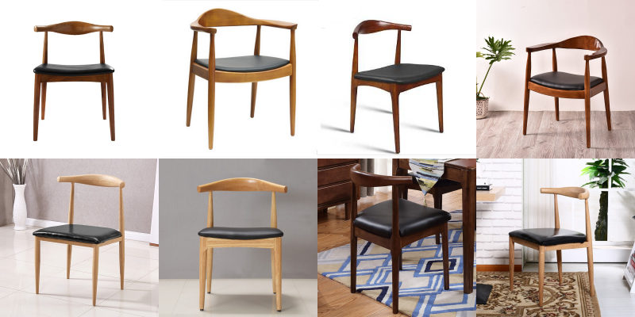
Exploratory data analysis
Real-world images of various goods.
Different occlusions, illumination, etc.
Most of items are centered on the picture.
There are extremely close classes.

Slide 6
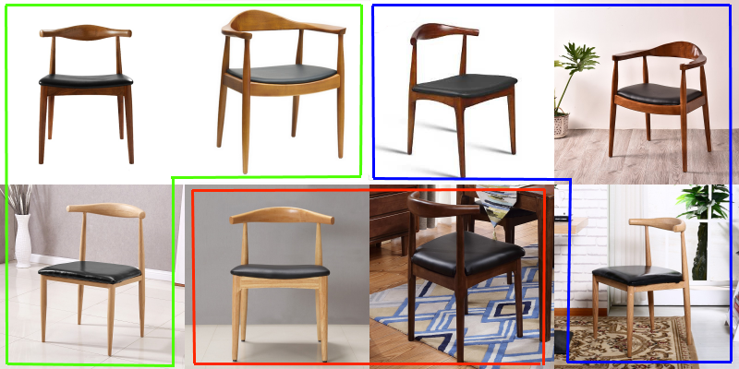

Exploratory data analysis

Slide 7
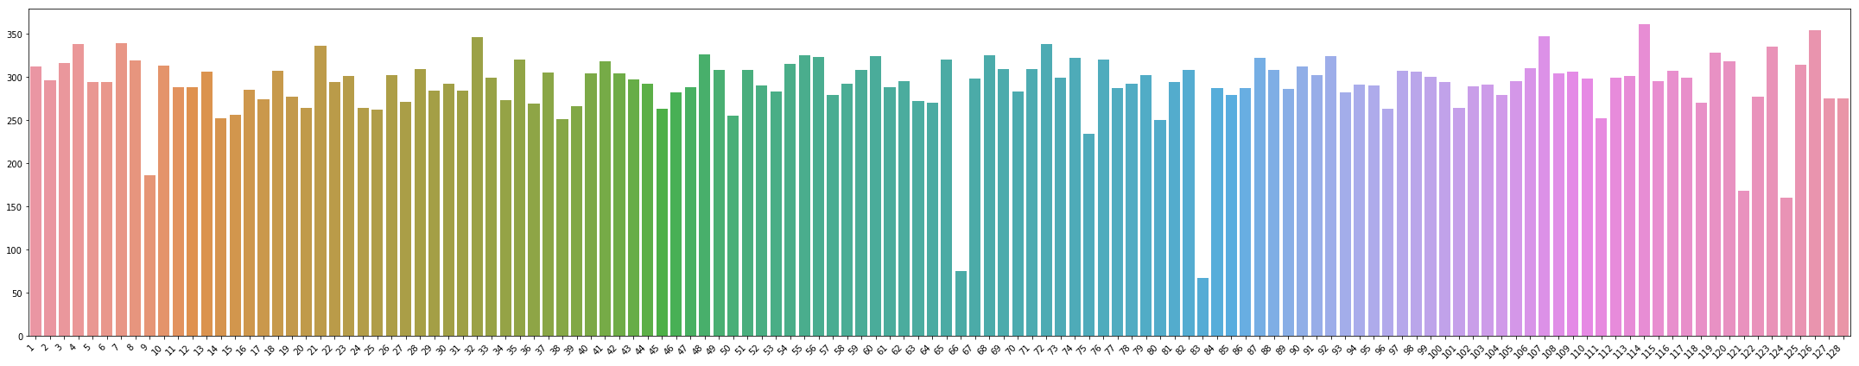
Dataset split
Validation set is used for hyperparameter tuning.
Test set is used for the final evaluation of the tuned model.
Train set – 37184 samples (imbalanced).
Validation set – 12800 samples (balanced).
Test set – 25600 samples (balanced).

Slide 8
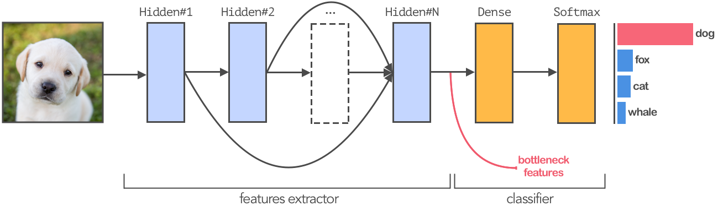
Transfer learning
Transfer learning – usage of a pre-trained on a very large dataset CNN instead of training from scratch.

Slide 9
Transfer learning
 | Your have little data | You have a lot of data
Datasets are similar | Train a classifier (usually, logistic regression or MLP) on bottleneck features | Fine-tune several or all layers
Datasets are different | Train a classifier on deep features of the CNN | Fine-tune all layers (use pre-trained weights as an initialization for your CNN)

Slide 10
Fine-tuning pre-trained CNN
fine-tuning.ipynb

Slide 11
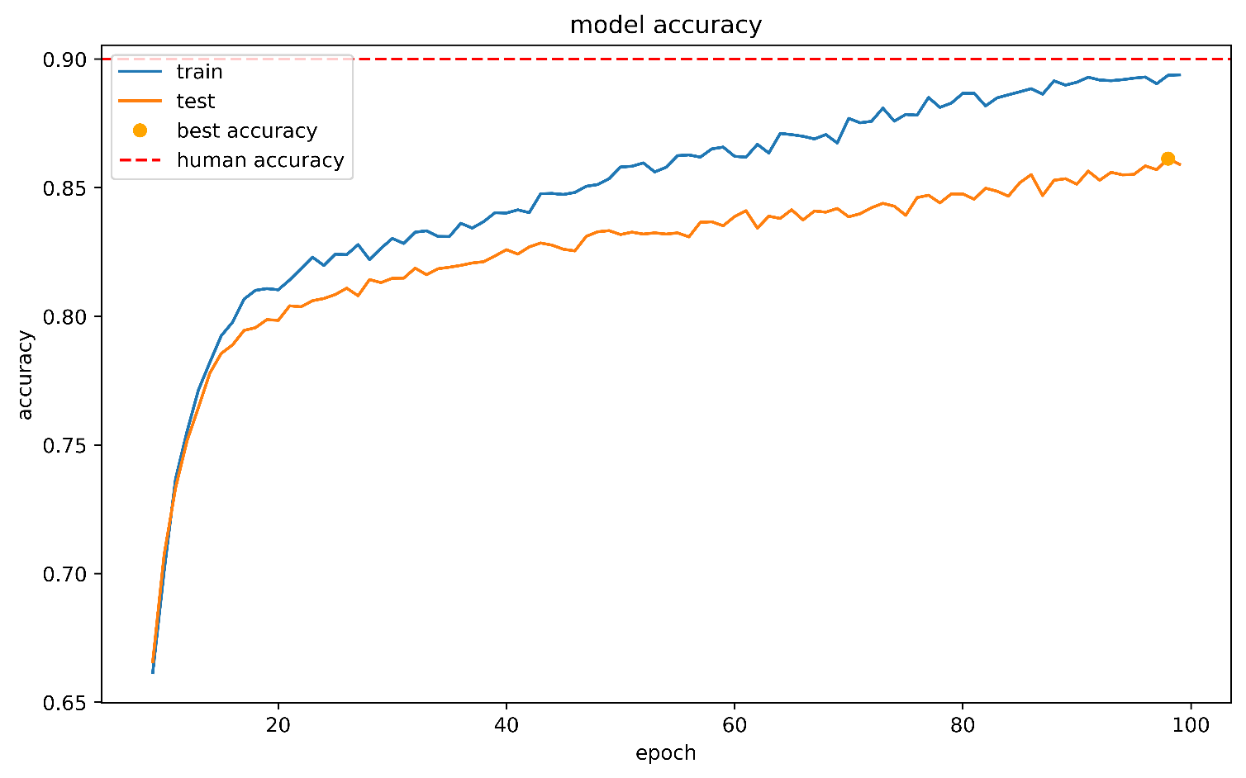
Learning curve
Underfitting (accuracy still improves, so you probably need higher learning rate and more training epochs)

Slide 12
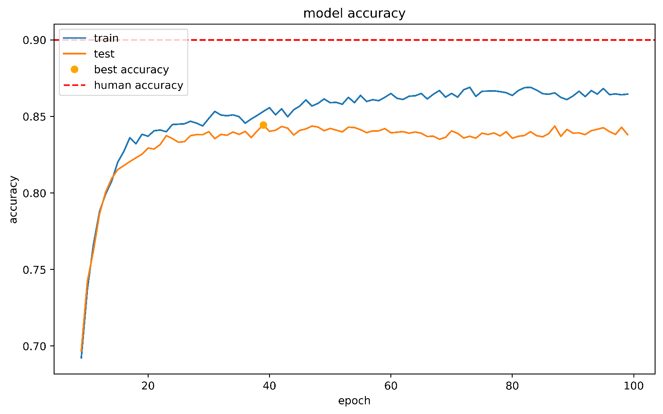
Learning curve
Underfitting (accuracy doesn’t improve so you need a deeper network)

Slide 13
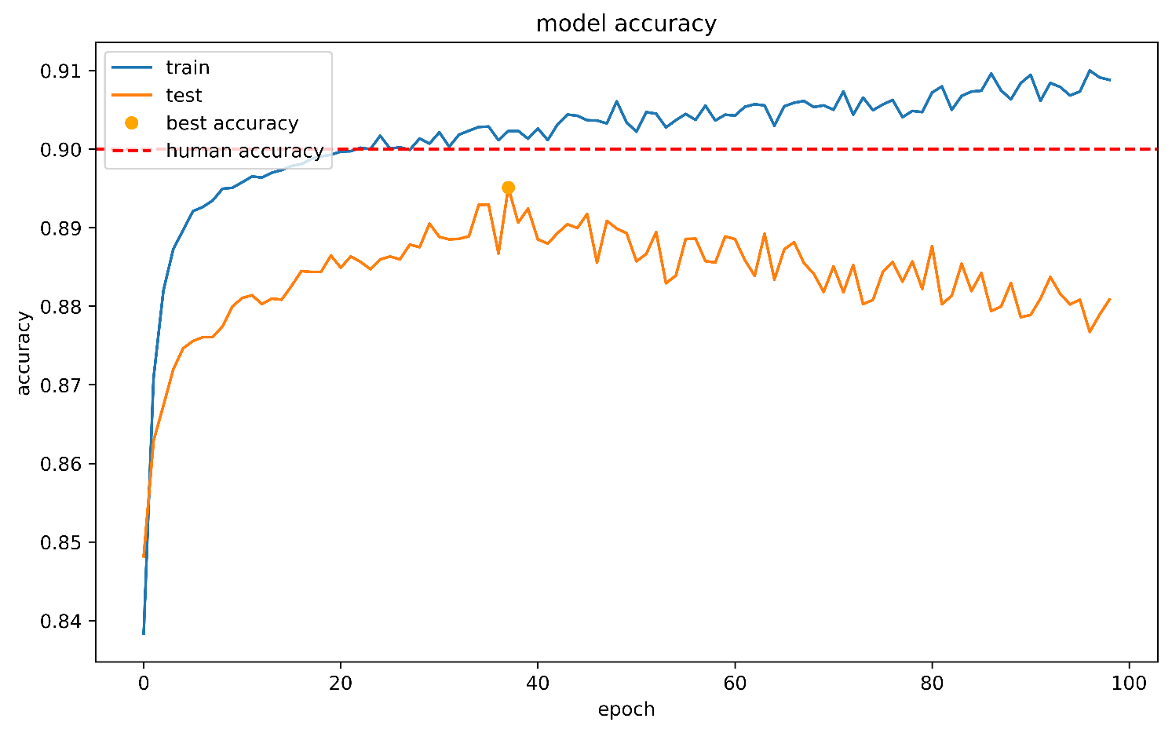
Learning curve
Overfitting (train accuracy increases while validation get worse, so you need to add regularization or increase dataset if possible)

Slide 14
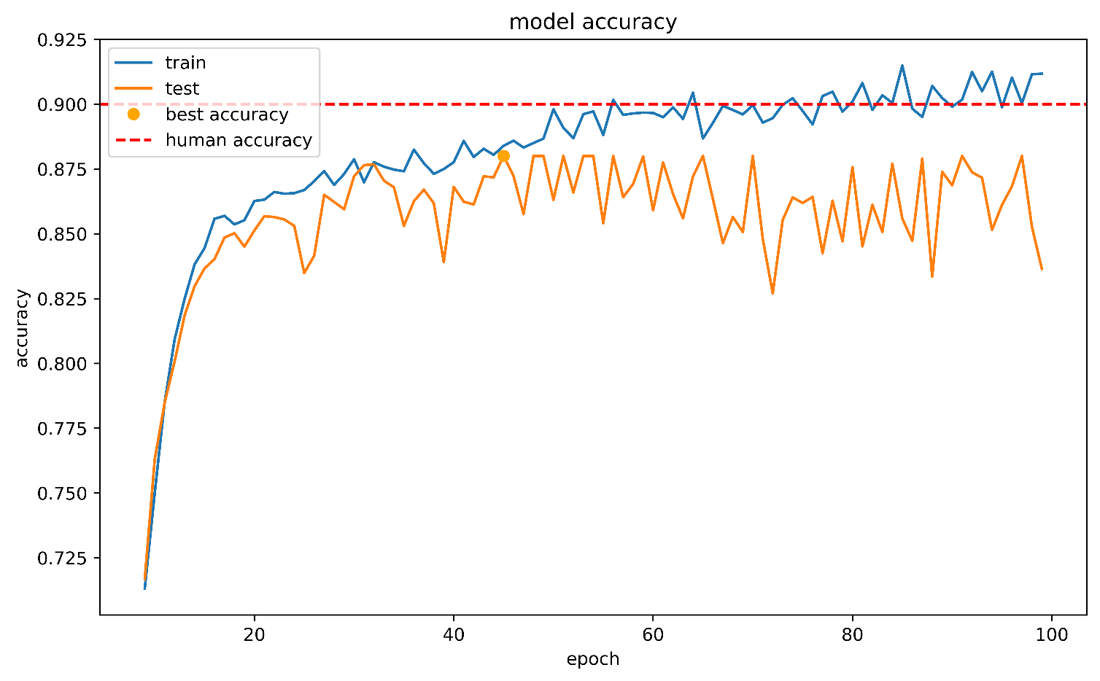
Learning curve
Overfitting with oscillations (network became unstable after several epochs; you need to decrease learning rate during training)

Slide 15
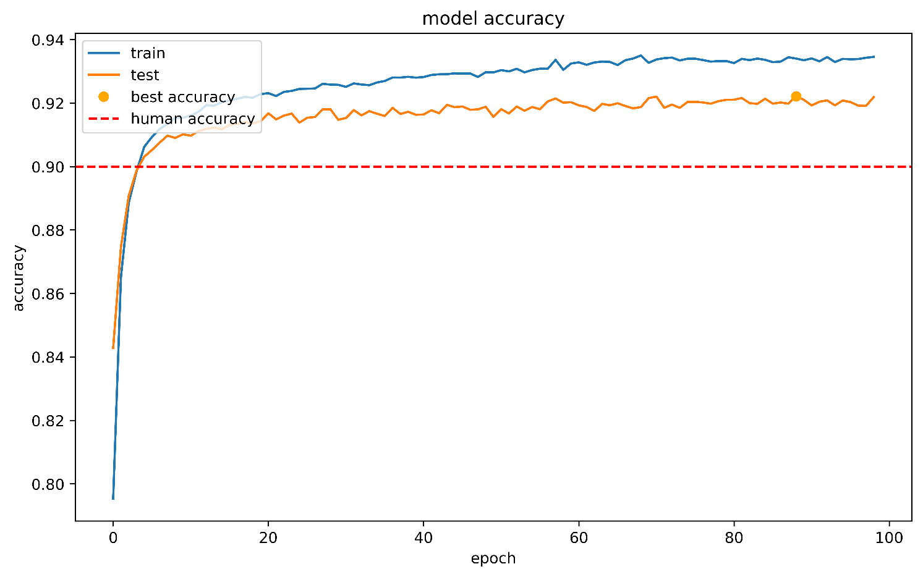
Learning curve
Almost perfect learning curve

Slide 16
Tuning more layers
fine-tuning.ipynb

Slide 17
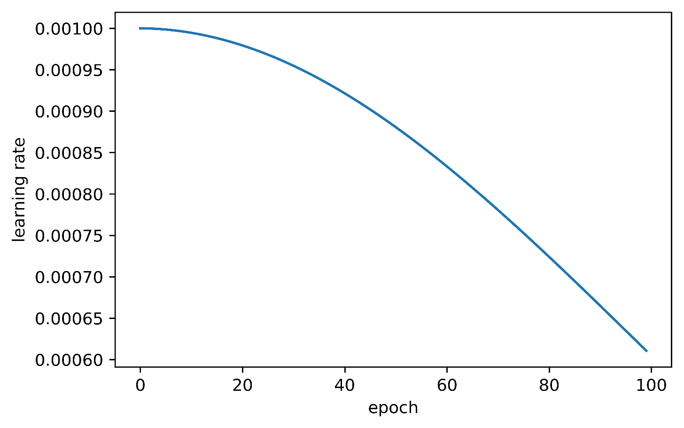
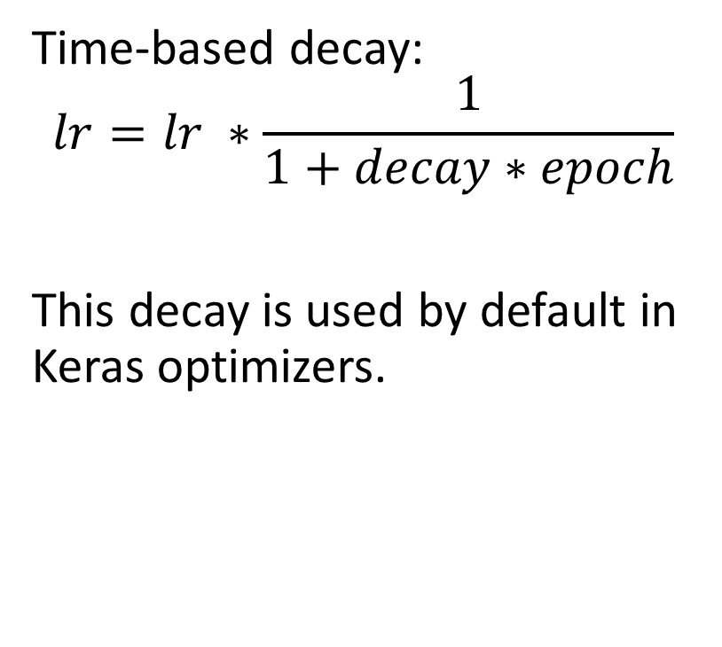
Learning rate strategies
Time-based decay:
$$lr=lr ∗\frac{1}{1+decay∗epoch}$$
This decay is used by default in Keras optimizers.

Slide 18
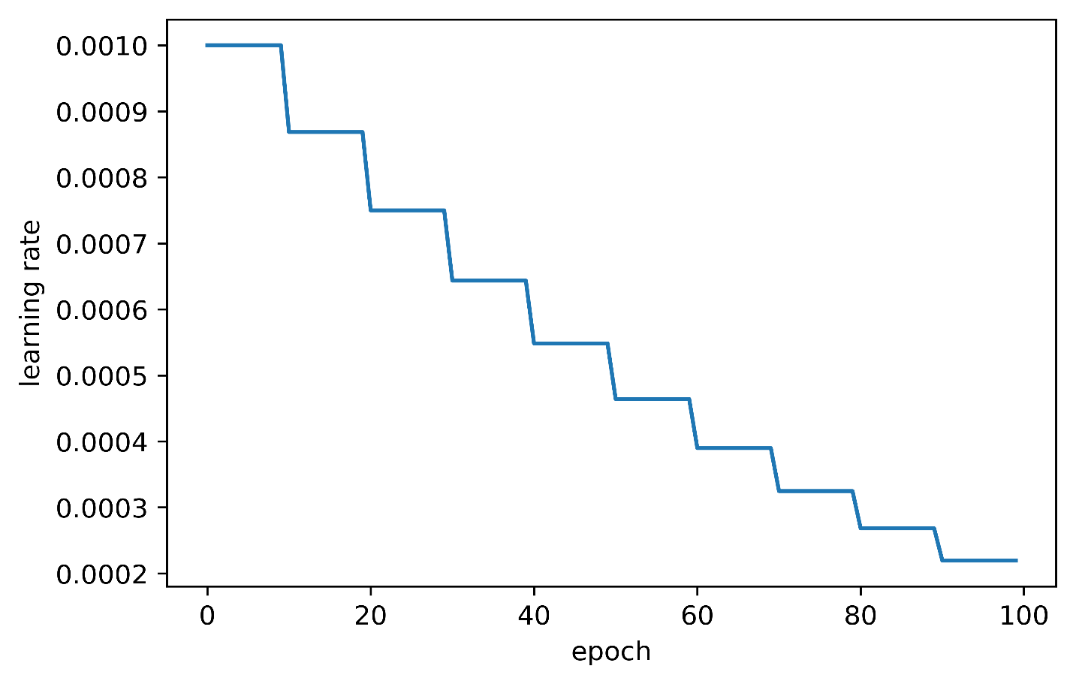

Learning rate strategies
Step decay:
$$lr={lr_{start}}^{\frac{1}{1 −decay∗drop}}$$
$$drop=\frac{epoch}{step}$$

Slide 19
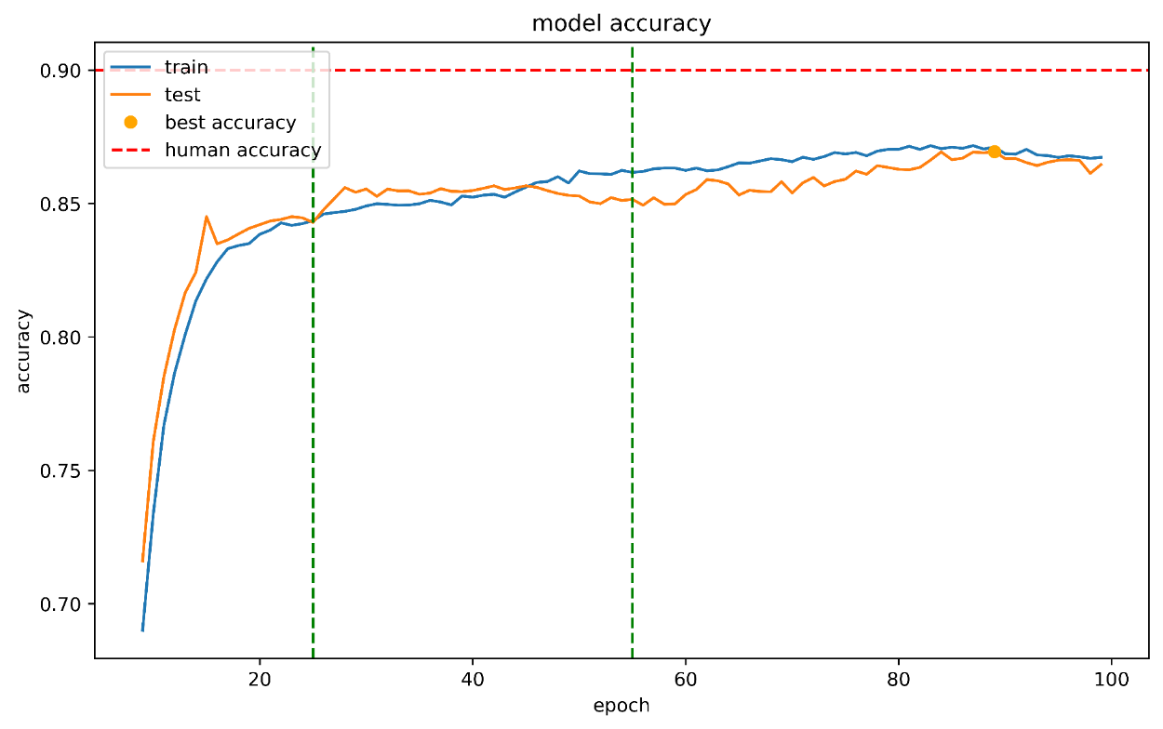
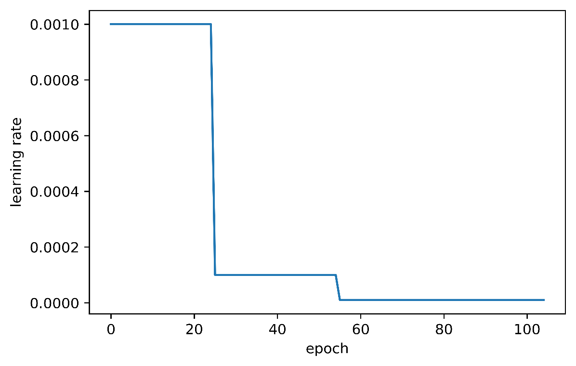
Reducing learning rate on plateau
Reducing learning rate whenever validation metric stops improving (can be combined with previously discussed strategies).
Keras implementation – ReduceLROnPlateau callback.

Slide 20
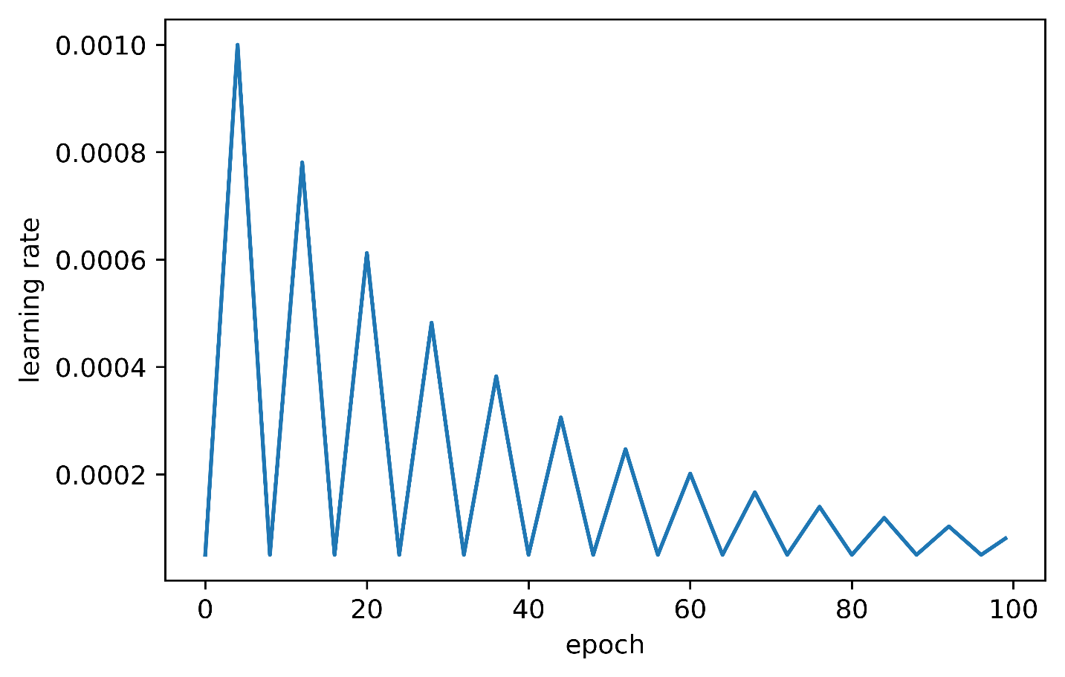
Cyclic learning rate
Learning rate increases and decreases in a cycle.
Upper bound of the cycle can be static or can decrease with time.
Upper bound is selected by LR finder algorithm.
Lower bound is chosen to be 1-2 orders of magnitude less than upper bound.
Original paper - https://arxiv.org/abs/1506.01186

Slide 21
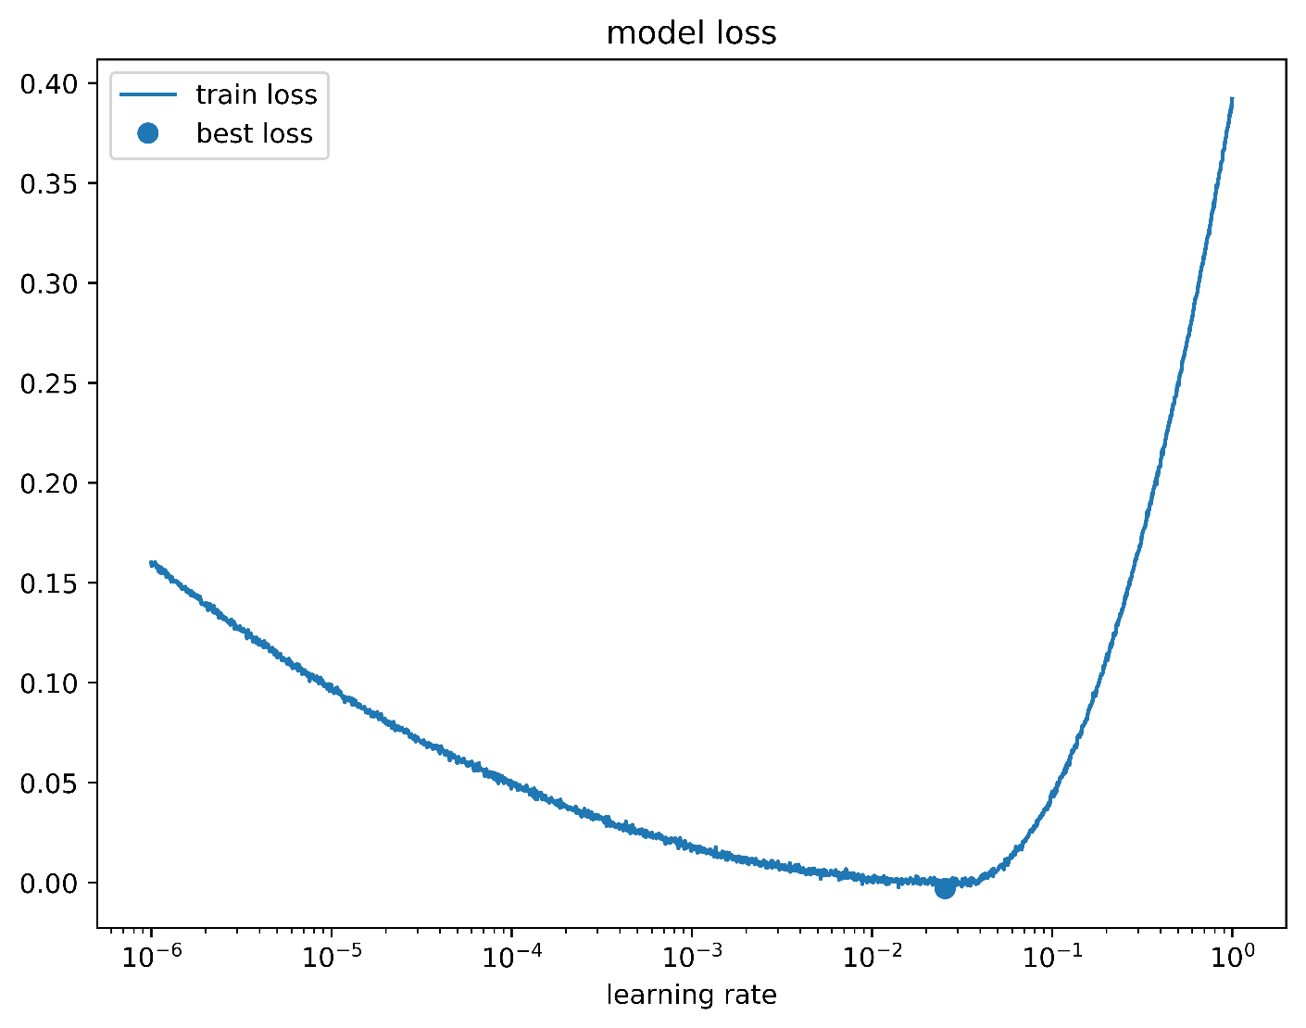
Learning rate finder
Select reasonably small lower bound (e.g. 1e-6)
Usually, 1e0 is a good choice for an upper bound
Increase learning rate exponentially
Plot smoothed loss vs LR
Select a point slightly lower than the global minimum

Slide 22
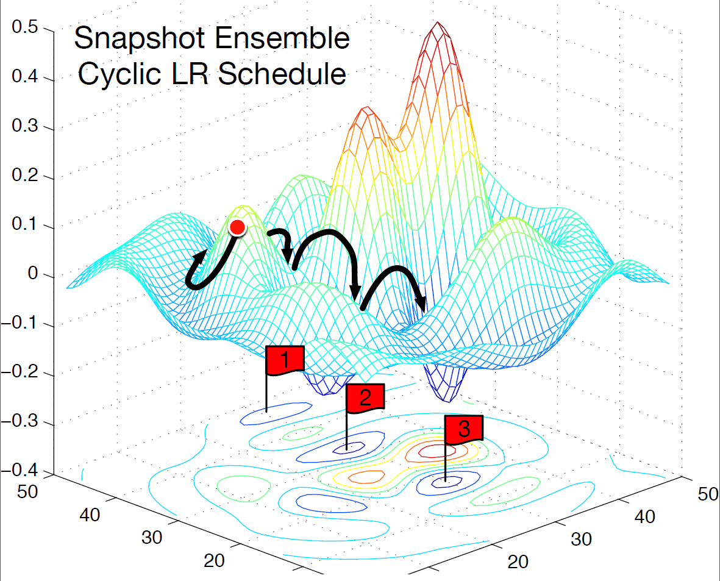
Snapshot ensemble
Source - https://arxiv.org/pdf/1704.00109.pdf

Slide 23
Learning rate finder and CLR
fine-tuning.ipynb

Slide 24
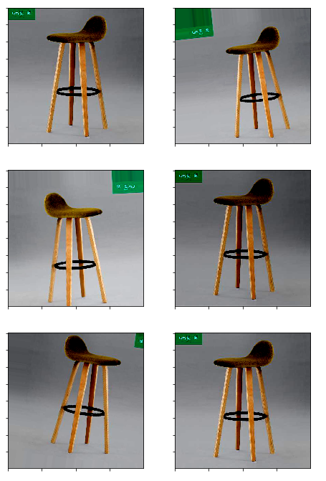
Augmentation
Augmentation increases dataset size by applying natural transformations to images.
Useful strategy:
Start with soft augmentation.
Make it harsher with time.
If the dataset is big enough, finish training with several epochs with soft augmentation / without any.
Implementation: https://github.com/albu/albumentations

Slide 25
Tuning whole network
fine-tuning.ipynb

Slide 26
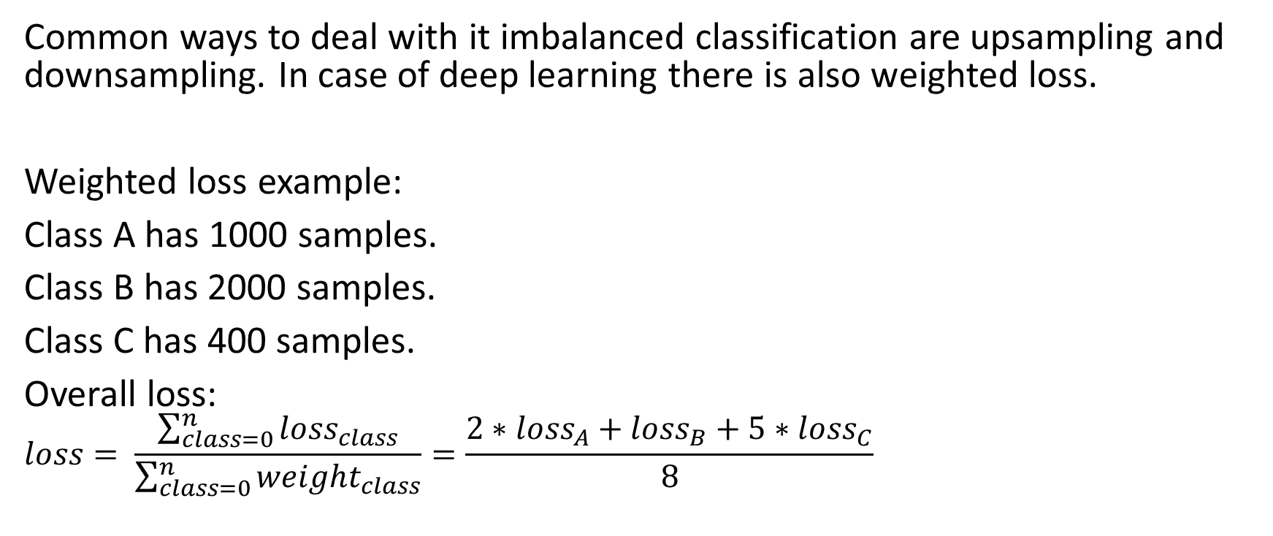
Dealing with imbalanced train set
Common ways to deal with it imbalanced classification are upsampling and downsampling. In case of deep learning there is also weighted loss.
Weighted loss example:
Class A has 1000 samples.
Class B has 2000 samples.
Class C has 400 samples.
Overall loss:
$$loss= \frac{\sum_{class=0}^{n}{loss_{class}}}{\sum_{class=0}^{n}{weight_{class}}}=\frac{2∗loss_{A}+loss_{B}+5∗loss_{C}}{8}$$

Slide 27
Weighted loss
fine-tuning.ipynb

Slide 28
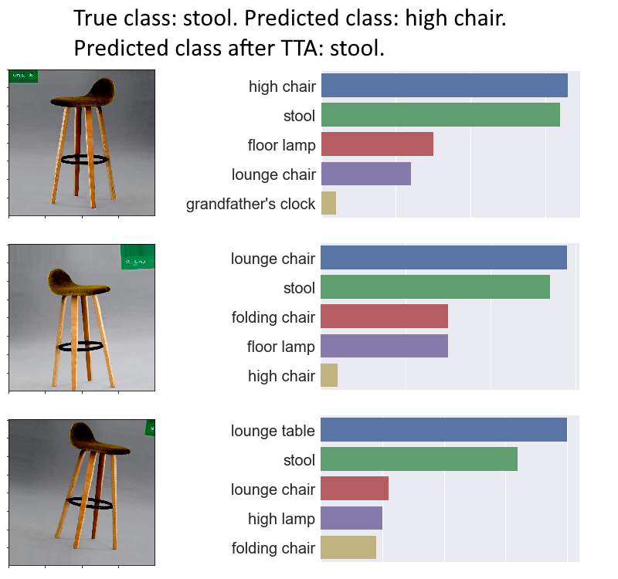
Test-time augmentation
One way to apply TTA is to use augmentations similar to training but softer.
Simpler strategies:
Only flips
Flips + crops
Caution: TTA increases inference time!

Slide 29
Predictions with TTA
fine-tuning.ipynb

Slide 30
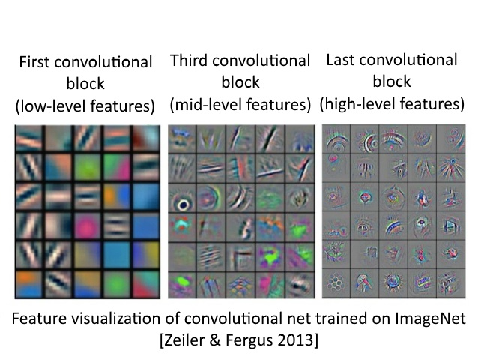
Semi-supervised approach
Deep layers of a CNN learn very generic features.
You can refine such feature extractors by training on unlabeled data.
Most popular approach for such training is called pseudolabeling.

Slide 31
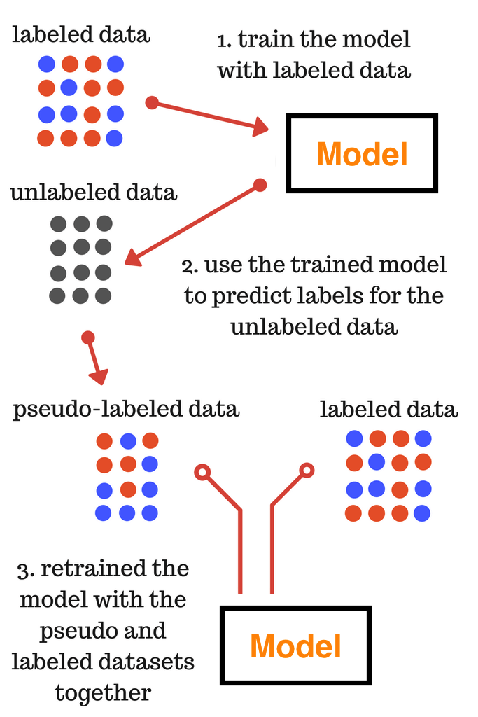
Pseudolabeling
Train classifier on the initial training set.
Predict validation / test set with your classifier.
Optional: remove images with low-confidence labels.
Add pseudolabeled data to your training set.
Use it to train CNN from scratch (some kind of a warmup) or to refine your previous classifier.
Source - https://www.analyticsvidhya.com/blog/2017/09/pseudo-labelling-semi-supervised-learning-technique/

Slide 32
Pseudolabeling constraints
Test dataset has reasonable size (at least comparable to the training set).
Network which is trained on pseudolabels is deep enough (especially when pseudolabels are generated by an ensemble of models).
Training data and pseudolabeled data are mixed in 1:2 – 1:4 proportions respectively.

Slide 33
Using pseudolabeling
In competitions:
Label test set with your ensemble;
Train new model;
Add it to the final ensemble.
In production:
Collect as much data as possible (both labeled and unlabeled);
Train model on labeled data;
Apply pseudolabeling.

Slide 34
Pseudolabeling
pseudolabeling.ipynb

Slide 35
Summary
Train network’s head
Add head to the convolutional part
Add augmentations and learning rate scheduling / CLR
Select appropriate loss
Predict with test-time augmentations
If you don’t have enough training data, apply pseudolabeling
Good luck!

Slide 36
Other tricks (out of scope)
How to select network architecture (size, regularization, pooling type, classifier structure)
How to select an optimizer (Adam, RMSprop, etc.)
Training on the bigger resolution
Hard samples mining
Ensembling

Slide 37
Thank you for your attention
Questions are welcomed

