Slide 1
FL Project Update:
Shambhala Harmonization
Containerization · Parallelization · Speed-up · Full Benchmark Run (1,296 harmonizations)
Pure-Python rewrite (no R / rpy2) · 30-worker parallelization · A_E speed-up: 8.6× lab / ~10× real-world · Metrics pipeline ~45% complete
Daniil Nikitin · BostonGene · 2026-05-28

Slide 2
Overview: Two Weeks of Work with Shambhala
1
Three workstreams completed:
• Shambhala containerization — pure-Python rewrite, no R, no rpy2
• Parallelization & speed-up research — 9 combinations tested; Precompute QN and CuBlock k-means clusters approved and deployed (approach A_E)
• Full benchmark run — 1,296 harmonizations completed; metrics calculation ~45% done
Metric | Status as of May 26th
Expression files harmonized | 1,296 / 1,296 (100% ✓)
Metrics calculated | 579 / 1,296 (~45%)
Speed-up gain (A_E) | ~8.6× lab / ~10× real-world
Test suite | 69 tests pass

Slide 3
Original Pipeline: long, inefficient, many temporary files
2
R wrapper (Shambhala2.R)
→ writes P_prim.txt to disk — merged [Input + P] matrix for QN
→ writes args.txt to disk — 3 integers: NH, NP, k
→ spawns Octave subprocess — Octave reads P_prim.txt and args.txt
→ Octave writes Cu_bis.txt — CuBlock-normalized output matrix
→ R reads Cu_bis.txt — applies Q-rescaling
Why each intermediate file exists:
• P_prim.txt — merged [Input + P] matrix; QN operates on the combined set so all samples share the same rank map
• args.txt — Octave cannot receive Python/R variables directly; integers (NH, NP, k) passed as plain text
• Cu_bis.txt — Octave cannot return data to R; CuBlock output written to disk for R to read back
Problems:
• Requires a full R installation
• File collisions when running multiple jobs in parallel from the same directory
• rpy2 version conflicts on newer Python
Solution: eliminate all three files — route data through process stdin/stdout streams instead.

Slide 4
New Pipeline: Python + Octave via Stdin/Stdout
3
Python (run_shambhala.py)
→ gene intersection + NA handling (drop / KNN)
→ format [batch + P] as TSV → pipe to Octave stdin
→ Octave (Shambhala2_piped.m) reads /dev/stdin
→ Octave writes normalized matrix to stdout
→ Python parses stdout → Q-rescaling in NumPy/pandas
Only 3 targeted changes to Shambhala2_piped.m:
• Remove args.txt reading — NH, NP, k injected via Octave --eval before script start
• readExpressionData("P_prim.txt") → readExpressionData('/dev/stdin')
• fopen / fprintf-to-file / fclose → fprintf(1, ...) (stdout = file descriptor 1)
CuBlock.m is UNTOUCHED — the core algorithm is verbatim from the original. All changes are in the I/O layer only.
• ProcessPoolExecutor (not threads) — each worker is an independent system process with its own Octave subprocess → stdin/stdout pipes can never interfere with each other
• All previous unit tests pass with the new piped implementation (30 tests)

Slide 5
Module Map: Shambhala_containerized/
4
Shambhala_containerized/
├── run_shambhala.py ← CLI entry point; orchestrates all steps
├── shambhala/
│ ├── octave_bridge.py ← sends TSV to Octave stdin; reads result from stdout
│ ├── parallel.py ← splits samples into worker batches; assembles results
│ ├── progress_display.py ← live progress bars in terminal; plain log in K8s
│ ├── q_rescale.py ← Q reference stats; gene-level mean/std alignment
│ ├── na_handling.py ← missing gene handling (drop or KNN-impute)
│ └── io_utils.py ← reads/writes local files and S3 (.csv/.tsv/.tsv.gz)
├── octave/
│ ├── Shambhala2_piped.m ← 3 targeted edits (stdin/stdout)
│ ├── CuBlock.m ← VERBATIM — zero changes
│ └── *.m (3 files) ← verbatim copies (QN, kmeans, readExpressionData)
├── harmonization_scripts/ ← cross-product benchmark (18 P/Q × 3 imp = 54 jobs)
└── tests/ (30 passing tests)
• progress_display.py: TTY mode = live ANSI progress bars; K8s mode = plain timestamped log lines (no interactive terminal in pod)
• ProcessPoolExecutor (not threads): each worker is a separate OS process with its own Octave subprocess — stdin/stdout pipes are fully isolated
• Tests: 30 unit tests (containerization) + 39 additional tests (speed-up fixtures) = 69 total

Slide 6
Initial Parallelization: Shambhala-Workers
5
• Before parallelization: Shambhala processes one sample at a time (sequential loop inside Octave)
• Running full 7100-sample FL dataset in a single Octave process: ~9 hours for P0std × Q0std
Solution: --n-shambhala-workers splits samples into N batches:
• Input divided into N equal batches
• Each batch sent to a separate Octave subprocess (independent process, own stdin/stdout pipe)
• All batches run in parallel using ProcessPoolExecutor
• Results assembled; Q-rescaling applied once on the merged output
Configuration | Time for P0std × Q0std, full dataset (strict: 7100 samples x 3500 genes)
1 worker (sequential Octave) | ~9 hours
30 workers (parallel batches, K8s pod 32 vCPU) | ~1–2 hours
• Remaining problem: large P variants (ANTE, GTExAffy, NBGPL570, NP=250) still took 6–8 h even with 30 workers
• KNN and softimpute imputation (more genes after imputation) grew 4–5× further
• Single large-P run under knn/softimpute: 2–3 days — full 54-job benchmark projected to take weeks
Root cause: QN and CuBlock both slow down when P is larger (NP=250 vs NP=39). Goal: cache computations identical across all N worker batches within one job.

Slide 7
P/Q Calibration Datasets: Zenodo and Normal B Cells Were Tested
6
FL input (S0, strict): 7,174 samples × 3,447 genes. Shambhala needs P (QN calibration anchor) and Q (final rescaling target).
P datasets (9 variants)
Name | Samples | Notes
P0std | 39 | Original Borisov 2021 / Zenodo; diverse tissues; standard benchmark reference
NBKass | 141 | Normal B cells, Kassandra; B-cell specific
NBRNAseq | 317 | Normal B cells, RNA-seq; platform match
NBGPL570 | 250 | Normal B cells, GPL570 Affy; largest NP → slowest
ANTE | 202 | Affymetrix reference; large gene panel (36k genes)
NBlegacy | 733 | Normal B cells, Normal_B_cells; BostonGene-curated
NBext | 878 | Normal B cells, extended; broadest B-cell coverage
Oncobox | 779 | Cancer reference; oncology-biased anchor (exploratory)
GTExAffy | 651 | GTEx Affymetrix; tissue-diverse; strict run failed (gene ID mismatch)
Q datasets (2 variants)
Name | Samples | Genes | Notes
Q0std | 100 | 11,887 | Original paper reference (GTEx RNA-seq); ~31–69% gene loss with strict FL input
QNBKass | 141 | 11,768 | Normal B cells, Kassandra; PERFECT gene overlap → 3,447 genes retained, zero gene loss
Key: Q0std causes 31–69% gene loss (different gene set from FL panel). QNBKass shares the exact gene set → zero gene loss when paired with any P dataset.

Slide 8
Additional Speed-Up Motivation: Shambhala can take up to 2-3 days
7
Even with 30 parallel Octave workers, per-run times were prohibitive:
Scenario | Imputation | Estimated time / Shambhala run
P0std (NP=39) | strict | ~1 h
Large P (ANTE, GTExAffy, NBext, NBGPL570) | strict | 6–8 h
Large P | knn or softimpute | 2–3 days
• KNN and softimpute produce more surviving genes (fewer dropped due to NAs) → larger input matrix → more QN and CuBlock work per sample
• Total benchmark cost without speed-up: 54 jobs × average ~12 h = ~27 days of compute on a single pod
• Goal: reduce per-run time by caching computations that are identical across all N worker batches within one job
Two bottlenecks identified:
• Bottleneck 1 — Quantile Normalization on P: each of 30 workers re-sorts the same P matrix (NP=250 for NBGPL570) independently
• Bottleneck 2 — k-means in CuBlock: 30 stochastic k-means runs per sample × N_samples per worker, with P-matrix-dependent complexity
Strategy: pre-compute QN reference and k-means clusters once before launching workers, then inject the cached results into every Octave subprocess.

Slide 9
Speed-Up Approaches: 9 Combinations Tested
8
All approaches pre-compute or approximate something Octave otherwise recomputes per sample. Trade-off: speed vs. fidelity to the original algorithm.
Combo | What it does | Speedup | Distortion
baseline | Exact Octave; no caching | 1.0× | 0.00%
A — Python QN ref. | Pre-compute QN sort order from P once; inject into every worker | ~1.0× | 0.98%
C_40 — P subsampling | Replace P with 40 centroids if NP>40; no effect at NP=39 | ~1.0× at NP=39 | 0.00%
C_20 — P subsampling | Same as C_40 but more aggressive (20 centroids) | ~1.6× | 2.45%
E — pre-run k-means | Run k-means on P genes once in Python; pass labels to Octave (skips 30 random inits) | ~10.6× | 1.26%
A_D — QN + synthetic P | Replace P matrix with 1 synthetic centroid; eliminates large-P overhead | ~5.3× | 14.67%
★ A_E — QN + k-means | Pre-compute BOTH: QN reference (A) + k-means labels (E) | ~8.6× | 1.39%
A_D_E — all flags | A + D + E combined | ~16.8× | 9.00%
G — Python CuBlock | Replace entire Octave CuBlock with pure Python | — | 226%
G fails (deadlock): Python PCG64 and Octave Mersenne Twister produce different k-means clusters from same seed → 226% distortion. Additionally, returning a large NumPy array from subprocess via ProcessPoolExecutor shared queue causes a permanent QueueFeederThread hang.
★ A_E selected: 8.6× speedup with only 1.39% mean relative distortion. No structural algorithm change — only caches two pre-computable results.

Slide 10
A_E Approved Approach: How Each Flag Works
9
A_E = --precompute-qn-reference + --precompute-cublock-clusters
Flag A — pre-compute QN reference in Python
• What: sort each gene in P by expression value; record rank-to-value mapping. Inject pre-computed lookup table into every Octave subprocess (no re-sorting of P)
• Why it helps: QN on large P matrix (NP=250 for NBGPL570) is the single biggest bottleneck. Without caching, each of 30 workers recomputes the same sort on the same P data
• Risk: Python qnorm library and Octave's QN agree to within 0.98% on continuous data (Bolstad 2003 method). For integer/tie-heavy data implementations may diverge slightly — stays below 1% in FL dataset
Flag E — pre-compute k-means clusters
• What: run k-means on P gene matrix once in Python with a fixed random seed; produce k=5 cluster labels. Pass labels to Octave via --eval — Octave skips its own k-means initialization
• Why it helps: CuBlock's inner loop runs k-means 30 times per sample (averaging over random initializations). Pre-computing removes all 30 × N_samples random k-means calls
• Why 1.39% distortion is acceptable: CuBlock already averages 30 stochastic runs to smooth out randomness. The single Python k-means pass uses a slightly different PRNG than Octave — deviation (1.39%) is comparable to natural run-to-run variability of the baseline itself
Both flags cache only external inputs (P matrix computations). The per-sample harmonization logic inside Octave/CuBlock is fully preserved.

Slide 11
A_E Performance Summary: Speed-up by 10x
10
Lab test (10-sample fixture, 8,174 genes, P0std NP=39):
Real-world K8s pod (S0, ~5,444 samples):
 | Baseline | A_E
Calculation time | ~48 s | ~5.6 s
Speedup | 1.0× | 8.6×
Mean relative distortion | 0.00% | 1.39%
Variant | Timestamp | Interval
ANTE × Q0std (knn) | 2026-05-22 16:01 | —
NBGPL570 × Q0std (knn) | 2026-05-22 16:42 | 41 min
NBKass × Q0std (knn) | 2026-05-22 17:22 | 40 min
NBRNAseq × Q0std (knn) | 2026-05-22 18:03 | 41 min
~40 minutes per run for ALL P/Q variants including the largest (NBGPL570, NP=250).
Before vs. after A_E deployment:
Metric | Before A_E | After A_E | Gain
Files per day | ~53 | ~517 | ~10×
Large-P run time (estimated) | ~4–6 h | ~40 min | ~6–9×
• Distortion metric: mean relative difference across all genes
• Values reach ~100,000 in Q-rescaled scale; max absolute difference dominated by outlier genes → not a useful metric
• Mean relative difference of 1.39% is within natural run-to-run variability of the stochastic baseline

Slide 12
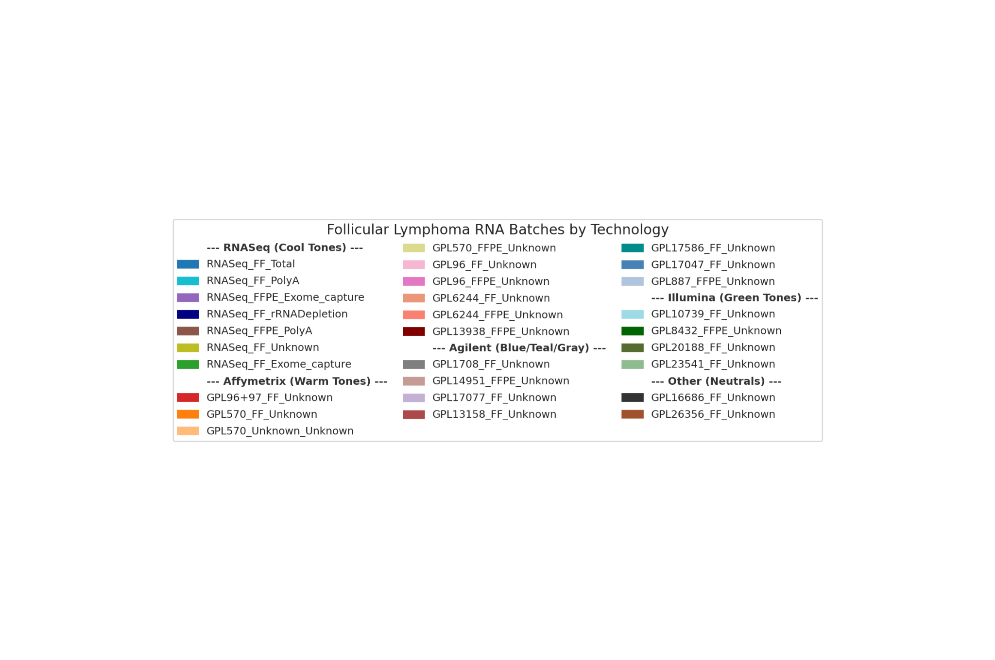
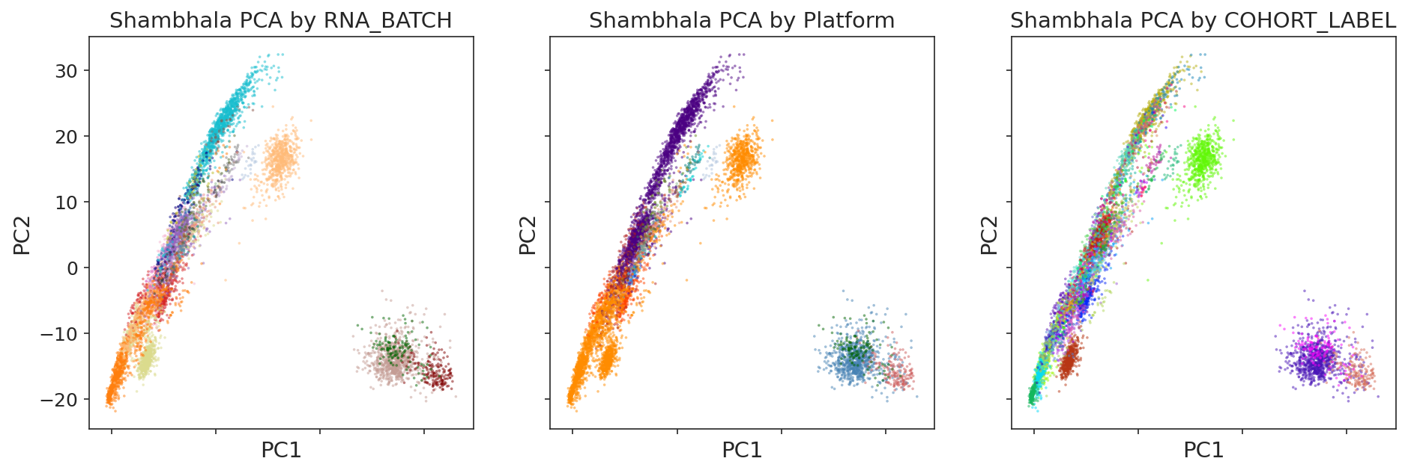
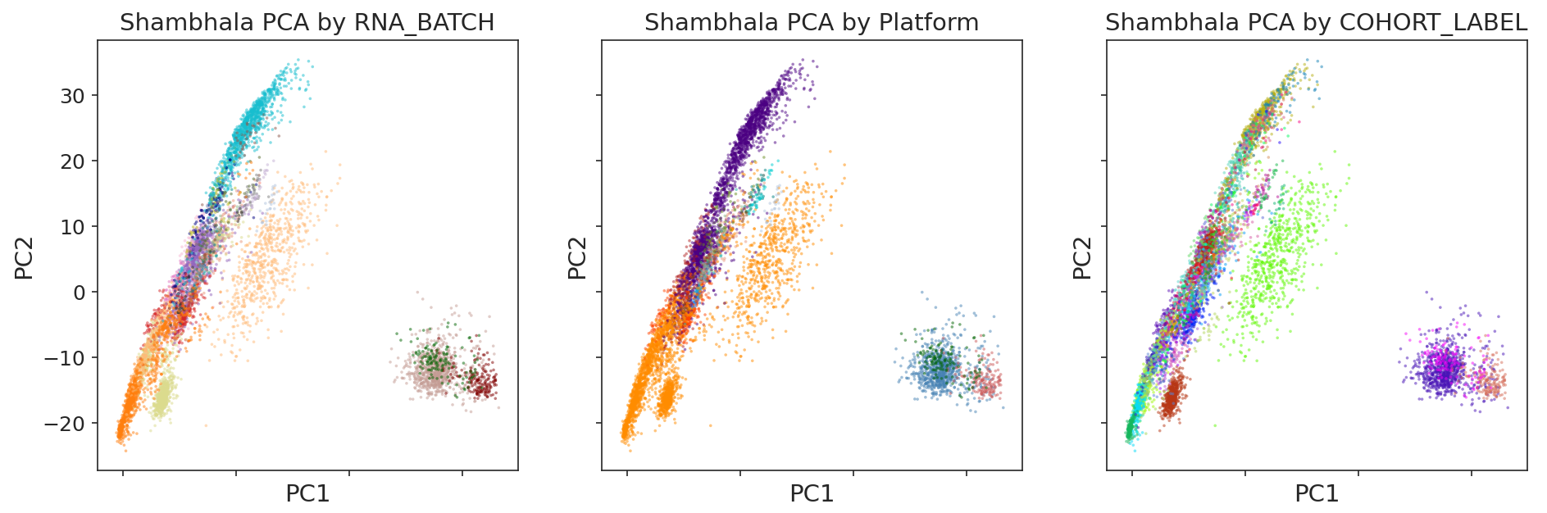
Original vs Speed-up Shambhala Comparison: Nearly Identical PCA Plots
10
Original
Speed-up

Slide 13
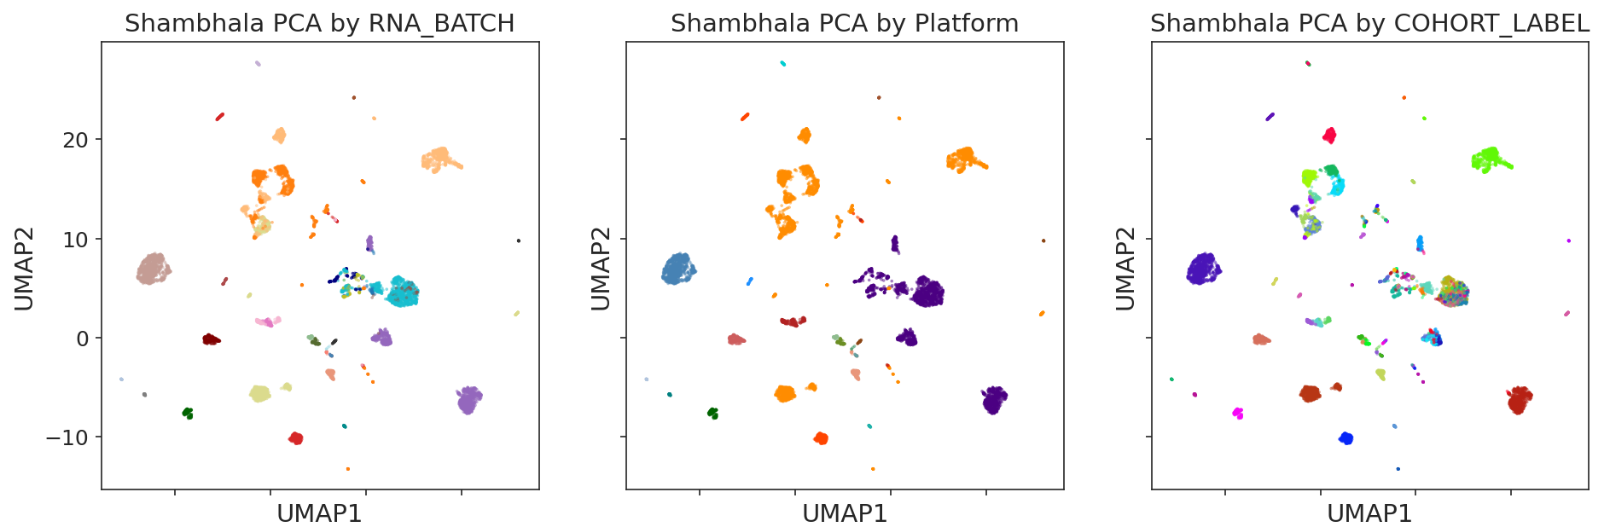
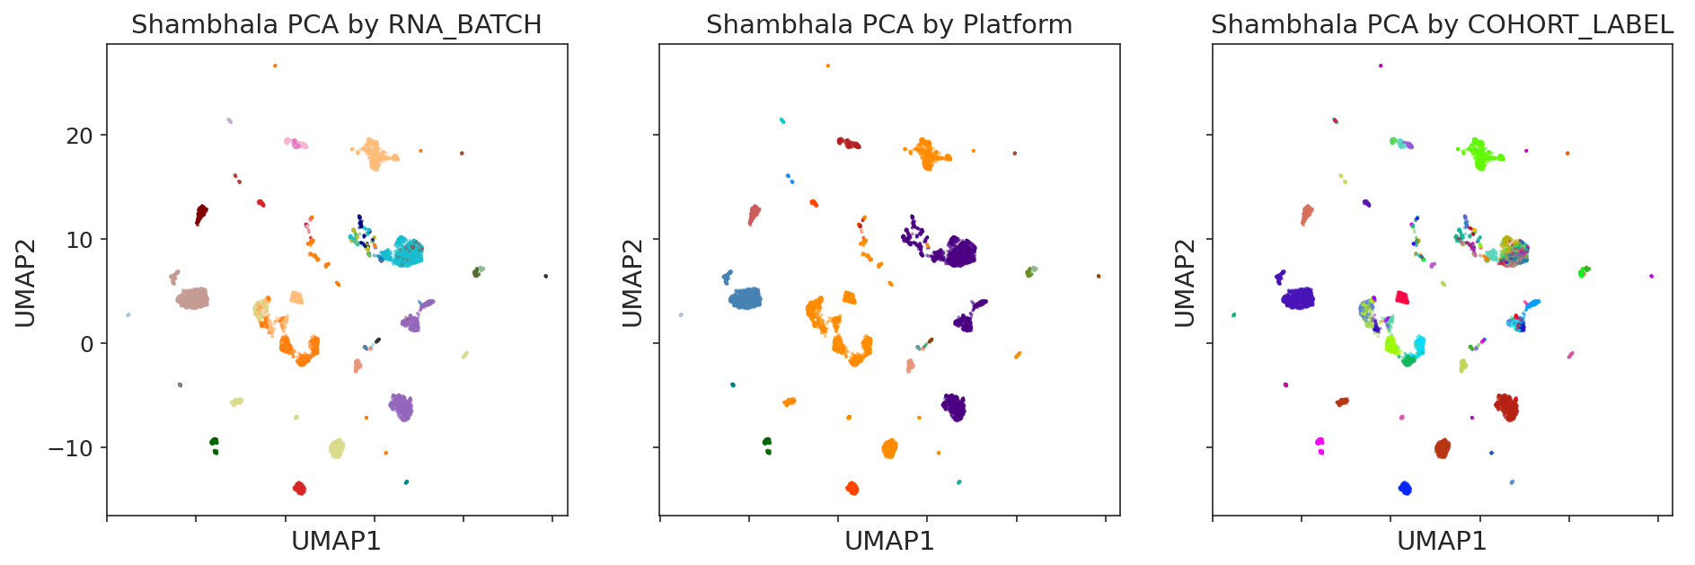
Original vs Speed-up Shambhala Comparison: Nearly Identical UMAP Plots
10
Original
Speed-up

Slide 14
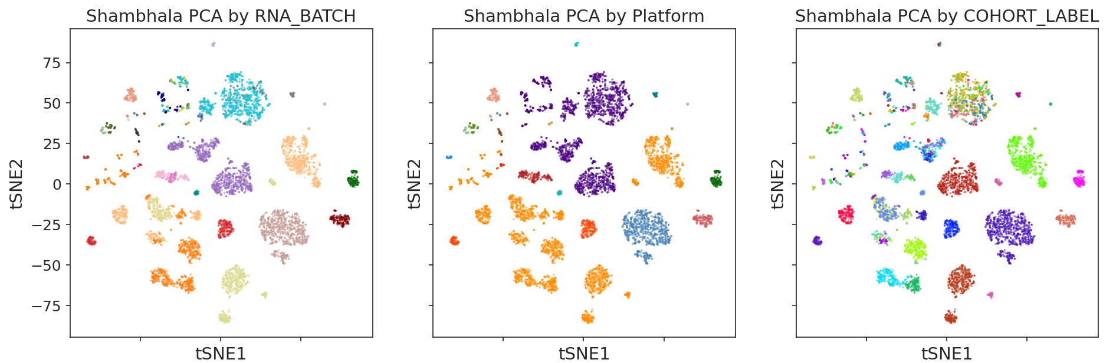
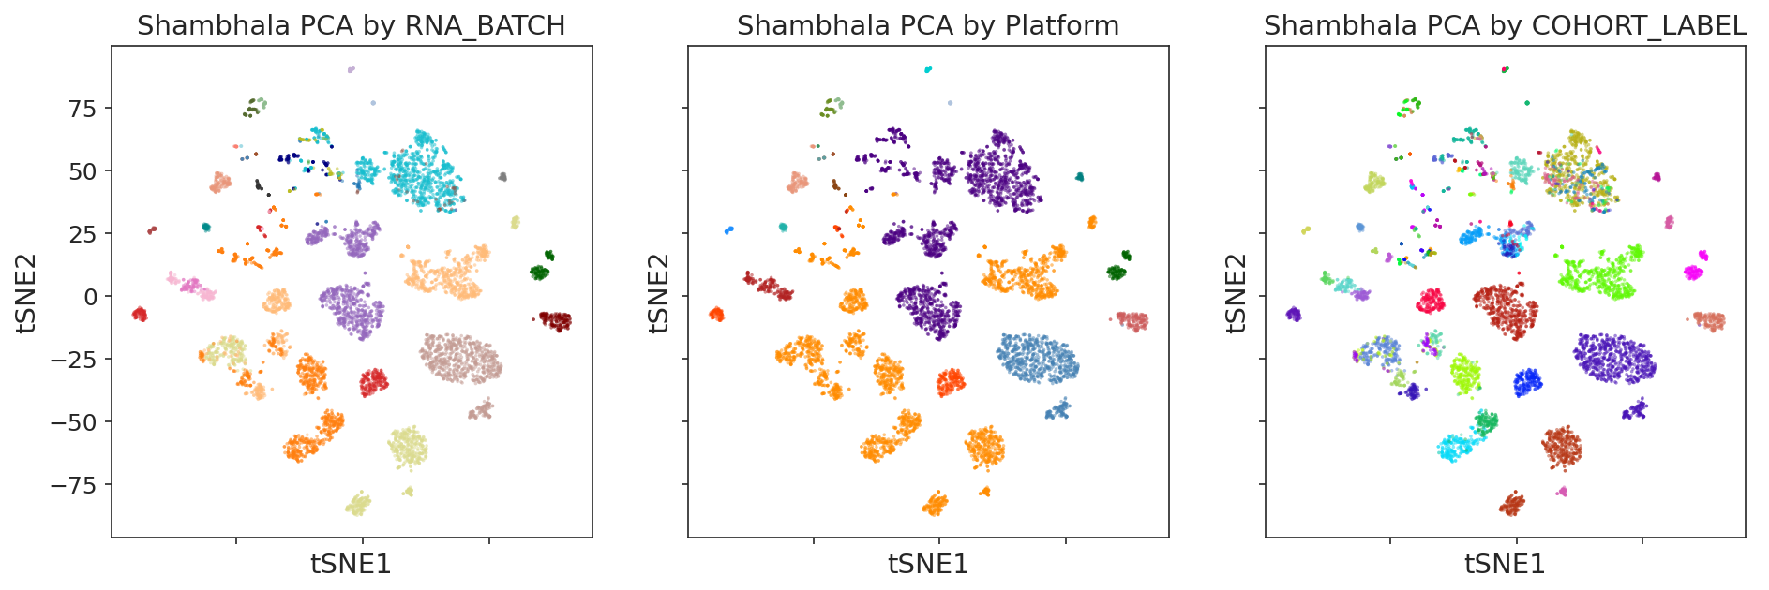
Original vs Speed-up Shambhala Comparison: Nearly Identical tSNE Plots
10
Original
Speed-up

Slide 15
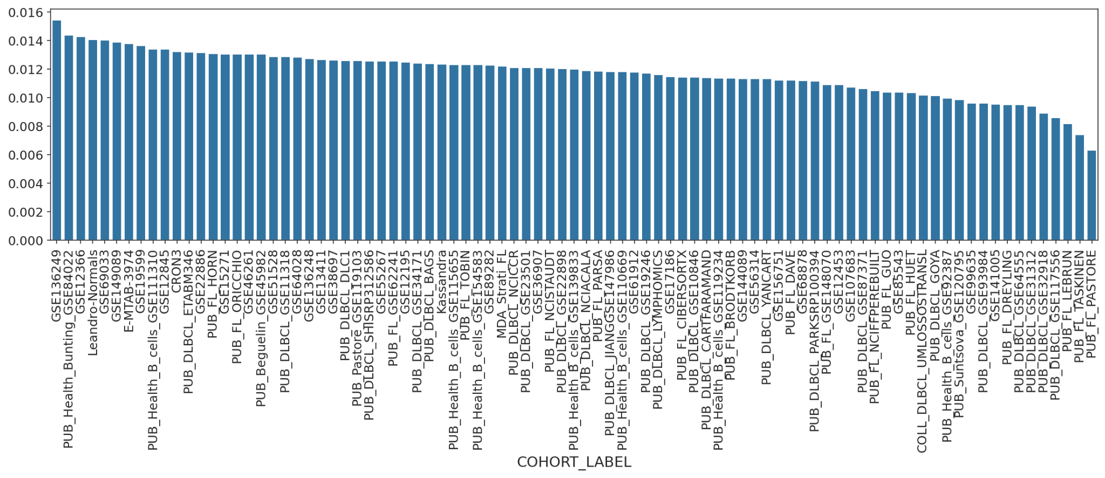
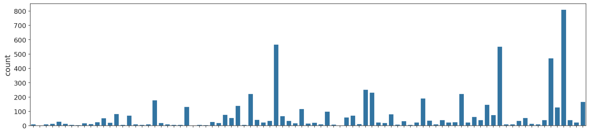
Mean relative change vs the original shambhala by cohort: low, no connection with sample size
10
SOM cohort, 0.27 relative change, 600 samples

Slide 16
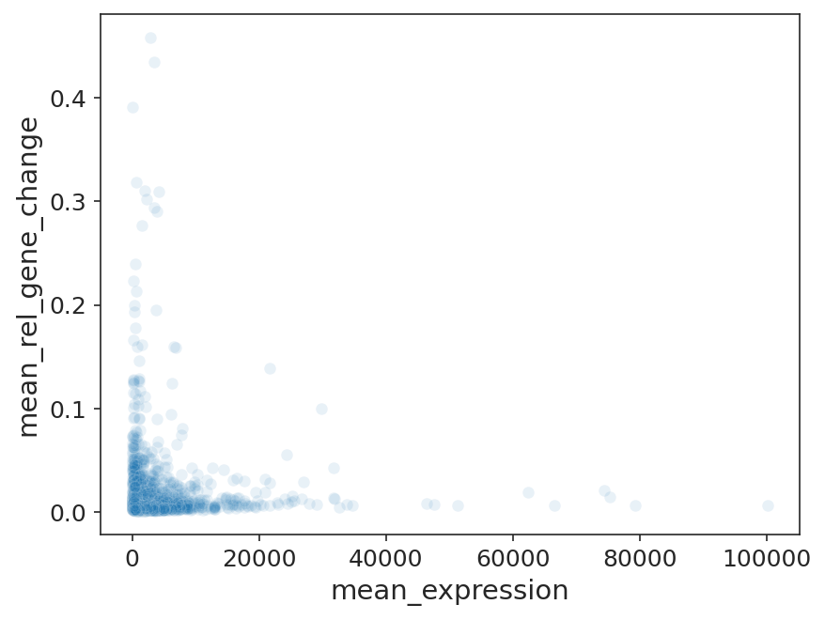
Mean relative change vs the original shambhala by gene: random noise
10

Slide 17
New Metrics Implemented: What Is Measured
11
11 metric groups computed per harmonized expression file. Three new/extended groups this period:
Group J — PC variance distribution (new)
• pct_var_pc1 through pct_var_pc10 and pct_var_cum_top10: % variance explained per PC
• Purpose: track batch effect removal. Before FSQN: PC1 ≈ 95%. After good normalization: PC1 drops to single-digit %
Group K — NA retention statistics (new)
• pct_genes_noNA, pct_samples_noNA, n_na_cells, pct_na_cells
• Purpose: detect methods that silently drop genes or samples (e.g. strict imputation removes all genes with any NA)
Group I — WaterMelon score (extended)
• wm_mean_batch: entropy-based clustering quality — LOW = same-batch samples NOT clustered together = good batch removal
• wm_mean_bio: HIGH = same-diagnosis samples DO cluster together = biology preserved
• wm_ratio_bio_batch: single composite score to rank methods (Zolotovskaya et al. 2020)
Previously implemented (groups A–H):
• PCA R², kBET, iLISI, cLISI, ASW (batch + biology), UMAP/tSNE centroid dispersion
• Pairwise KS tests, variancePartition mixed-model decomposition, kNN graph connectivity, intra/inter-group distance ratios

Slide 18
Benchmark Progress: Expression Files
12
S3 bucket: $FL_S3_BUCKET/FL_batch_correction/exp/ | Log date: 2026-05-26
Shambhala harmonizations:
████████████████████████████████████████████████████████████████ 100%
1,297 / 1,296 expected
18 P/Q variants × 3 imputations × 12 strategies × 2 post_rm variants
(One extra file is an exploratory speed-up test.)
All 1,296 Shambhala harmonizations complete.
All-methods expression files on S3 (Shambhala + all other 39 methods):
████████████████████████████████████████████████████████░░░░░░░░ 75%
3,282 total (Shambhala: 1,297 | Other methods: 1,985)
• 12 strategies covered: S0 (all samples), A–I batch exclusion variants, C RNA-seq only, D malignant only, F–H platform subsets, I rare-batch removal
• 39 normalization methods × 11 strategies × 4 imputation × 2 post_rm = 3,432 S3 outputs (target)

Slide 19
Benchmark Progress: Metrics Files
13
S3 bucket: $FL_S3_BUCKET/FL_batch_correction/metrics/ | Log date: 2026-05-26
Shambhala metrics calculated:
████████████████████████████████░░░░░░░░░░░░░░░░░░░░░░░░░░░░░░ 45%
579 / 1,296 expected
Started 2026-05-24 on fl-metrics pod
All-methods metrics on S3:
████████████████████████████████████████████████████░░░░░░░░░░░░ 66%
2,401 total (Shambhala: 579 | Other methods: 1,822)
• Metrics date range for Shambhala: 2026-05-24 15:40 → 2026-05-26 13:05
• Completed Shambhala metrics strategies: A, B, C, D, E1, E2, E3, S0 ✓
• In progress: F, G, H, I
• Expected completion: ~2026-05-28 (2 more days from log date)
Once metrics complete: aggregate into shambhala_metrics.csv → load into harmonization_metrics_analysis.ipynb → rank all 18 P/Q variants by batch metrics and select best for downstream SOM analysis.

Slide 20
Summary
14
Built and deployed:
• Pure-Python Shambhala pipeline — no R, no rpy2, no intermediate files
• 30-worker parallelization (shambhala-workers): 9 h → 1–2 h for P0std
• A_E speed-up approved: 8.6× lab / ~10× real-world throughput gain
• 1,296 Shambhala expression harmonizations — 100% complete
Running now:
• Metrics: 579/1,296 Shambhala files done (~45%); projected completion ~2026-05-28
• Once complete → aggregate into shambhala_metrics.csv → load into harmonization_metrics_analysis.ipynb
Open questions:
• Which P/Q combination performs best by batch metrics? (answer pending metrics completion)
• Should Shambhala runs be restricted to RNA-seq only (same decision as for SOM pipeline)?
• Is the normal B cell Q reference (QNBKass) biologically more appropriate for FL cohorts than GTEx (Q0std)?
• Are B-cell-specific P/Q references (NBlegacy, NBext, >700 samples) at risk of over-calibrating toward normal B-cell baseline and compressing tumor subtype signal?

Slide 21
Planned Work — Next Steps
15
• 1. Presentation on Shambhala and its adaptation — document normalization runs before/after speed-up; present quantitative throughput improvement and parallelization approach. (This presentation.)
• 2. Comparison of test dataset before and after speed-up — show output expression values do not change materially (1.39% mean relative diff); explain what was accelerated.
• 3. Verify completeness of harmonizations; estimate per-run time per Shambhala variant via AWS S3 file listing timestamps. (Done — Slides 10 and 12–13.)
• 4. Select best Shambhala attempt from those available by Wednesday evening — once metrics complete, rank all 18 P/Q variants and pick top performer for downstream SOM analysis.
• 5. Continue trend analysis — extend harmonization_metrics_analysis.ipynb with Shambhala results; compare with the 39-method benchmark.
• 6. Propose a decision tree — document normalization choice logic (platform, imputation, post-removal) as a practical decision tree for the manuscript.
• 7. Start writing the article — begin drafting the harmonization benchmark methods and results section.
Generated: 2026-05-28 | Pipeline: shambhala_adoption/Shambhala_containerized/ | Pod: fl-shambhala

Slide 22
FL Project Update:
New methods and best attempts
Shambhala · Metrics · Decision tree
Daniil Nikitin · BostonGene · 2026-05-28

Slide 23
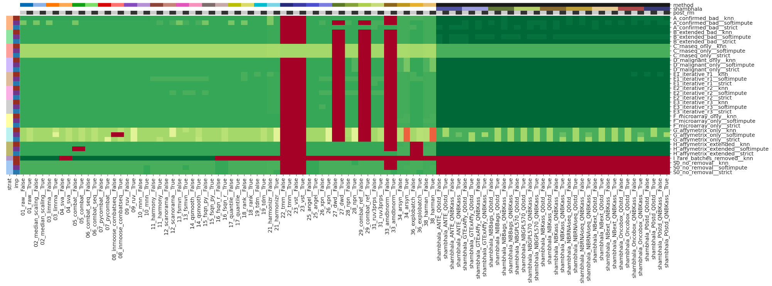
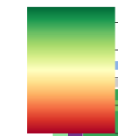
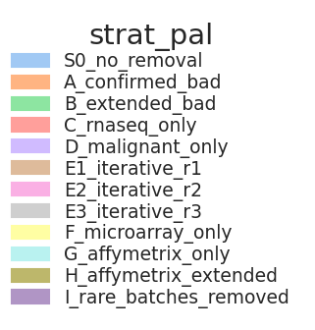

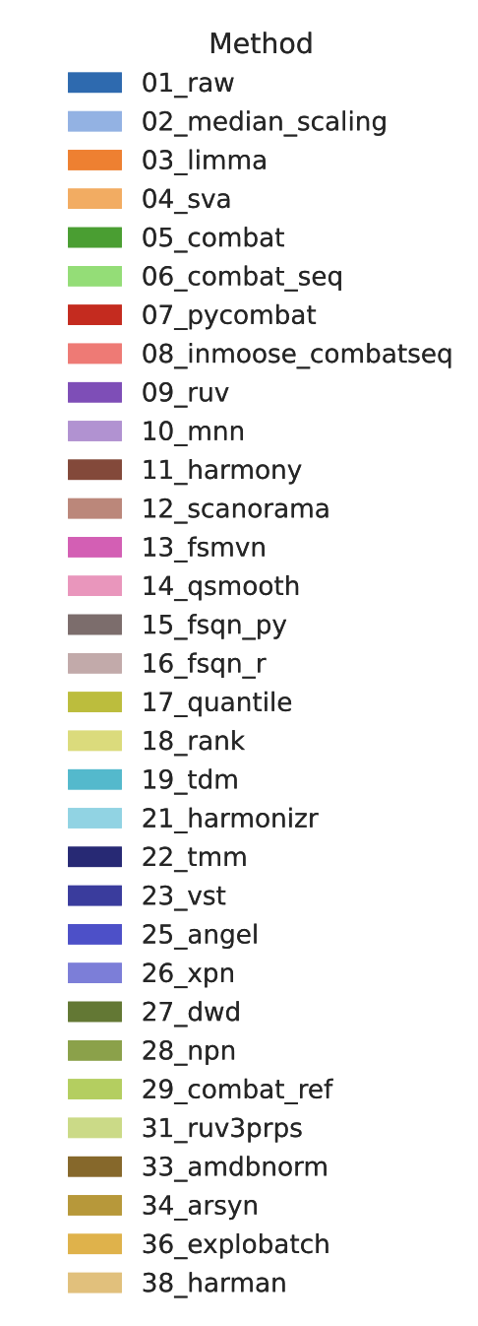
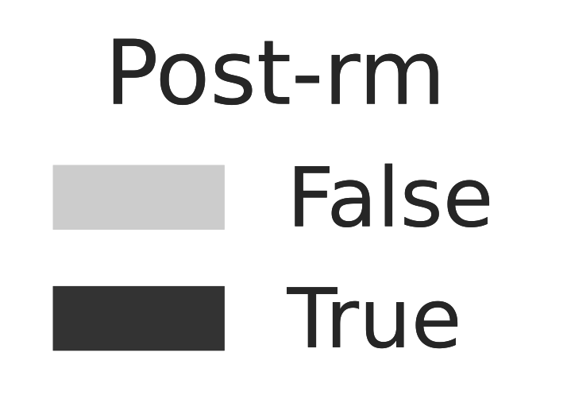
Metrics status as of May 28: 2930/3200 harmonization attempts do have their metrics. Heatmap of metrics number by attempt
Old calculations shambhala with less metrics
New shambhala with more metrics
To be calculated
Metrics number
200
150
Normalization method
100
50

Slide 24
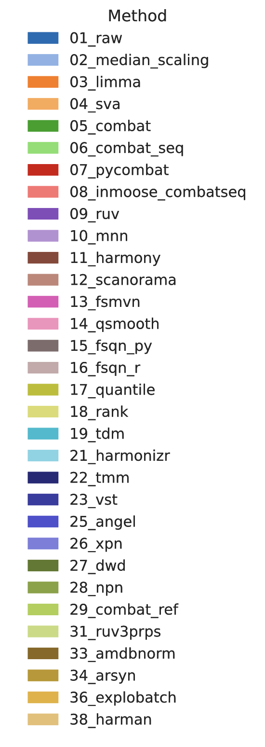
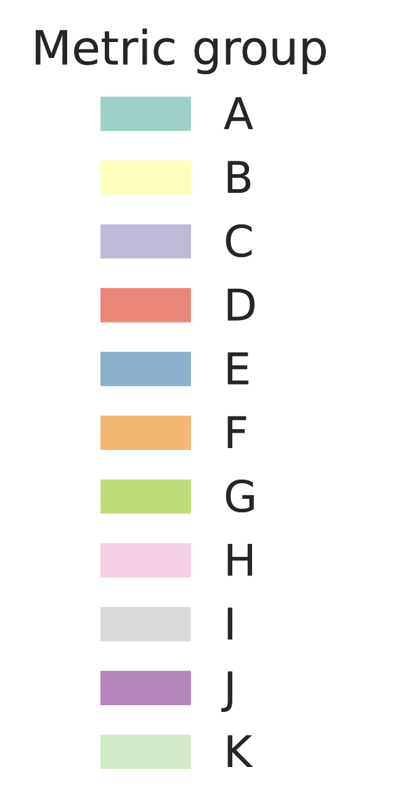
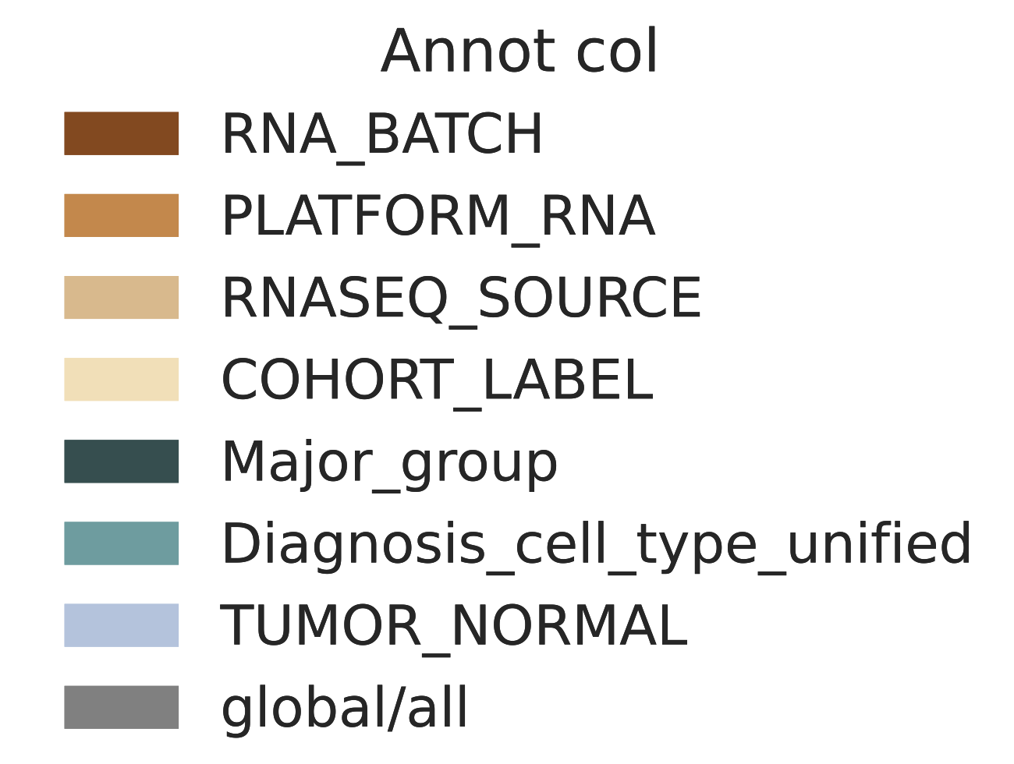
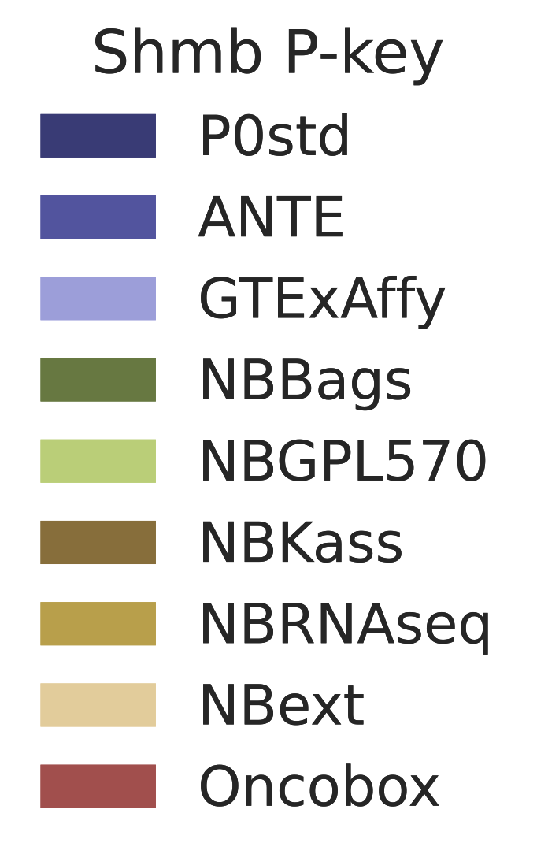
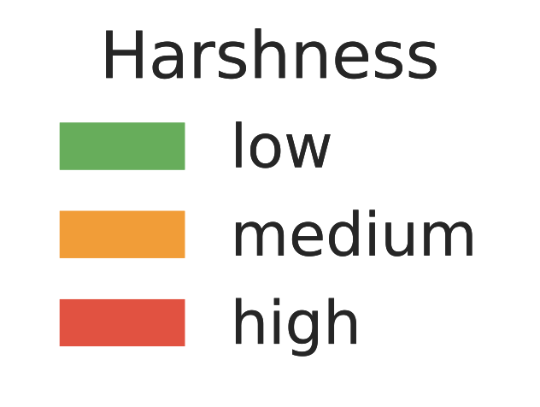
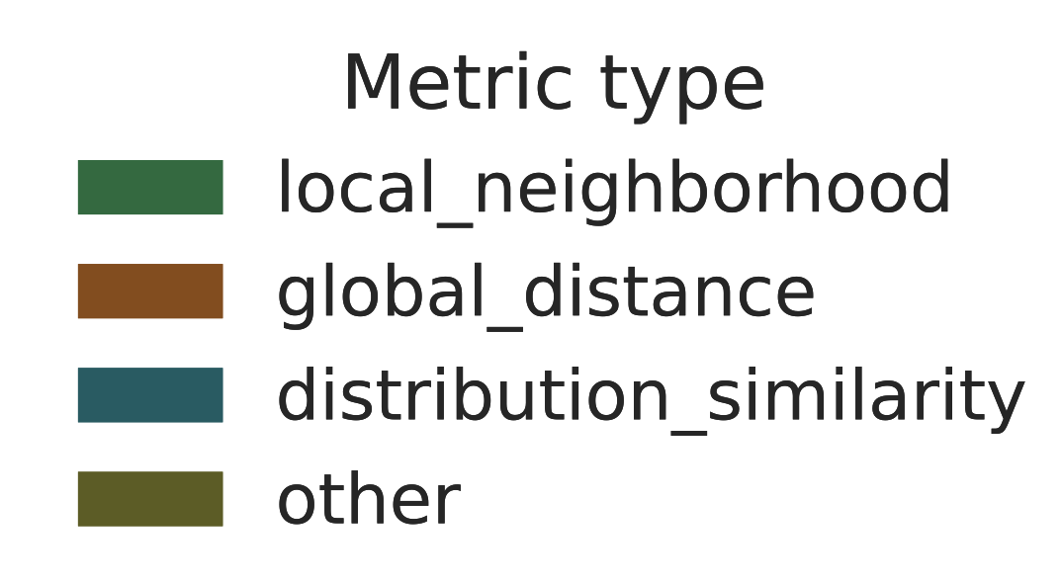
Palettes for metrics clustermap
Rows
Columns
Left
Right
Top
Bottom
Shambhala

Slide 25
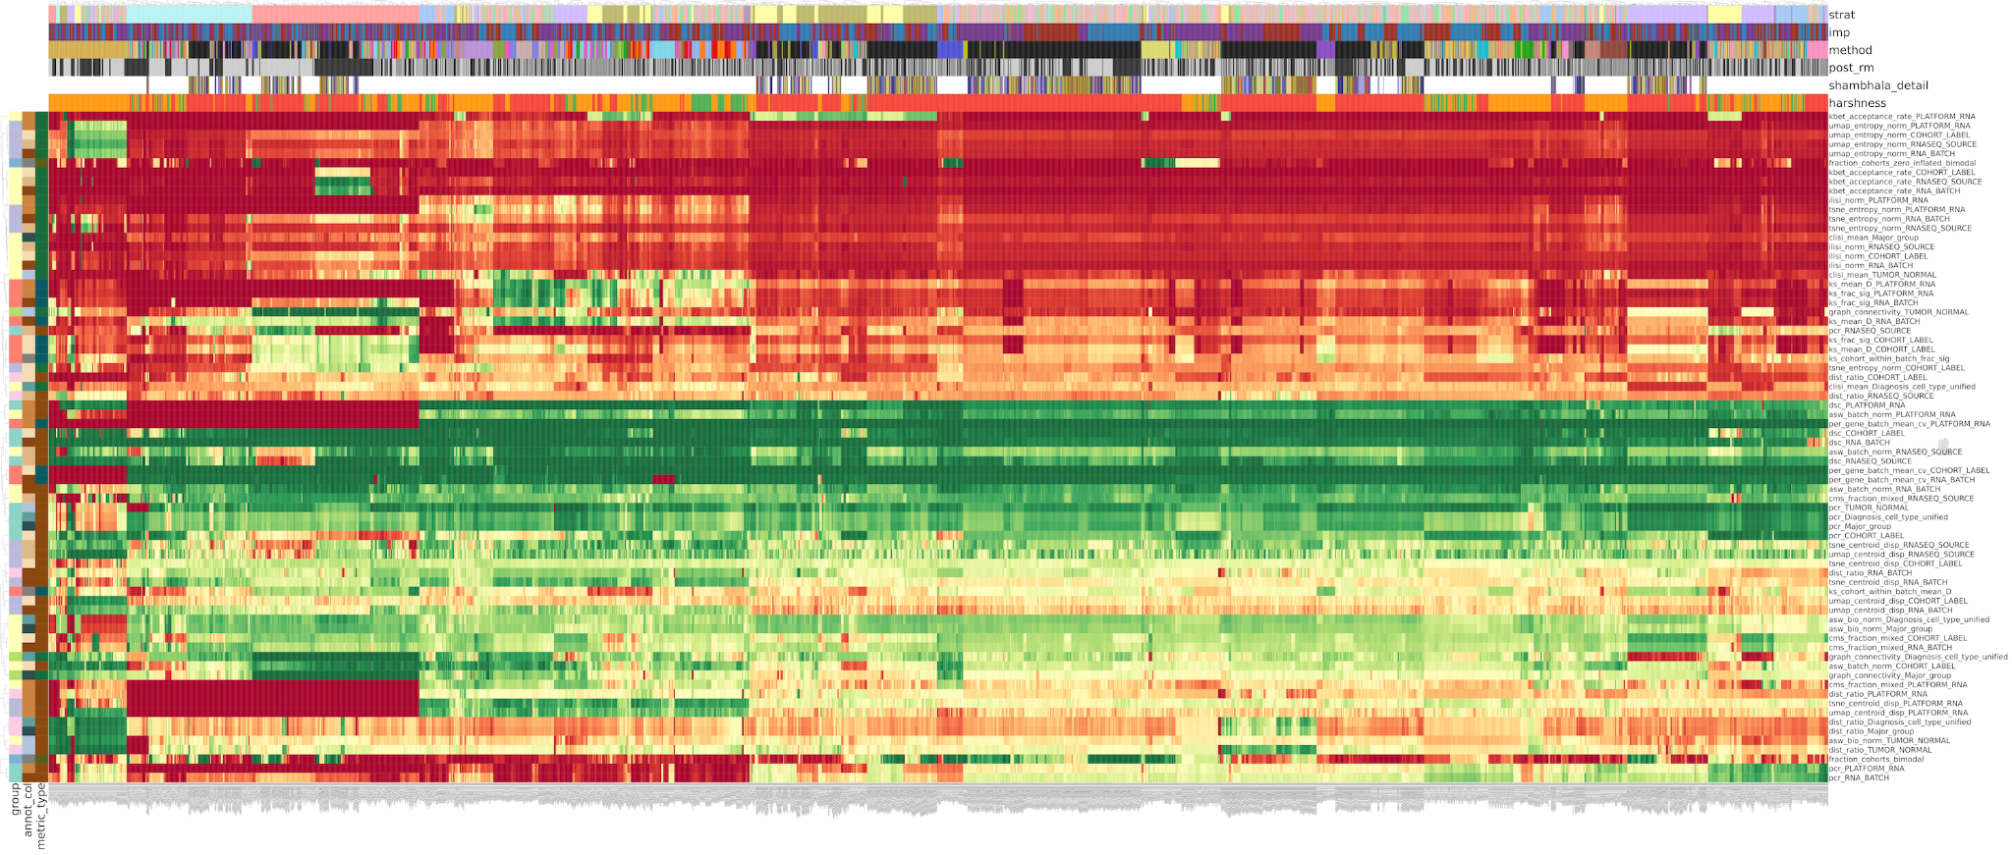
Metrics clustermap: 2930 harmonization attempts. Shambhala does not help
Shambhala slightly improves RNASeq
Mnn, still the best
Bad Angel
Interesting?
Bad with many NAs
Bad local metrics
Good global metrics
Shambhala helps to improve RNASeq only harmonization, but does not help to cross-harmonize RNASeq and Microarrays

Slide 26
Best shambhala attempts: BAD

Slide 27
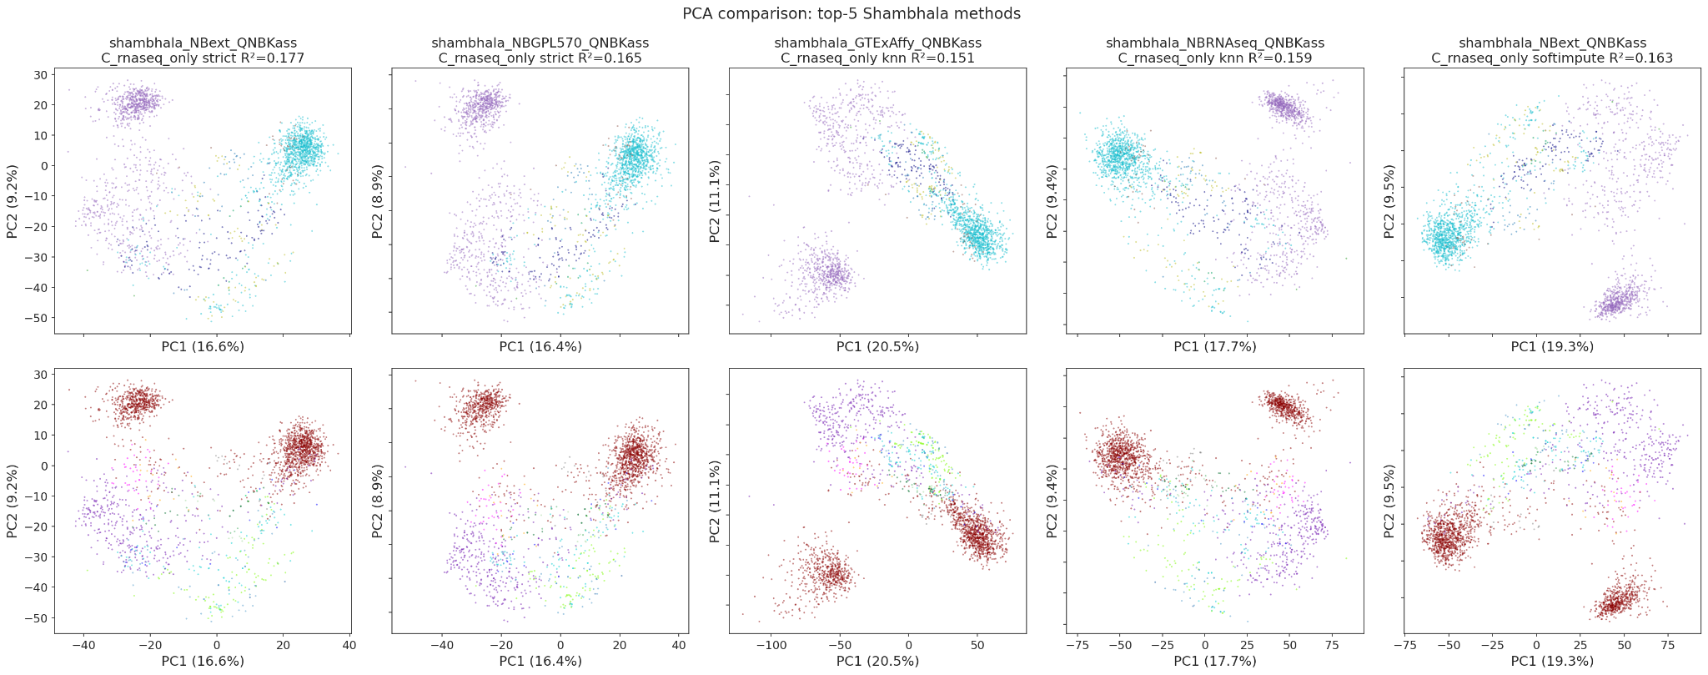
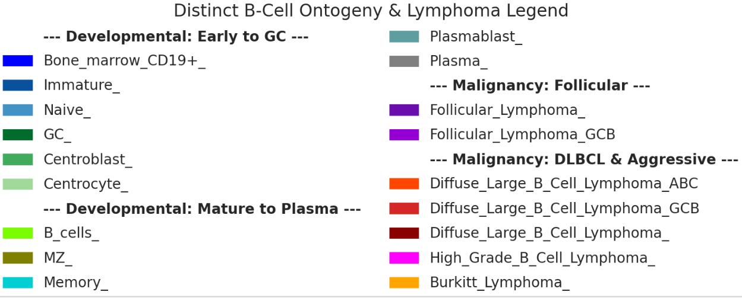
RNASeq only best shambhala attempts by PCA: no mixing of FF and FFPE. Worse than SVA

Slide 28
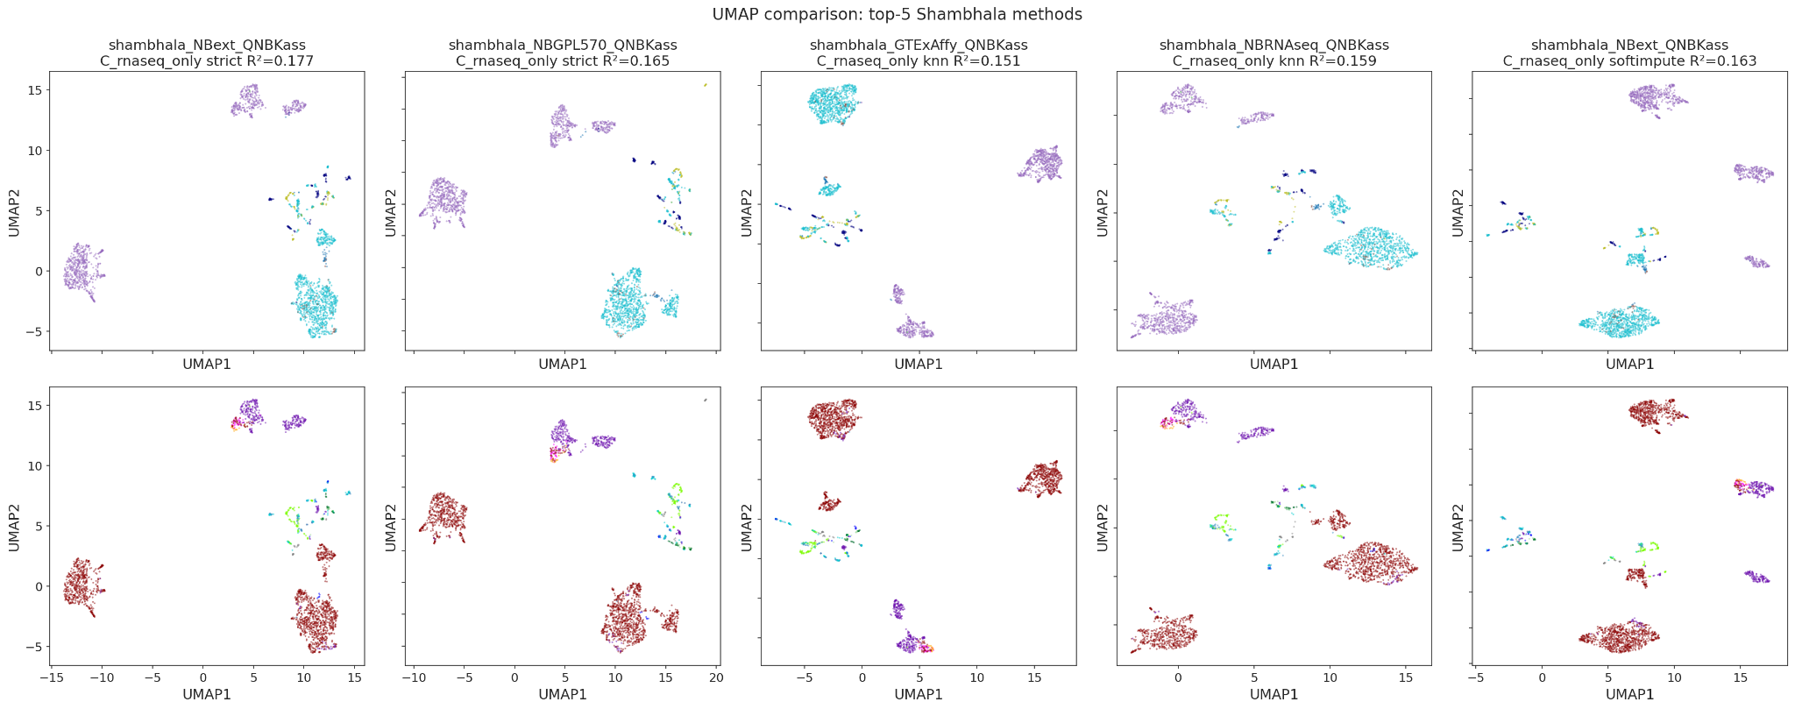
RNASeq only best shambhala attempts by UMAP: no mixing of FF and FFPE. Worse than SVA

Slide 29
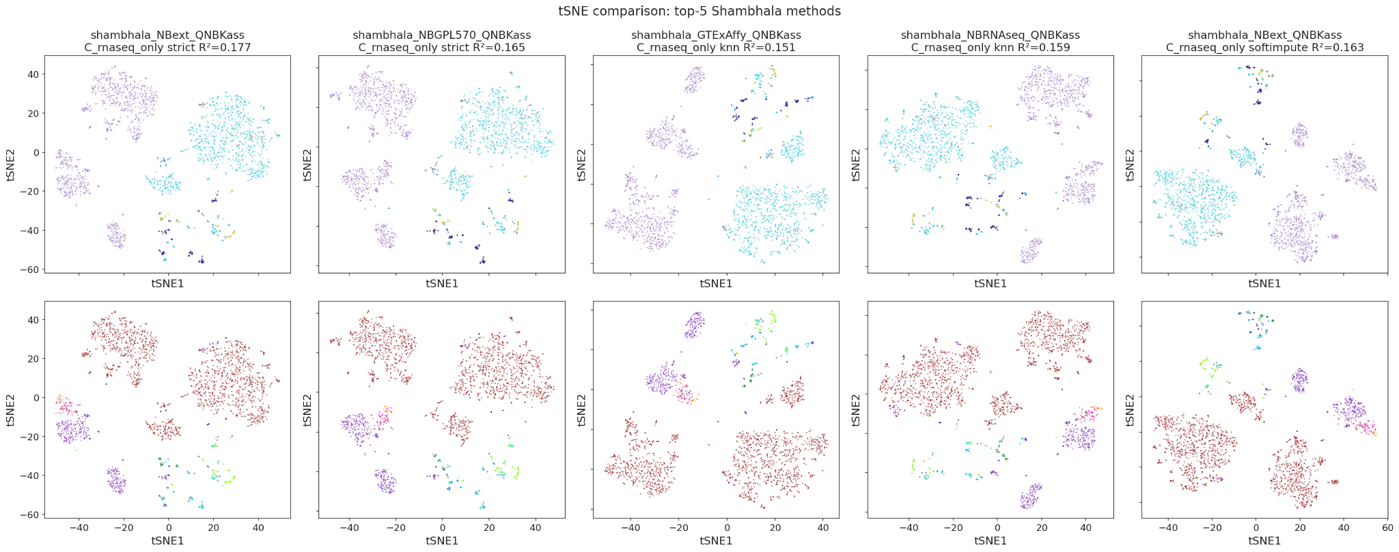
RNASeq only best shambhala attempts by tSNE: no mixing of FF and FFPE. Worse than SVA

Slide 30
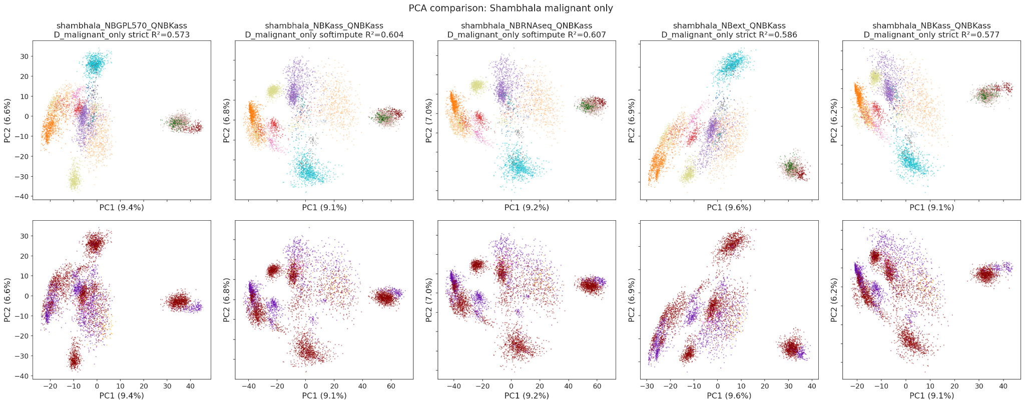
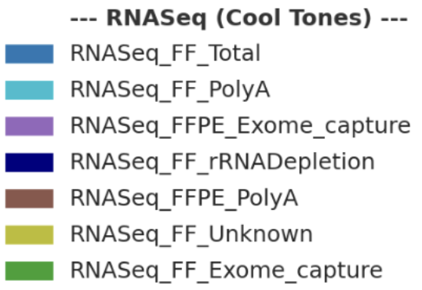
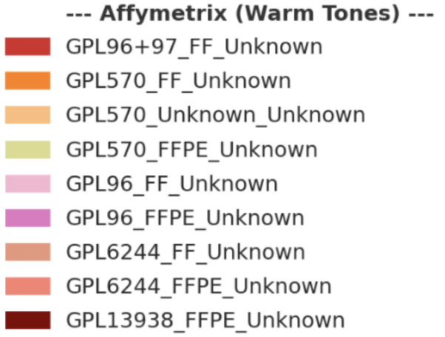
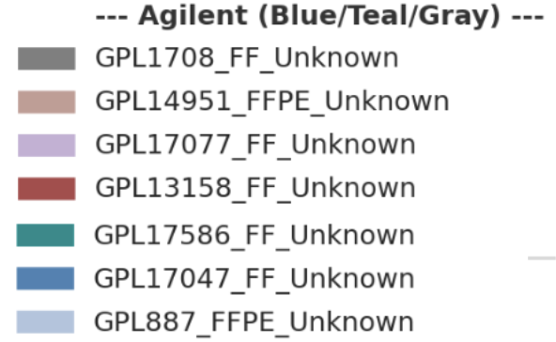
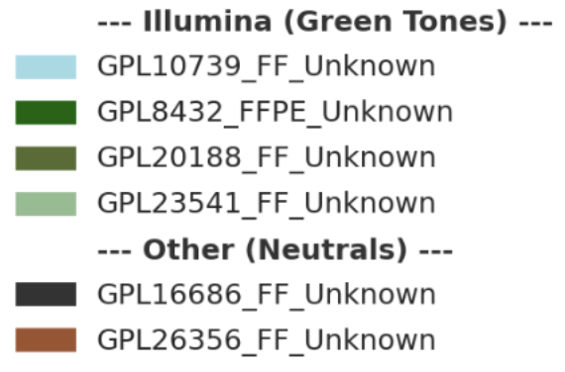
Shambhala attempts for Malignant only: again no mixing, PCA

Slide 31
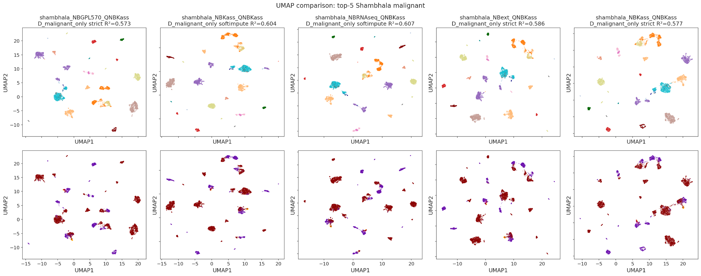
Shambhala attempts for Malignant only: again no mixing, UMAP

Slide 32
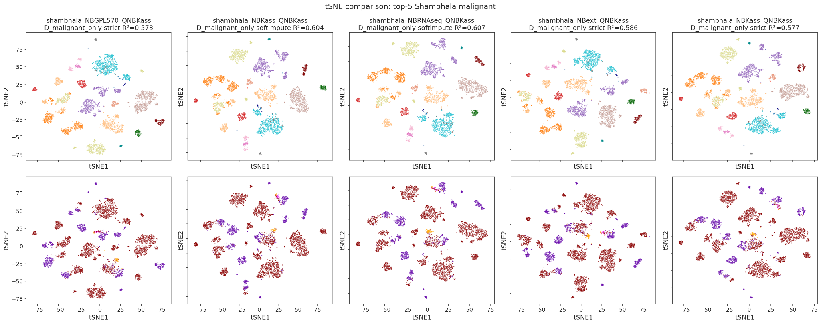
Shambhala attempts for Malignant only: again no mixing, tSNE

Slide 33
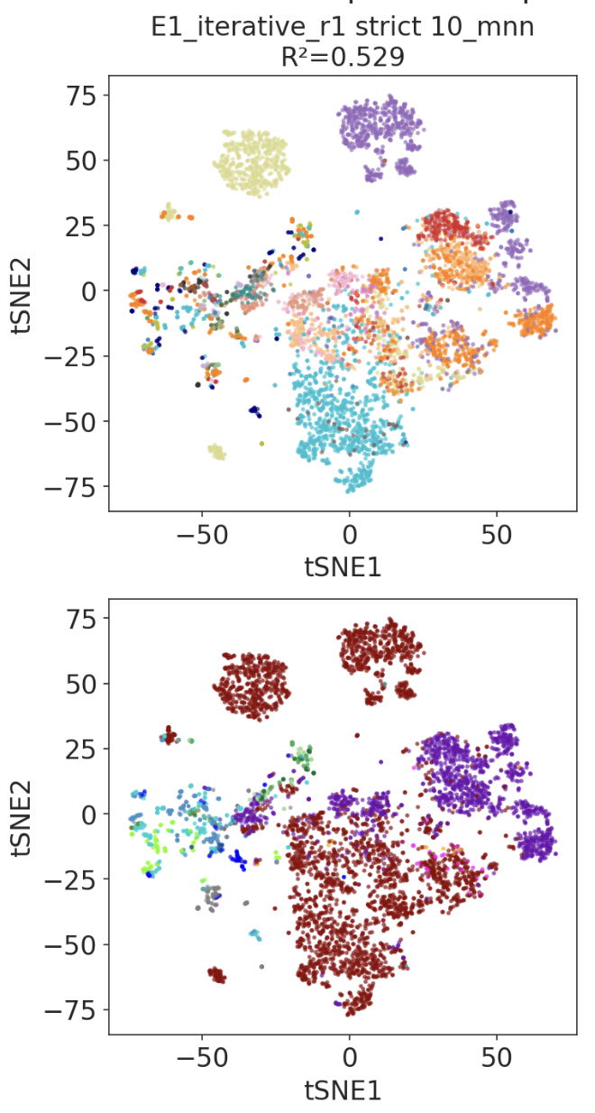
Decision tree for harmonization approaches, draft
Take FF only or FFPE-only
RNASeq only -> SVA
RNASeq + Microarrays -> MNN + post-removal by visual inspection

Slide 34
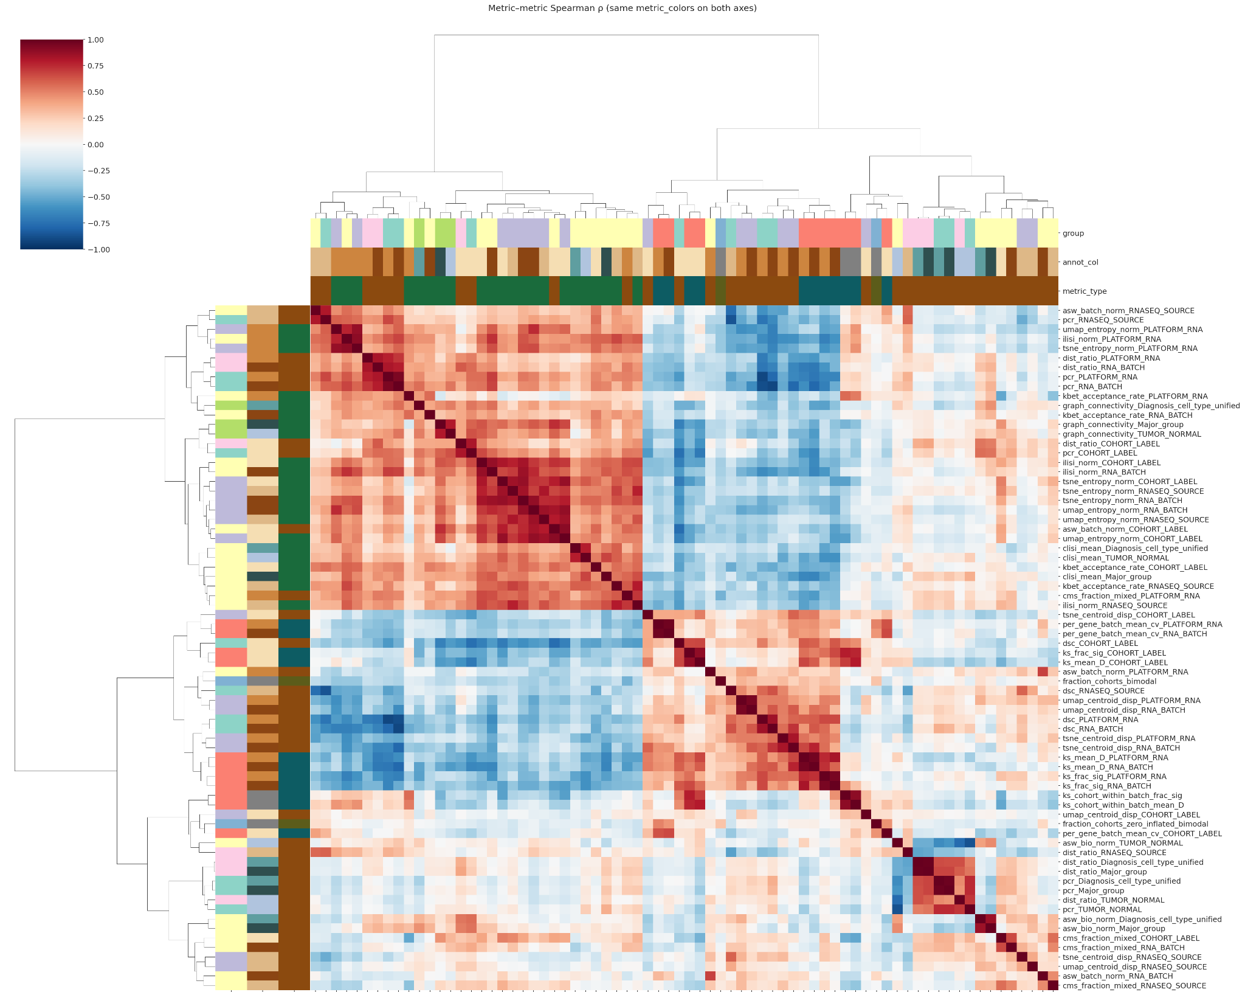
Trends in metrics: the same two groups, local and global

Slide 35
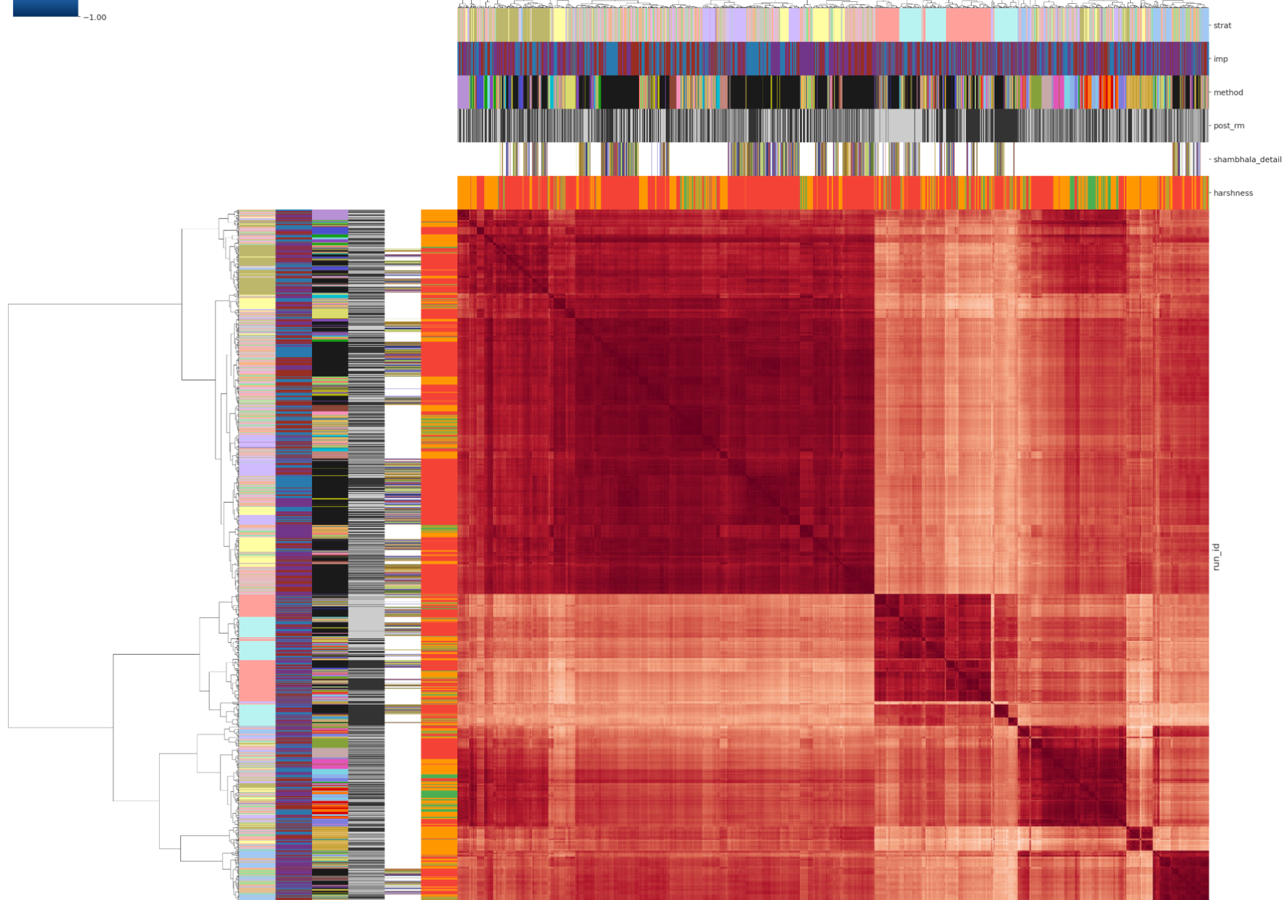
Correlation plot of harmonization attempts: no pattern, shambhala does not improve the performance
More harsh methods, bad

Slide 36
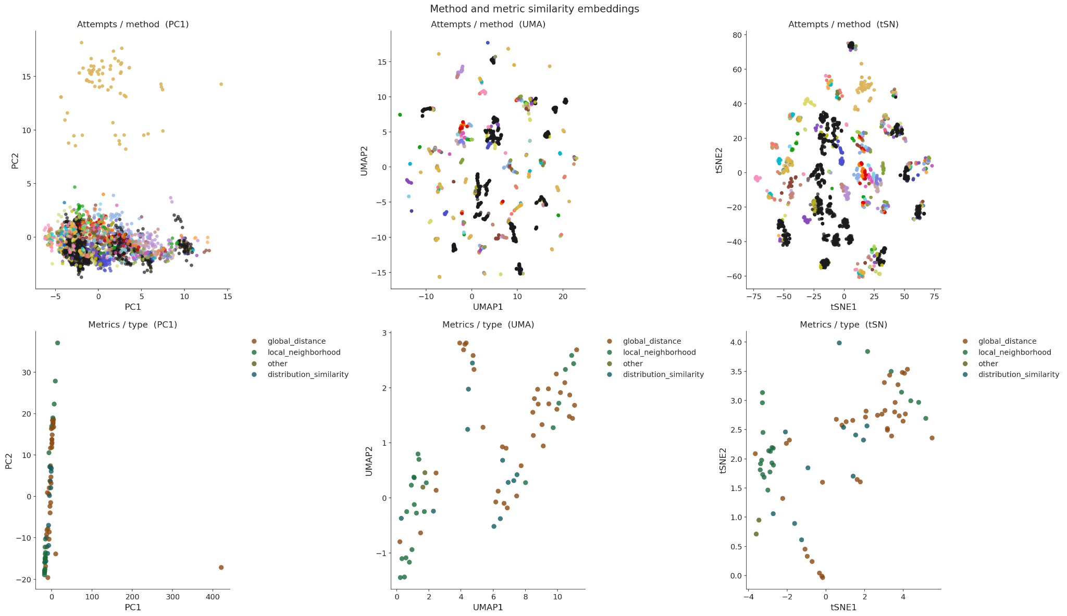
Dimensional reduction plots of harmonization attempts and metrics: no pattern for methods, shambhala does not differ from other approaches. Metrics form 2 groups
Shambhala

Slide 37
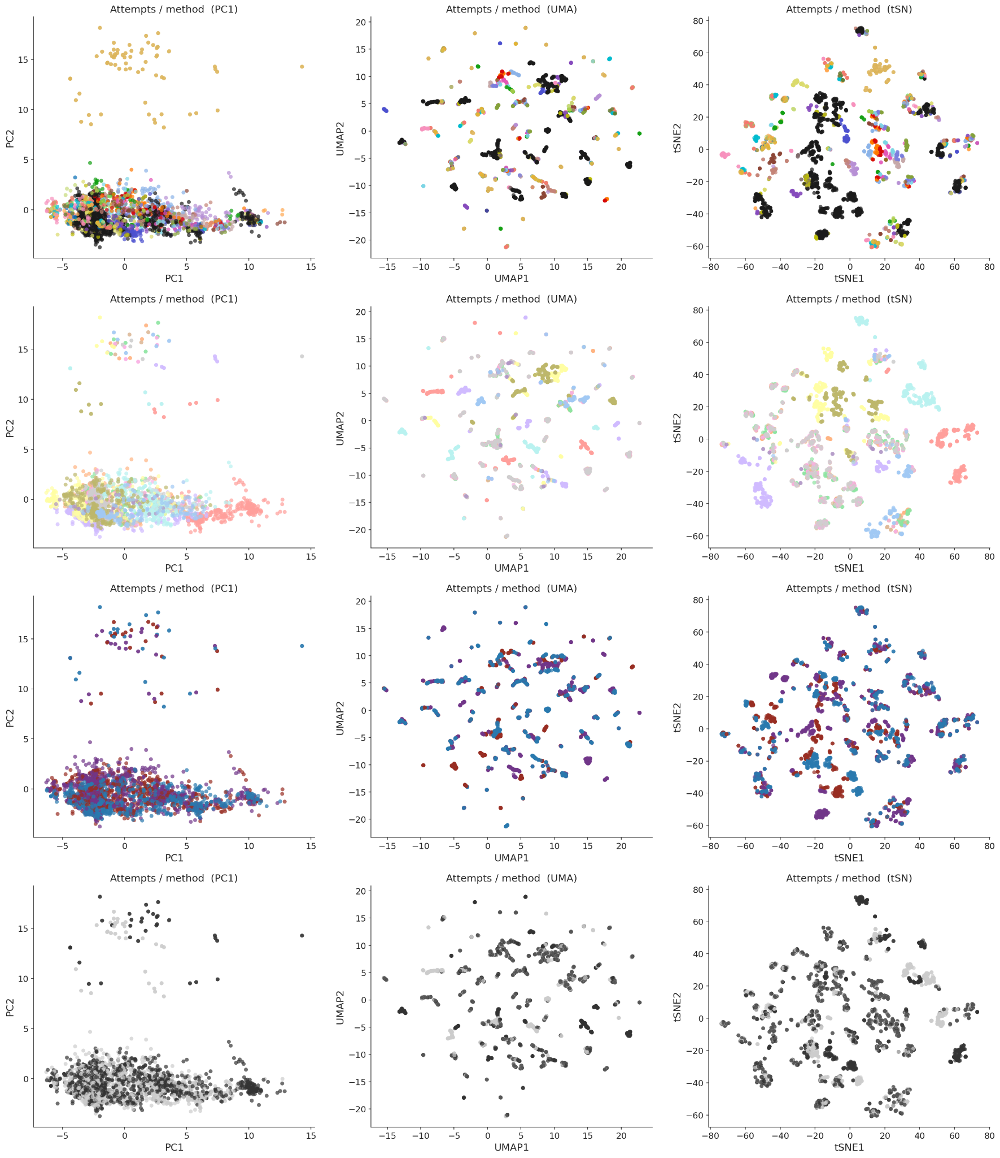
Methods
Dimensional reduction plots of harmonization attempts: Batch removal strategy -> Harmonization method -> Imputation -> Post-removal
Batch removal
The largest clusters are formed by batch removal strategies - especially RNA Seq only, Malignant only, Microarrays
Imputation

Slide 38
tSNE plots for harmonization attempts: each Batch removal attempt occupies domain space, than smaller areas are covered with Harmonization methods, and the smallest ones - by Imputations
Normalization method
Batch removal strategy
Imputation
Affymetrix + Microarrays
GPL570
Iterative
RNASeq
Malignant
All
Normalization method
Shambhala

Slide 39
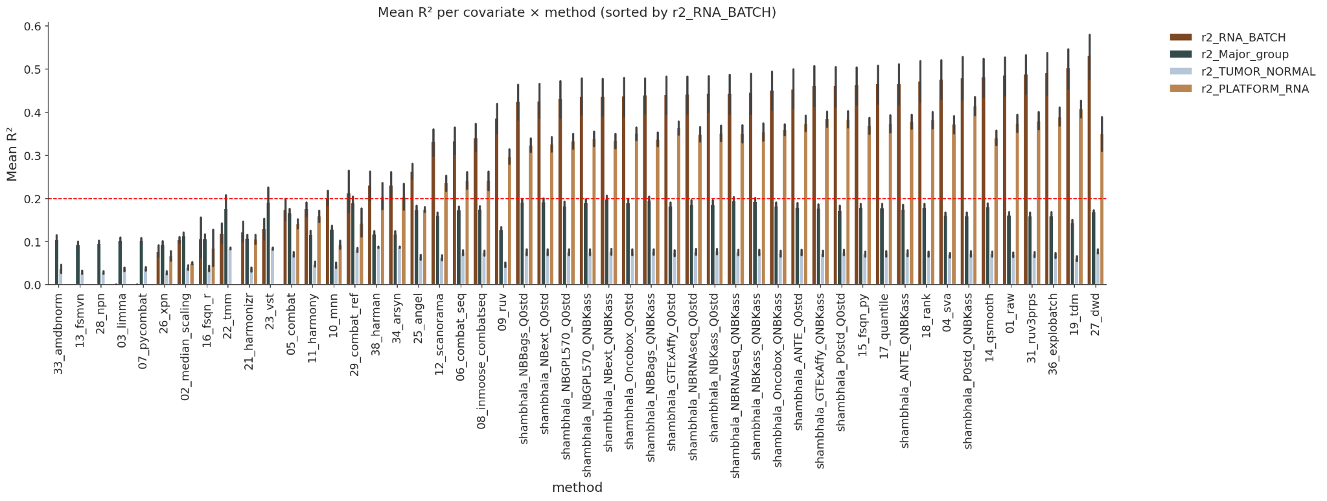
R2 by major columns by Harm methods: 5 are OK
Good - Biology higher than batch
So-so - Biology comparable batch
Bad - Biology lower than batch

Slide 40
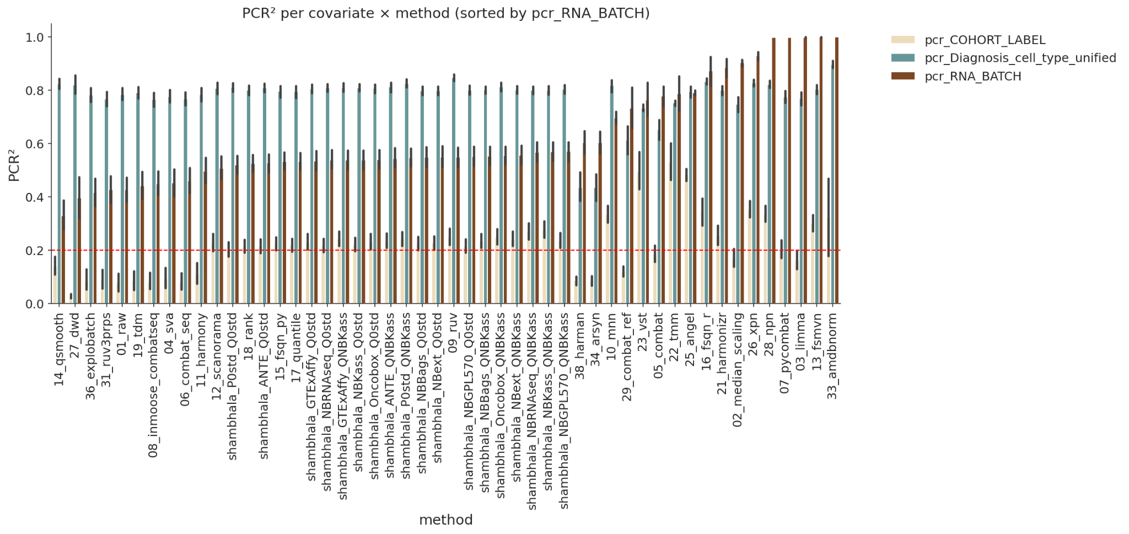
PCR by major columns by Harm methods: 4 are OK
Principal component regression
Good - Better than RAW
Bad -Worse than RAW
So-so - Like RAW

Slide 41
Conclusions
Most harmonizers (except MNN and SVA) cannot catch subtle biological differences between FL, DLBCL and normal GC B cells - they were devised on cohorts with large biological differences (TCGA, GTEx etc).

Slide 42
Next steps, short timeline: the first article
Add FF_only, FFPE_only
Complete the metrics analysis
Add Venn diagrams for Shambhala datasets and my cohorts of different imputations and batch removal strategies.
Decision tree, make it beautiful
Article plan: major figures structured by takeaways.
Local vs global metrics
Methods harshness
Relative importance of batch removal, harmonization, imputation
Best approaches for each scenario

Slide 43
Next steps, long timeline: the second potential technical article
Reliably pythonify CuBlock - faster and more reusable
Develop shambhala_3 that will catch subtle biological differences between FL, DLBCL etc: replace CuBlock with MNN which was successful particularly for the FL cohort
Add new metrics of transfer learning:
  5-fold cross-validation within the entire cohort to predict classes (DLBCL, FL, etc) -> accuracy, AUC, MCC etc
  Take pairs of cohorts with all classes present: learn on a larger one, predict the smaller one - external applicability tested. Again accuracy, AUC etc.
  Study Borisov 2023 article 10.3389/fmolb.2023.1237129 and implement its approaches
  Randomly permute class labels and test whether the metrics are high again - the random background test
  How to learn and predict: test KNN, SVM, try DNN using pytorch/tensorflow.
Add NBextended as a third Q0 dataset for shambhala
Based on all of the above, proceed with the shambhala3 and release it in the article

