Slide 1
Secure Browsing Using Anti-Phishing
Ruchi Bhuta BE CMPN A(11)
Pooja Ekbote BE CMPN A(34)
Nikita Jadhav BE CMPN A(48)
Under the guidance of Ms. Pradnya Rane

Slide 2
Introduction
Our project outlines the Anti-phishing Technique on the social networking sites.
Phishing attacks mainly focus on websites, where attacker carry out fraudulent activities.
Attacker uses replica of original website that is send to the user, user fills and submits the sensitive information into the website.

Slide 3
Problem Formulation
Phished web pages have high visual similarities to the original web page.
Victims of phishing web pages may expose their bank account, password, credit card number which can be misused by attacker.
Hence to provide high security we are using Visual Cryptography for anti phishing.

Slide 4
Objective
Anti-phishing techniques are used to combat phishing.
To make the user capable of identifying the fake website. Once the identification is done the user can safely use the website with full security from attackers.
One of the Anti-phishing techniques which we aim at is (2,3) colored Visual Cryptography.

Slide 5
Literature Review
The Phishing Guide Understanding & Preventing Phishing Attacks:
-This topic focusses on analyzing the tools and techniques which the professional criminals are being using currently.
Disadvantage:-
It provides the limited scope to identify strategy.
The performance measure is 66.45%.[1]

Slide 6
Literature Review
CAPTCHA : Using Hard AI Problems For Security
Disadvantage:-
Not all people have same intelligence to solve the problem , imply win-win situation: either the problems are solved or remain unsolved.
The performance measure is 85.30%[1]

Slide 7
Literature Review
A Text-Graphics Character CAPTCHA for Password Authentication:
Disadvantage:-
slow, large database are required and retrieving time is large.
The performance measure is 89.54%. [1]

Slide 8
Literature Review
Hashed Based Visual Cryptography Scheme For Image Authentication
Disadvantage:-
It needs separate hardware for authentication.
The performance measure is 90.15%. [1]

Slide 9
Literature Review
Visual Cryptography (Basic)
Disadvantage:-
This approach works only for black & white images.
If any one of the share is lost then a share generation algorithm is to be run to generate the share again which will take a lot of time.
The performance measure is 72.55%. [1]

Slide 10
Extension of the previous research
Overcoming these drawbacks we are going to implement (2,3) visual cryptography using color images
Where 3 is the number of shares in which the image is divided and 2or 3 is the number of shares required for recovery

Slide 11
Features
Conversion from ARGB to CMYK helps in saving space.
The problem of earlier algorithm of fixed size image is eliminated.
Faster to generate shares using randomized algorithm.
Efficient reconstruction of image by working at pixel level.

Slide 12
System Analysis
Functional Requirements:
According to the functions of the system it is divided into three modules:-
Input Requirements:-
User Details
Image
Shares
Processing Requirements:-
It is core software which uses the image from the input module
Generation of Shares
Stacking of Shares
Output Requirements:-
Stacked Image

Slide 13
Feasibility
Hardware Requirements:-
Pentium Processor
Minimum 512 MB RAM
10 GB Hard Disk
Software Requirements:-
Matlab
Xampp

Slide 14
Proposed System
The proposed approach can be divided into two phases:
Registration phase
Login phase

Slide 16
Algorithm:-
Registration Phase: Share Generation
1. Take Input from user:- User details ,an image
2. Scan each pixel of image
3. Convert the image from ARGB format to CMYK .
4. The number of shares the image would be divided is 3 and number of shares to reconstruct the image (2 or 3) .
Step: I: Take an image as input and calculate its width (w) and height (h).
Step II: Scan each pixel of image and convert to 32 bit binary string let PIX
Step III: Call Random Function for plotting the pixels for shares
Step IV: Create 1D array to store constructed pixels of each share
Step V: Construct three shares from the array
5. Shares are distributed to the user and the server, where Share 1 and common share is given to user and Share 2 and common is given to server.
6. End.

Slide 17
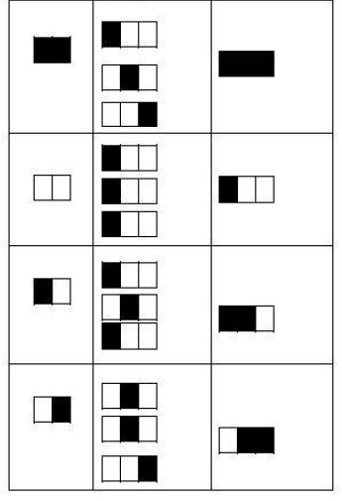
Share Generation

Slide 18

Original image

Slide 19
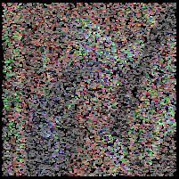
Share1 (Server )
Shares Generated
Share2
(User)
Share3
(Server )

Slide 21
Login Phase: Stacking of Shares
1. Input from user it’s details and share
2. Input Server share and common share
3. Scan pixels of each share and store it in an array
4. Combine the arrays to get a final array which contains a combination of pixels of each share using OR operation.
5. Generate an image of this array by plotting the pixels
6. This generated image is then given to the user
7. User verifies the image with the original image
• if (generated image==original)
Secure website continue shopping
• Else
Not safe site abort.
8. End

Slide 22
Login Phase
Case 1:
Reconstruction using 3 shares:-
User Logs in using Share2(Mandatory)
Server gives Share1 and Share3
All the three shares are stacked together using (2,3) colored visual cryptography algorithm
Stacked Image is displayed on user screen

Slide 23

Reconstruction using 3 shares

Slide 24
Login Phase
Reconstruction using 2 shares:-
Case 2: (If share1 or share3 is lost)
User Logs in using Share2(Mandatory)
Server gives Share1 or Share3
The two shares are stacked together using (2,3) colored visual cryptography algorithm
Stacked Image is displayed on user screen

Slide 25
Login Phase
Reconstruction using 2 shares:-
Case 3: (If user share is lost)
User requests share
Server authenticates user and sends share3
The two shares are stacked together using (2,3) colored visual cryptography algorithm
Stacked Image is displayed on user screen

Slide 26

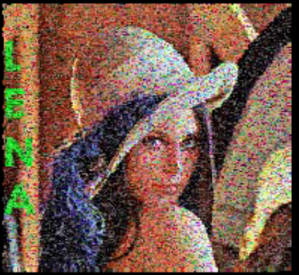
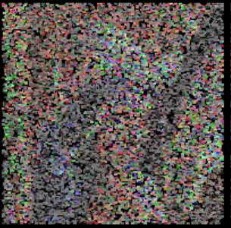
Reconstruction using 2 shares

Slide 27
Login Phase
Case 4: If site is phished
User enters its share2
Random share is given by fake site.
Stacked image displayed on user screen.

Slide 28

Phished Page: Image Generated

Slide 29
Analysis Modeling
Use Case Diagram
Functional Modeling-Data Flow Diagram
Activity Diagram
Sequence Diagram

Slide 30
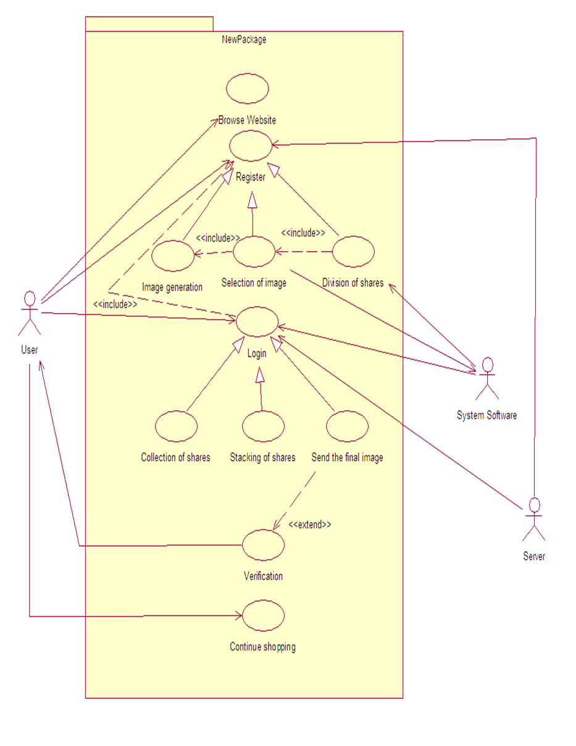
Usecase diagram

Slide 31
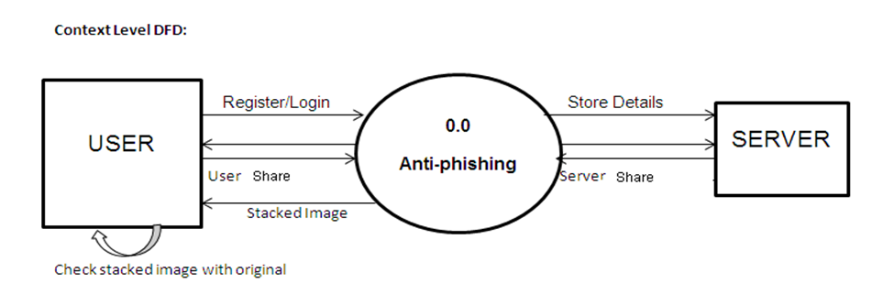
Context level DFD

Slide 32
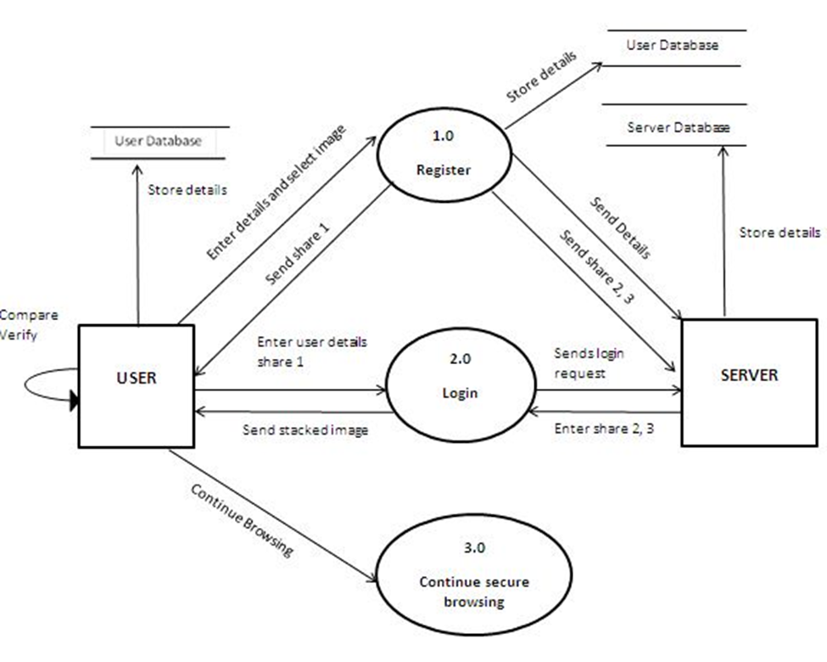
Level 0 DFD

Slide 33
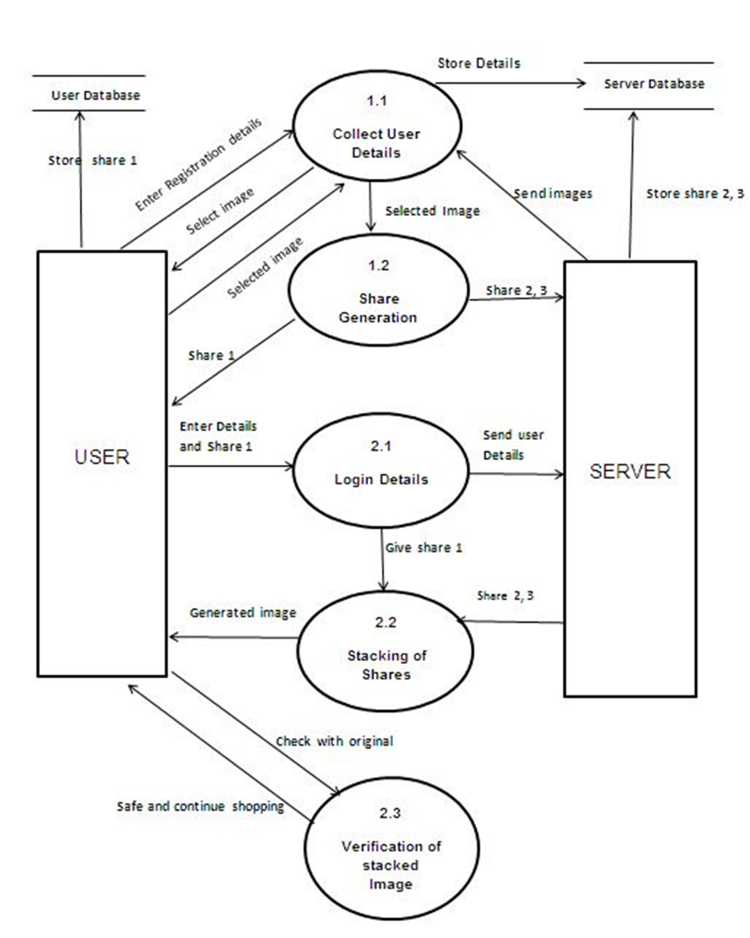
Level 1 DFD

Slide 34
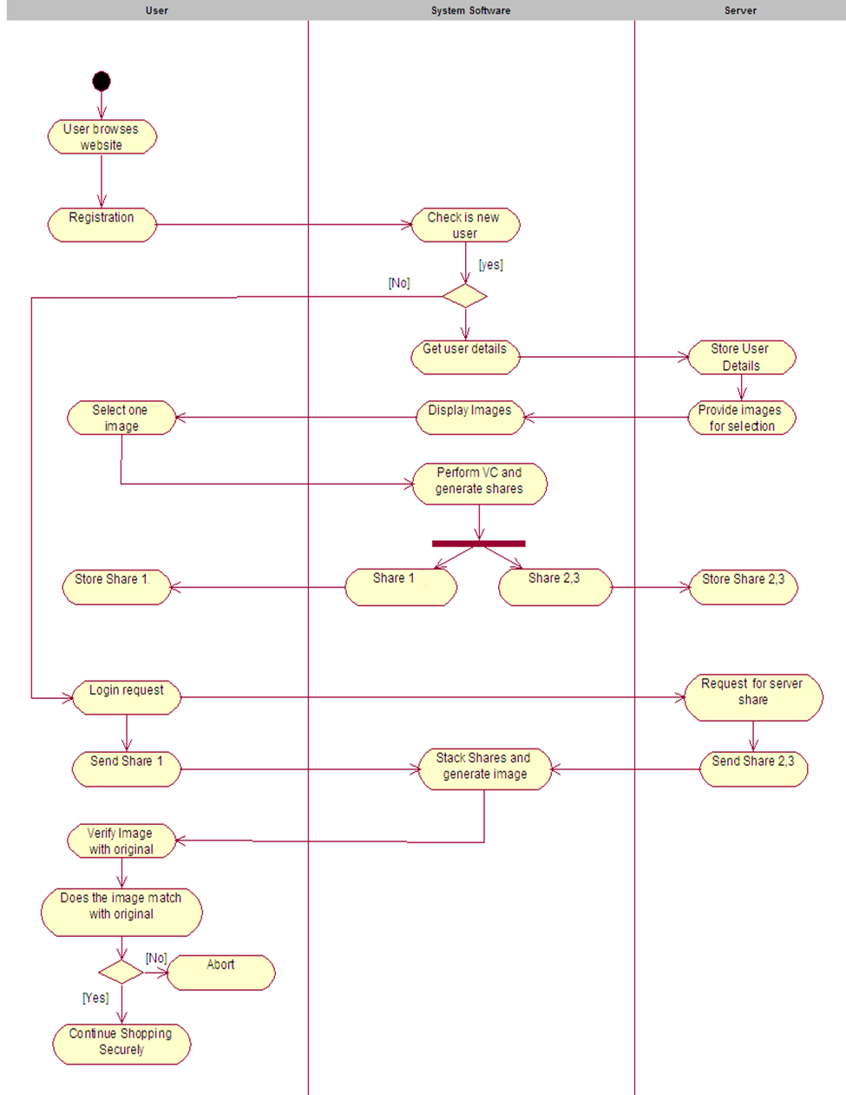
Activity Diagram

Slide 35
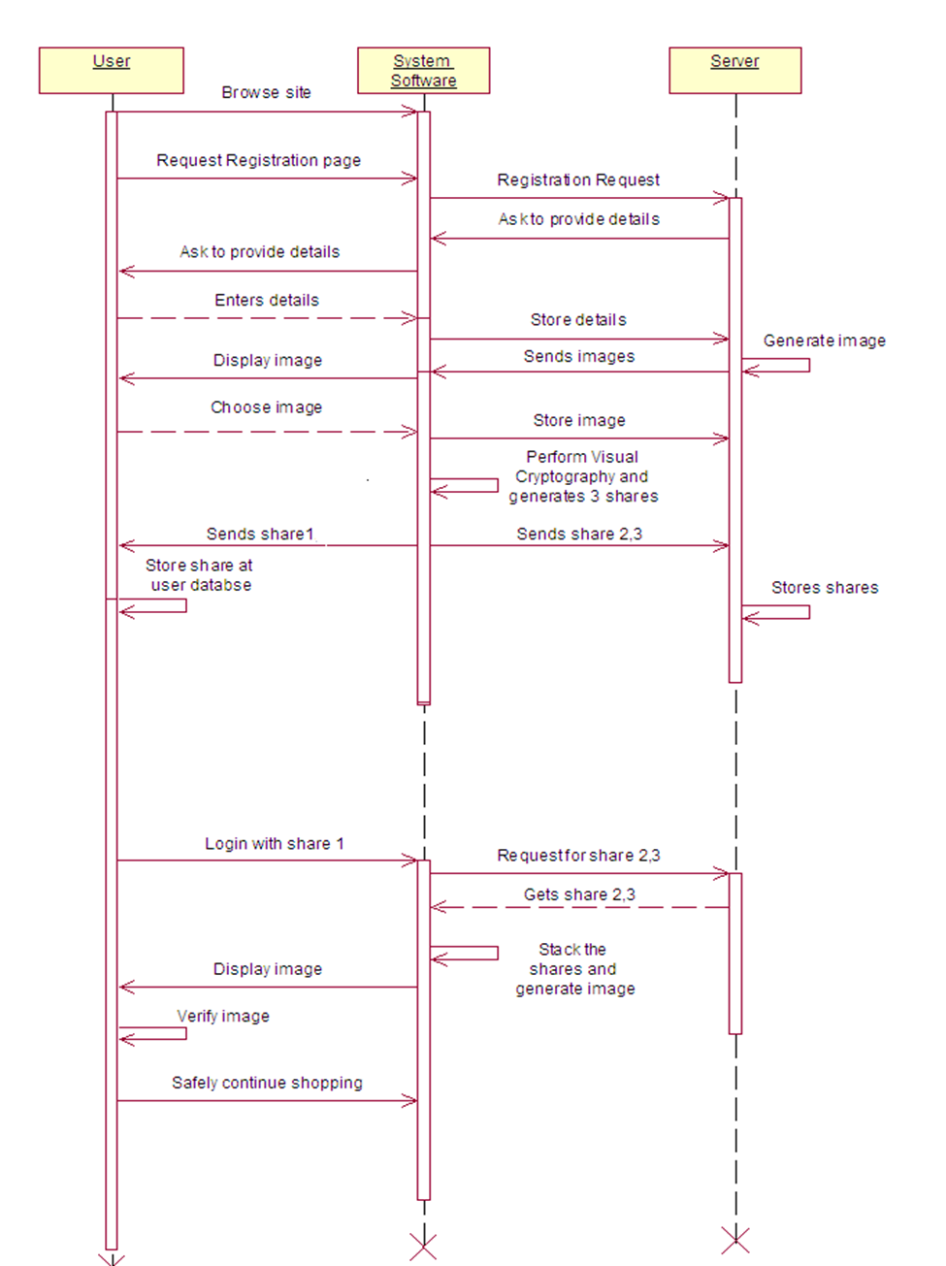
Sequence Diagram

Slide 36
Conclusion
In this project we have proposed a technique (2,3) Visual Cryptography on color images.
At the time of dividing an image into 3 number of shares we have used randomized algorithm. This technique needs very less mathematical calculation.
Each share reflects very little or even no information regarding the original image to human eye.

Slide 37
References
[1] Image Based Authentication Using Visual Cryptography and Encryption Algorithm Shreya Zarkar, Sayali vaidya, Arifa Tadvi, Tanashree Chavan, Prof. Achal Bharambe /(IJCSIT) International Journal of Computer Science and Information Technologies, Vol. 6 (2) , 2015, 1692-1696.
[2 ]K-n secret sharing visual cryptography scheme for color image using random number Shyamalendu Kandar et al. / International Journal of Engineering Science and Technology (IJEST)Haldia Institute of Technology, Haldia, India.
[3] M.Naor and A.sShamir, “Visual cryptography,” Advances in Cryptology-Eurocrypt’94, pp. 1–12, 1995
[4] A Novel Anti Phishing framework based on Visual Cryptography. 978-1-4673-0449-8/12/$31.00 ©2012 IEEE.
[5] Design and Implementation of a (2, 2) and a (2, 3) Visual Cryptographic SchemeSpecial Issue of IJCCT Vol.1 Issue 2, 3, 4; 2010 for International Conference [ACCTA-2010], 3-5 August 2010

Slide 38
Questions ??
Thank You

