Slide 1


DSAN Chatbot
Aashika Padmanabhan, Nikita Pardeshi, Mitali Shah, Shazia Sulaiman

Slide 2
Agenda
Introduction
Use Case- DSAN chatbot
- Advantages
Models used
Data preparation
Model Evaluation
Demo

Slide 3
Why DSAN Chatbot?
Every year DSAN Admissions team gets the same set (albeit slightly nuanced version) of questions wrt Application, Scholarship, GMAT.
The student Ambassador, Admissions team will have to sort through these questions and send responses.
Some responses are canned which opens the need for a DSAN Chatbot.
This can be integrated into the website which can act as first line of defense for the prospective student questions.

Slide 4




Advantages
OPTIMIZE COST
24/7 AVAILABILITY
CONSISTENCY IN ANSWERS
INSTANT RESPONSE

Slide 5
Birds Eye View of Roadmap for Chatbot creation
Request data access permission
Understand DSAN analytics inbox
Obtaining permission from DSAN Admin for access to actual data(set of emails and response of the past 2 years)
Answers prospective students Queries
1
2
Data Preprocessing
Going through inbox and identifying candidate emails
Finalize as perfect candidate for Chatbot
4
3
Nuanced variation of same questions posed
5
6
7
Creating Dataset
Model Fitting & Evaluation
Building an interface
Creating dataset with questions, context, tags and answers
Trying models using Deep Learning, BERT. Deep Learning chatbot turned out to be the best model
Creation of a user-interactive interface using Flask

Slide 6
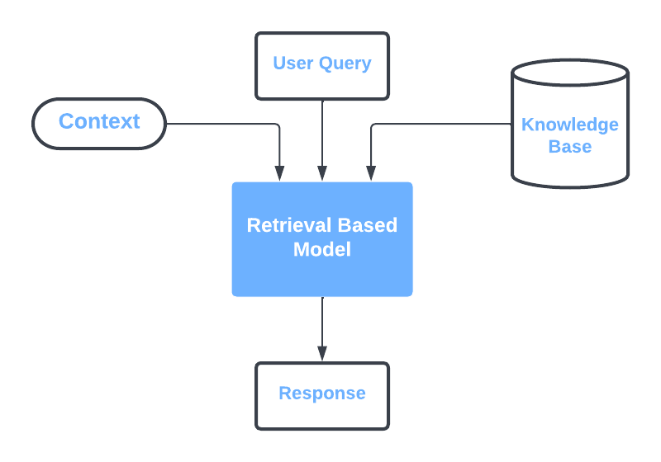
Chatbot Models
Retrieval Based model : Responses are based on existing information.
Generative : Chatbots that generate new dialogue based on large amounts of conversational training data.
Intent classifier : It determines what the user is trying to achieve by assigning intents as specified in the NLP algorithm.
Notes:
The chatbot is trained to provide the best possible response from a database of predefined responses. Retrieval-based systems are limited to predefined responses. For example, an intent can be “find opening hours”, “find a product”, “find the nearest store”.

Slide 7


Models
Sequential Keras Model
BERT- base uncased

Slide 8
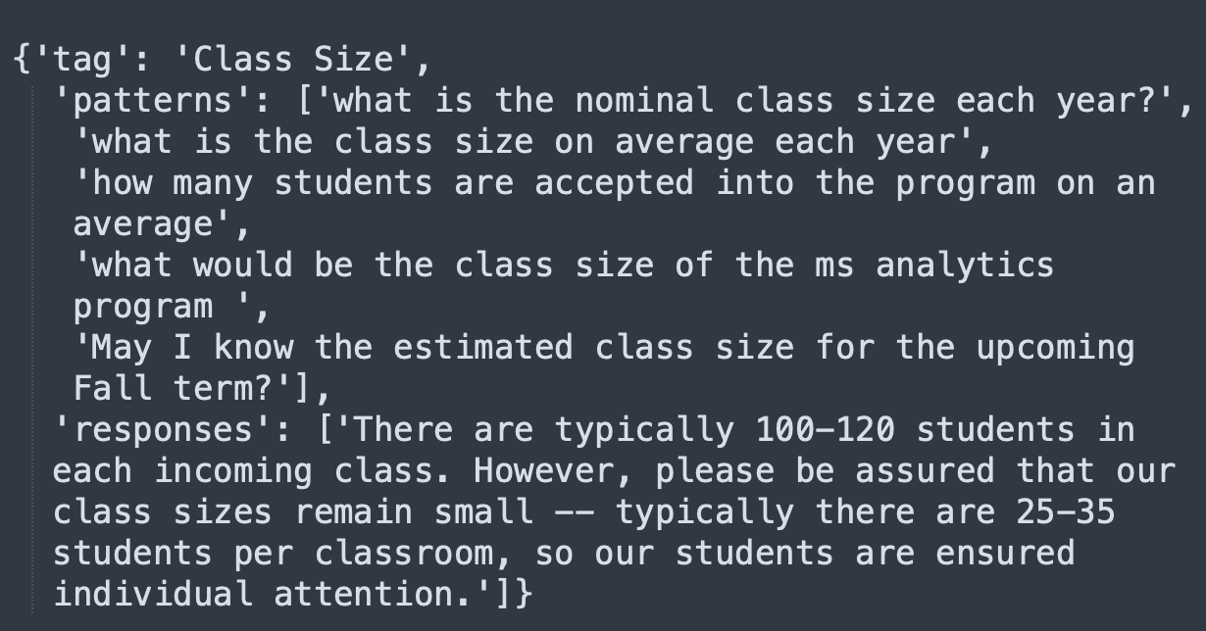
DATA PREPARATION
Analyze all FAQs from Grad analytics inbox
Identify the intent
Keras
BERT
Categorize into different segments based on their intent
Identify answer start and end and add the corresponding answer text
Convert to json with ‘tag’, ‘pattern’ (questions), ‘response’
Convert to json with ‘context’, ‘question’, ‘answer’[ start, end, text]

Slide 9
SEQUENTIAL KERAS MODEL
3 layer neural network
Input: Question and Intent (tag)
The neural network behaves as a classifier. It predicts the probability of the question being under each tag. The tag with the highest probability is picked.
The predicted tag is mapped to a predefined random response.

Slide 10
BERT
BERT base uncased model trained on the SQUAD 1.1 dataset and fine-tuned on custom QA dataset.
Input requirements for fine-tuning the model: A context for the question,
Corresponding answer, answer start and end for training the model.
Chose to explore BERT for testing human like interaction apart from academic/ research-based applications.
Disadvantages of BERT in this scenario:
Lacks human-like responses. Generates very specific, sometimes one-word answers.
For predicting an answer to a question asked without a context, further steps need to be taken such as predicting the tag as well and then selecting the best answer.
Notes:
If asked why bert base uncased: this model is primarily aimed at being fine-tuned on tasks that use the whole sentence (potentially masked) to make decisions, such as sequence classification, token classification or question answering. For tasks such as text generation you should look at model like GPT2.

Slide 11

Model Evaluation
Notes:
Here we will compare both the quantitative and qualitative accuracies of the 2 models and assess the outputs from each model and reason the preference of sequential keras model over BERT.

Slide 12
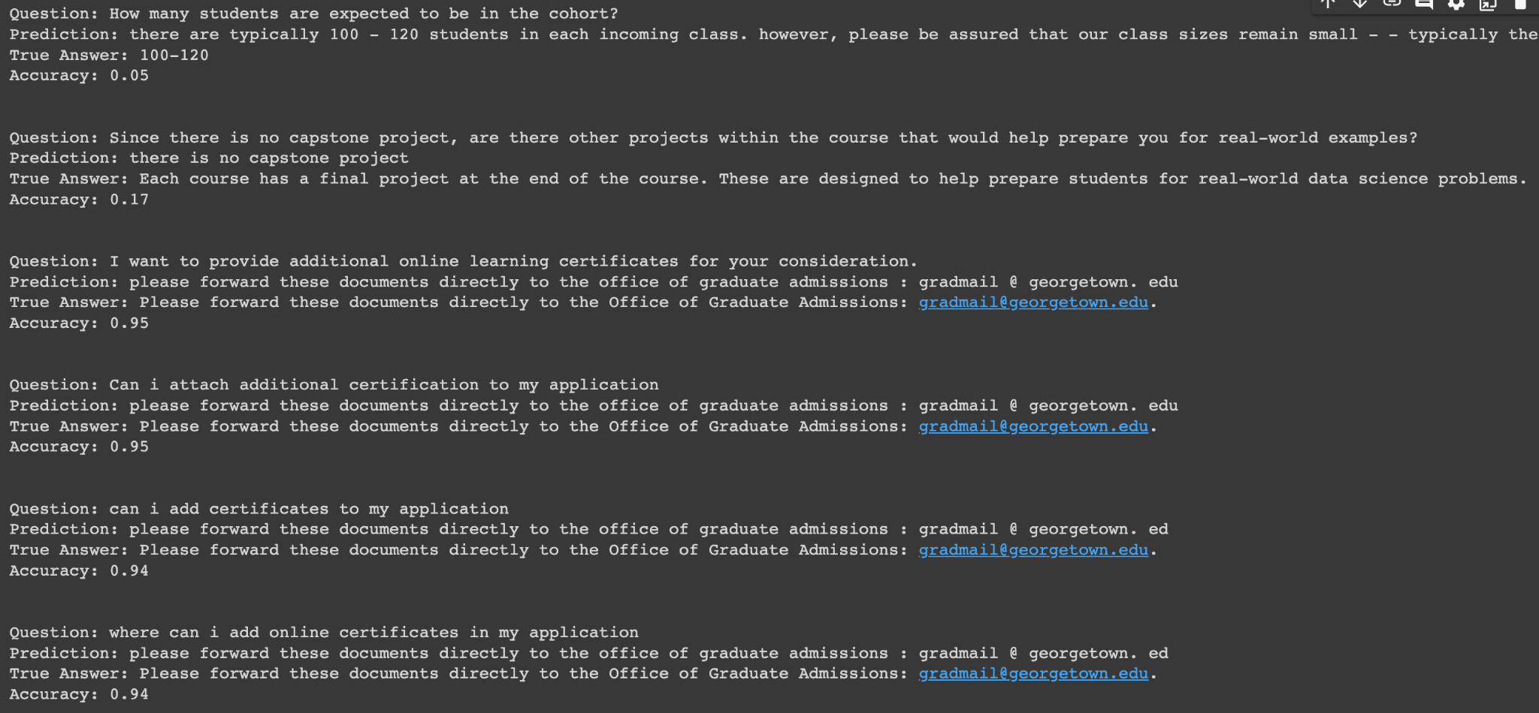
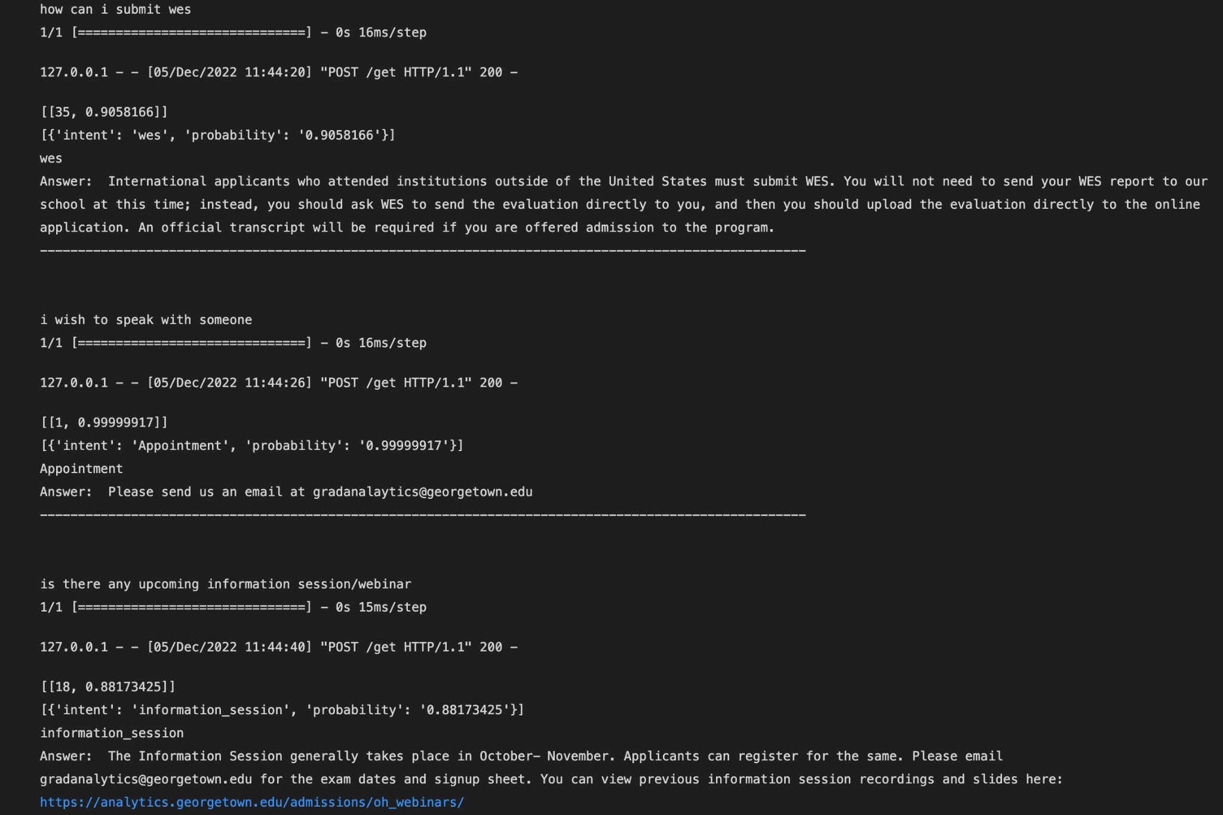
Results
We asked the bot a set of 20 questions (emails) and evaluated which answers are satisfactory and which are not.
Satisfactory level = 12/ 20 answers were absolutely satisfactory (~ 60%)
Notes:
BERT: Accuracy was calculated based on the percentage of the correct answer present in the predicted answer.
Keras: Tags with the highest probability are retrieved and a random answer is selected for the input question from a list of predefined answers.
We chose the Sequential Keras model due to its ability to select thorough answers as provided in the dataset.
Quantitative Accuracy - When we trained the model, the model achieved a train accuracy of 100%. Also, we selected 20 random/paraphrased questions and gave an accuracy of 75%
Qualitative Accuracy - The response were then analysed for understanding the responses, experience, likelihood of using chatbot again, bot providing the same answer for paraphrased questions. The response was satisfactory for 60% of the cases.

Slide 13

DEMO

Slide 14



Improvements
Dataset can be expanded to answer wider range of questions
Link admissions teams' calendar and select appointment slots and book
Make the bot more humanlike and less restricted

Slide 15
Thank you

