Slide 1


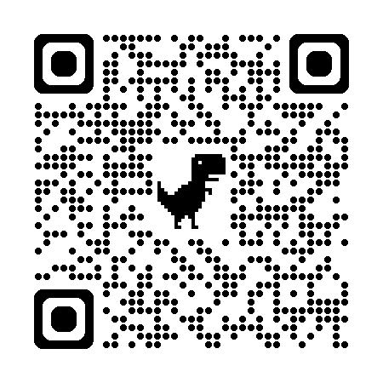
Data Science Convention 2025
21st March 2025 : ExxonMobil Spring Campus, TX

Slide 2
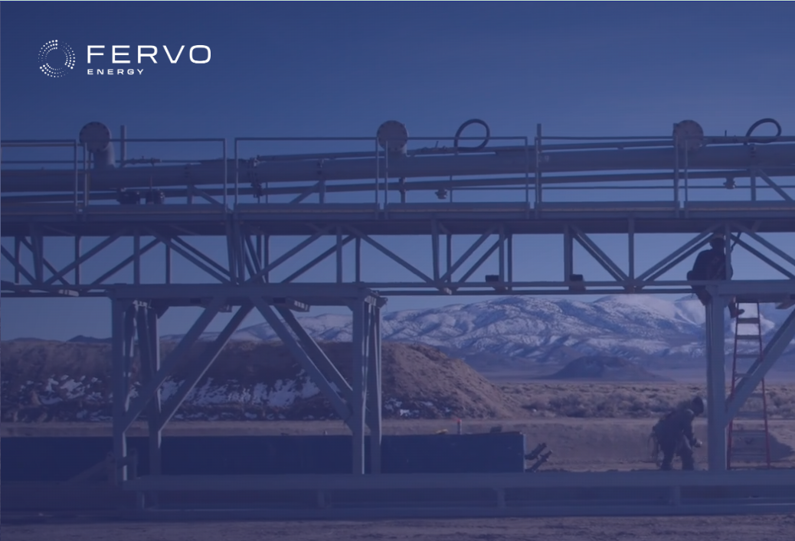

ML Challenge 2025
Improving drilling performance
SPE GCS ML Challenge Team
Arjun Roy, Sri Poludasu, Prithvi Chauhan, Eric Wang & Jamie Li
Fervo Liaison – Kanu Obinna

Slide 3
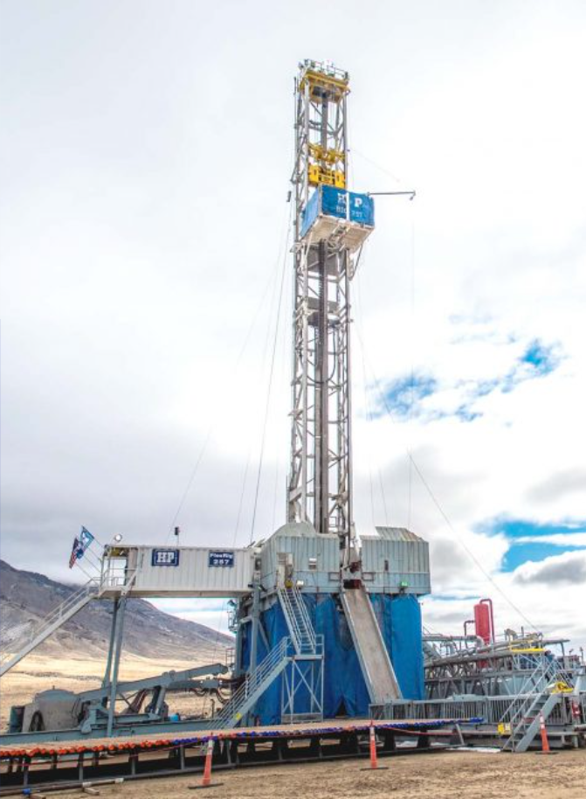
Background
Knowledge of temperature distribution along the well bore is extremely important for efficient drilling of geothermal wells
One of the most critical measurements during and after drilling a geothermal well is the bottom hole circulating temperature (BHCT)
Precise estimation of the BHCT is important for preventing failures of drilling tool tips and thereby reducing downtime
Based on existing drilling parameters drilling teams need to predict if it is safe to continue to drill or not

Slide 4
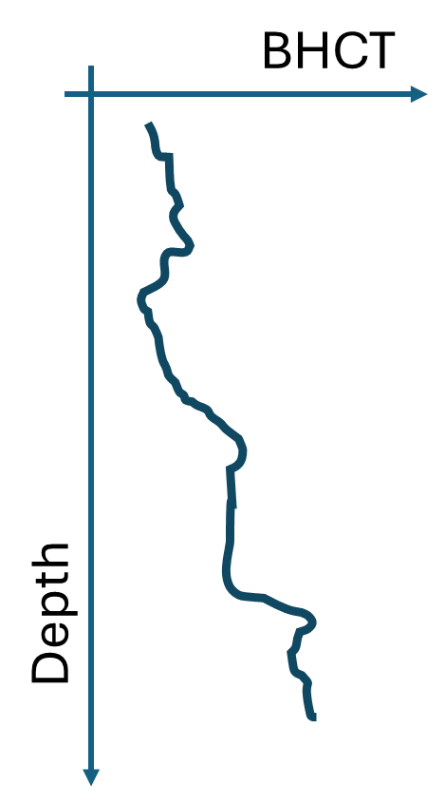
Data Description
The dataset comprises of different drilling parameters that are measured during the drilling of geo-thermal wells
The main output parameter is bottom hole circulating temperature (BHCT), which is present in the column “Bttm Pipe Temp (°F)”
Depth of the well is recorded in the column 'Depth(ft)’
The training dataset comprises data from 3 wells that have been drilled in a similar geographical region but have different depths.
The data is not uniformly sampled and has outliers. Participants are expected to pre-process the data and (if required) sample it uniformly prior to model building.

Slide 5
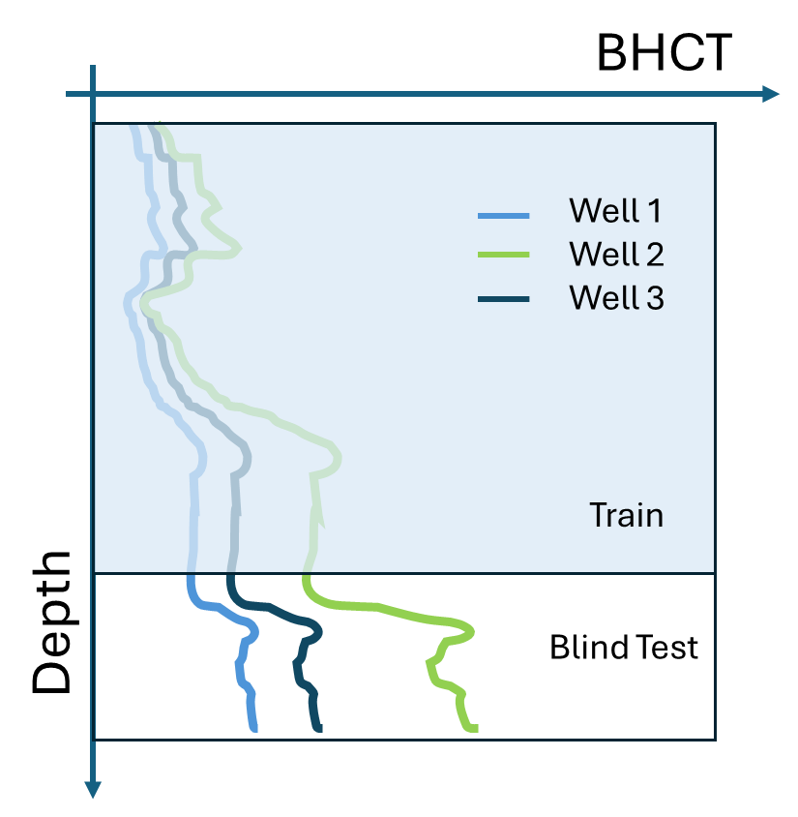
ML Challenge Objective: Phase 1
Generic model training
Participants will be provided with drilling log data (which will include BHCT measurements) across multiple wells in the same geographical region
The objective of this phase is to train one generic model using data from all wells that will be able to predict BHCT (as a function of depth) in the next 500 ft, given all other drilling parameters.
In this phase participants will be asked to submit their BHCT vs depth predictions for the next 500 feet for all the wells in the training data using their single generic model
500 ft

Slide 6
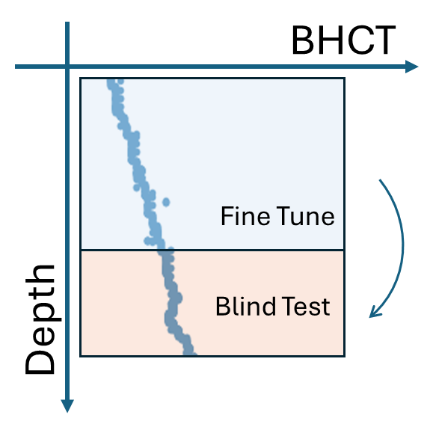
ML Challenge Objective: Phase 2
Model fine tuning
Participants will be provided with 2 segments of drilling log data (which will include BHCT measurements). The logs may or may not be from the wells that the generic model was trained on.
The objective of this phase is to fine tune the generic model built in phase 1 for each of the 2 new datasets to build 2 new to fine-tuned models. Participants are free to re-use data from phase 1 to test/validate their fine-tuning algorithm.
In this phase participants will be asked to submit their BHCT vs depth predictions for the next 500 feet for each of the 2 new datasets using the corresponding fine-tuned model.

Slide 7
Evaluation
BHCT predictions submitted by the participants for each well (for the next 500 ft) will be compared against measured values of BHCT. The key evaluation metric that will be used is coefficient of determination (R-squared). This will be done for all the predictions submitted in phase 1 and 2.
Participants will also be required to submit their code and a 2-3 page document describing their model architecture, fine-tuning/model update approach and data preprocessing steps. This document will also be evaluated by the judges.
Each entry will be evaluated based on the following aspects:
BHCT predictions on blind test data (in both phases) (50 %: 25% for Phase 1 and 25% for Phase 2)
Model architecture and fine-tune/model update algorithm (30 %)
Data pre-processing (20%)

Slide 8
Submission Guidelines -1
The link to the dataset and challenge guidelines will be shared via email.
The dataset contains a folder for each phase, viz: phase_1 and phase_2
Folder “phase_1”:
The training datasets are in 3 csv files, viz. Training_dataset_1.csv, Training_dataset_2.csv, Training_dataset_3.csv
The x-values for the test data set are in the following 3 csv files:
Test_dataset_1.csv, Test_dataset_2.csv and Test_dataset_3.csv
The test answers must be recorded in the remaining 3 files that are provided, viz:
phase1_blind_test_predictions_1.csv, phase1_blind_test_predictions_2.csv, and phase1_blind_test_predictions_3.csv,

Slide 9
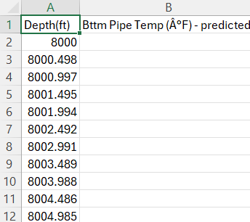
Submission Guidelines -2
Folder “phase_2”:
The training datasets are in 2 csv files, viz. FineTune_Train_dataset_1.csv, FineTune_Train_dataset_2.csv
The x-values for the test data set are in the following 2 csv files:
FineTune_Test_dataset_1.csv and FineTune_Test_dataset_2.csv
The test answers must be recorded in the remaining 2 files that are provided, viz:
phase2_blind_test_predictions_1.csv and phase2_blind_test_predictions_2.csv
The figure is a sample of the format in which the answers are to be submitted. Participants are required to fill in the second column “Bttm Pipe Temp (°F) – predicted” with their predictions corresponding to the depth values mentioned in column “Depth(ft)”

Slide 10
Submission Guidelines -3
Each team needs to submit all their results in a zipped folder that has the name of the team on it.
The zipped folder must contain the following files:
Predictions (5 files):
phase1_blind_test_predictions_1.csv, phase1_blind_test_predictions_2.csv, phase1_blind_test_predictions_3.csv
phase2_blind_test_predictions_1.csv, phase2_blind_test_predictions_2.csv
Code to train, predict and fine-tune model
2-3 page document that describes the model architecture, fine-tuning/model update approach and data preprocessing steps.
Link to slack workspace:
https://join.slack.com/t/fervospemlcha-km21065/shared_invite/zt-2ykyvkd4y-O0pYVGQ7W5IUBiGiDKunNQ

Slide 11
Additional Information
Link to slack workspace (for questions and clarifications)
https://join.slack.com/t/fervospemlcha-km21065/shared_invite/zt-2ykyvkd4y-O0pYVGQ7W5IUBiGiDKunNQ
Important dates
Jan 31st – Kickoff
Feb 1st – Dataset release (if registration form is submitted)
Feb 28th – Challenge ends/Submissions due
Mar 14th – Winners announced through email
Mar 21st – Award ceremony at DSC

