Slide 1

College Management System Using Spring
Team Members Name and Enrolment Numbers:-
Nikita Shaha EBEON1222703282
Abhijeet More EBEON1222703331
Sanket Shinde EBEON1222703338
Nikita Kadam EBEON1222703333
Shailja Dalvi EBEON1222703294
Guided by Vardharajan A.

Slide 2
College Management System
Entire Modules:
Home-Page Module
Student Module
Sign up and Sign in Module
Faculty Module
Books Management Modules
Hostel Management Module
Fee management Module
Payment Processing Module
Chat-bot Module
Examination Management Module
Verification Module (Email, QR code and OTP,Recaptcha)
Courses Management Modules

Slide 3
College Management System
Goal of Modules
Main aim in developing College Management System is to storing data, maintaining student profiles, analyzing administrative and academic data, improving communication, and engaging students.
Modules
Home Page Module
Student Module
Login Module
Recaptcha Module

Slide 4
1.Home Page Module
Home View
About Us View
Admission View
Events View
2.Login Module
Sign In
Sign Out

Slide 5
3.Student Module
Create Student
Remove Student
Update Student
View Student
4.Recaptcha Module
Recapture Or Checking Or Verification

Slide 6
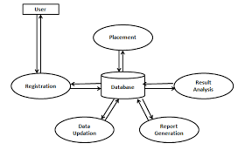
ERP Diagram

Slide 7
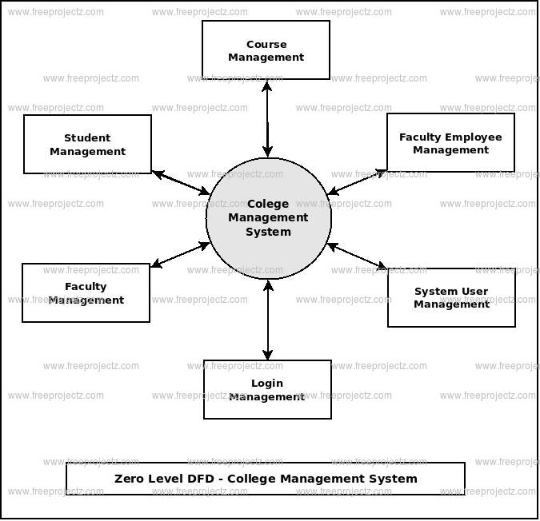
Dataflow diagram

Slide 8
Challenging issues
Internet Connectivity
Handling User Requirements

Slide 9
Features
Easy to access
24/7
Time Saving
Improve Communication
Improve Engagement
Reliability

Slide 10
Future enhancement
Online Assessment
Question Bank Management
Online Exam Solutions
Pre Examination Processing
Post Examination Processing

Slide 11
Conclusion
The system will greatly simplify and speed the management process. It will describe the paper work. The admin, faculty or the student will perform all the task very easily and more convenience way. The system offers reliability, security, time savings and easy control. The proposed system will describes the work time of the admin as well as the faculty. This will brings more perfection to the work.

