Slide 1
Nutrition Agent
IBM HACKATHON PROJECT
Presented By: Nikita Nagnath Kendre
Faculty name : Aman Shrivastava
College Name & Department : DES Pune University ,Pune (Computer Science )

Slide 2
OUTLINE
Problem Statement
Technology used
Wow factor
End users
Result
Conclusion
Git-hub Link
Future scope
IBM Certifications

Slide 3
Problem Statement
Nutrition Agent
The Challenge - In an era where health awareness is growing, individuals increasingly seek personalized nutrition guidance. However, most existing tools provide generic diet plans, lack real-time adaptability, and fail to consider a person's holistic lifestyle, cultural preferences, allergies, and evolving health conditions. Furthermore, dieticians and nutritionists face limitations in scaling personalized consultations due to time and resource constraints.

Slide 4
Technology used
IBM Watsonx Assistant (ChatBot creation & conversation flow)
IBM Cloud Services (deployment & hosting)
AI & Natural Language Processing (NLP)
Watsonx Runtime

Slide 5
IBM cloud services used
IBM Cloud Watsonx Assistant

Slide 6
Wow factors
Real-time personalized meal plans Reduces load on customer service executives
Smart food swap recommendations (healthier alternatives)
Dynamic adaptation to medical conditions & lifestyle goals

Slide 7
End users
Health-conscious individuals
Nutritionists & dieticians (scalable support)
Fitness enthusiasts & athletes

Slide 8
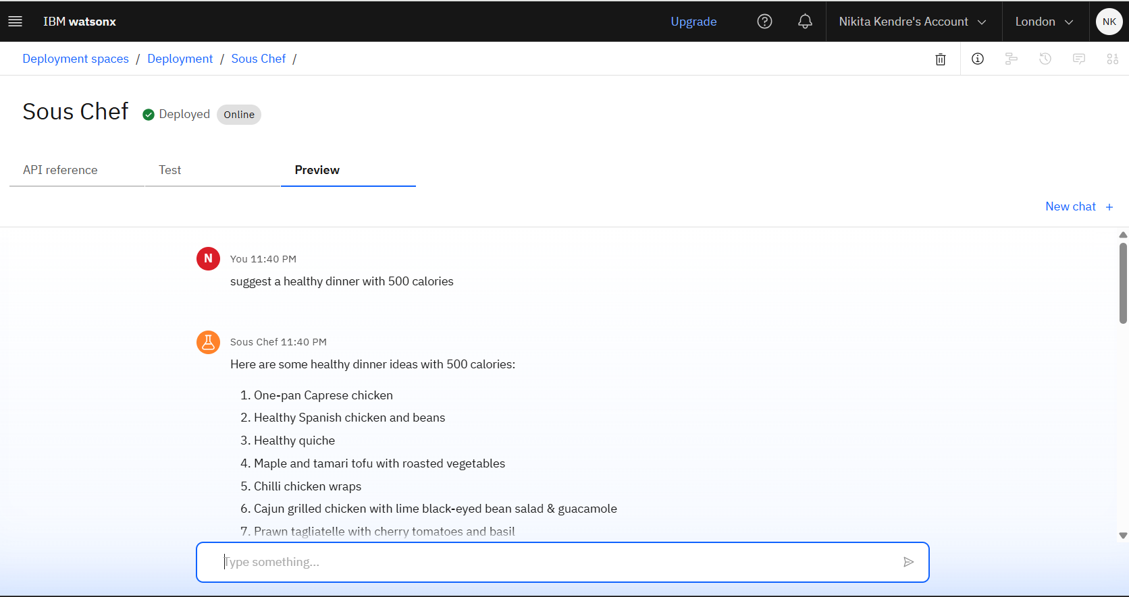
Results

Slide 9
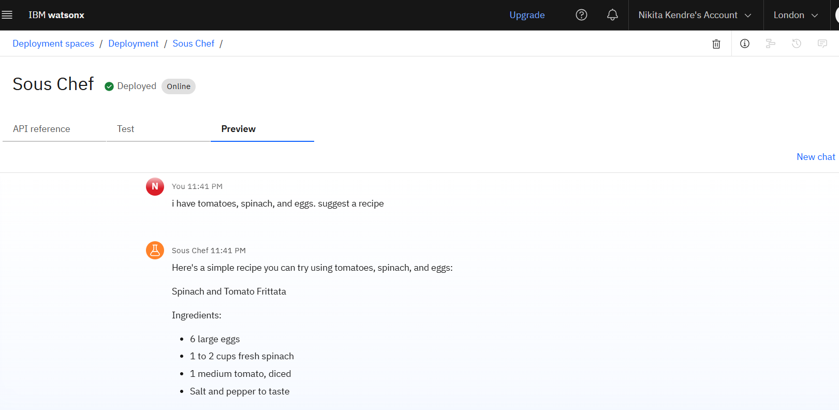
Results

Slide 10
Conclusion
The AI Nutrition Assistant bridges the gap between generic diet apps and in-person nutrition counselling. It provides personalized, adaptive, and culturally aware nutrition plans that are explainable, scalable, and accessible—making nutrition guidance smarter and more impactful..

Slide 11
GitHub Link
https://eu-gb.dataplatform.cloud.ibm.com/ml-runtime/deployments/6e51cd37-fe30-4ce6-a2ca-0980d972a008/chat?space_id=983615e8-fc66-4e8c-b8d2-a1142ef9fe26&context=wx&flush=true

Slide 12
Future scope
Integration with wearables (fitness trackers, smartwatches)
Integrate with Core Banking Systems for real-time data
Expansion of multilingual & cultural food databases
Integration with telemedicine platforms

Slide 13
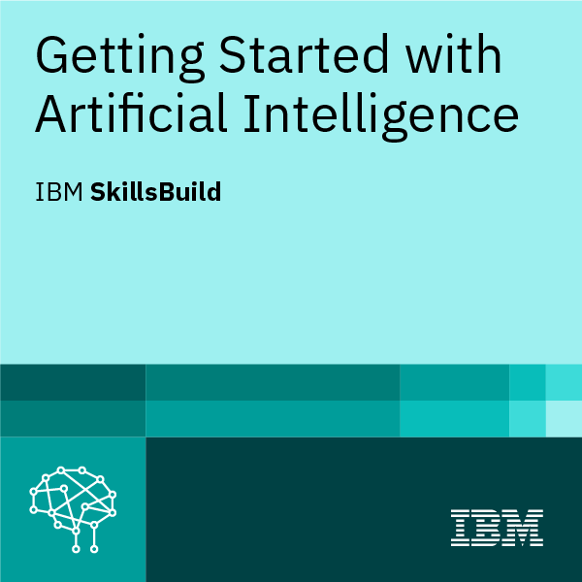
IBM Certifications

Slide 14
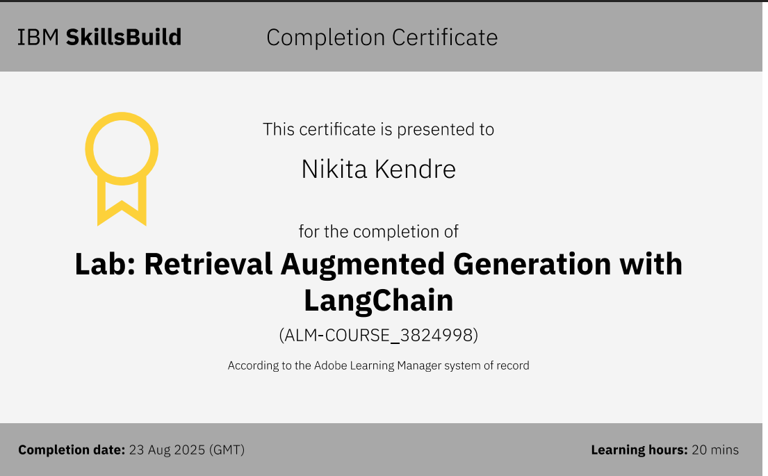
IBM Certifications

Slide 15
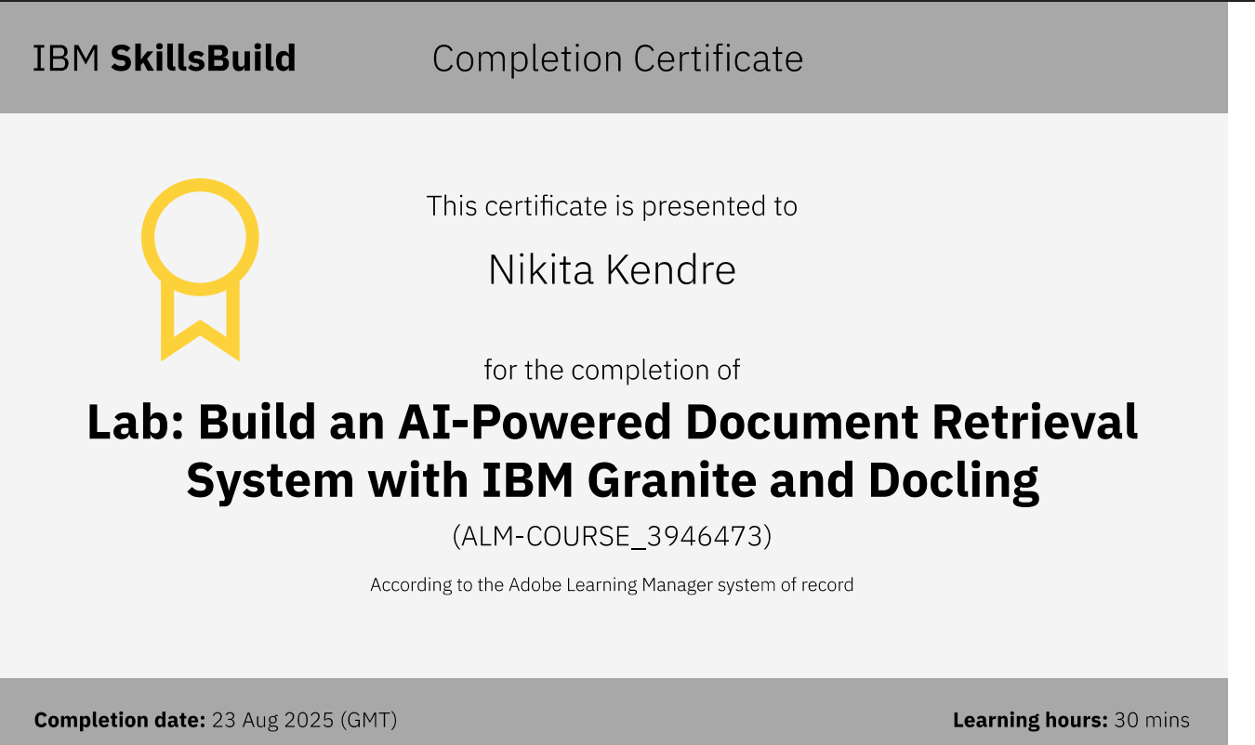
IBM Certifications

Slide 16
THANK YOU

