Slide 1
AI
Artificial Intellegence

Slide 2
What is Artificial Intelligence (AI)?
AI (Artificial Intelligence) is a machine’s ability to perform cognitive functions as humans do, such as perceiving, learning, reasoning, and solving problems. The benchmark for AI is the human level concerning in teams of reasoning, speech, and vision.

Slide 3
Introduction to Artificial Intelligence Levels
Nowadays, AI is used in almost all industries, giving a technological edge to all companies integrating AI at scale. According to McKinsey, AI has the potential to create 600 billion dollars of value in retail bring 50 per cent more incremental value in banking compared with other analytics techniques. In transport and logistics, the potential revenue jump is 89% more.
Concretely, if an organization uses AI for its marketing team, it can automate mundane and repetitive tasks, allowing the sales representative to focus on relationship building, lead nurturing, etc. A company named Gong provides a conversation intelligence service. Each time a Sales Representative makes a phone call, the machine records, transcribes and analyzes the chat. The VP can use AI analytics and recommendation to formulate a winning strategy.
In a nutshell, AI provides cutting-edge technology to deal with complex data that a human being cannot handle. AI automates redundant jobs allowing a worker to focus on the high level, value-added tasks. When AI is implemented at scale, it leads to cost reduction and revenue increase

Slide 4
History of Artificial Intelligence
Artificial Intelligence is a buzzword today, although this term is not new. In 1956, avant-garde experts from different backgrounds decided to organize a summer research project on AI. Four bright minds led the project; John McCarthy (Dartmouth College), Marvin Minsky (Harvard University), Nathaniel Rochester (IBM), and Claude Shannon (Bell Telephone Laboratories).
Here, is Brief history of Artificial Intelligence:

Slide 5
Year Milestone / Innovation
Year | Milestone / Innovation
1923 | Karel Čapek plays named “Rossum’s Universal Robots, the first use of the word “robot” in English.
1943 | Foundations for neural networks laid.
1945 | Isaac Asimov, a Columbia University alumni, use the term Robotics.
1956 | John McCarthy first used the term Artificial Intelligence. Demonstration of the first running AI program at Carnegie Mellon University.
1964 | Danny Bobrow’s dissertation at MIT showed how computers could understand natural language.
1969 | Scientists at Stanford Research Institute Developed Shakey. A robot equipped with locomotion and problem-solving.

Slide 6
1979 | The world’s first computer-controlled autonomous vehicle, Stanford Cart, was built.
1990 | Significant demonstrations in machine learning
1997 | The Deep Blue Chess Program beat the then world chess champion, Garry Kasparov.
2000 | Interactive robot pets have become commercially available. MIT displays Kismet, a robot with a face that expresses emotions.
2006 | AI came into the Business world in the year 2006. Companies like Facebook, Netflix, Twitter started using AI.
2012 | Google has launched an Android app feature called “Google now”, which provides the user with a prediction.
2018 | The “Project Debater” from IBM debated complex topics with two master debaters and performed exceptionally well.

Slide 7
1979 | The world’s first computer-controlled autonomous vehicle, Stanford Cart, was built.
1990 | Significant demonstrations in machine learning
1997 | The Deep Blue Chess Program beat the then world chess champion, Garry Kasparov.
2000 | Interactive robot pets have become commercially available. MIT displays Kismet, a robot with a face that expresses emotions.
2006 | AI came into the Business world in the year 2006. Companies like Facebook, Netflix, Twitter started using AI.
2012 | Google has launched an Android app feature called “Google now”, which provides the user with a prediction.
2018 | The “Project Debater” from IBM debated complex topics with two master debaters and performed exceptionally well.

Slide 8
Goals of Artificial Intelligence
Here are the main Goals of AI:
It helps you reduce the amount of time needed to perform specific tasks.
Making it easier for humans to interact with machines.
Facilitating human-computer interaction in a way that is more natural and efficient.
Improving the accuracy and speed of medical diagnoses.
Helping people learn new information more quickly.
Enhancing communication between humans and machines.

Slide 9
Subfields of Artificial Intelligence
Here, are some important subfields of Artificial Intelligence:
Machine Learning: Machine learning is the art of studying algorithms that learn from examples and experiences. Machine learning is based on the idea that some patterns in the data were identified and used for future predictions. The difference from hardcoding rules is that the machine learns to find such rules.
Deep Learning: Deep learning is a sub-field of machine learning. Deep learning does not mean the machine learns more in-depth knowledge; it uses different layers to learn from the data. The depth of the model is represented by the number of layers in the model. For instance, the Google LeNet model for image recognition counts 22 layers.
Natural Language Processing: A neural network is a group of connected I/O units where each connection has a weight associated with its computer programs. It helps you to build predictive models from large databases. This model builds upon the human nervous system. You can use this model to conduct image understanding, human learning, computer speech, etc.

Slide 10
Expert Systems: An expert system is an interactive and reliable computer-based decision-making system that uses facts and heuristics to solve complex decision-making problems. It is also considered at the highest level of human intelligence. The main goal of an expert system is to solve the most complex issues in a specific domain.
Fuzzy Logic: Fuzzy Logic is defined as a many-valued logic form that may have truth values of variables in any real number between 0 and 1. It is the handle concept of partial truth. In real life, we may encounter a situation where we can’t decide whether the statement is true or false.

Slide 11
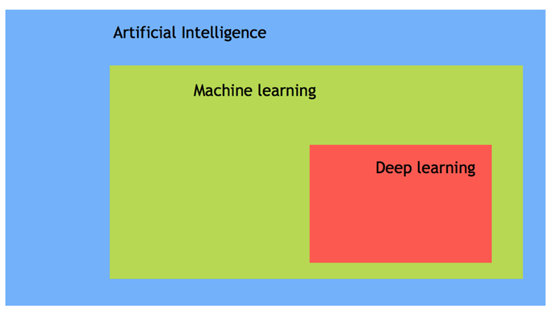

Slide 12
Types of Artificial Intelligence
There are three main types of artificial intelligence: rule-based, decision tree, and neural networks.
Narrow AI is a type of AI that helps you perform a dedicated task with intelligence.
General AI is a type of AI intelligence that can perform any intellectual task efficiently like a human.
Rule-based AI is based on a set of pre-determined rules that are applied to an input data set. The system then produces a corresponding output.
Decision tree AI is similar to rule-based AI in that it uses sets of pre-determined rules to make decisions. However, the decision tree also allows for branching and looping to consider different options.
Super AI is a type of AI that allows computers to understand human language and respond in a natural way.
Robot intelligence is a type of AI that allows robots to have complex cognitive abilities, including reasoning, planning, and learning.

Slide 13
AI Vs Machine Learning
Most of our smartphone, daily device or even the internet uses Artificial Intelligence. Very often, AI and machine learning are used interchangeably by big companies that want to announce their latest innovation. However, Machine learning and AI are different in some ways.
AI- artificial intelligence- is the science of training machines to perform human tasks. The term was invented in the 1950s when scientists began exploring how computers could solve problems on their own.

Slide 14
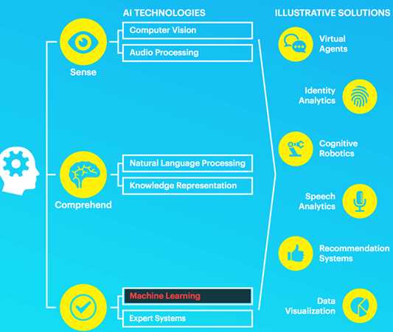

Slide 15
AI is used in all industries, from marketing to supply chain, finance, food-processing sector. According to a McKinsey survey, financial services and high tech communication are leading the AI fields.
Demand of AI in various Industries

Slide 16
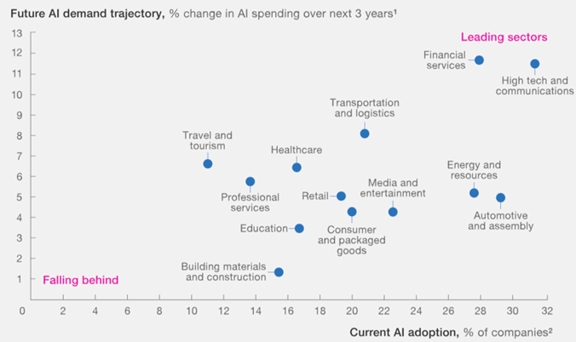

Slide 17
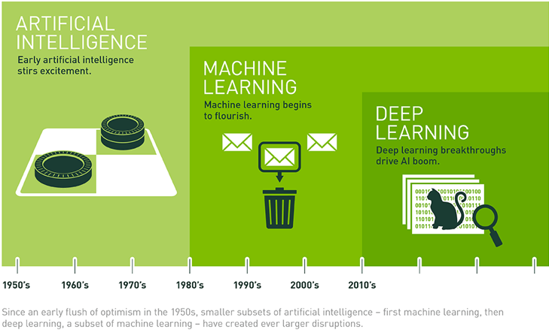
Why is AI booming now?
Now in this Artificial Intelligence testing tutorial, let’s learn why AI is booming now. Let’s understand by the below diagram.

Slide 18
A neural network has been out since the nineties with the seminal paper of Yann LeCun. However, it started to become famous around the year 2012. Explained by three critical factors for its popularity are:
Hardware
Data
Algorithm
Machine learning is an experimental field, meaning it needs data to test new ideas or approaches. With the boom of the internet, data became more easily accessible. Besides, giant companies like NVIDIA and AMD have developed high-performance graphics chips for the gaming market.

Slide 19
Data
Deep learning is the structure of the model, and the data is the fluid to make it alive. Data powers artificial intelligence. Without data, nothing can be done. The latest Technologies have pushed the boundaries of data storage, and it is easier than ever to store a high amount of data in a data center.

Slide 20
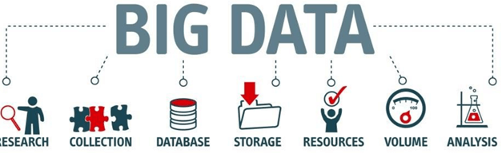

Slide 21
Summary
AI is a full form of Artificial intelligence is the science of training machines to imitate or reproduce human tasks.
A scientist can use different methods to train a machine. At the beginning of the AI’s ages, programmers wrote hard-coded programs, typing every logical possibility the machine could face and how to respond.
When a system grows complex, it becomes difficult to manage the rules. To overcome this issue, the machine can use data to learn how to take care of all the situations from a given environment.
The most important feature of having a powerful AI is that it has enough data with considerable heterogeneity. For example, a machine can learn different languages as long as it has enough words to learn from.
AI is the new cutting-edge technology. Ventures capitalists invest billions of dollars in startups or AI projects, and McKinsey estimates AI can boost every industry by at least a double-digit growth rate.
General AI, Rule-based AI, Decision tree AI, Super AI are types of artificial intelligence.

Slide 22
OpenCV in Python
What is Computer Vision?
The term Computer Vision (CV) is used and heard very often in artificial intelligence (AI) and deep learning (DL) applications. The term essentially means giving a computer the ability to see the world as we humans do.
Computer Vision is a field of study which enables computers to replicate the human visual system. As already mentioned above, It’s a subset of artificial intelligence which collects information from digital images or videos and processes them to define the attributes. The entire process involves image acquiring, screening, analysing, identifying and extracting information. This extensive processing helps computers to understand any visual content and act on it accordingly.
Computer vision projects translate digital visual content into explicit descriptions to gather multi-dimensional data. This data is then turned into a computer-readable language to aid the decision-making process. The main objective of this branch of artificial intelligence is to teach machines to collect information from pixels.

Slide 23
How does a computer read an image?
How does a human mind apprehend an image? When you see the image below,what do you actually see and how do you say what is in the Image?
You most probably look for different shapes and colours in the Image and that might help you decide that this is an image of a dog. But does a computer also see it in the same way? The answer is no.
A digital image is an image composed of picture elements, also known as pixels, each with finite, discrete quantities of numeric representation for its intensity or grey level. So the computer sees an image as numerical values of these pixels and in order to recognise a certain image, it has to recognise the patterns and regularities in this numerical data.

Slide 24
What is OpenCV?
OpenCV ( Open Source Computer Vision Library) is an open source software library for computer vision and machine learning. OpenCV was created to provide a shared infrastructure for applications for computer vision and to speed up the use of machine perception in consumer products. OpenCV, as a BSD-licensed software, makes it simple for companies to use and change the code. There are some predefined packages and libraries that make our life simple and OpenCV is one of them.

Slide 25
OpenCV installation
pip install opencv-python

Slide 26
Read & Save Images
Now for OpenCV to work on any image, it must be able to read it. Here we will see how to read a file and save it after we are done with it. Let’s see how to do it:
Imread function in OpenCV
We use the imread function to read images,here is the syntax of this function
cv2.imread(path, flag)
The path parameter takes a string representing the path of the image to be read.The file should be in the working directory or we must give the full path to the image.The other parameter is the flag which is used to specify how our image should be read. Here are possible values that it takes and their working:
cv2.IMREAD_COLOR: It specifies to convert the image to the 3 channel BGR
colour image. Any transparency of image will be neglected. It is the default
flag. Alternatively, we can passinteger value 1 for this flag.

Slide 27
cv2.IMREAD_GRAYSCALE: It specifies to convert an image to thesingle channel
grayscale image. Alternatively, we can pass integer value 0 for this flag.
cv2.IMREAD_UNCHANGED: It specifies to load an image as such including alpha
channel.Alternatively, we can pass integer value -1 for this flag.
Usually the method imread() returns an image that is loaded from the specified file but in case the image cannot be read because of unsupported file format, missing file, unsupported or invalid format, it just returns a matrix. Here is a example in which we read an image from my storage.

Slide 28
Imwrite function in OpenCV
We can use OpenCV’s imwrite() function to save an image in a storage device and the file extension defines the image format as shown in the example below. The syntax is the following:
cv2.imwrite(filename, image)
Parameters:
filename: A string representing the file name. The filename must include image format.
image: It is the image that is to be saved.

Slide 29
Here is an example in which we use this function:
1
2
3
4
5
6
import cv2
# read image
img = cv2.imread(r'C:\Users\Mirza\dog.jpeg', 1)
# save image
status = cv2.imwrite(r'C:\Users\Mirza\dog.jpeg',img)
print("Image written sucess? : ", status)

Slide 30
Access pixel values and modify them
So there are basically two ways to access a pixel value in an Image and modify them.First let us see how we can access a particular pixel value of an image.
import numpy as np
import cv2 as cv
img = cv.imread(r'C:\Users\Mirza\dog.jpeg')
px = img[100,100]
print( px )

Slide 31
Output:
[157 166 200]
Now as you can see we got a list containing 3 values.As we know OpenCV stores the color image as BGR color image,so the first value in the list is the value of the blue channel of this particular pixel, and the rest are values for green and red channels.

Slide 32
We can also access only one of the channels as shown below:
6
7
8
# accessing only blue pixel
blue = img[100,100,0]
print( blue )
Output
157

Slide 33
To modify the values, we just need to access the pixel and then overwrite it with a value as shown below:
1
2
img[100,100] = [255,255,255]
print( img[100,100] )
Output:
[255 255 255]

Slide 34
This method to access and modify the pixel values is slow so you should make use of NumPy library as it is optimized for fast array calculations. For accessing individual pixel values, the Numpy array methods, array.item() and array.itemset() are considered better as they always return a scalar. However, if you want to access all the B,G,R values, you will need to call array.item() separately for each value as shown below:
# accessing RED value
img.item(10,10,2)
>>59
# modifying RED value
img.itemset((10,10,2),100)
img.item(10,10,2)
>>100

Slide 35
Access Image properties
What do we mean by image properties here? Often it is important to know the size(total number of pixels in the image), number of rows, columns, and channels.We can access the later three by using the shape() method as shown below:
print( img.shape )
>>(342, 548, 3)
print( img.size )
>>562248

Slide 36
OpenCV Resize Image
Usually when working on images,we often need to resize the images according to certain requirements.Mostly you will do such operation in Machine learning and deep learning as it reduces the time of training of a neural network. As the number of pixels in an image increases, the more is the number of input nodes that in turn increases the complexity of the model. We use an inbuilt resize() method to resize an image.

Slide 37
Syntax: cv2.resize(s, size,fx,fy,interpolation)
Parameters:
s - input image (required).
size - desired size for the output image after resizing (required)
fx - Scale factor along the horizontal axis.(optional)
fy - Scale factor along the vertical axis.
Interpolation(optional) - This flag uses following methods:
INTER_NEAREST – a nearest-neighbor interpolation
INTER_LINEAR – a bilinear interpolation (used by default)
INTER_AREA – resampling using pixel area relation. It may be a preferred method for image decimation, as it gives moire’-free results. But when the image is zoomed, it is similar to the INTER_NEAREST method.
INTER_CUBIC – a bicubic interpolation over 4×4 pixel neighborhood
INTER_LANCZOS4 – a Lanczos interpolation over 8×8 pixel neighborhood

Slide 38
import cv2
import numpy as np
#importing the opencv module
import cv2
# using imread('path') and 1 denotes read as color image
img = cv2.imread('dog.jpg',1)
print(img.shape)
img_resized=cv2.resize(img, (780, 540),
interpolation = cv2.INTER_NEAREST)
cv2.imshow("Resized",img_resized)
cv2.waitKey(0)
cv2.destroyAllWindows()

Slide 39
OpenCV Image Rotation
We may need to rotate an image in some of the cases and we can do it easily by using OpenCV .We use cv2.rotate() method to rotate a 2D array in multiples of 90 degrees.Here is the syntax:
Syntax: cv2.rotate( src, rotateCode[, dst] )
Parameters:
src: It is the image to be rotated.
rotateCode: It is an enum to specify how to rotate the array.Here are some of the possible values :
cv2.cv2.ROTATE_90_CLOCKWISE
cv2.ROTATE_180
cv2.ROTATE_90_COUNTERCLOCKWISE

Slide 40
Here is an example using this function.
1 2 3 4 5 6 7 8 9 10 11 12 | import cv2 import numpy as np #importing the opencv module import cv2 # using imread('path') and 1 denotes read as color image img = cv2.imread('dog.jpg',1) print(img.shape) image = cv2.rotate(img, cv2.ROTATE_90_COUNTERCLOCKWISE) cv2.imshow("Rotated",image) cv2.waitKey() cv2.destroyAllWindows()

