Slide 1

Matplotlib

Slide 2
What is Matplotlib?
Matplotlib is a low level graph plotting library in python that serves as a visualization utility.
Matplotlib was created by John D. Hunter.
Matplotlib is open source and we can use it freely.
Matplotlib is mostly written in python, a few segments are written in C, Objective-C and Javascript for Platform compatibility.

Slide 3
Installation of Matplotlib
If you have Python and PIP already installed on a system, then installation of Matplotlib is very easy.
Install it using this command:
C:\Users\Your Name>pip install matplotlib

Slide 4
Checking Matplotlib Version
The version string is stored under __version__ attribute.
Example
import matplotlib
print(matplotlib.__version__)

Slide 5
Matplotlib Pyplot
Pyplot
Most of the Matplotlib utilities lies under the pyplot submodule, and are usually imported under the plt alias:
import matplotlib.pyplot as plt
Now the Pyplot package can be referred to as plt.
Example
Draw a line in a diagram from position (0,0) to position (6,250):
import matplotlib.pyplot as plt
import numpy as np
xpoints = np.array([0, 6])
ypoints = np.array([0, 250])
plt.plot(xpoints, ypoints)
plt.show()

Slide 6
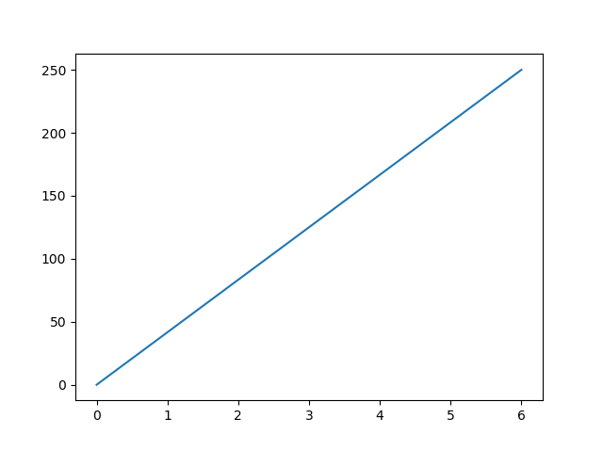
Output:

Slide 7
Matplotlib Plotting
Plotting x and y points
The plot() function is used to draw points (markers) in a diagram.
By default, the plot() function draws a line from point to point.
The function takes parameters for specifying points in the diagram.
Parameter 1 is an array containing the points on the x-axis.
Parameter 2 is an array containing the points on the y-axis.
If we need to plot a line from (1, 3) to (8, 10), we have to pass two arrays [1, 8] and [3, 10] to the plot function.

Slide 8
Example
Draw a line in a diagram from position (1, 3) to position (8, 10):
import matplotlib.pyplot as plt
import numpy as np
xpoints = np.array([1, 8])
ypoints = np.array([3, 10])
plt.plot(xpoints, ypoints)
plt.show()

Slide 9


Slide 10
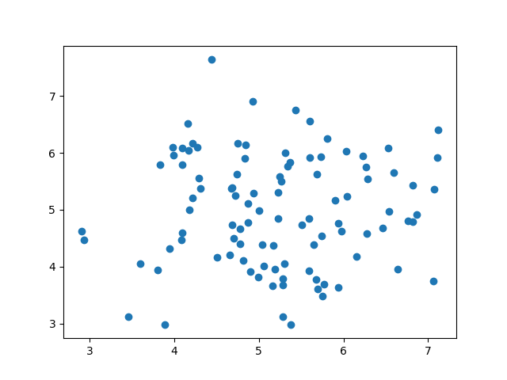
Machine Learning - Scatter Plot
Scatter Plot
A scatter plot is a diagram where each value in the data set is represented by a dot.

Slide 11
The Matplotlib module has a method for drawing scatter plots, it needs two arrays of the same length, one for the values of the x-axis, and one for the values of the y-axis:
x = [5,7,8,7,2,17,2,9,4,11,12,9,6]
y = [99,86,87,88,111,86,103,87,94,78,77,85,86]
The x array represents the age of each car.
The y array represents the speed of each car.

Slide 12
Example
Use the scatter() method to draw a scatter plot diagram:
import matplotlib.pyplot as plt
x = [5,7,8,7,2,17,2,9,4,11,12,9,6]
y = [99,86,87,88,111,86,103,87,94,78,77,85,86]
plt.scatter(x, y)
plt.show()

Slide 13
Scatter Plot Explained
The x-axis represents ages, and the y-axis represents speeds.
What we can read from the diagram is that the two fastest cars were both 2 years old, and the slowest car was 12 years old.
Note: It seems that the newer the car, the faster it drives, but that could be a coincidence, after all we only registered 13 cars.

Slide 14
Random Data Distributions
In Machine Learning the data sets can contain thousands-, or even millions, of values.
You might not have real world data when you are testing an algorithm, you might have to use randomly generated values.
As we have learned in the previous chapter, the NumPy module can help us with that!
Let us create two arrays that are both filled with 1000 random numbers from a normal data distribution.
The first array will have the mean set to 5.0 with a standard deviation of 1.0.
The second array will have the mean set to 10.0 with a standard deviation of 2.0:

Slide 15
Example
A scatter plot with 1000 dots:
import numpy
import matplotlib.pyplot as plt
x = numpy.random.normal(5.0, 1.0, 1000)
y = numpy.random.normal(10.0, 2.0, 1000)
plt.scatter(x, y)
plt.show()

Slide 16
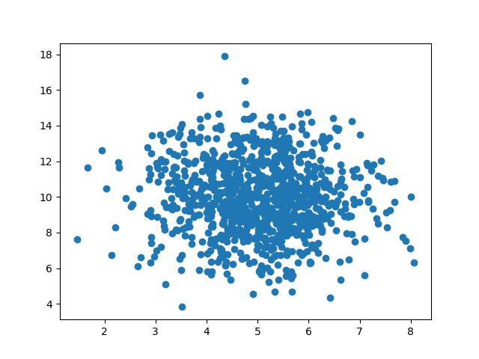
Result:

Slide 17
Machine Learning - Linear Regression
Regression
The term regression is used when you try to find the relationship between variables.
In Machine Learning, and in statistical modeling, that relationship is used to predict the outcome of future events

Slide 18
Linear Regression
Linear regression uses the relationship between the data-points to draw a straight line through all them.
This line can be used to predict future values.

Slide 19
How Does it Work?
Python has methods for finding a relationship between data-points and to draw a line of linear regression. We will show you how to use these methods instead of going through the mathematic formula.
In the example below, the x-axis represents age, and the y-axis represents speed. We have registered the age and speed of 13 cars as they were passing a tollbooth. Let us see if the data we collected could be used in a linear regression:
Example
Start by drawing a scatter plot:
import matplotlib.pyplot as plt
x = [5,7,8,7,2,17,2,9,4,11,12,9,6]
y = [99,86,87,88,111,86,103,87,94,78,77,85,86]
plt.scatter(x, y)
plt.show()

Slide 20
Example
Import scipy and draw the line of Linear Regression:
import matplotlib.pyplot as plt from scipy import stats x = [5,7,8,7,2,17,2,9,4,11,12,9,6] y = [99,86,87,88,111,86,103,87,94,78,77,85,86] slope, intercept, r, p, std_err = stats.linregress(x, y) def myfunc(x): return slope * x + intercept mymodel = list(map(myfunc, x)) plt.scatter(x, y) plt.plot(x, mymodel) plt.show()

Slide 21
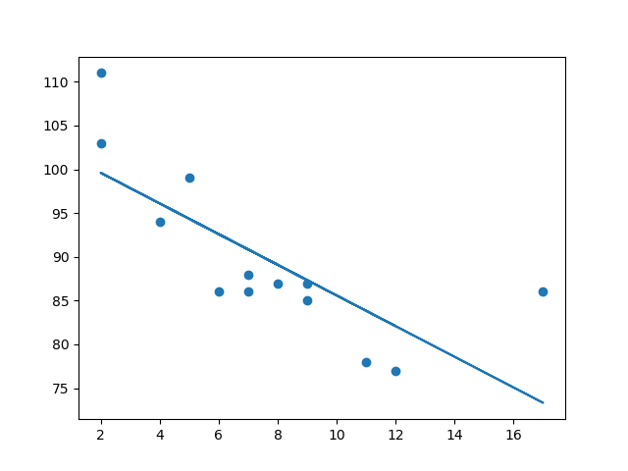
Result:

Slide 22
R for Relationship
It is important to know how the relationship between the values of the x-axis and the values of the y-axis is, if there are no relationship the linear regression can not be used to predict anything.
This relationship - the coefficient of correlation - is called r.
The r value ranges from -1 to 1, where 0 means no relationship, and 1 (and -1) means 100% related.
Python and the Scipy module will compute this value for you, all you have to do is feed it with the x and y values.

Slide 23
Example
How well does my data fit in a linear regression?
from scipy import stats
x = [5,7,8,7,2,17,2,9,4,11,12,9,6]
y = [99,86,87,88,111,86,103,87,94,78,77,85,86]
slope, intercept, r, p, std_err = stats.linregress(x, y)
print(r)

Slide 24
Predict Future Values
Now we can use the information we have gathered to predict future values.
Example: Let us try to predict the speed of a 10 years old car.
To do so, we need the same myfunc() function from the example above:
def myfunc(x):
return slope * x + intercept
Example
Predict the speed of a 10 years old car:
from scipy import stats
x = [5,7,8,7,2,17,2,9,4,11,12,9,6]
y = [99,86,87,88,111,86,103,87,94,78,77,85,86]
slope, intercept, r, p, std_err = stats.linregress(x, y)
def myfunc(x):
return slope * x + intercept
speed = myfunc(10)
print(speed)

Slide 25
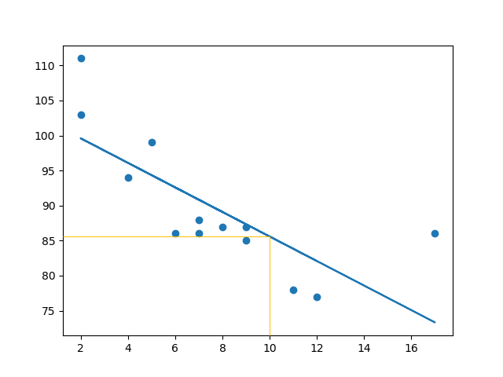
The example predicted a speed at 85.6, which we also could read from the diagram:

Slide 26
Bad Fit?
Let us create an example where linear regression would not be the best method to predict future values.
Example
These values for the x- and y-axis should result in a very bad fit for linear regression:
import matplotlib.pyplot as plt
from scipy import stats
x = [89,43,36,36,95,10,66,34,38,20,26,29,48,64,6,5,36,66,72,40]
y = [21,46,3,35,67,95,53,72,58,10,26,34,90,33,38,20,56,2,47,15]
slope, intercept, r, p, std_err = stats.linregress(x, y)
def myfunc(x):
return slope * x + intercept
mymodel = list(map(myfunc, x))
plt.scatter(x, y)
plt.plot(x, mymodel)
plt.show()

Slide 27
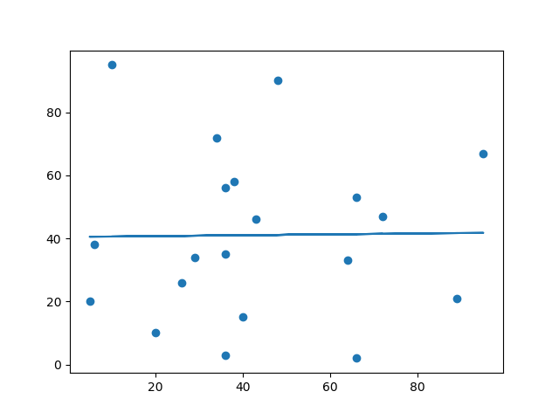
Result:

Slide 28
And the r for relationship?
Example
You should get a very low r value.
import numpy
from scipy import stats
x = [89,43,36,36,95,10,66,34,38,20,26,29,48,64,6,5,36,66,72,40]
y = [21,46,3,35,67,95,53,72,58,10,26,34,90,33,38,20,56,2,47,15]
slope, intercept, r, p, std_err = stats.linregress(x, y)
print(r)
The result: 0.013 indicates a very bad relationship, and tells us that this data set is not suitable for linear regression.

Slide 29
Multiple Regression
Multiple regression is like linear regression, but with more than one independent value, meaning that we try to predict a value based on two or more variables.

Slide 30
Take a look at the data set below, it contains so me information about cars
Car | Model | Volume | Weight | CO2
Toyota | Aygo | 1000 | 790 | 99
Mitsubishi | Space Star | 1200 | 1160 | 95
Skoda | Citigo | 1000 | 929 | 95
Fiat | 500 | 900 | 865 | 90
Mini | Cooper | 1500 | 1140 | 105
VW | Up! | 1000 | 929 | 105
Skoda | Fabia | 1400 | 1109 | 90
Mercedes | A-Class | 1500 | 1365 | 92
Ford | Fiesta | 1500 | 1112 | 98
Audi | A1 | 1600 | 1150 | 99
Hyundai | I20 | 1100 | 980 | 99

Slide 31
We can predict the CO2 emission of a car based on the size of the engine, but with multiple regression we can throw in more variables, like the weight of the car, to make the prediction more accurate.

Slide 32
How Does it Work?
In Python we have modules that will do the work for us. Start by importing the Pandas module.
import pandas
Learn about the Pandas module in our Pandas Tutorial.
The Pandas module allows us to read csv files and return a DataFrame object.
The file is meant for testing purposes only,

Slide 33
Example
See the whole example in action:
import pandas
from sklearn import linear_model
df = pandas.read_csv("cars.csv")
X = df[['Weight', 'Volume']]
y = df['CO2']
regr = linear_model.LinearRegression()
regr.fit(X, y)
#predict the CO2 emission of a car where the weight is 2300kg, and the volume is 1300cm3:
predictedCO2 = regr.predict([[2300, 1300]])
print(predictedCO2)

Slide 34
Result:
[107.2087328]
We have predicted that a car with 1.3 liter engine, and a weight of 2300 kg, will release approximately 107 grams of CO2 for every kilometer it drives.

