Slide 1
zekeLabs
Learning made Simpler ! www.zekeLabs.com

Slide 2
About zekeLabs
We help Corporates stay ahead of the Technology transition curve by Reskilling and Up-skilling the Employees.
We provide Training & Mentoring to IT Professionals on Cutting Edge Technologies.
We are pioneers in establishing Industry Standard for Result Based Training (RBT) & Technical Training Processes.

Slide 3

About me
Enterprise Architect @ Zekelabs
 7
years in data processing
 5 years with MPP
 4
years with
Hadoop
 Spark Developer & Corporate Trainer
 http://www.zekelabs.com

Slide 4
Outline
 Spark Motivation
 Spark Pillars
 Spark Architecture
 Spark Shuffle
 Spark
DataFrame

Slide 5
Outline
 Spark
Motivation
 Spark Pillars
 Spark Architecture
 Spark Shuffle
 Spark
DataFrame

Slide 6
Spark Motivation
 Difficultly
of
programming directly
in
Hadoop
MapReduce

Slide 7
Spark Motivation
 Difficultly
of
programming directly
in Hadoop
MapReduce
 Performance bottlenecks, or
batch not
fitting use cases

Slide 8
Spark Motivation
 Difficultly
of
programming directly
in Hadoop
MapReduce
 Performance bottlenecks, or
batch not
fitting use cases
 Better
support iterative jobs
typical
for
machine learning

Slide 9
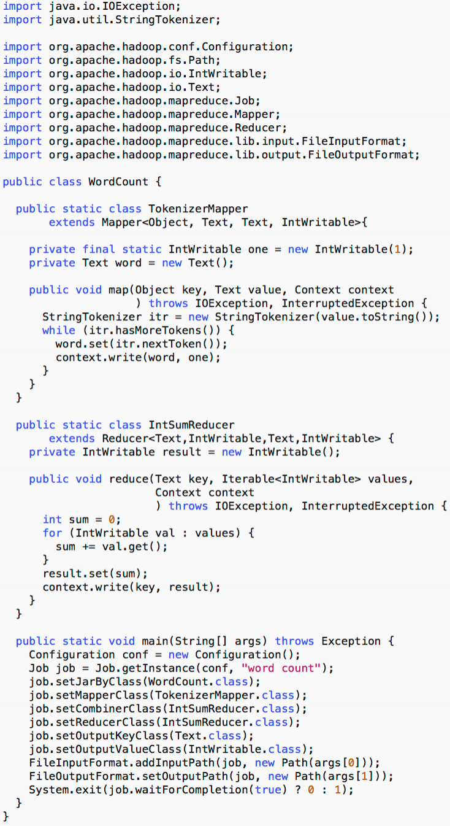
Difficulty of Programming in MR
Word Count implementations
 Hadoop
MR – 61 lines
in Java
 Spark – 1 line in interactive shell
sc.textFile('...').flatMap(lambda x: x.split())
.map(lambda x: (x, 1)).reduceByKey(lambda x, y: x+y)
VS
.saveAsTextFile('...')

Slide 10
Performance Bottlenecks
How many times the data is put to the HDD during a single
MapReduce Job?
 One
 Tw o
 Three
 More

Slide 11
Performance Bottlenecks
How many times the data is put to the HDD during a single
MapReduce Job?
 One
 Tw o
ü Three
ü More

Slide 12
Performance Bottlenecks
Consider Hive as main SQL tool

Slide 13
Performance Bottlenecks
Consider Hive as main SQL tool
 Typical
Hive query is
translated to 3-5 MR jobs

Slide 14
Performance Bottlenecks
Consider Hive as main SQL tool
 Typical
Hive query is
translated to 3-5 MR jobs
 Each MR would scan put
data to HDD 3+ times

Slide 15
Performance Bottlenecks
Consider Hive as main SQL tool
 Typical
Hive query is
translated to 3-5 MR jobs
 Each MR would scan put
data to HDD 3+ times
 Each put
to HDD – write followed by
read

Slide 16
Performance Bottlenecks
Consider Hive as main SQL tool
 Typical
Hive query is
translated to 3-5 MR jobs
 Each MR would scan put
data to HDD 3+ times
 Each put
to HDD – write followed by
read
 Sums up to 18-30 scans
Hive query
of
data during a single

Slide 17
Performance Bottlenecks
Spark offers you
 Lazy Computations
– Optimize the job before executing

Slide 18
Performance Bottlenecks
Spark offers you
 Lazy Computations
– Optimize the job before executing
 In-memory data caching
–
Scan HDD only once, then scan your RAM

Slide 19
Performance Bottlenecks
Spark offers you
 Lazy Computations
– Optimize the job before executing
 In-memory data caching
–
Scan HDD only once, then scan your RAM
 Efficient
pipelining
–
Avoids the data hitting the HDD by all means

Slide 20
Outline
 Spark Motivation
 Spark
Pillars
 Spark Architecture
 Spark Shuffle
 Spark
DataFrame

Slide 21
Spark Pillars
Two main abstractions of Spark

Slide 22
Spark Pillars
Two main abstractions of Spark
 RDD
– Resilient
Distributed Dataset

Slide 23
Spark Pillars
Two main abstractions of Spark
 RDD
– Resilient
Distributed Dataset
 DAG
– Direct Acyclic
Graph

Slide 24
RDD
 Simple view
–
RDD is collection of data items split into partitions and
stored in memory on worker nodes of the cluster

Slide 25
RDD
 Simple view
–
RDD is collection of data items split into partitions and
stored in memory on worker nodes of the cluster
 Complex
view
–
RDD is an interface for data transformation

Slide 26
RDD
 Simple view
–
RDD is collection of data items split into partitions and
stored in memory on worker nodes of the cluster
 Complex
view
–
–
RDD is an interface for data transformation
RDD refers to the data stored either in persisted store
(HDFS, Cassandra, HBase, etc.) or in cache (memory,
memory+disks, disk only, etc.) or in another RDD

Slide 27
RDD
 Complex
view (cont’d)
–
Partitions are recomputed on failure or cache eviction

Slide 28
RDD
 Complex
view (cont’d)
–
–
Partitions are recomputed on failure or cache eviction
Metadata stored for interface
▪
Partitions – set of data splits associated with this RDD

Slide 29
RDD
 Complex
view (cont’d)
–
–
Partitions are recomputed on failure or cache eviction
Metadata stored for interface
▪
▪
Partitions – set of data splits associated with this RDD
Dependencies – list of parent RDDs involved in computation

Slide 30
RDD
 Complex
view (cont’d)
–
–
Partitions are recomputed on failure or cache eviction
Metadata stored for interface
▪
▪
▪
Partitions – set of data splits associated with this RDD
Dependencies – list of parent RDDs involved in computation
Compute – function to compute partition of the RDD given the
parent partitions from the Dependencies

Slide 31
RDD
 Complex
view (cont’d)
–
–
Partitions are recomputed on failure or cache eviction
Metadata stored for interface
▪
▪
▪
Partitions – set of data splits associated with this RDD
Dependencies – list of parent RDDs involved in computation
Compute – function to compute partition of the RDD given the
parent partitions from the Dependencies
▪
Preferred Locations – where is the best place to put
computations on this partition (data locality)

Slide 32
RDD
 Complex
view (cont’d)
–
–
Partitions are recomputed on failure or cache eviction
Metadata stored for interface
▪
▪
▪
Partitions – set of data splits associated with this RDD
Dependencies – list of parent RDDs involved in computation
Compute – function to compute partition of the RDD given the
parent partitions from the Dependencies
▪
Preferred Locations – where is the best place to put
computations on this partition (data locality)
▪
Partitioner – how the data is split into partitions

Slide 33
RDD
 RDD is
the main and only
manipulation in Spark
tool
for
data
 Two
classes
of
operations
–
Transformations
– Actions

Slide 34
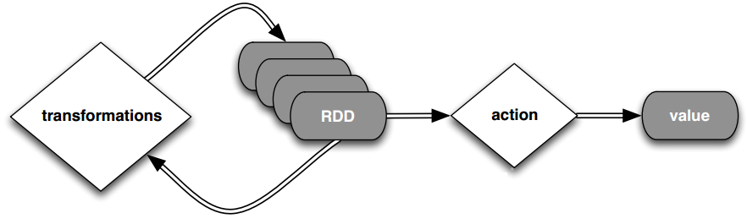
RDD
Lazy computations model
Transformation cause only metadata change

Slide 35
DAG
Direct Acyclic Graph – sequence of computations
performed on data

Slide 36
DAG
Direct Acyclic Graph – sequence of computations
performed on data
 Node
– RDD partition

Slide 37
DAG
Direct Acyclic Graph – sequence of computations
performed on data
 Node
– RDD partition
 Edge
– transformation on top of
data

Slide 38
DAG
Direct Acyclic Graph – sequence of computations
performed on data
 Node
– RDD partition
 Edge
– transformation on top of
data
 Acyclic
– graph
cannot
return to the older
partition

Slide 39
DAG
Direct Acyclic Graph – sequence of computations
performed on data
 Node
– RDD partition
 Edge
– transformation on top of
data
 Acyclic
– graph
cannot
return to the older
partition
 Direct
an action that
data partition state (from A to B)
– transformation is
transitions

Slide 40
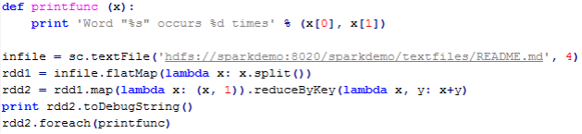
DAG
WordCount example

Slide 41

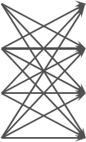

DAG
WordCount example
sc.textFile(‘hdfs://…’)
flatMap
map
reduceByKey
foreach
 |  |  |  |  | RDD |  |  |  | RDD |  |  |  | RDD |  |  |  | RDD |  |  | RDD
Splits
HDFS
RDD Partitions
HDFS Input

Slide 42
Outline
 Spark Motivation
 Spark Pillars
 Spark
Architecture
 Spark Shuffle
 Spark
DataFrames

Slide 43




Spark Cluster
Driver Node
Worker Node
Worker Node
Worker Node
…

Slide 44






Spark Cluster
Driver Node
Driver
Worker Node
Worker Node
Worker Node
Executor
Executor
Executor
Executor
Executor
Executor
…
…
…
…

Slide 45






Spark Cluster
Driver Node
Driver
Spark Context
Worker Node
Worker Node
Worker Node
Executor
Executor
Executor
Executor
Executor
Executor
Cache
Cache
Cache
Cache
…
Cache
Cache
…
…
…

Slide 46
Spark Cluster
Driver Node
Driver
Spark Context
Worker Node
Worker Node
Worker Node
Executor
Executor
Executor
Executor
Executor
Executor
Cache
Cache
Cache
Cache
…
Cache
Cache
…
…
…
Task
Task
Task
Task
Task
Task
Task
Task
Task
Task
Task
Task
Task
…
…
Task
…
Task
…
Task
…
Task
…
Task

Slide 47
Spark Cluster
 Driver
–
Entry point of the Spark Shell (Scala, Python, R)

Slide 48
Spark Cluster
 Driver
–
–
Entry point of the Spark Shell (Scala, Python, R)
The place where SparkContext is created

Slide 49
Spark Cluster
 Driver
–
–
–
Entry point of the Spark Shell (Scala, Python, R)
The place where SparkContext is created
Translates RDD into the execution graph

Slide 50
Spark Cluster
 Driver
–
–
–
–
Entry point of the Spark Shell (Scala, Python, R)
The place where SparkContext is created
Translates RDD into the execution graph
Splits graph into stages

Slide 51
Spark Cluster
 Driver
–
–
–
–
–
Entry point of the Spark Shell (Scala, Python, R)
The place where SparkContext is created
Translates RDD into the execution graph
Splits graph into stages
Schedules tasks and controls their execution

Slide 52
Spark Cluster
 Driver
–
–
–
–
–
–
Entry point of the Spark Shell (Scala, Python, R)
The place where SparkContext is created
Translates RDD into the execution graph
Splits graph into stages
Schedules tasks and controls their execution
Stores metadata about all the RDDs and their partitions

Slide 53
Spark Cluster
 Driver
–
–
–
–
–
–
–
Entry point of the Spark Shell (Scala, Python, R)
The place where SparkContext is created
Translates RDD into the execution graph
Splits graph into stages
Schedules tasks and controls their execution
Stores metadata about all the RDDs and their partitions
Brings up Spark WebUI with job information

Slide 54
Spark Cluster
 Executor
–
Stores the data in cache in JVM heap or on HDDs

Slide 55
Spark Cluster
 Executor
–
–
Stores the data in cache in JVM heap or on HDDs
Reads data from external sources

Slide 56
Spark Cluster
 Executor
–
–
–
Stores the data in cache in JVM heap or on HDDs
Reads data from external sources
Writes data to external sources

Slide 57
Spark Cluster
 Executor
–
–
–
–
Stores the data in cache in JVM heap or on HDDs
Reads data from external sources
Writes data to external sources
Performs all the data processing

Slide 58
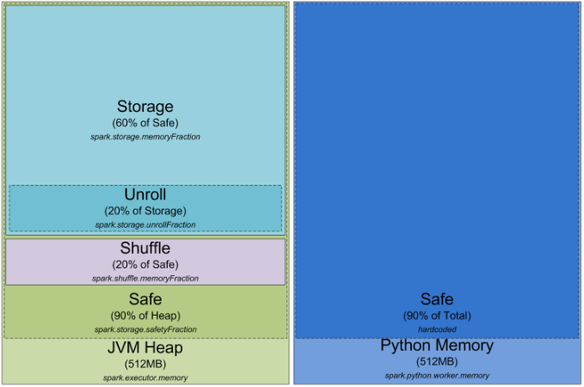
Executor Memory

Slide 59
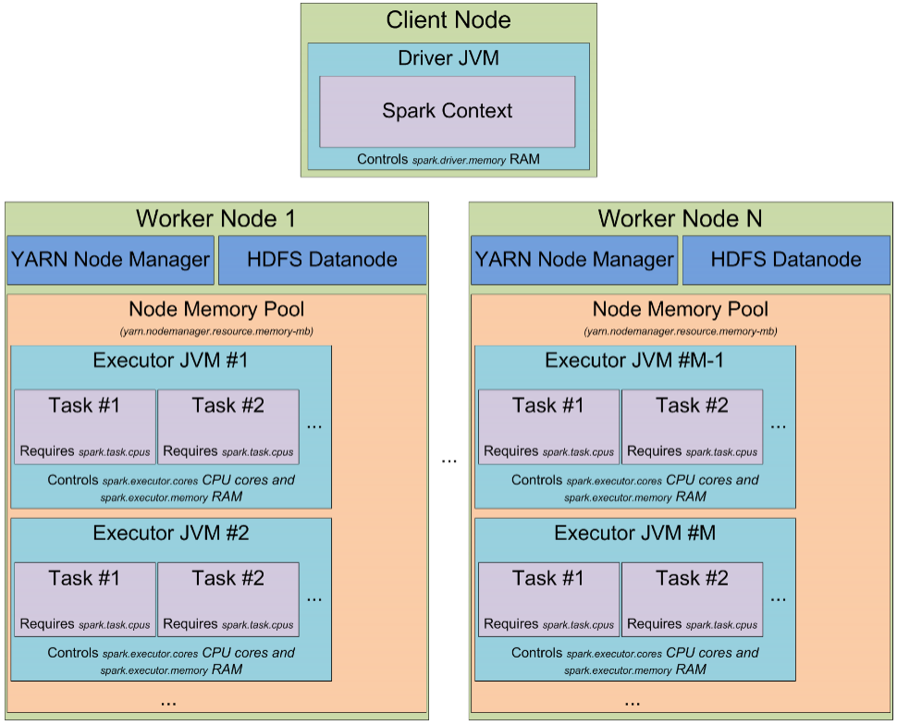
Spark Cluster – Detailed

Slide 60
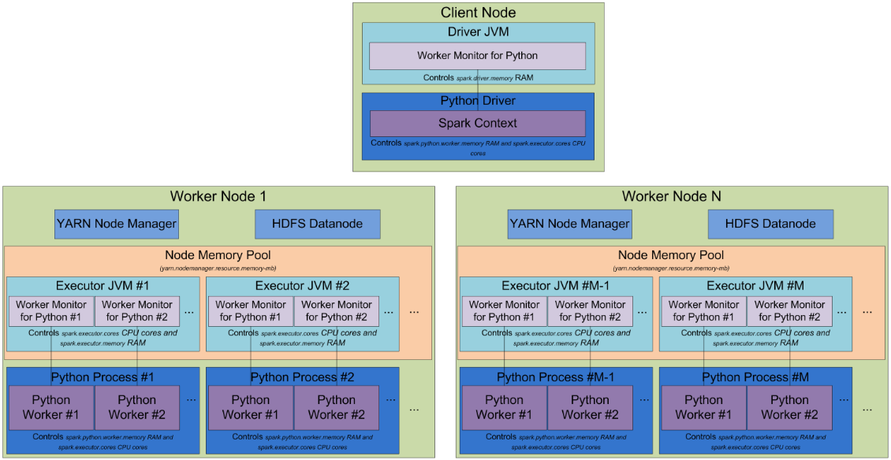
Spark Cluster – PySpark

Slide 61
Application Decomposition
 Application
–
Single instance of SparkContext that stores some data
processing logic and can schedule series of jobs,
sequentially or in parallel (SparkContext is thread-safe)

Slide 62
Application Decomposition
 Application
–
Single instance of SparkContext that stores some data
processing logic and can schedule series of jobs,
sequentially or in parallel (SparkContext is thread-safe)
 Job
–
Complete set of transformations on RDD that finishes
with action or data saving, triggered by the driver
application

Slide 63
Application Decomposition
 Stage
–
Set of transformations that can be pipelined and
executed by a single independent worker. Usually it is
app the transformations between “read”, “shuffle”,
“action”, “save”

Slide 64
Application Decomposition
 Stage
–
Set of transformations that can be pipelined and
executed by a single independent worker. Usually it is
app the transformations between “read”, “shuffle”,
“action”, “save”
 Ta s k
–
Execution of the stage on a single data partition. Basic
unit of scheduling

Slide 65

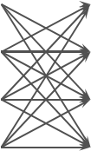

WordCount Example
sc.textFile(‘hdfs://…’)
flatMap
map
reduceByKey
foreach
 |  |  |  |  | RDD |  |  |  | RDD |  |  |  | RDD |  |  |  | RDD |  |  | RDD
Splits
HDFS
RDD Partitions
HDFS Input

Slide 71
Persistence in Spark
Persistence Level | Description
MEMORY_ONLY | Store RDD as deserialized Java objects in the JVM. If the RDD does not fit in memory, some partitions will not be cached and will be recomputed on the fly each time they're needed. This is the default level.
MEMORY_AND_DISK | Store RDD as deserialized Java objects in the JVM. If the RDD does not fit in memory, store the partitions that don't fit on disk, and read them from there when they're needed.
MEMORY_ONLY_SER | Store RDD as serialized Java objects (one byte array per partition). This is generally more space-efficient than deserialized objects, especially when using a fast serializer, but more CPU-intensive to read.
MEMORY_AND_DISK_SER | Similar to MEMORY_ONLY_SER, but spill partitions that don't fit in memory to disk instead of recomputing them on the fly each time they're needed.
DISK_ONLY | Store the RDD partitions only on disk.
MEMORY_ONLY_2, DISK_ONLY_2, etc. | Same as the levels above, but replicate each partition on two cluster nodes.

Slide 72
Persistence in Spark
 Spark considers memory as
eviction rules
a cache with LRU
 If
“Disk” is
involved,
data is
evicted to disks
rdd = sc.parallelize(xrange(1000))
rdd.cache().count()
rdd.persist(StorageLevel.MEMORY_AND_DISK_SER).count()
rdd.unpersist()

Slide 73
Outline
 Spark Motivation
 Spark Pillars
 Spark Architecture
 Spark
Shuffle
 Spark
DataFrame

Slide 74
Shuffles in Spark
 Hash Shuffle
– default
prior
to 1.2.0

Slide 75
Shuffles in Spark
 Hash Shuffle
– default
prior
to 1.2.0
 Sort Shuffle
–
default now

Slide 76
Shuffles in Spark
 Hash Shuffle
– default
prior
to 1.2.0
 Sort Shuffle
–
default now
 Tungsten Sort
– new optimized one!

Slide 77
Hash Shuffle

Slide 78





Hash Shuffle
Executor JVM
Partition
Partition
Partition
Partition
Partition
Partition
Partition
Partition

Slide 82
Hash Shuffle with Consolidation

Slide 83
Hash Shuffle With Consolidation
Executor JVM
Partition
Partition
Partition
Partition
Partition
Partition
Partition
Partition

Slide 90
Sort Shuffle

Slide 91





Sort Shuffle
Executor JVM
spark.storage.[safetyFraction * memoryFraction]
Partition
Partition
Partition
Partition
Partition
Partition
Partition
Partition
Partition
Partition

Slide 92



Sort Shuffle
Executor JVM
spark.storage.[safetyFraction * memoryFraction]
Partition
Partition
Partition
Partition
Partition
Partition
Partition
Partition
Partition
Partition
spark.executor.cores / spark.task.cpus
“map”
task
…
“map”
task

Slide 93



Sort Shuffle
Executor JVM
spark.storage.[safetyFraction * memoryFraction]
Partition
Partition
Partition
Partition
Partition
Partition
Partition
Partition
Partition
Partition
spark.shuffle.
[safetyFraction * memoryFraction]
spark.executor.cores / spark.task.cpus
“map”
task
…
AppendOnlyMap
…
“map”
task
AppendOnlyMap

Slide 94
Sort Shuffle
Executor JVM
spark.storage.[safetyFraction * memoryFraction]
Partition
Partition
Partition
Partition
Partition
Partition
Partition
Partition
Partition
Partition
spark.shuffle.
[safetyFraction * memoryFraction]
sort &
spill
spark.executor.cores / spark.task.cpus
“map”
task
…
AppendOnlyMap
…
“map”
task
AppendOnlyMap

Slide 95


Sort Shuffle
Executor JVM
Local
Directory
spark.storage.[safetyFraction * memoryFraction]
Partition
Partition
Partition
Partition
Partition
Partition
Partition
Partition
Partition
Partition
spark.shuffle.
[safetyFraction * memoryFraction]
sort &
spill
index
Output File
spark.executor.cores / spark.task.cpus
“map”
task
…
AppendOnlyMap
…
“map”
task
AppendOnlyMap

Slide 96
Sort Shuffle
Executor JVM
Local
Directory
spark.storage.[safetyFraction * memoryFraction]
Partition
Partition
Partition
Partition
Partition
Partition
Partition
Partition
Partition
Partition
spark.shuffle.
[safetyFraction * memoryFraction]
sort &
spill
index
Output File
spark.executor.cores / spark.task.cpus
“map”
task
…
AppendOnlyMap
…
index
Output File
“map”
task
sort &
spill
AppendOnlyMap

Slide 97
Sort Shuffle
Executor JVM
Local
Directory
spark.storage.[safetyFraction * memoryFraction]
Partition
Partition
Partition
Partition
Partition
Partition
Partition
Partition
Partition
Partition
spark.shuffle.
[safetyFraction * memoryFraction]
sort &
spill
index
Output File
spark.executor.cores / spark.task.cpus
“map”
task
…
index
Output File
…
…
AppendOnlyMap
sort &
spill
…
index
Output File
“map”
task
sort &
spill
AppendOnlyMap

Slide 99
Tungsten Sort Shuffle

Slide 100




Tungsten Sort Shuffle
Executor JVM
spark.storage.[safetyFraction * memoryFraction]
Partition
Partition
Partition
Partition
Partition
Partition
Partition
Partition
Partition
Partition

Slide 101

Tungsten Sort Shuffle
Executor JVM
spark.storage.[safetyFraction * memoryFraction]
Partition
Partition
Partition
Partition
Partition
Partition
Partition
Partition
Partition
Partition
“map”
task
spark.executor.cores / spark.task.cpus

Slide 110
Outline
 Spark Motivation
 Spark Pillars
 Spark Architecture
 Spark Shuffle
 Spark
DataFrame

Slide 111
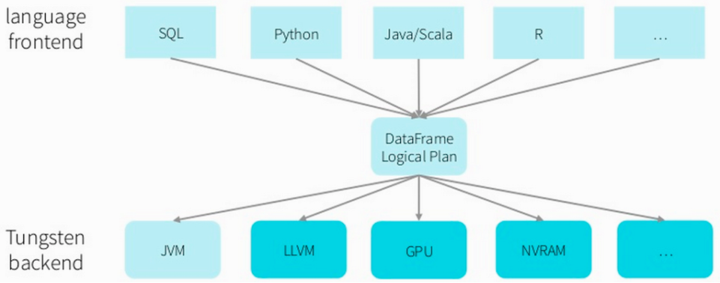
DataFrame Idea

Slide 112
DataFrame Implementation
 Interface
– DataFrame is an RDD with schema – field names, field
data types and statistics
– Unified transformation interface in all
transformations are passed to JVM
languages, all
the
– Can be accessed as
RDD,
the RDD of Row objects
in this
case transformed to

Slide 113
DataFrame Implementation
 Internals
–
–
Internally it is the same RDD
Data is stored in row-columnar format, row chunk size
is set by spark.sql.inMemoryColumnarStorage.batchSize
– Each column in each partition stores
for partition pruning
min-max
values
– Allows
better
compression ratio than standard RDD
– Delivers faster performance for small subsets of
columns

Slide 114


Questions?
Pivotal Confidential–Internal Use Only | 11 3
Questions?
Pivotal Confidential–Internal Use Only
Pivotal Confidential–Internal Use Only
11 3
11 3

Slide 115



BUILT FOR THE SPEED OF BUSINESS

