Slide 1
Replit Free vs Linode (Paid) — In-Depth Survey
Overview, Services, Pricing, Limits, Usability, Performance & Security

Slide 2
Executive Summary
Quick findings & recommendation:
  • Replit Free: Best for rapid prototyping, education, and collaborative coding. Zero setup, instant sharing, limited resources.
  • Linode (Paid): Best for production workloads requiring full control, predictable performance, and compliance options. Higher ops overhead.
  Recommendation: Use Replit for development and demos; use Linode for production, scaling, and regulated workloads.

Slide 3
Replit (Free) — Overview & Target Users
Overview:
  • Browser-based IDE + managed runtime for many languages.
Target users:
  – Beginners, students, educators.
  – Developers prototyping quickly and sharing demos.
  – Small teams using collaborative coding features.

Slide 4
Linode (Paid) — Overview & Target Users
Overview:
  • Infrastructure-as-a-Service (VPS) providing virtual servers, storage, networking.
Target users:
  – Developers, startups, and businesses needing control and uptime.
  – Ops teams running production services, databases, and containers.
  – Users requiring data residency and compliance controls.

Slide 5
Hands-on experiment:
Steps Performed :
Step 1: Account Setup
Go to replit.com
Sign up using Google/GitHub/email
Open the dashboard
Step 2: Create a New Repl
Click “+ Create Repl”
Select Python
Name the project → test-project
Click Create Repl

Slide 6
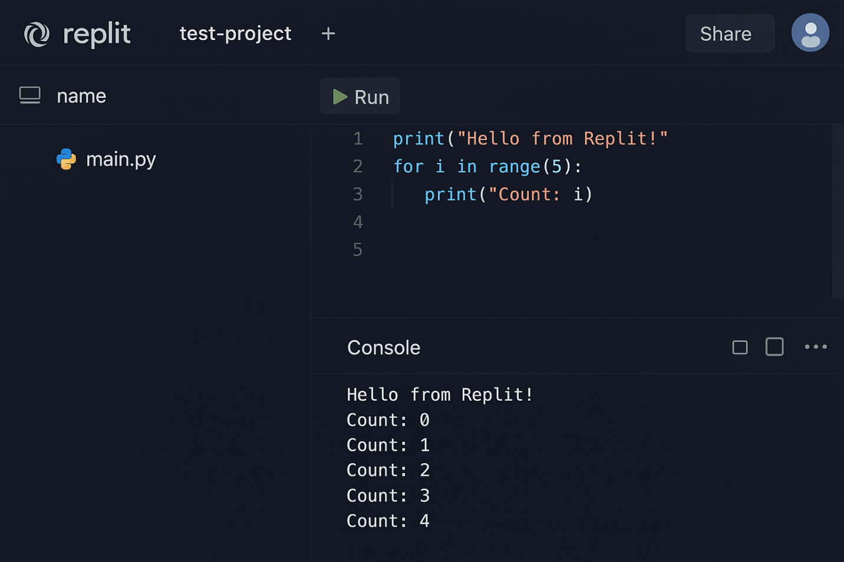
Step 3: Write and Run Code
In main.py, type:

Slide 7
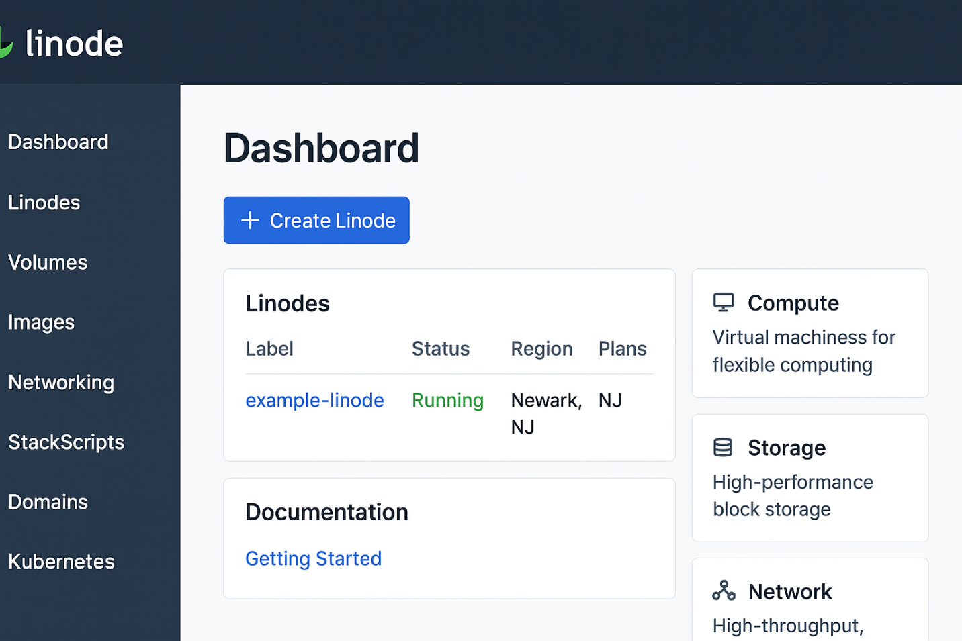
Below is a generated screenshot-style image of the Linode dashboard of report.

Slide 8
Core Services & Features
Replit (Free) — Key Features:
  • Online IDE with multiplayer editing
  • Instant run & basic hosting (public Repls)
  • Multi-language support, package manager, and shell access
  • Limited AI-assisted coding on free tier
  • GitHub integration and educational tools
Linode (Paid) — Key Features:
  • VPS (shared/dedicated), block/object storage, managed DB
  • Managed Kubernetes (LKE), load balancers, and networking
  • API/CLI automation, snapshots, backups, and firewall
  • Deterministic resource plans and multiple regions

Slide 9
Pricing Model & Approximate Costs
Replit Pricing (high level):
  • Free tier: $0 (public Repls, resource-limited)
  • Paid individual: ~ $20/month (private Repls, higher quotas)
  • Teams/Enterprise: per-user pricing, SLA and governance options
Linode Pricing (examples):
  • Nanode: $5/month — 1GB RAM, 1 vCPU, 25GB SSD, 1TB transfer
  • 2–4GB: $12–$24/month — common small production sizes
  • Bandwidth overage: ~$0.01–$0.10/GB (region-dependent)

Slide 10
Limitations & Usability
Replit Limitations & Usability:
  • Auto-sleep on free Repls; limited runtime and RAM/CPU
  • Free projects are public by default; private Repls require paid plan
  • Less suitable for long-running background processes or high concurrency
  • Very low setup friction and excellent for collaborative use
Linode Limitations & Usability:
  • Requires sysadmin knowledge: OS updates, security, backups
  • Additional managed services cost extra (managed DB, backups)
  • Greater operational flexibility and predictable behavior

Slide 11
Performance Characteristics & Scalability
Replit Performance:
  • Suitable for light compute and I/O; not for CPU-heavy tasks
  • Platform may throttle resources; concurrency limited by plan
  • Quick startup and immediate dev feedback
Linode Performance:
  • Predictable CPU, RAM, and network; choose region for latency
  • Scale vertically (bigger instances) or horizontally (multiple VMs, LKE)
  • Better for databases, sustained traffic, and background workers

Slide 12
Security Considerations & Recommendations
Security Notes:
  • Replit: Platform-managed security; enterprise plans offer SOC 2 and SSO.
  • Linode: You control OS-level security, encryption, firewalling, and backups.
  • For sensitive/regulatory data (PHI, PCI): prefer IaaS with appropriate contracts (BAA) and hardened servers.
Recommendations:
  • Use Replit free for learning, prototypes, and demos.
  • Use Linode for production, compliance needs, and scalable services.
  • Consider hybrid: develop on Replit, deploy on Linode for production.

