Slide 1
ResNet50
Marushkai Nikita, RCSE, 4167

Slide 2
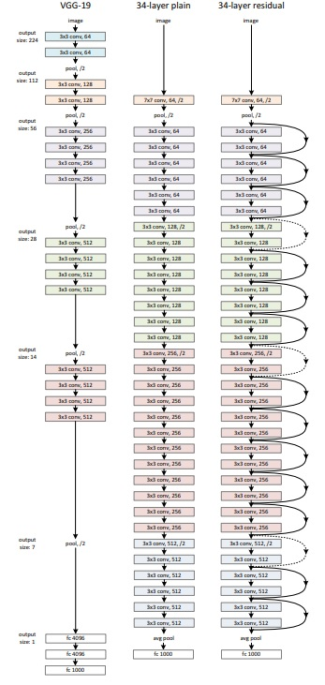
Structure of ResNet50
Deep network
Residual connections between layers (key feature)
224x224 image resizing
Per-pixel mean gets substracted
Standard color augmentation
Batch normalization after each convolution and before activation
SGD with mini-batch of 256
Initial learning rate: 0.1, divided by 10 when model plateaus
60 x 10^4 iterations
No dropout

Slide 3
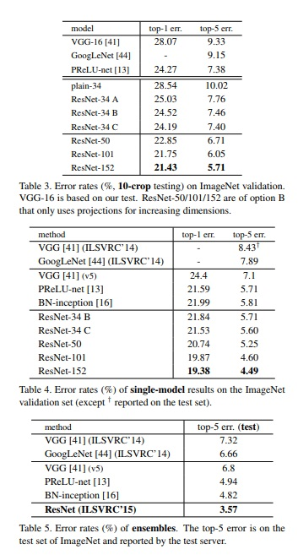
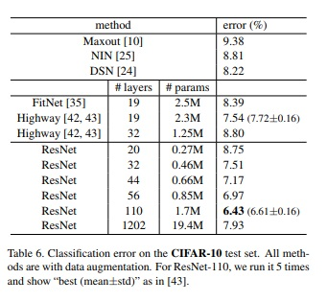
Relevance
Developed in 2015
Much less resources needed than VGG (3.6 bFLOPS vs 19.6 bFLOPS)
Gives the fastest prediction (according to my own comparision)
Low error rates,
Compared to other models

Slide 4
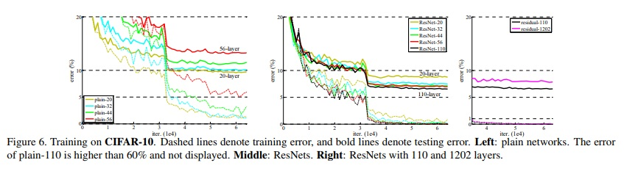
Advantages
Much less computation power needed, compared to former deep networks
Doesn’t degradate with increasing number of layers up to 100
Comparatively small number of model
High classification accuracy
Gives the fastest prediction (according to my own comparision)

Slide 5
Disadvantages
Doesn’t increase accuracy with aggressively deep networks
1000 layers network gives higher test error then 100 layers one
Difficult to remove layers if needed because of millions of features and parameters.
Long training time, which takes sometimes weeks or so, which is bad for real world applications. (applicable for most of the deep networks)

Slide 6
Usage
Fast image recognition
Feature extraction
Object detection and classification
Differentiation objects and clusterise them

Slide 7
Conclusion
Nowadays, ResNet in it’s variations is one of the best deep convolutional network models, developed for Image recognition.
This model was a revolution in deep CNNs, because it’s made possible to create deeper networks without great increasing in optimization difficulty, and making neural network which doesn’t over fit, how it was when they used to simply stack layers. That was possible by introducing new kind of connections between layers – residual connections and identity mapping (layers, which doesn’t do anything). Nowadays this model stimulates a huge interest and make researches to create more advanced models based on the ResNet.

Slide 8

Thank you for attention

