Slide 1
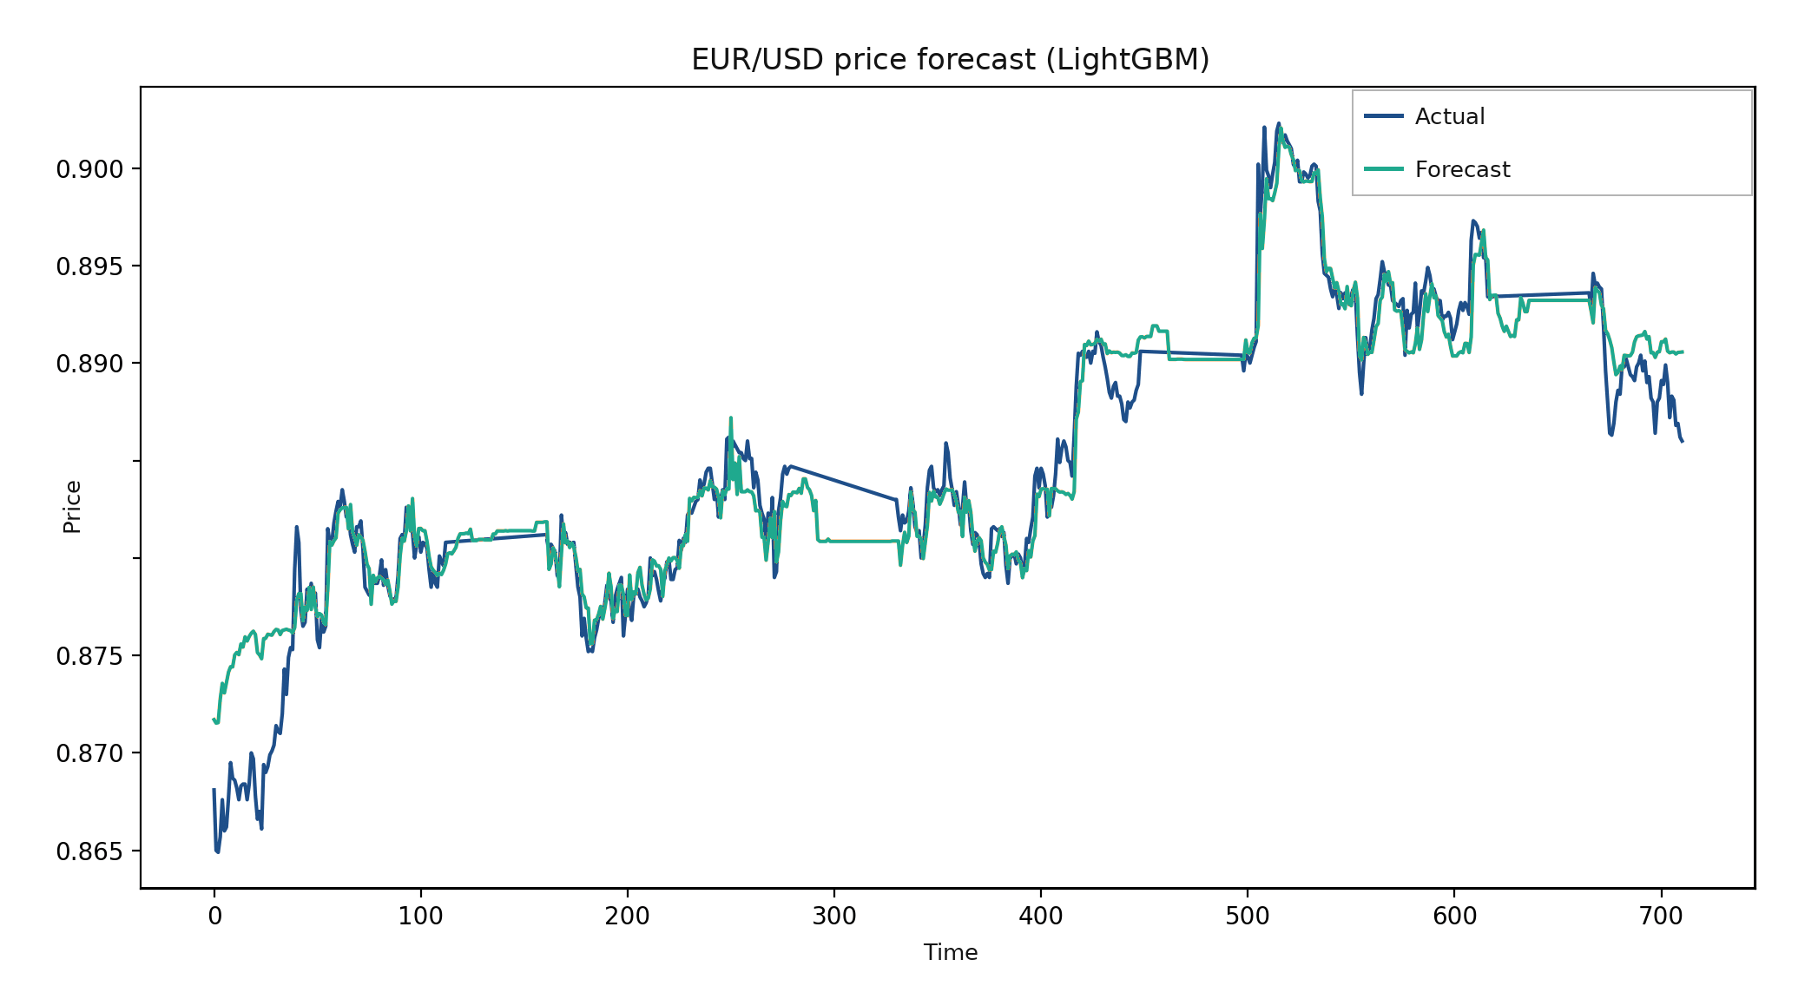
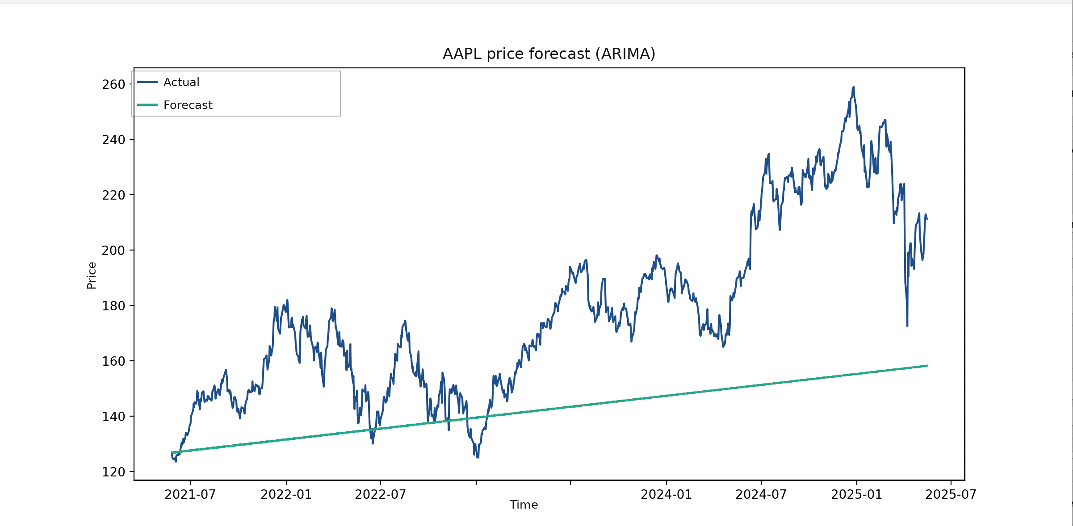


NUST MISIS | Independent Coursework Project | 2025
5
3
5,000
Forecasting Financial Time Series
Classical Statistics vs. Machine Learning — A Comparative Study
forecasting methods
benchmarked
real market series
(FX & equity)
observations
per series
Nikita Meshcheryakov · Dept. of Data Science, NUST MISIS
1
Motivation & Objectives
2
Data & Methods
3
Experimental Results
4
Example Forecasts & Conclusion
Financial markets generate large, noisy, non-stationary time series. Forecasting them well underpins trading, risk management, and portfolio decisions. Classical models (ARIMA, SSA) assume stationarity and linear structure; modern ML/DL and hybrid models promise to capture nonlinear, regime-shifting behavior — but does that promise hold on real market data?
Data
Each model is trained once on the first 90% of a series and evaluated on the held-out last 10%. MSE/MAE below are for AAPL (the hardest series); MAPE is averaged across all three series.
Source: Twelve Data REST API (api.twelvedata.com)
3 series × 5,000 points — split 90% train / 10% test: USD/RUB (hourly), EUR/USD (daily), AAPL (daily)
Preprocessing: fixed-frequency resampling and time interpolation to fill gaps
Metric | NeuralProphet | LSTM | ARIMA | LightGBM | SSA+AR
MSE | 1003.7 | 1051.2 | 1415.4 | 1275.6 | 952.6
MAE | 27.36 | 28.13 | 29.36 | 27.29 | 24.84
MAPE, % (avg) | 6.43 | 8.56 | 9.30 | 8.80 | 7.31
What this project does
Benchmarks 5 forecasting methods head-to-head on the same real market data
Measures accuracy (MAE, MSE, MAPE), stability under noise, and computational cost
Packages the pipeline as a configurable Python tool (symbol, interval, forecast horizon)
Pipeline
Pull data from API
Resample & interpolate
Average MAPE by model (%, lower is better)
Technology stack
ADF stationarity test
Good case — LightGBM on EUR/USD tracks the realized price closely.
Python 3 · NumPy · pandas · scikit-learn · LightGBM · TensorFlow · PyTorch · statsmodels · pmdarima · NeuralProphet · Seaborn / Matplotlib — developed and run in Google Colab, data pulled live via the Twelve Data REST API.
Engineer features (lags, SMA, RSI, MACD)
Poster & research self-assessment
Train 5 models
Good poster fit: a concrete applied-ML task, quantitative metrics, real forecast plots, and honestly reported negative results — all read well at poster distance.
As research, it is a solid benchmarking study rather than a novel contribution: it applies existing libraries — one library per method — to a well-posed comparison question, with no new algorithm or theory.
Evaluate: MAE / MSE / MAPE
Methods compared
ARIMA — Grid search over (p,d,q) by AIC; differencing guided by the Augmented Dickey–Fuller test.
SSA + AR — Singular spectrum decomposition of the series; autoregressive reconstruction of the trajectory matrix.
Failure case — ARIMA on AAPL degenerates to a near-straight line, missing every swing.
Path to a stronger study (priority order)
LSTM — 2-layer recurrent network (50 units, dropout 0.2) trained on lag + technical-indicator features.
Pattern across assets
✓
Add a naive baseline — done — persistence beats walk-forward SSA+AR on USD/RUB (0.12% vs 0.46% MAPE); confirms the concern was real.
LightGBM — Gradient-boosted trees (200 estimators) trained on the same engineered feature set.
Easiest: EUR/USD (smooth trend, few shocks) — almost every model tracks it well
Hardest: AAPL (volatile, no stable trend) — all models struggle; ARIMA/SSA collapse toward a near-straight line
LightGBM and NeuralProphet are the most consistent performers across all three series
Conclusion
Hybrid statistical+neural models (NeuralProphet) and tree ensembles with engineered features (LightGBM) generalize best without heavy tuning
Pure statistical models (ARIMA, SSA+AR) are competitive only when a series is close to stationary/linear — rare in real financial data
Deliverable: an open, configurable pipeline — analysts pick a symbol, interval and forecast horizon
✓
Use one forecasting protocol for every model — done — walk-forward ARIMA (order 5,0,5) on AAPL ties the naive baseline (0.81% vs 0.81% MAPE) instead of collapsing to a line.
NeuralProphet — Trend + seasonality regression fused with a small neural component (7 lags).
✓
Measure training / inference time — done — ARIMA order search: 130s; LSTM fit: 100.7s (Apple M4) — now logged in the pipeline.
Baseline check (verified) — Persistence (naive) baseline checked post-hoc on a fresh data pull: on USD/RUB it beats walk-forward SSA+AR (0.12% vs 0.46% MAPE); on AAPL, walk-forward ARIMA(5,0,5) ties it almost exactly (0.81% vs 0.81%). Different data window than the table above (pulled ~a year apart), so treat as a qualitative check, not a re-run of the same experiment.
Related work
4
Walk-forward CV + significance test — multiple rolling windows, mean ± std per metric, Diebold–Mariano test between the top two models.
Consistent with other ARIMA-vs-LSTM-vs-gradient-boosting studies on stocks/forex, and with SSA-vs-ARIMA work on EUR/USD: tree/DL models tend to beat ARIMA, while SSA's edge depends heavily on how strong the trend is (see References).
5
Widen the asset sample — 2–3 series per class (equities, FX, maybe crypto/rates) before claiming a general ranking.
Future work
Backtest with a simple trading rule and transaction costs, not just point-forecast error
Blend NeuralProphet and LightGBM into a small ensemble to combine their complementary strengths
Validate on a fresh, truly out-of-sample period after the models were finalized (live paper-trading check)
Limitations & Scope
References
Forecast horizons differ across models: NeuralProphet/ARIMA/SSA emit the full multi-step horizon at once, while LightGBM/LSTM effectively use recently realized values — read metric gaps with this in mind, not as a strictly apples-to-apples benchmark
One train/test split per series; no walk-forward cross-validation or significance testing (e.g. Diebold–Mariano) — small MAE gaps between top models are not proven statistically significant
Only 3 series (one per asset class) — the method ranking is indicative, not a general claim
Lag / technical-indicator features were given only to the ML models, not to ARIMA/SSA
HSE Bijournal — SSA for financial time series forecasting (2023)
Anacleto et al. — SSA vs. ARIMA-GARCH for EUR/USD forecasting
Comparative study: ARIMA vs. LSTM vs. XGBoost for stock prediction (2024–25)
Triebe et al. — NeuralProphet: Explainable Forecasting at Scale (arXiv 2111.15397)
A. Nielsen, “Practical Time Series Analysis,” O’Reilly
Yandex ML Handbook — ARIMA models; Time series analytics
Contact Nikita Meshcheryakov · NUST MISIS, 2025 · Telegram @no_status_now · nikitatalent@gmail.com
Scan for code
Scan for Telegram
Code github.com/NikitaMeshDS/financial_time_series_analysis

