Slide 1
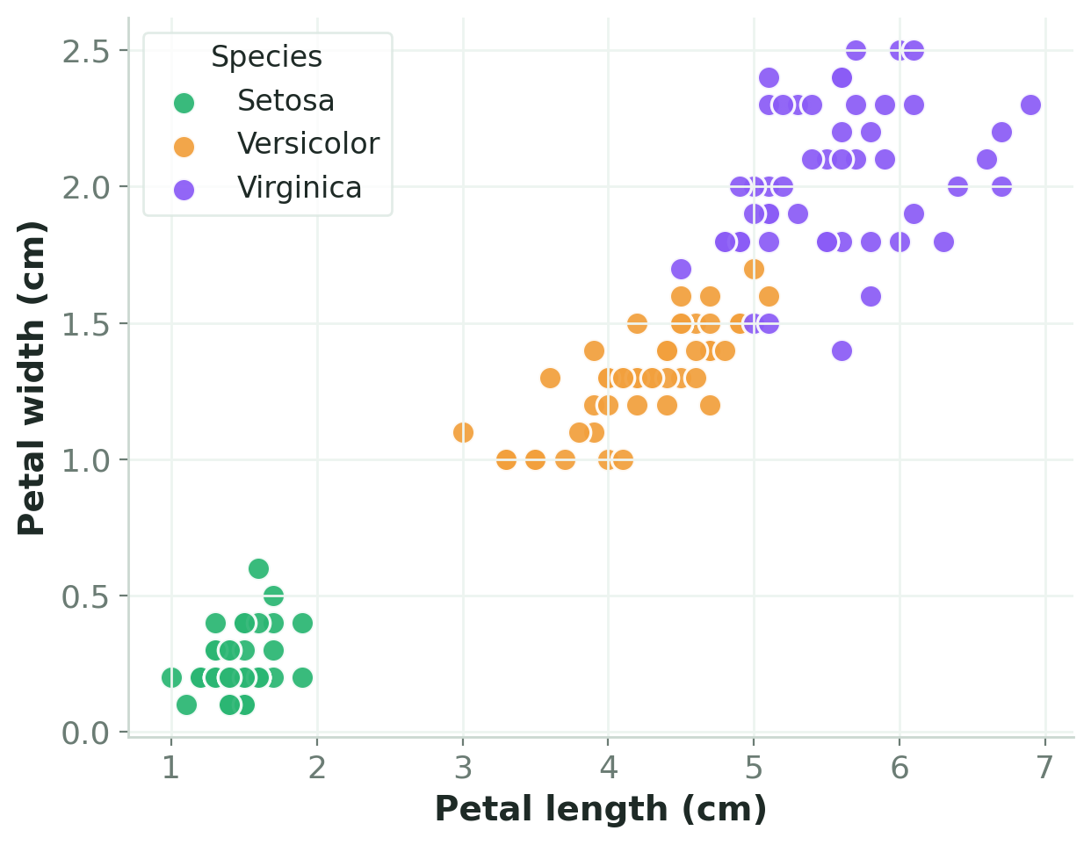




MACHINE LEARNING · CLASSIFICATION
Decision Tree
Classifier
The 3 species we'll classify
Classifying Iris flowers with a flowchart of simple yes / no questions.
BUILT WITH
Python · scikit-learn · matplotlib · pandas

Slide 2



THEORY · 1
What is a Decision Tree?
A Decision Tree predicts by asking a chain of yes / no questions about the data — exactly like a flowchart.
petal length ≤ 2.45?
True
False
Asks simple questions
Each node tests one feature against a threshold (e.g. petal length ≤ 2.45?).
Setosa
petal width ≤ 1.75?
Follows the branches
The answer sends the flower left or right, down to the next question.
Versicolor
Virginica
Lands on a leaf
Each leaf is a final answer — the predicted flower species.
The model just follows the arrows to a leaf.
Decision Tree · Iris Classification
02

Slide 3
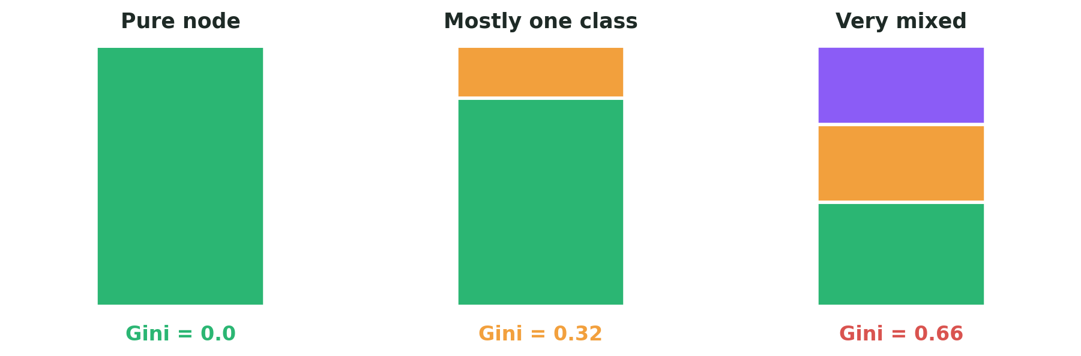
THEORY · 2
How the tree chooses a split
At each step the tree tries every possible question and keeps the one that makes the resulting groups as pure as possible. Purity is measured by Gini impurity — 0 means a group is all one species; higher means more mixed.
Lower Gini = a better, cleaner split
Decision Tree · Iris Classification
03

Slide 4

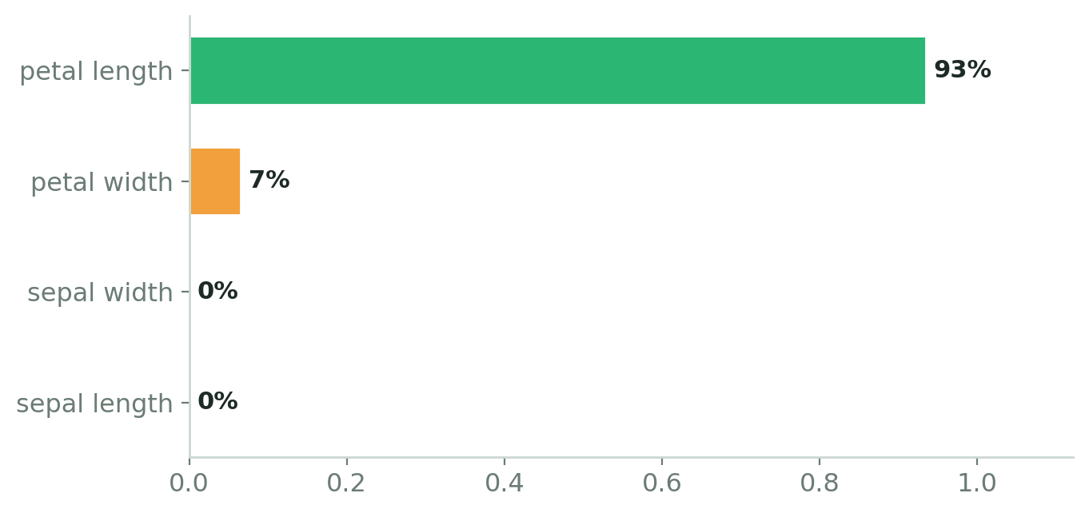

THEORY · 3
Depth, overfitting & which features matter
Trees rank features — petals win
max_depth = 3 keeps it simple
Depth = how many questions deep the tree can go. A shallow tree generalises; a very deep tree can memorise noise — that’s overfitting.
No feature scaling needed
Trees split on thresholds, not distances, so big and small features mix fine. Using raw cm values also keeps the drawn tree readable.
Decision Tree · Iris Classification
04

Slide 5
THEORY · 4
The Iris Dataset
150
3
4
Petals alone separate the species
flowers
species
measurements
THE FOUR MEASUREMENTS (FEATURES → X)
Sepal length
Sepal width
Petal length
Petal width
THE ANSWER (TARGET → Y)
0 · Setosa
1 · Versicolor
2 · Virginica
Decision Tree · Iris Classification
05

Slide 6






THE WORKFLOW
7 steps from raw flowers to a drawn tree
STEP 1
STEP 2
STEP 3
STEP 4
Import
Load data
Split
Train tree
STEP 5
STEP 6
STEP 7
Predict
Evaluate
Visualise
Next: every step explained line by line →
Decision Tree · Iris Classification
06

Slide 7

STEP 1 · CODE
Import the tools
imports.py
LINE BY LINE
pandas
handle data as tidy tables.
# the libraries we need
import pandas as pd
import matplotlib.pyplot as plt
from sklearn.datasets import load_iris
from sklearn.model_selection import (
train_test_split)
from sklearn.tree import (
DecisionTreeClassifier, plot_tree)
from sklearn.metrics import (
accuracy_score,
confusion_matrix,
classification_report)
matplotlib.pyplot
draws the tree and charts.
load_iris
the sample flower dataset.
train_test_split
split into train vs. test.
DecisionTree + metrics
the model, tree-drawer & scoring tools.
Decision Tree · Iris Classification
07

Slide 8
STEP 2 · CODE
Load the dataset
load.py
LINE BY LINE
load_iris()
loads the built-in flower dataset.
# load the Iris flower dataset
iris = load_iris()
# X = features, Y = labels (0/1/2)
X = iris.data
Y = iris.target
X = iris.data
the inputs — the 4 measurements.
Y = iris.target
the labels — species as 0 / 1 / 2.
Decision Tree · Iris Classification
08

Slide 9
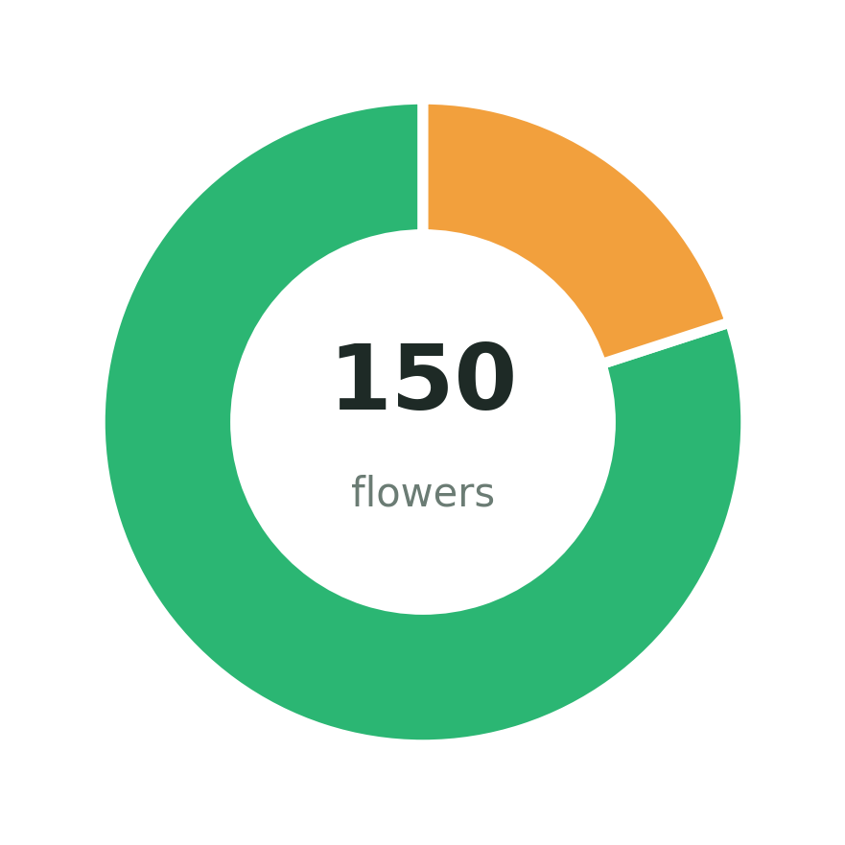
STEP 3 · CODE
Split: train vs. test
split.py
LINE BY LINE
test_size=0.2
hold back 20% to test the tree.
# 80% to train, 20% to test
X_train, X_test, Y_train, Y_test = (
train_test_split(
X, Y,
test_size=0.2,
random_state=42))
random_state=42
fixes the split so runs match.
4 outputs
train + test inputs and labels.
80% train
20% test
Decision Tree · Iris Classification
09

Slide 10
STEP 4 · CODE
Create & train the tree
train.py
LINE BY LINE
criterion='gini'
split to make each group as pure as it can.
# gini split, capped at depth 3
Decison_tree = DecisionTreeClassifier(
criterion='gini',
max_depth=3,
random_state=42)
# fit = learn the question rules
Decison_tree.fit(X_train, Y_train)
max_depth=3
at most 3 questions deep — avoids overfitting.
.fit(...)
learns the yes/no rules from the training data.
No feature scaling required
Decision Tree · Iris Classification
10

Slide 11
STEP 5 · CODE
Make predictions
predict.py
LINE BY LINE
# predict species for test flowers
Y_pred = Decison_tree.predict(X_test)
.predict(X_test)
sends each test flower down the tree to a leaf.
Y_pred
the predicted species (0 / 1 / 2) for every flower.
Decision Tree · Iris Classification
11

Slide 12
STEP 6 · CODE
Check the performance
evaluate.py
LINE BY LINE
accuracy_score
the % of test flowers it got right.
# accuracy (fraction correct)
Accuracy = accuracy_score(
Y_test, Y_pred)
# grid of right vs. confused
conf_mat = confusion_matrix(
Y_test, Y_pred)
# precision / recall / f1
Detailed_report = classification_report(
Y_test, Y_pred)
confusion_matrix
grid of correct vs. confused guesses.
classification_report
precision / recall / f1 per species.
Decision Tree · Iris Classification
12

Slide 13
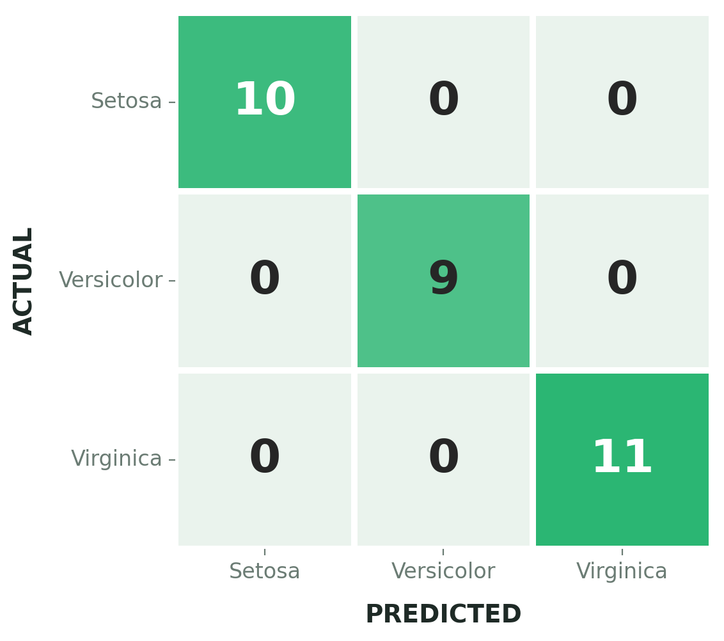
STEP 6 · OUTPUT
The model's report card
Confusion matrix
100%
accuracy — 30 / 30 test flowers correct
(max_depth = 3, random_state = 42)
CLASSIFICATION REPORT
Species | Precision | Recall | F1
Setosa | 1.00 | 1.00 | 1.00
Versicolor | 1.00 | 1.00 | 1.00
Virginica | 1.00 | 1.00 | 1.00
Every species classified perfectly — no confusion.
Decision Tree · Iris Classification
13

Slide 14
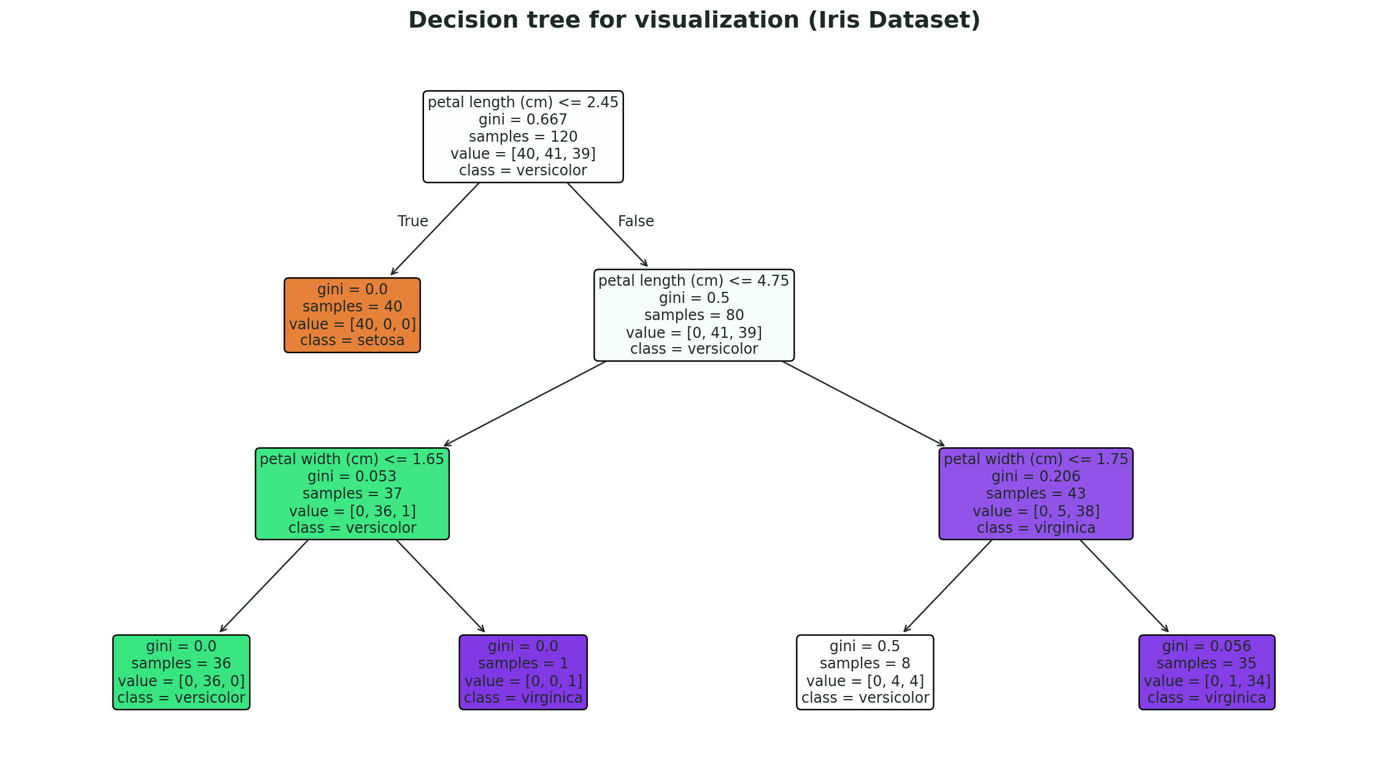
STEP 7 · CODE + OUTPUT
Draw the tree (plt.show)
visualise.py
THE OUTPUT → the trained decision tree
# draw the trained tree
plt.figure(figsize=(15, 20))
plot_tree(Decison_tree,
feature_names=iris.feature_names,
class_names=iris.target_names,
filled=True,
rounded=True,
fontsize=12)
# add a title and display it
plt.title("Decision tree (Iris)")
plt.show()
Decision Tree · Iris Classification
14

Slide 15

RECAP
What we built
A flowchart of questions
Each node splits on one feature; following the answers leads to a species.
100%
Splits that cut Gini
test accuracy
Questions are chosen to make the groups as pure as possible, up to depth 3.
Decision Tree · depth 3
Read & visualised
100% accuracy — and the drawn tree shows it relies almost entirely on petals.
Decision Tree · Iris Classification
15

