Slide 1


Retail Analysis
Presented By: Nikita Nikam

Slide 2
About me
Background
I have recently completed my Bachelor’s Degree in Information Technology from Savitribai Phule Pune University (SPPU).
Why you want to learn Data Science
I want to learn Data Science because it helps understand large amounts of data and convert it into
useful insights. It enables predicting future trends and solving real-world problems using data.
Data Science because it combines statistics, programming, and machine learning to analyze
complex datasets and build predictive models. It helps uncover hidden patterns, optimize
processes, and support data-driven decision-making.
LinkedIn and GitHub profile URLs
https://www.linkedin.com/in/nikita-nikam-184b39240
NikitaNikam1 (Nikita Nikam) · GitHub

Slide 3
Agenda
Real World Scenarios
Objective of the Project
ER Diagram and schema explanation
Key analysis questions
SQL query results with screenshots or summaries
Final business insights and recommendations
Conclusion

Slide 4
Problem Statement
Retail businesses generate large volumes of transactional data, but without proper analysis, this data cannot be effectively used for decision-making.
The challenge is to transform raw retail data into meaningful insights that help management understand customer behavior, sales performance, product demand, logistics efficiency, and revenue trends.
Objective of the project
Analyze retail business data using SQL to extract meaningful insights
Study customer behavior, sales trends, product categories, and seller performance
Evaluate order processing, payments, reviews, and delivery efficiency
Support data-driven decisions to improve customer experience, operations, and revenue growth

Slide 5
Why a Relational Database Is Needed
Data is spread across multiple entities:
Customers
Orders
Products
Payments
Sellers
Review
Tables are connected using primary and foreign keys.
Enables Data integrity,Efficient joins,Scalable analysis
A relational database is ideal because the data has clear relationships between entities.

Slide 6
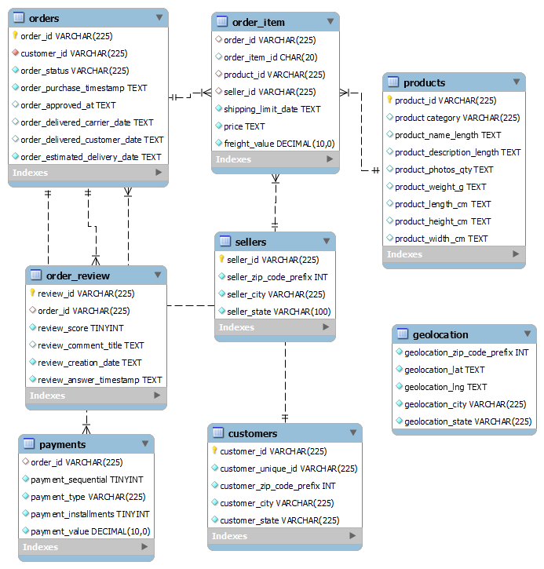
ER Diagram and schema explanation

Slide 7
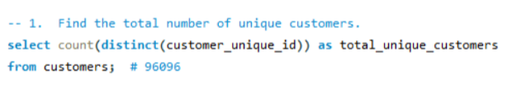

SQL query result
1. What is the total number of unique customers?
This query finds how many different customers are there in total.
result

Slide 8
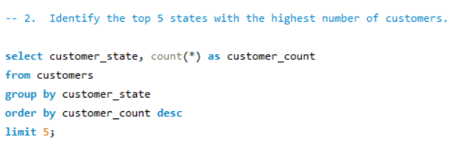
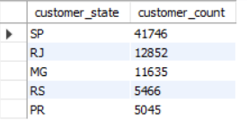
2. Which are the top 5 states with the highest number of customers?
This analysis highlights top5 states (SP,RJ,MG,RS,PR) with the highest customers.
result

Slide 9
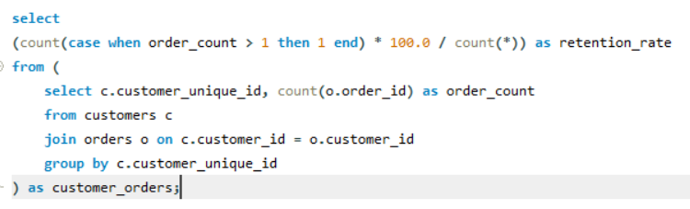

3. What is the customer retention rate (customers who placed more than one order)?
This query measures customer retention rate by identifying how many customers placed more than one order.
result

Slide 10
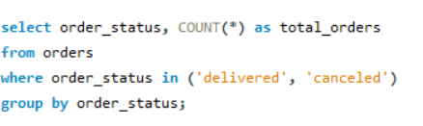
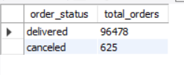
4. What is the total number of delivered and canceled orders?
This query compares successful deliveries against cancellations to assess operational efficiency.
result

Slide 11
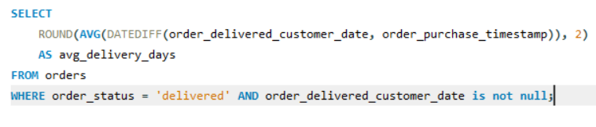

5. What is the average delivery time?
This query calculates the average delivery time to evaluate logistics performance and understand its impact on customer experience.
result

Slide 12
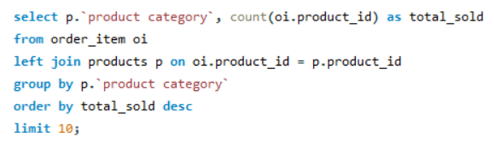
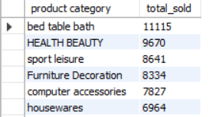
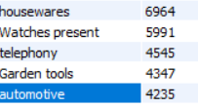
6. Find the top 10 most sold product categories.
This query identifies the most popular product categories based on total items sold.
result

Slide 13
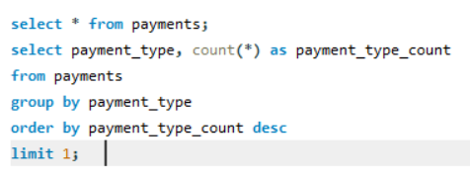

7. Find the most common payment type.
This query identifies the dominant payment methods to help businesses optimize the checkout process and design better promotional offers.
result

Slide 14
Business Insights
The platform has a strong customer base, indicating effective market reach.
Customer demand is concentrated in a few states, enabling targeted regional strategies.
Low repeat purchases highlight weak customer retention, requiring loyalty and engagement initiatives.
Order fulfillment is efficient, with deliveries far exceeding cancellations, though further optimization is possible.
Logistics performance and delivery speed directly impact customer satisfaction and reviews.
A few product categories drive most sales, making them key priorities for inventory and promotions.
Credit cards dominate payment methods, presenting opportunities for checkout optimization and card-based offers.

Slide 15
Conclusion
This project showcases the use of SQL for real-world retail data analysis, uncovering insights into customer behavior, order performance, product demand, delivery efficiency, and payment preferences. The findings highlight strong customer reach, low retention opportunities, efficient deliveries with scope for improvement, and the dominance of key product categories and payment methods, enabling data-driven business decisions.

Slide 16

THANK YOU

