Slide 1
24GHz-Radar for movement detection
System Driven Hardware Design
Presented by:
Nikita Anant Patil

Slide 2
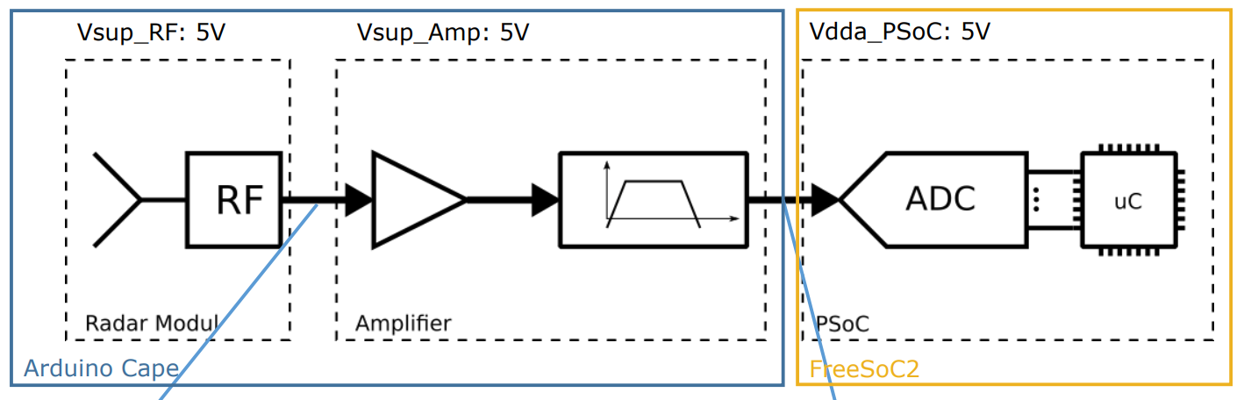

Slide 3
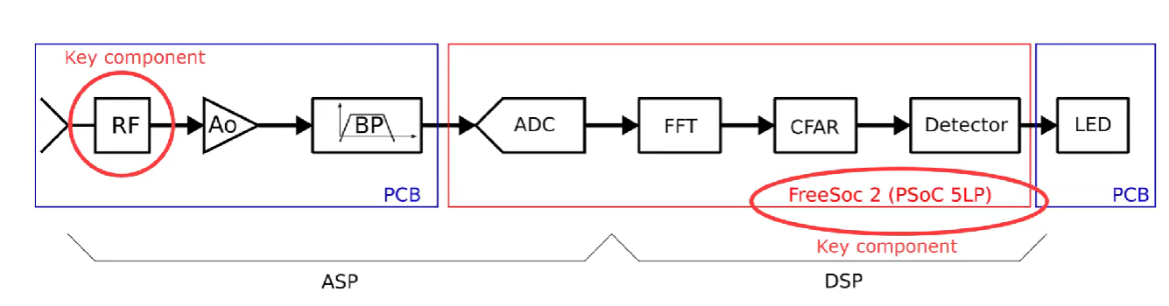
System function for the user: A 24 GHz radar detects movements and signals this by turning on a red LED, as long as a movement is detected.

Slide 4
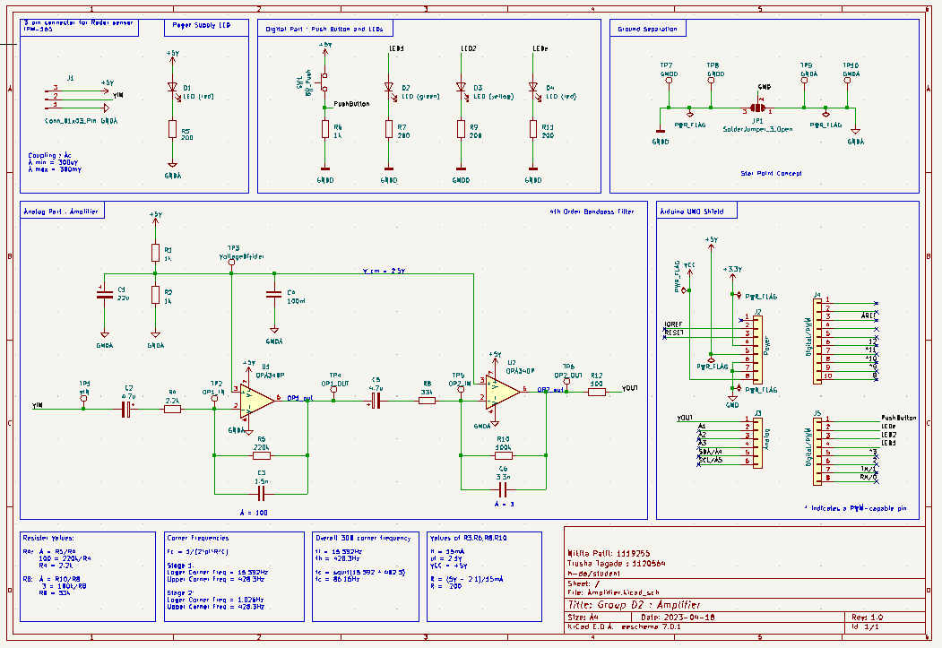

Slide 5
Analog Part : Amplifier (Calculations)
Resister value:
R4:-
A = R5/ R4
100 = 220k/ R4
R4 = 2.2k
R8:-
A = R9/ R8
3 = 100k/ R8
R7 = 33k
Corner Frequencies:
Fc = 1/ (2*pi*R*C)
Stage1 :
Lower Corner Freq = 15.392 Hz
Upper Corner Freq = 428.3 Hz
Stage 2:
Lower Corner Freq = 1.026 Hz
Upper Corner Freq = 428.3 Hz
Overall 3DB corner frequency:
fl = 15.392 Hz
fh = 428.3 Hz
fc = squrt ( 15.392 * 482.3 )
fc = 86.16 Hz

Slide 6
Digital part : Push buttons and LEDs (calculations)
Values of R6, R7, R9, R11 :-
If = 15mA
uf = 2.1V
VCC = +5V
R = (5V - 2.1)/15mA
R = 194k
R = 200k ( standard value as per E24 pdf )

Slide 7
Components Placing

Slide 8
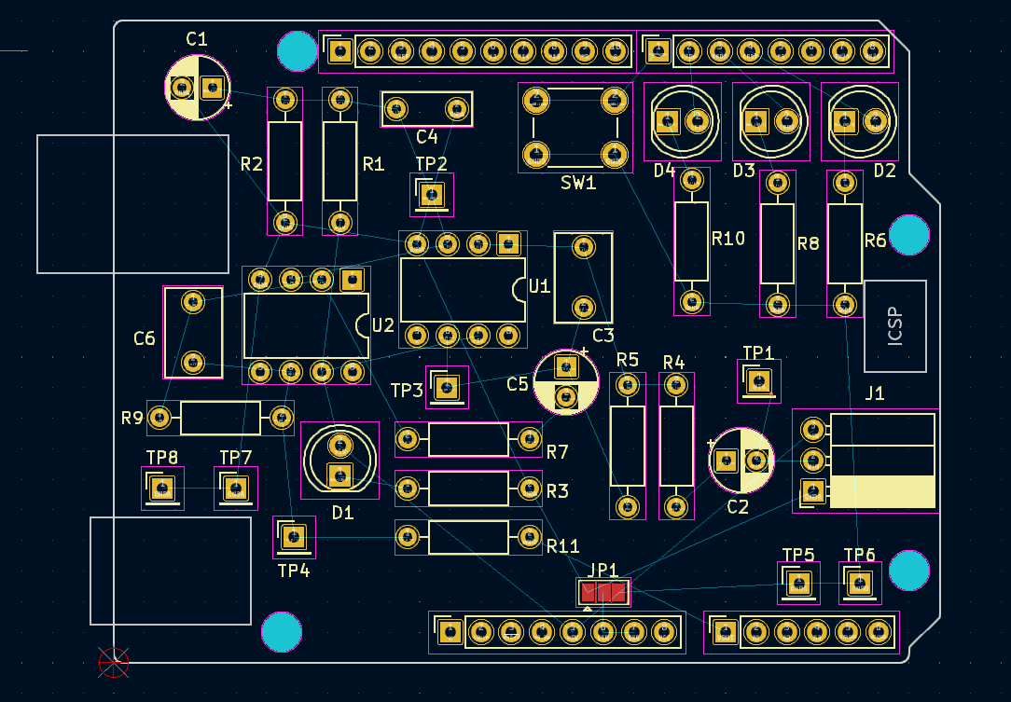

Slide 9
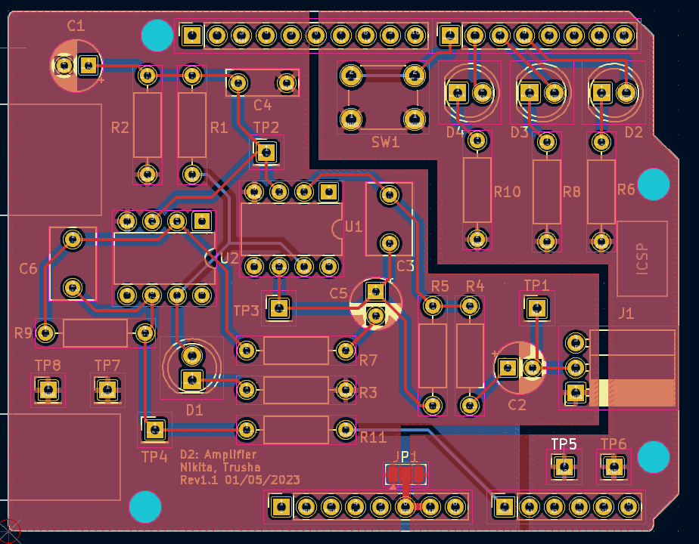

Slide 10
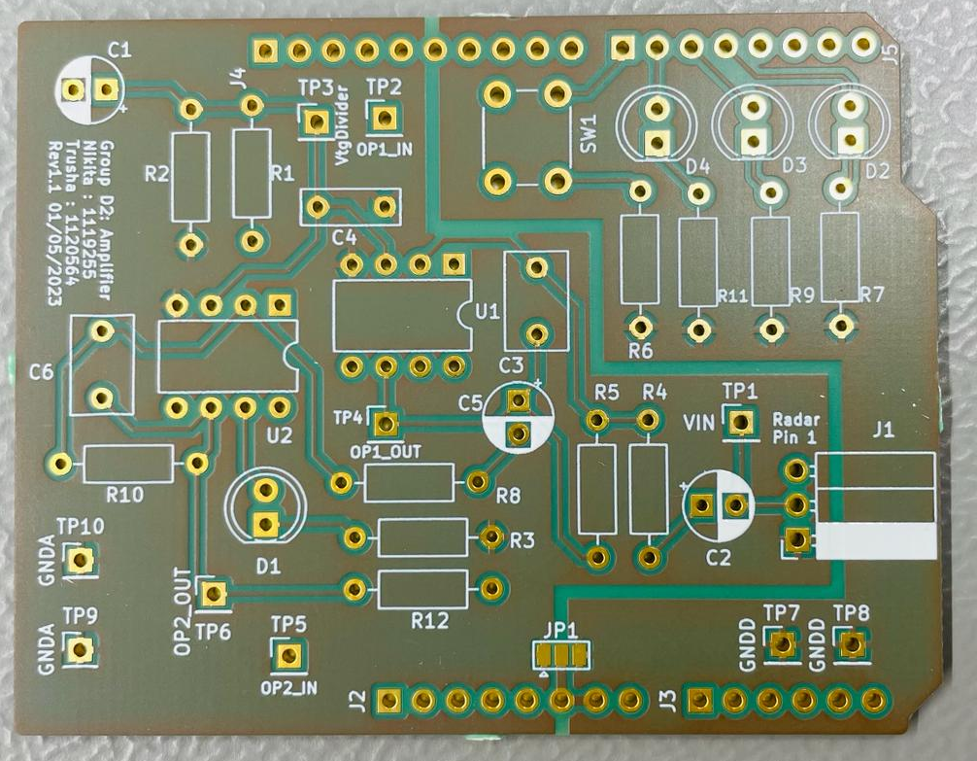
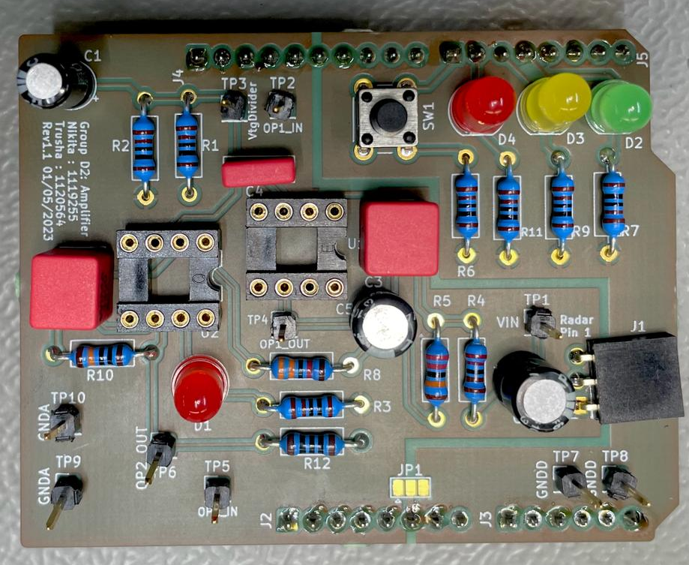

Slide 11
Software Development Assignment
SDHD : LAB 3

Slide 12
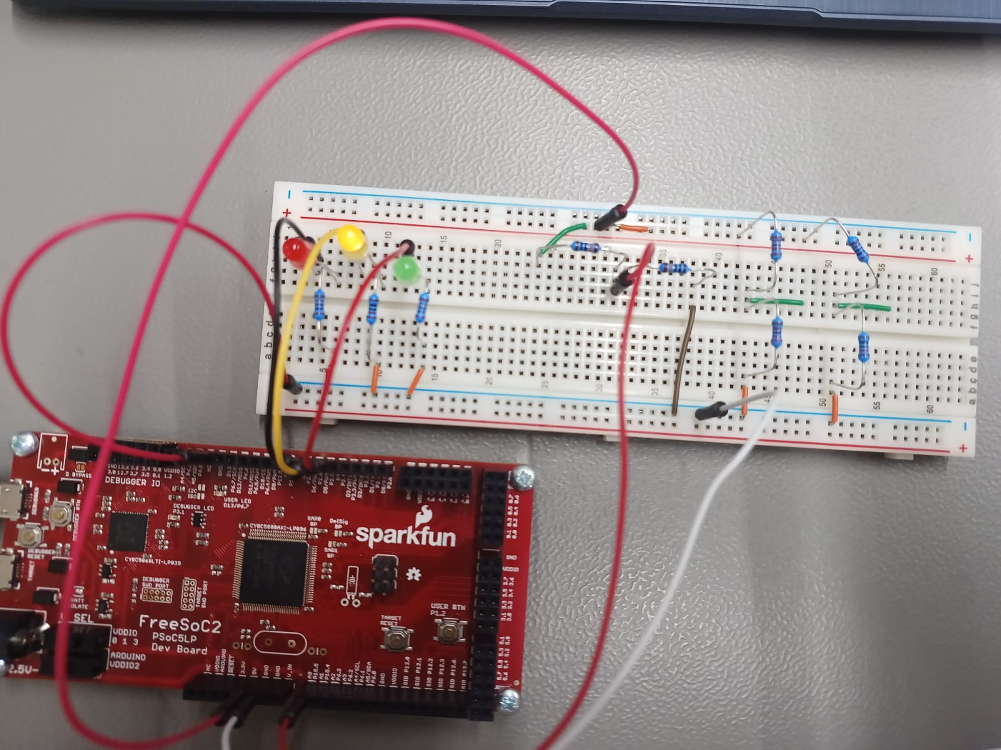
Testing ADC

Slide 13
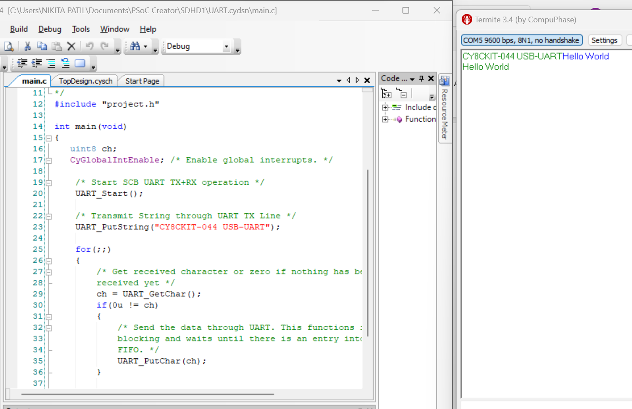
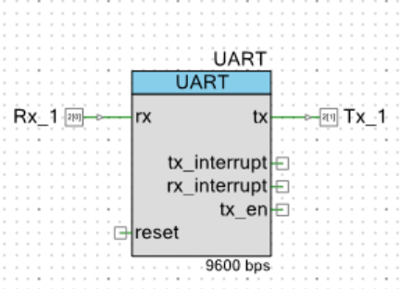
Testing UART

Slide 14
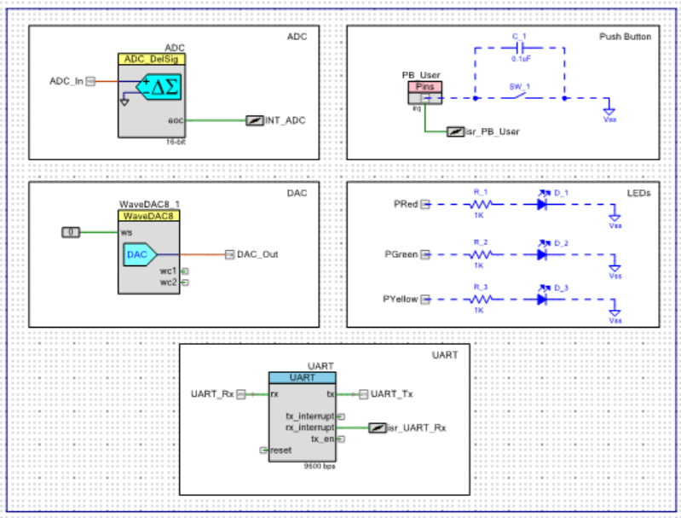

Slide 15
State Machine Implementation

Slide 16
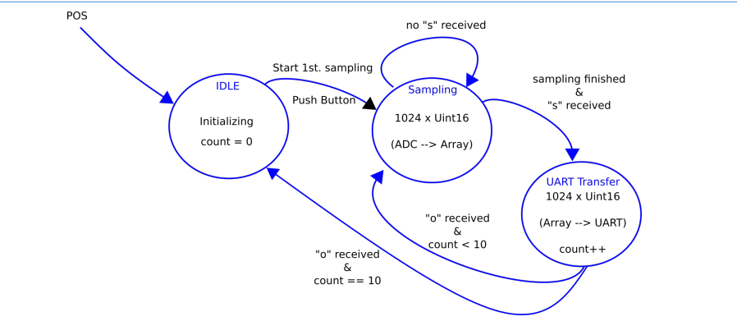

Slide 17
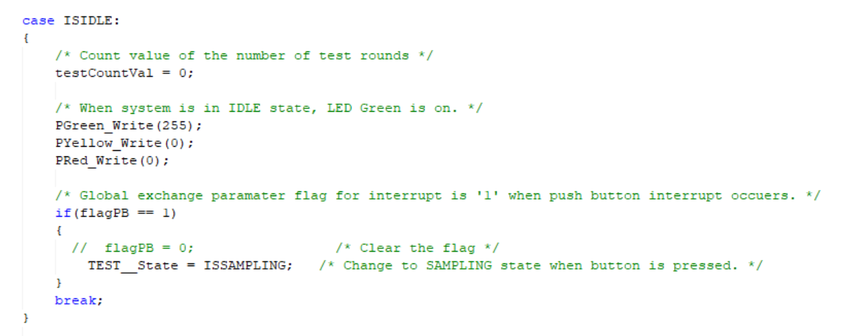
Idle State

Slide 18
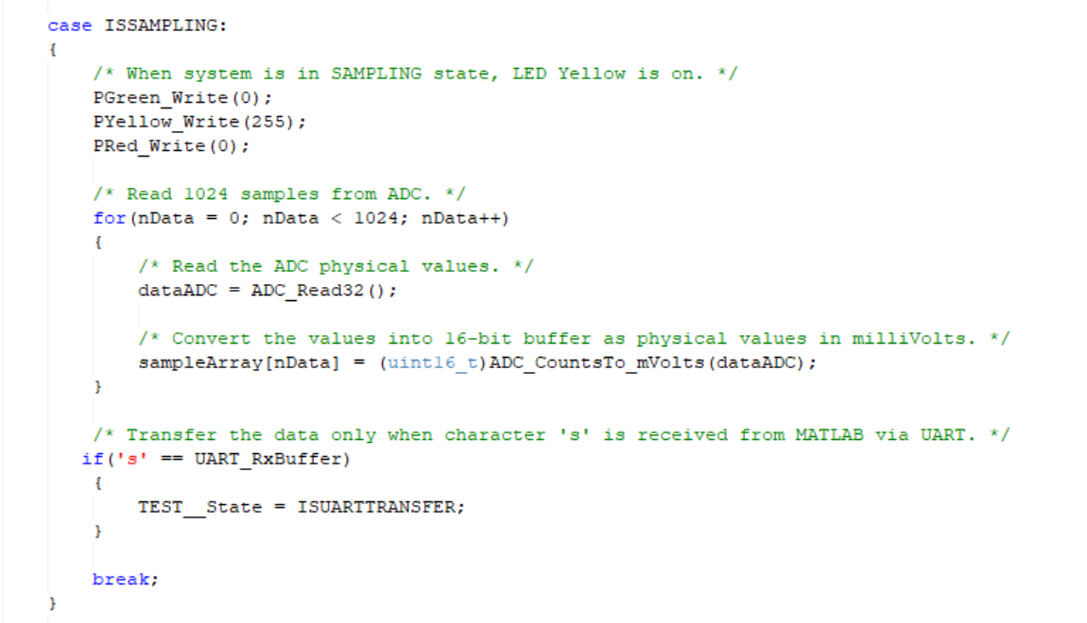
Sampling State

Slide 19
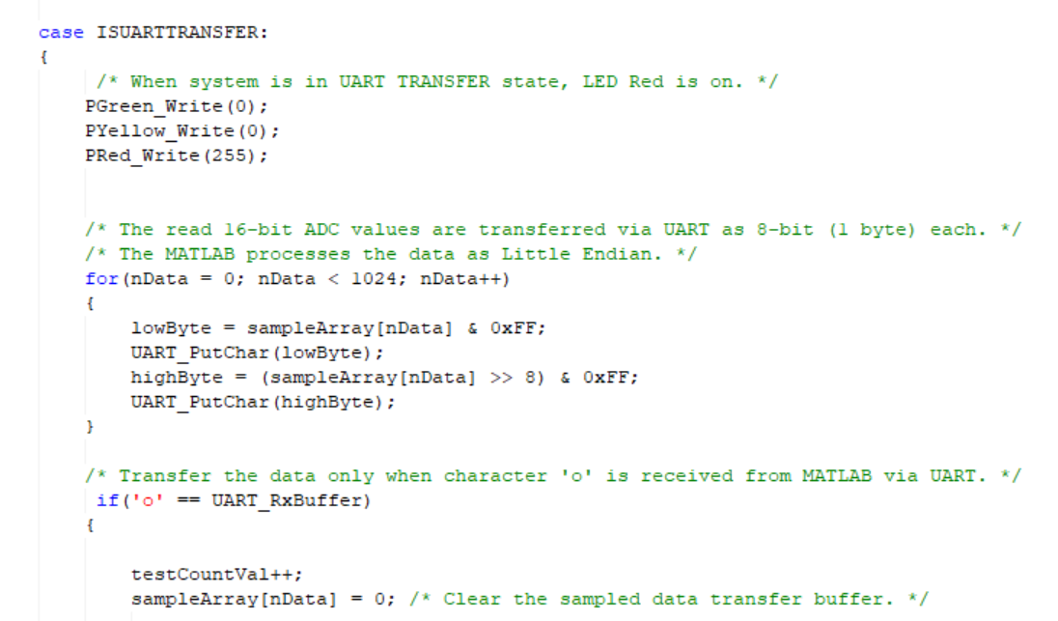
UART Transfer State

Slide 20
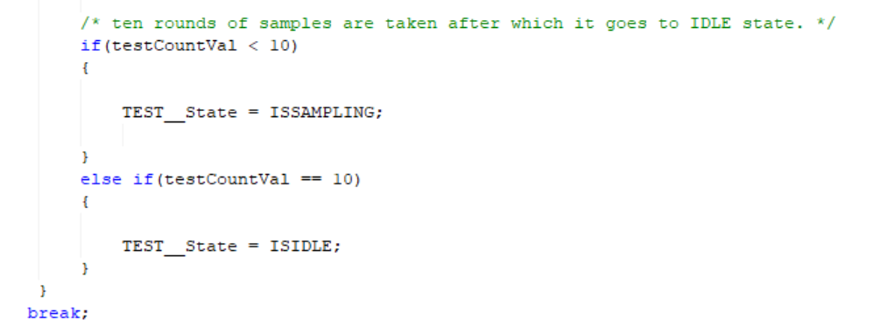

Slide 21
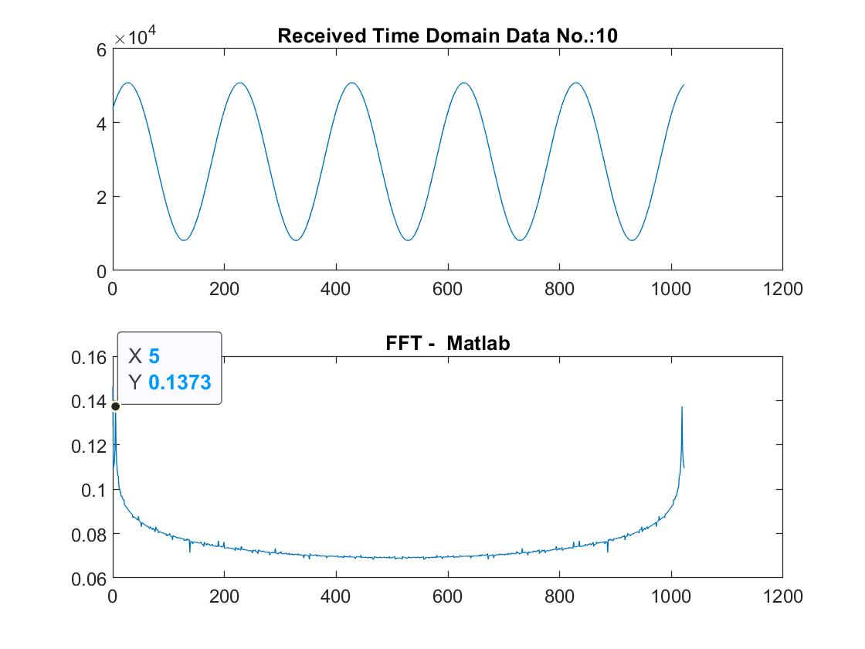

Slide 22
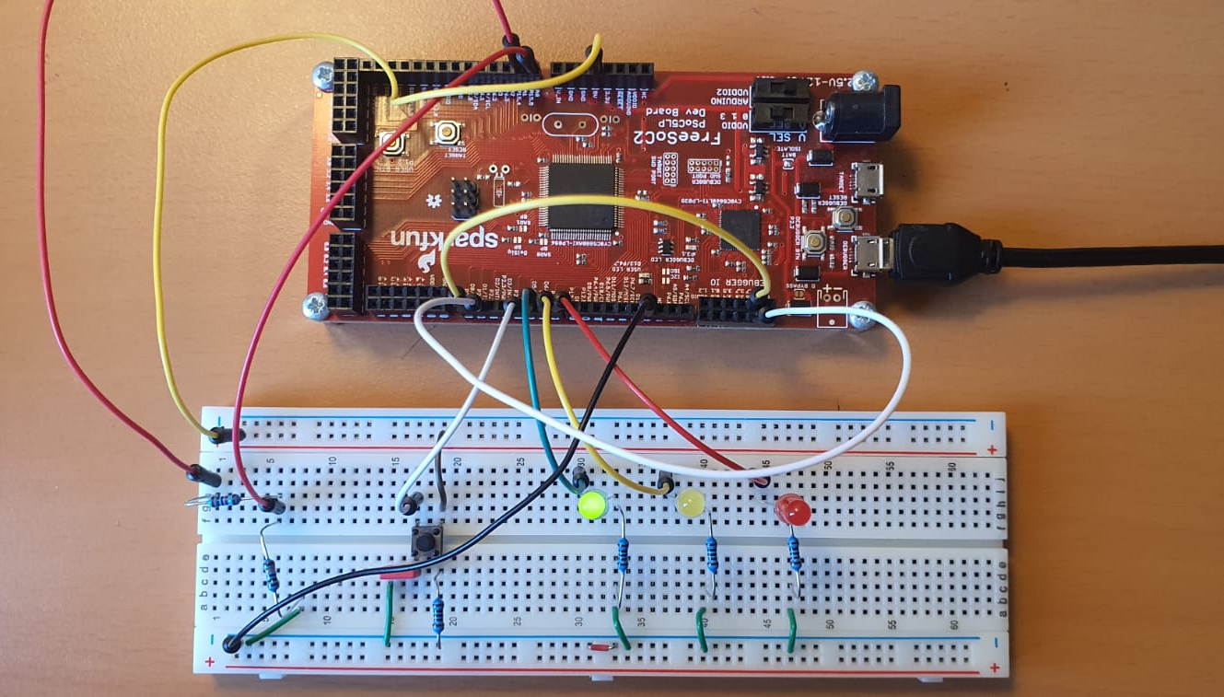

Slide 23
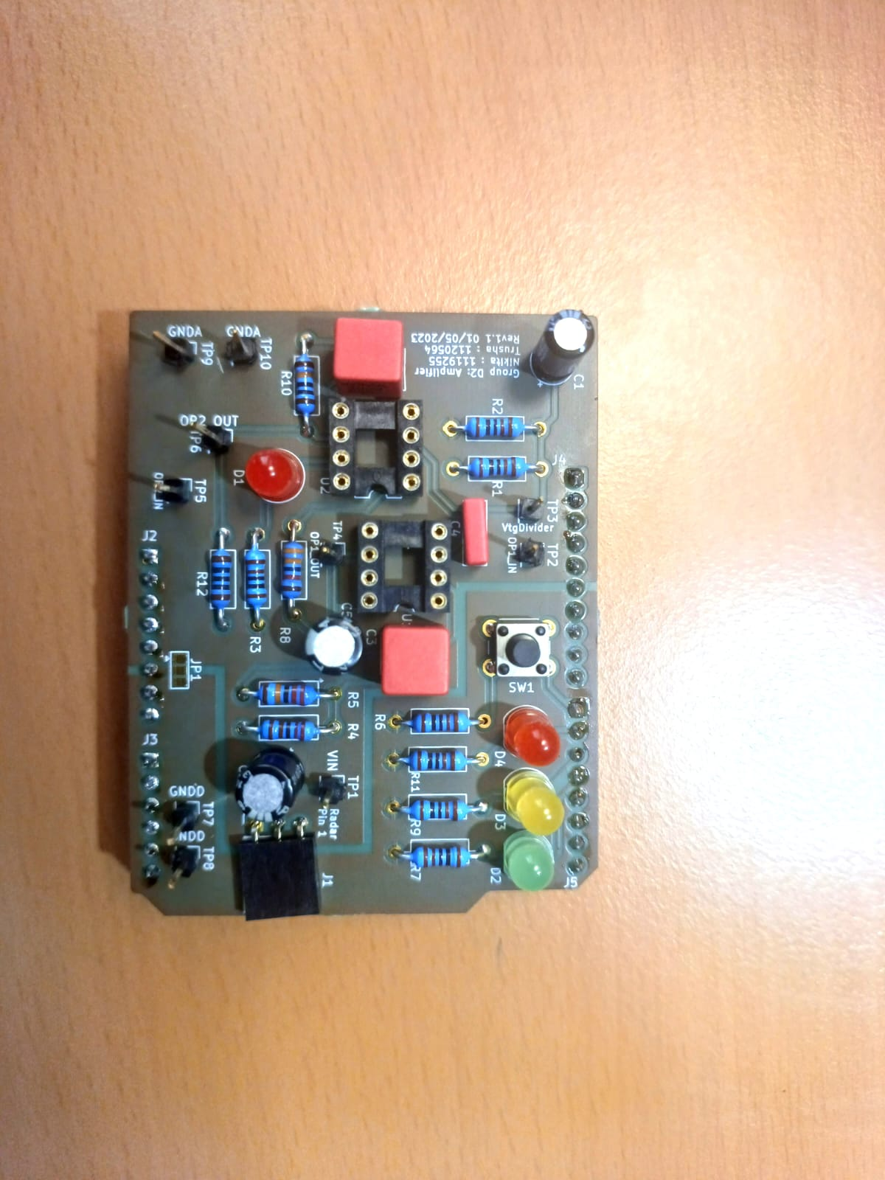
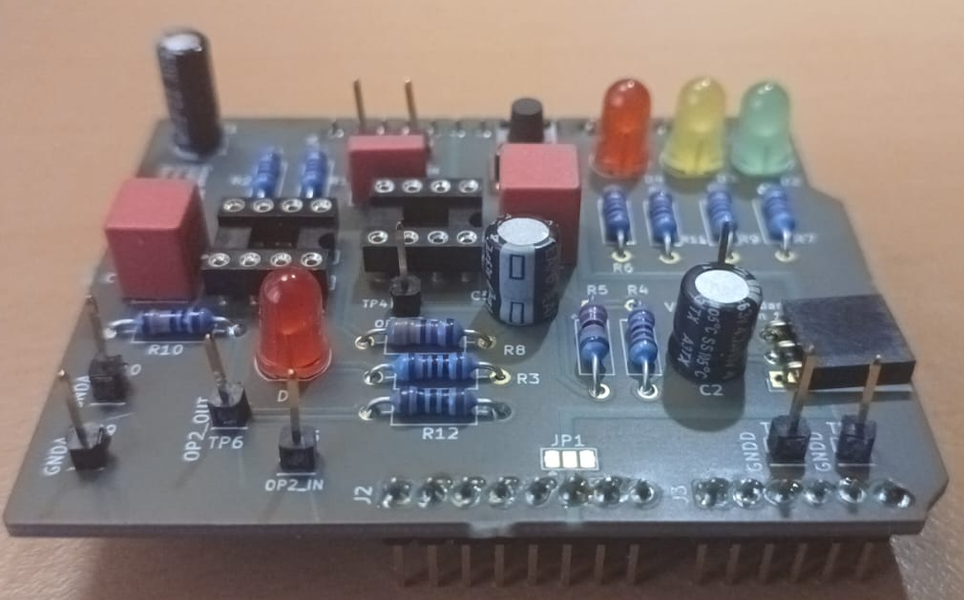
PCB

Slide 24
Testing

Slide 25
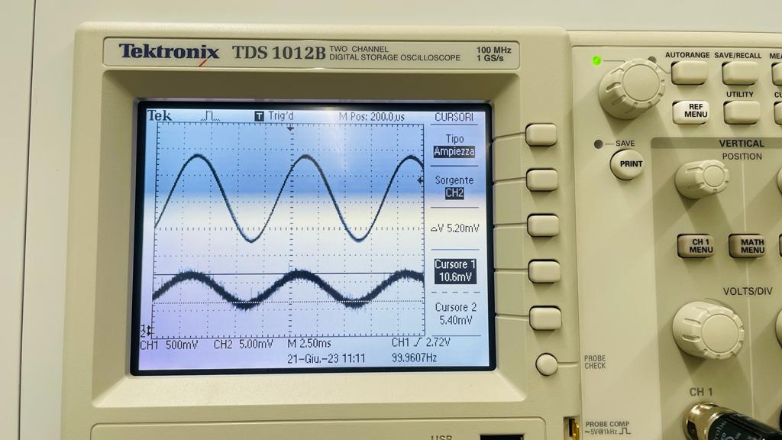

Slide 26
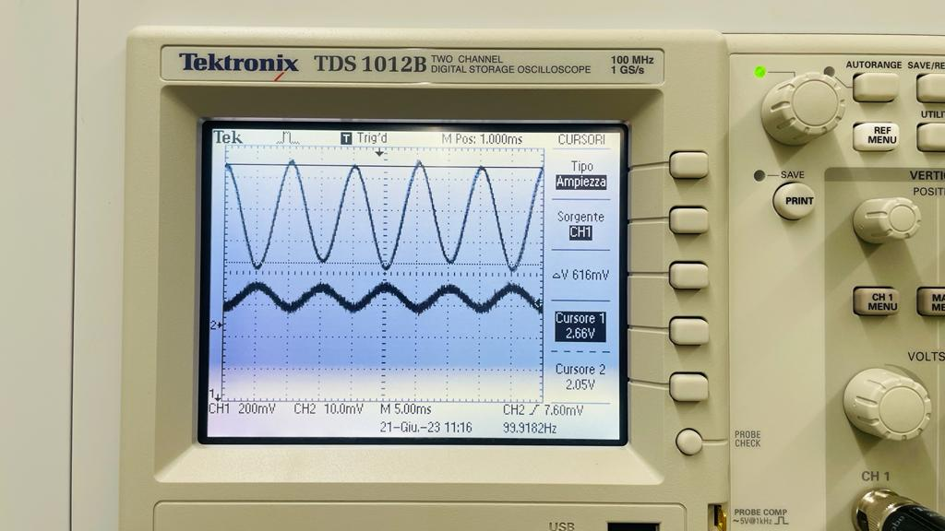

Slide 27
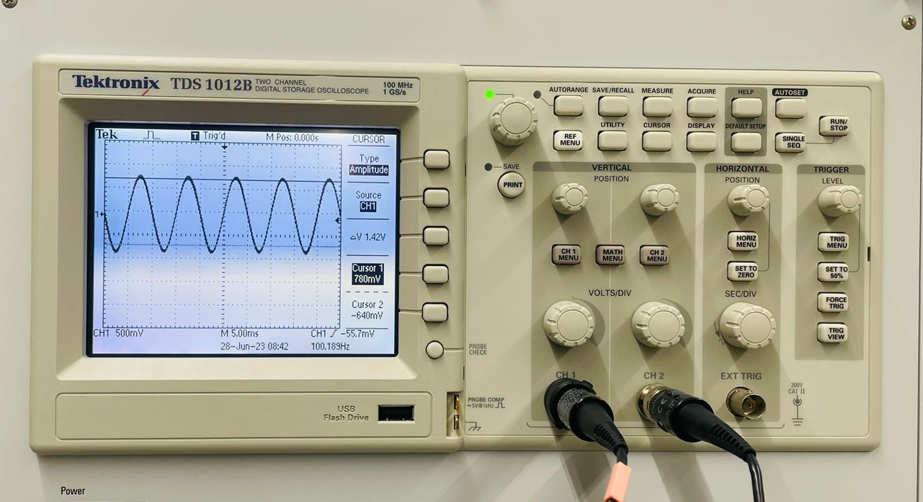

Slide 28
Corner Frequencies:
Lower Corner Freq = 18.39 Hz
Upper Corner Freq = 300 Hz

Slide 29
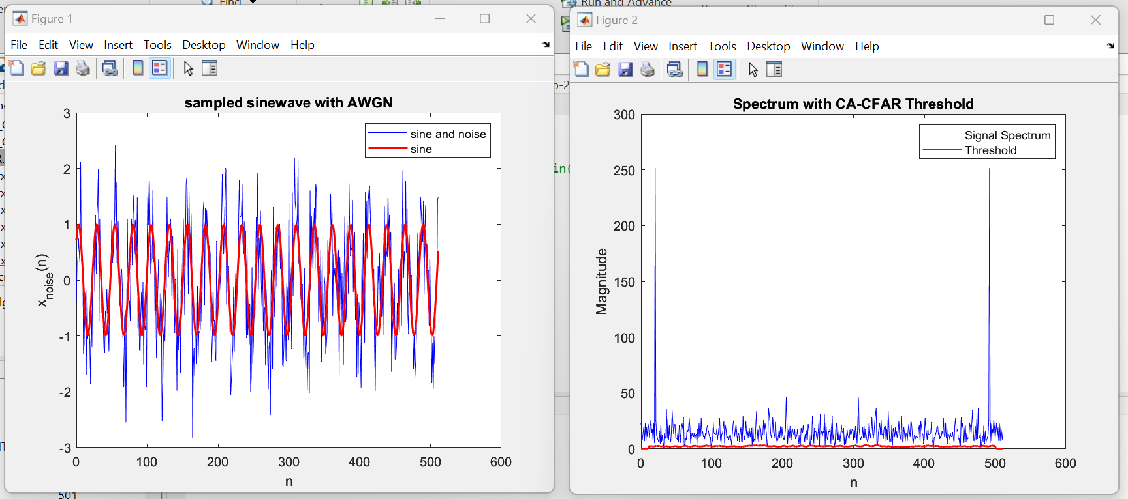
CFAR

Slide 30
Thank You

