Slide 1
Eamus!
Guideline

Slide 2

Eamus! presentation
This presentation will walk you through the process of starting the ship
This will be required for final presentation
Please pay attention, as you will have to remember all of this

Slide 3


Main menu
Level selector menu
This will open help menu
This will exit the game
Close this window
Space level
Airport level

Slide 4
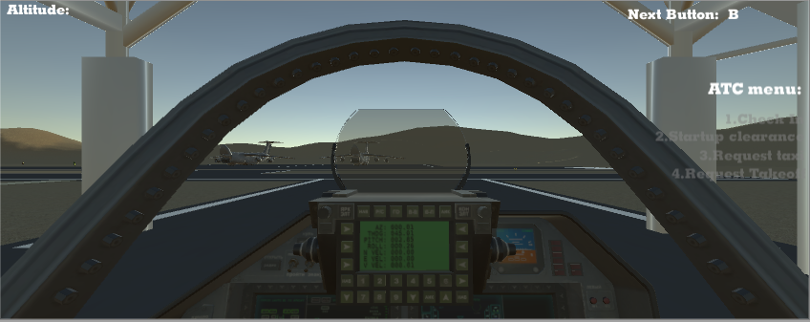
Airport Level
This will probably stay in final build
Underneath Engine temp will be visible when
Preheat is on, min temp is 200C
Altitude level
ATC menu
Usually hidden
Visible after
Backslash
Is pressed

Slide 5
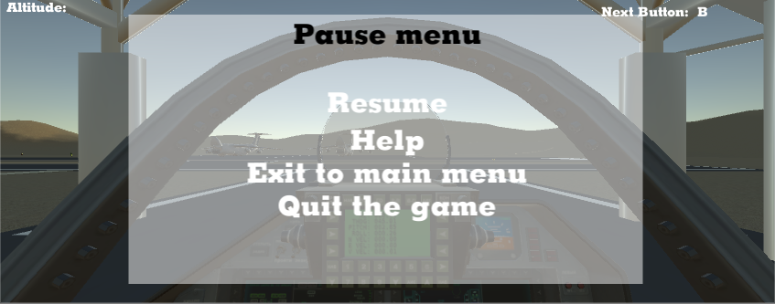
Escape menu
This menu will pause the game, nothing should happen while this menu is open
This will resume the game
Help menu
Closes current scene
And opens main menu
Exits the game completely

Slide 6
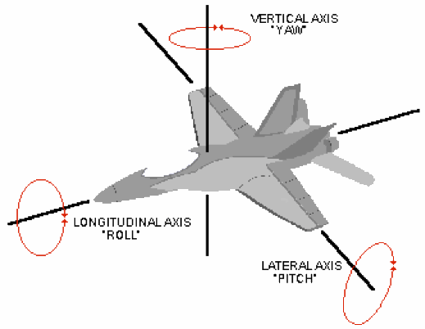
Input Commands
This part is complicated, but try to learn this
Basic controls
Esc, opens escape menu
Backslash, Opens ATC menu
Q/E Yaw
W/S Pitch
A/D Roll
Z/X Thrust

Slide 7
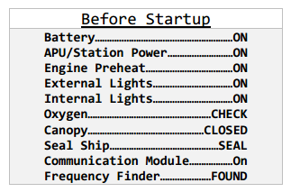
Start Up w/ keyboard
This will only be required in Emergency situation, but lets cover this
All of them will be in order, lets start with 1st section
Battery On/Off Input(B).
Power On/Off Input (P).
Preheat On/Off Input (num0).
External Lights On/Off Input (1).
Internal Light On/Off Input (2).
Canopy Close/Open Input (C).
Canopy Lock/Unlock Input (V).
Communication Module On/Off input (H).
Frequency Found (F)
After frequency found Contact the ATC and check-in(Important!). Without this you cannot start the Reactor.

Slide 8
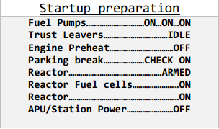
Continue
This section will cover the StartUp preparation
3 Fuel Pumps On/Off Input(num1,num2,num3) In order.
Reactor Armed On Input(num4), in order to do this Preheat(OFF).
Reactor Fuel cells Input(num5).
Reactor On/Off Input(num6), Power(OFF).
Contact the ATC again, with engine start clearance.

Slide 9

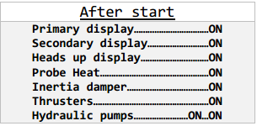
Continue
This will cover few sections
After ATC cleared engine start, Unlock the engine (L).
Engine start Input(K).
Second section is After start
PFD(Primary flight Display) On/Off Input(num7).
SFD On/Off Input(num8).
HUD(Heads Up Display) On/Off Input(num9).
Probe heat On/Off Input(7).
2 Hydraulic Pumps On/Off Input (4,5) In Order.

Slide 10


Final Section
This will cover Before takeoff and After takeoff sections
Landing Lights On/Off Input(6).
Contact the ATC for Taxi clearance.
If in space Thrusters On/Off Input(3).
Parking break On/Off Input(R).
Contact the ATC for Takeoff clearance.
And last after takeoff
Gear Up/Down Input(G).
Inertia Damper On/Off Input(I).

