Slide 1
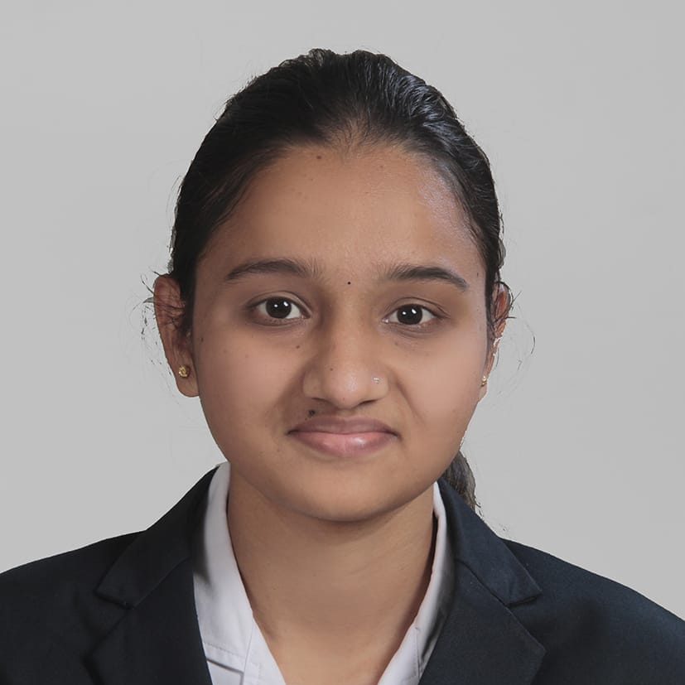

Nikita Sanjay Punde
Sr. Analyst/Software Engineer
Bachelor in Electronics and Telecommunication : 2018-22
Skills
MUMBAI
nikita.punde@capgemini.com
C# | Basics, OOPS, Arrays ,Loops.
.NET Framework | ADO.NET, WEB API, Entity Framework , ASP .NET with MVC.
Database | SQL
Tools | VISUAL STUDIO,SSMS.
UI Technology | HTML ,CSS, JavaScript
Add On Skills | Communication Skills, Team Management
+91 9075785433
A4
Full Stack Developer
Hands on experience on c#, ADO.NET, SQL Server, ASP.NET MVC with WEBAPI
Knowledge on creating Single page web application
Hands on experience in developing web pages using HTML, CSS, JavaScript
Having knowledge on Git and GitHub
Attended training in iTransform-Microsoft.Net
GitHub Link
Developed a WEB APPLICATION as part of case study using .NET WEBAPI , & ANGULAR.
Developed a case study on Roll-Off project by using Web API , SQL Server management studio, User Interface created using HTML, CSS, JavaScript
Tools used Platform:
Visual Studio Google
VS Code

