Slide 1
Stock Market Prediction
RNS INSTITUTE OF TECHNOLOGY
BENGALURU - 98
DEPARTMENT OF INFORMATION SCIENCE & ENGINEERING
Presentation on Internship
NIKITA PYATI PADMACHANDANA N
USN: 1RN19IS095 USN:1RN19IS097

Slide 2
AGENDA
Abstract
About the Company
Introduction
Literature Survey
Requirements
System Design
Detailed Design
Implementation
Results
Conclusion and Future Enhancements
References

Slide 3
ABSTRACT
A stock market is a public market where you can buy and sell shares for publicly listed companies. The stocks, also known as equities, represent ownership in the company. The stock exchange is the mediator that allows the buying and selling of shares.
Stock price analysis has been a critical area of research and is one of the top applications of machine learning. This tutorial will teach you how to perform stock price prediction using machine learning .

Slide 4
ABOUT THE COMPANY
NASTECH – New Age Solutions & Technologies
NASTECH is formed with the purpose of bridging the gap between Academia and Industry.
Nastech is one of the leading Global Certification and Training service providers for technical and management programs for educational institutions.
They collaborate with educational institutes to understand their requirements and form a strategy in consultation with all stakeholders to fulfill those by skilling , reskilling and upskilling the students and faculties on new age skills and technologies.
Industry and project oriented student training programs.
Certification programs mapped to Global Certification Exams from Microsoft/EC- Council/Google/AWS/ Adobe).

Slide 5
INTRODUCTION
Stock Price Prediction using machine learning helps you discover the future value of company stock and other financial assets traded on an exchange. The entire idea of predicting stock prices is to gain significant profits. Predicting how the stock market will perform is a hard task to do. There are other factors involved in the prediction, such as physical and psychological factors, rational and irrational behavior, and so on. All these factors combine to make share prices dynamic and volatile. This makes it very difficult to predict stock prices with high accuracy.

Slide 6
LITERATURE SURVEY
In this literature review, we investigate machine learning techniques that are applied for stock market prediction.
[1] A focus area in this literature review is the stock markets investigated in the literature as well as the types of variables used as input in the machine learning techniques used for predicting these markets.
[2] An extensive examination of the data, in particular, the markets and stock indices covered in the predictions, as well as the 2173 unique variables used for stock market predictions, including technical indicators, macro-economic variables, and fundamental indicators.

Slide 7
LITERATURE SURVEY
[3] an in-depth review of the machine learning techniques and their variants deployed for the predictions. In addition, we provide a bibliometric analysis of these journal articles, highlighting the most influential works and articles.

Slide 8
REQUIREMENTS
HARDWARE REQUIREMENTS
Processor : Any Processor above 500 MHz
RAM : 512Mb
Hard Disk : 4 GB
Input device : Standard Keyboard and Mouse
Output device : VGA and High Resolution Monitor
SOFTWARE REQUIREMENTS
Operating system : Windows 10
IDE : Jupyter Notebook, Google Colab
Tools/Technologies : Python, Pandas, Numpy ,Matplotlib, Yahoo finance API,fbProphet ,Streamlit

Slide 9
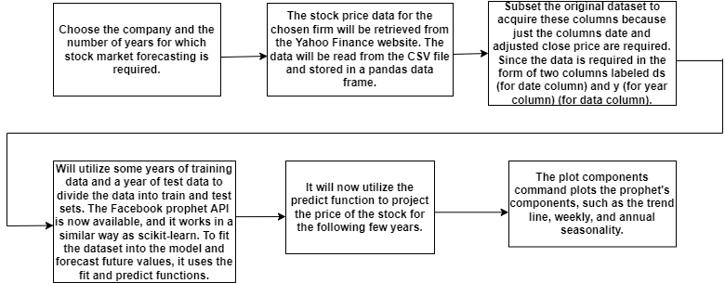
SYSTEM DESIGN

Slide 10
SYSTEM DESIGN
First Select the company and the time period for which stock market forecasting is needed. The chosen firm's stock price data will be taken from the Yahoo Finance website. The data from the CSV file will be read and stored in a pandas data frame. Only the columns date and adjusted close price are required, thus subset the original dataset to get these columns. Because the data must be entered in two columns, ds (for date column) and y (for year column) (for data column).
Then it will use some years' worth of data for training and a year's worth of data for testing, and will divide the data into train and test sets. The Facebook prophet API, which operates similarly to scikit-learn, is now available. The fit and predict functions are used to fit the dataset into the model and forecast future values
It will now use the predict function to forecast the stock's price for the next few years..
Plotting the prophet's components, including as the trend line, weekly, and annual seasonality, is done with the plot components command.

Slide 11
DETAILED DESIGN
1.Load the data
We’ll be using data from yahoo finance API and predict the values for future.
2.Selecting the specific data
Since we’ll be predicting the “Close” value, we shall only take “Date” and “Close” column.
3.Building the model
We instantiate the Facebook prophet API, this prophet API works similar to sklearn model. It uses the fit function to fit the dataset into the model and predict function to forecast future values.
4.Prediction
Now, for the last step, we will ask the model to predict future values and then visualize the predictions.

Slide 12
IMPLEMENTATION
%%writefile app6.py
import streamlit as st
from datetime import date
import yfinance as yf
from fbprophet import Prophet
from fbprophet.plot import plot_plotly
from plotly import graph_objs as go
START = "2010-01-01“
TODAY = date.today().strftime("%Y-%m-%d")
st.title('Stock Market Prediction’)
st.image('/content/stock.png',width=800)
st.write("Alphabet Inc.(Google) -- GOOG")
st.write("Apple Inc -- AAPL")
st.write("Microsoft Corporation -- MSFT")
st.write("Amazon.com, Inc. -- AMZN")
st.write("Meta Platforms, Inc. -- FB")
st.write("Tesla, Inc. -- TSLA")
stocks = ('GOOG', 'AAPL', 'MSFT', 'AMZN','FB','TSLA’)
selected_stock = st.selectbox('Select dataset for prediction', stocks)
n_years = st.slider('Years of prediction:', 1, 4)period = n_years * 365
@st.cache
def load_data(ticker):
data = yf.download(ticker, START, TODAY)
data.reset_index(inplace=True)
return data
data_load_state = st.text('Loading data...’)
data = load_data(selected_stock)
data_load_state.text('Loading data... done!’)
st.subheader('Raw data’)
st.write(data.tail())
# Plot raw data
def plot_raw_data():
fig = go.Figure()
fig.add_trace(go.Scatter(x=data['Date'], y=data['Open'], name="stock_open"))
fig.add_trace(go.Scatter(x=data['Date'], y=data['Close'], name="stock_close"))
fig.layout.update(title_text='Time Series data with Rangeslider’,
xaxis_rangeslider_visible=True)st.plotly_chart(fig)
plot_raw_data()

Slide 13
IMPLEMENTATION
# Predict forecast with Prophet.
df_train = data[['Date','Close’]]
df_train = df_train.rename(columns={"Date": "ds", "Close": "y"})
m = Prophet()
m.fit(df_train)
future = m.make_future_dataframe(periods=period)
forecast = m.predict(future)
# Show and plot forecast
st.subheader('Forecast data’)
st.write(forecast.tail())
st.write(f'Forecast plot for {n_years} years’)
fig1 = plot_plotly(m, forecast)
st.plotly_chart(fig1)
st.write("Forecast components")
fig2 = m.plot_components(forecast)
st.write(fig2)

Slide 14
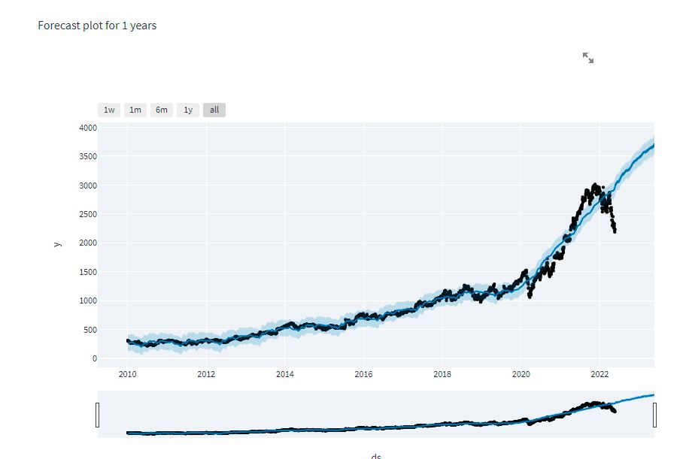
RESULTS
This emphasizes the importance of time in stock market forecasting. The model was trained and tested using time series data. The prophet library was used to extract important information, and the results were successful. Its capacity to deal with seasonality proved to be incredibly beneficial, reducing the uncertainty involved with stock market price forecasting. It was discovered that data closer to the current time had a substantial impact on prediction, implying that as time passes, prior stock values appear to be less important than current prices.

Slide 15
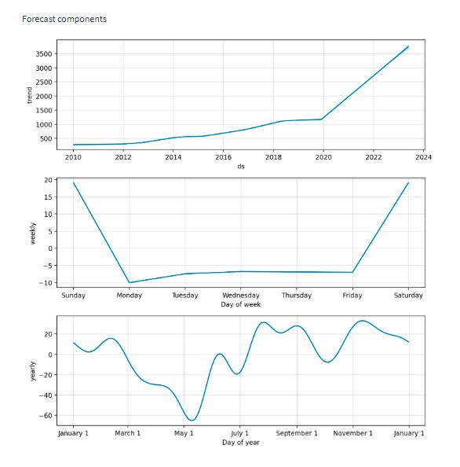
RESULTS

Slide 16
CONCLUSIONS
Living in a constantly evolving world, it has become a necessity to adapt to the world as change has become the norm. Harnessing the power of predicting the volatile stock market can bring some stability in an individual’s life. To do so requires the careful consideration of several factors, but the most important one of them all would be time. A novel method to exploit time of its insights is by employing the Prophet library. We concluded that historic data holds significance in terms of prediction and the closing price increased on certain months and days of the week. The complexity of time and the variance of seasonality has to be studied in depth in order to improve the existing models. Our future work would focus on studying the other impactful factors affecting the stock market and how best they can be integrated with time.

Slide 17
LIMITATIONS
With an understanding of what stock and the stock market is, let’s understand why people fascinate by a Machine Learning model that can predict the stock price. A Machine Learning model predicts the value of an observation based on several inputs that are predictors. The stock market is working similarly, i.e., based on several inputs, the stock price fluctuates. However, the bone of contention is that, unlike other problems that generally are predicted, the predictions of stock prices are rather complicated as it is often prey to the butterfly effect. Anything, any event in the outside world, can influence the price of the stock. These include political events, economic news, competitors or related stock movements, and other challenges such as rumor, anxiety, and other psychological factors. Capturing all these inputs makes stock market prediction challenging and Machine Learning a potential candidate for it. It can take a large number of inputs and assess the patterns and their relation to a dependent variable (the stock price).

Slide 18
FUTURE ENHANCEMENTS
The LSTM model, which is frequently used for similar reasons, might be constructed.
For maybe better outcomes, deep learning models could be constructed that consider financial news stories as well as financial characteristics such as a closing price, trading volume, profit and loss statements, and so on.
For a better understanding, comparisons between different companies could be made.
With better research and better tuning, more accurate results can be predicted. FB Prophet can be used to do efficient Time Series analysis, as it provides fast and simple to use methods for this purpose.

Slide 19
REFERENCES
[1]. Ballings, M, Dirk Van den Poel and Nathalie Hespeels, Ruben Gryp (2015). Evaluating multipleclassifiers for stock price direction prediction. Expert Systems with Applications, Elsevier Ltd.
[2]. Banco Santander dataset from Quandl website, https://www.quandl.com/data/EURONEXT/SANT
[3]. B. Cao, J. Zhao, Z. Lv, Y. Gu, P. Yang and S. K. Halgamuge (2020), Multiobjective Evolution of FuzzyRough Neural Network via Distributed Parallelism for Stock Prediction, IEEE Transactions on FuzzySystems, Volume 28.
[4]. D. Cabrera, R. Rubilar and C. Cubillos (2019). Resilience in the Decision-Making of an ArtificialAutonomous System on the Stock Market, IEEE Access, Volume 7.
[5]. D Peng (2019). Analysis of Investor Sentiment and Stock Market Volatility Trend Based on Big DataStrategy, International Conference on Robots & Intelligent System (ICRIS), Haikou, China

Slide 20
THANK YOU

