Slide 1
US Privacy Compliance Program
Consumer-Facing Toolkit for Websites and Mobile Apps
January 27, 2020
Rick Kanemasu
Beau Dunn
DIGITAL PLATFORMS
AND INNOVATION

Slide 2
Purpose of Document
This document (“Consumer-Facing Toolkit for Websites and Mobile Apps”) was created for the U.S. Privacy Compliance Program in 2019. With the new California Consumer Protection Agency (CCPA) law going into effect on January 1, 2020, new requirements were established for all CCNA websites and mobile apps. This document defines the changes that are required.

Slide 3
Table of Contents
US Privacy Compliance Program Explanation | 3
Website Requirements | 9
Mobile App Requirements | 14
FAQ | 17

Slide 4
United States Privacy Compliance Program - Explanation
The California Consumer Privacy Act (CCPA) went into effect on January 1, 2020.
The act gives California residents additional consumer rights pertaining to how companies utilize and share their data.
While the act only applies to California residents, TCCC will extend privacy rights to all consumers within the US. Hence the program name “US Privacy Compliance Program.”

Slide 5

USPCP – What Constitutes Legal Compliance
KEY REQUIREMENTS
Include “Do Not Sell My Personal Information” button on websites | Must provide consumers “opt-out” to prohibit sale or transfer of their personal information to a third party. Must avoid requesting opt-in consent for 12 months after a consumer opts out.
Provide at least two methods for receiving consumer requests | Web site Toll-free number
Respond to consumer requests, free-of-charge, within 45 days in portable format | Consumers can request access, deletion, and portability of their data – going back 12 months in time
Do not discriminate against consumers | Cannot deny goods or services, charge different prices, provide a different level of quality, etc. if consumer exercises rights
Provide certain disclosures/notices to consumers | Notices must include what is being collected, why it’s being collected, how it’s being used, who it’s being shared with, what is being sold, how to opt-out (processing or sale), how to request deletion, etc.
Get correct consent from minors | Parental consent needed for minors under 13 years of age. Opt-in consent from the minor if under 16 years of age.
Train employees | Specific individuals/groups responsible for responding to individual rights requests and anyone responsible for complying with the law

Slide 6
Consumer Now Have the Ability To:
Request the information businesses have collected on them
Object to having their data sold/shared
Request and receive data that is collected on them in a portable format
Ask businesses to delete their personal data
Hold companies accountable for the safeguarding of personal information

Slide 7
Consumer-Facing Asset Updates: Websites
In order to ensure that all consumer-facing websites are compliant, TCCC is requiring the following steps:
Footer Links. Add standard footer links for Privacy, Terms of Use and “Do Not Sell My Personal Information”
Privacy Banner. Add a privacy banner that informs consumers of our tracking practices and gives them access to additional information (e.g. Terms of Use, Privacy Policy)
Registration. Ensure that all registration/sign-up pages support explicit consent
IRM Assessment Process. Ensure that all sites complete a Risk Intake Questionnaire and go through the IRM Assessment Process

Slide 8
Consumer-Facing Asset Updates: Mobile Apps
In order to ensure that all consumer-facing mobile apps are compliant, TCCC is requiring the following steps:
Privacy Portal. Ensure that all mobile apps provide access to the Privacy Portal. Link needs to be located no more than 2 clicks away from the app home screen
Do Not Sell My Personal Information. Ensure that all mobile apps provide a link titled “Do Not Sell My Personal Information” that points to the Privacy Portal. This link needs to be on the app home screen. It can be a menu option (as opposed to a link)
Privacy Policy & TOU. Ensure that all mobile apps provide links to the correct Privacy Policy and Terms of Use Agreement
Registration. Ensure that all registration/sign-up capability supports explicit consent
IRM Assessment Process. Ensure that all mobile apps complete a Risk Intake Questionnaire and go through the IRM Assessment Process

Slide 9
Table of Contents
US Privacy Compliance Program Explanation | 3
Website Requirements | 9
Mobile App Requirements | 14
FAQ | 17

Slide 10
Site Updates: Footer Links
Explanation:
Expectations:
Steps to Complete:
The following footer links need to get added to your site(s): Link Verbiage: Privacy URL: https://us.coca-cola.com/privacy-policy/ Link Verbiage: Do Not Sell My Personal Information URL: https://us.coca-cola.com/privacy-policy#rights Link Verbiage: Terms of Use URL:https://us.coca-cola.com/terms-of-use/ | All consumer-facing sites are updated with the appropriate footer links | Engage IT counterpart and/or managing agency to communicate the needs Make specified changes in test Publish to production

Slide 11
Site Updates: Privacy Banner
Explanation:
Expectations:
Steps to Complete:
Privacy Banner is needed in order to disclose TCCC’s tracking activities and give consumers access to additional information. | Site Owners will work with Global MDS team (Morgan Yates) to add OneTrust Privacy Banner (JavaScript snippet) onto their site(s). This will require site development and coordination with the global team. | Identify all sites that need the banner (any consumer-facing US site) Contact Morgan Yates (morgan@coca-cola.com) to get a code snippet created Retrieve Privacy Banner code snippet from Box Place OneTrust JavaScript snippet onto site Publish website

Slide 12
Site Updates: Registration (Explicit consent)
Explanation:
Expectations:
Steps to Complete:
The law requires that we obtain explicit consent from minors age 13-15 prior to registration This involves updating registration/sign-up pages to require 13-15 year old users to check a box that notes agreement with Terms of Use and Privacy Policy. The Terms of Use and Privacy Policy agreement checkbox can not be pre-checked. TCCC is going to require all users to check the box in order to complete registration | If your site supports user login/registration, you MUST require ALL users to explicitly agree to the Privacy Policy and Terms of Use. The agreement must be explicit, meaning that user must actively accept (check a box) in order to register on the site. The following language should be included next to the checkbox “By checking this box, you are confirming your acceptance of the Coca-Cola company Terms of Use and Privacy Policy” Users that registered prior to this change will need to explicitly agree to the Privacy Policy and Terms of use upon logging in | Confirm understanding of requirements Work with your IT support team to make specified updates Publish to production

Slide 13
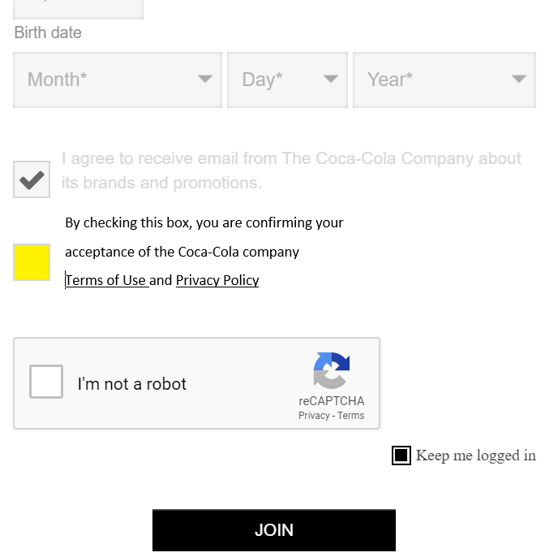
Registration (Explicit consent) - Example

Slide 14
Table of Contents
US Privacy Compliance Program Explanation | 3
Website Requirements | 9
Mobile App Requirements | 14
FAQ | 17

Slide 15
Mobile App Updates: External Links
Explanation:
Expectations:
Steps to Complete:
The following links need to get added to your app: Link Verbiage: Privacy URL: https://us.coca-cola.com/privacy-policy/ Link Verbiage: Do Not Sell My Personal Information URL: https://us.coca-cola.com/privacy-policy#rights Link Verbiage: Terms of Use URL:https://us.coca-cola.com/terms-of-use/ | The app DOES NOT need an overt privacy notification banner. The app DOES need to link to the Privacy Portal from the home screen (no more than 2 clicks away). The app DOES need to have a “Do Not Sell My Personal Information” button on the home screen (can be in the menu). | Engage IT counterpart and/or managing agency to communicate the needs Make mobile app updates in test Publish changes to production

Slide 16
Mobile App Updates: Explicit consent
Explanation:
Expectations:
Steps to Complete:
The law requires that we obtain explicit consent from minors age 13-15 prior to registration This involves updating registration/sign-up pages to require 13-15 year old users to check a box that notes agreement with Terms of Use and Privacy Policy. The Terms of Use and Privacy Policy agreement checkbox can not be pre-checked. TCCC is going to require all users to check the box in order to complete registration | If your site supports user login/registration, you MUST require ALL users to explicitly agree to the Privacy Policy and Terms of Use. The agreement must be explicit, meaning that user must actively accept (check a box) in order to register on the site. The following language should be included next to the checkbox “By checking this box, you are confirming your acceptance of the Coca-Cola company Terms of Use and Privacy Policy” Users that registered prior to this change will need to explicitly agree to the Privacy Policy and Terms of use upon logging in on or after 12/1/2019 | Confirm understanding of requirements Work with your IT support team to make specified updates Publish to production

Slide 17
Table of Contents
US Privacy Compliance Program Explanation | 3
Website Requirements | 9
Mobile App Requirements | 14
FAQ | 17

Slide 18
Frequently Asked Questions
No. | Question | Answer
1 | Do I need to have the Privacy Notifications if my site doesn’t collect any Personal Information? | Yes, all websites and mobile apps that are consumer-facing (i.e., a U.S. consumer can reach the site and want to use it) are within scope. If the website or mobile app is targeted for a non-U.S. country, it is not within scope. If it a global website or mobile app and many users are from the U.S., it is within scope.
2 | How do I get a code snippet for the Privacy Banner? | Contact Morgan Yates. OneTrust Consent banner scripts that have been created for all websites at CCNA can be found on Box here: https://coke.box.com/s/pokh5gl81ufdqchi7ktz4u7mzyc0b1k4
3 | When is the explicit consent question required? | The law requires that we obtain explicit consent from minors age 13-15 prior to registration. This involves updating registration/sign-up pages to require 13-15 year old users to check a box that notes agreement with Terms of Use and Privacy Policy. For sites that just have a Contact Us page, explicit consent is not required.
4 | Do I have to get explicit consent from consumers who are already registered? | Yes. For sites already live, you will have to get explicit consent for consumers (e.g., members) who registered but were not served up the explicit consent. You may either email them a link to update their consent or have them get the consent question the next time they logon.

