Slide 1


Consumer Goods Ad-hoc Insights
Created by- Nikita Surve

Slide 2
Background/ Context
Company Overview:
Atliq Hardware is one of the leading computer hardware producers in India and well expanded in other countries too.
However, the management noticed that they do not get enough insights to make quick and smart data-informed decisions.
Problem:
There are 10 ad-hoc requests for which the company needs insights
Approach:
Run a SQL query to answer these requests. Convert it into visualizations and present the Insights to the toplevel management.

Slide 3
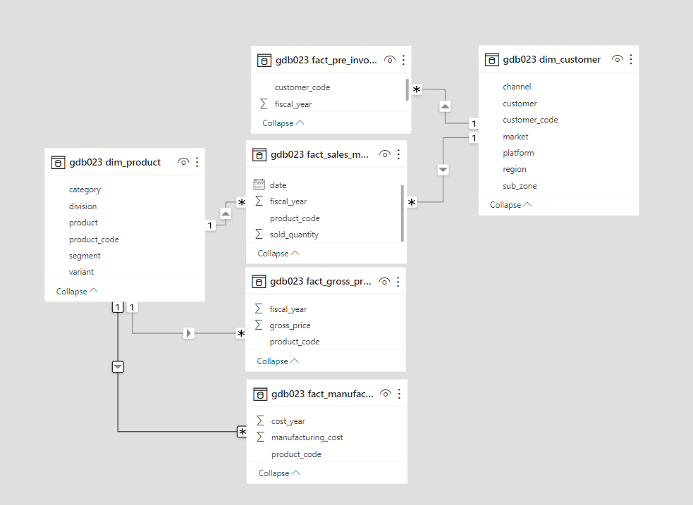
Data Model
Data consist of 4 fact tables:- monthly sales, pre-invoice deductions, gross price, manufacturing cost and 2 dimension tables:- customer and product table.
Sales data is available for fiscal year 2020 and 2021.

Slide 4
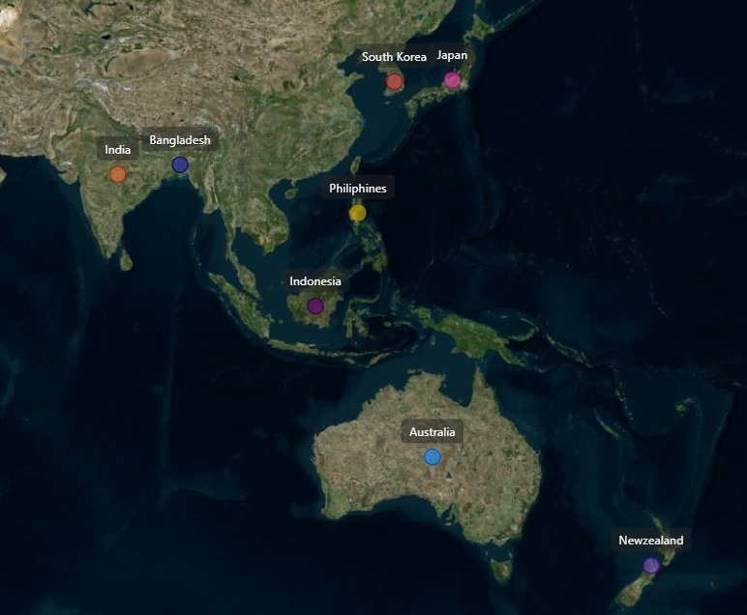
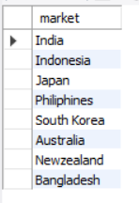
1. Provide the list of markets in which customer "Atliq Exclusive" operates its business in the APAC region.
Query Output

Slide 5

2. What is the percentage of unique product increase in 2021 vs. 2020?
The final output contains these fields,
unique_products_2020
unique_products_2021
percentage_change
Query Output

Slide 6
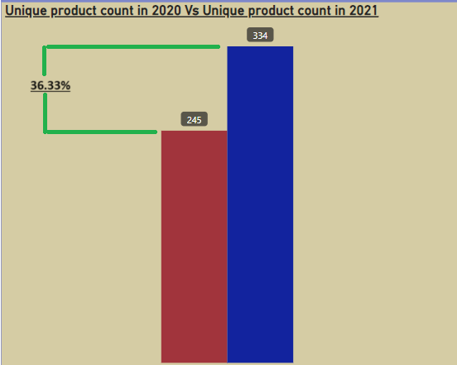
Insight
The percentage change in new products increase by 36.33% in FY21 in comparison with FY20
2020
2021

Slide 7
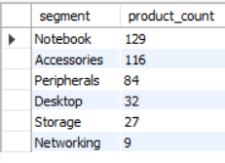
3.Provide a report with all the unique product counts for each segment and sort them in descending order of product counts.
The final output contains 2 fields,
segment
product_count
Query Output

Slide 8
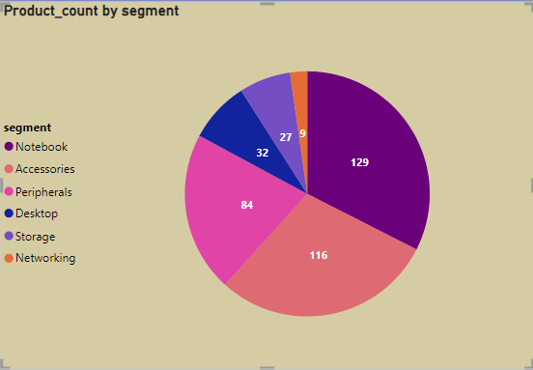
Insight
Atliq hardware has wide range of products under the segment- Notebook and Accessories.
However, There are few segments like Networking, Storage and Desktop which need focus in order to diversify.

Slide 9
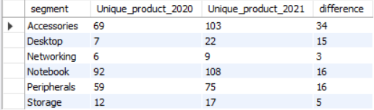
4. Follow-up: Which segment had the most increase in unique products in 2021 vs 2020?
The final output contains these fields
segment
product_count_2020
product_count_2021
difference
Query Output

Slide 10
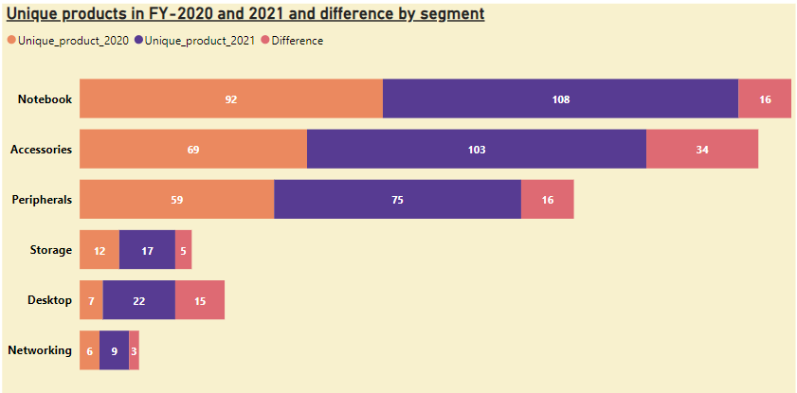
Insight
There are increase in product count in segment in 2021.
Segments like Desktop and Accessories shows remarkable increase in the product count in 2021.
Storage and networking segments still need attention in increasing products.

Slide 11

5. Get the products that have the highest and lowest manufacturing costs.
The final output should contain these fields
product_code
product
manufacturing_cost
Query Output
From the query output, it is clear that product- “AQ HOME Allin 1 Gen 2” has highest manufacturing cost 240.54$ and product
“AQ Master wired x1 Ms” has least manufacturing cost which is 0.89$

Slide 12
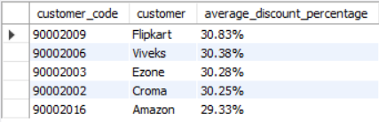
6. Generate a report which contains the top 5 customers who received an average high pre_invoice_discount_pct for the fiscal year 2021 and in the Indian market.
The final output should contain these fields
customer_code
customer
average_discount_percentage
Query Output

Slide 13
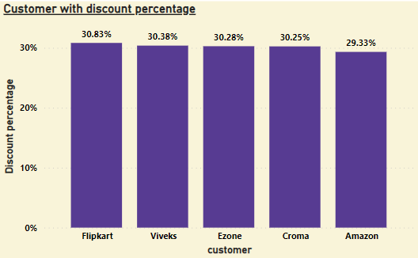
Insight
The chart illustrate the customers in Indian market with discount percentage more than the average discount percentage in FY 2021.
Flipkart get the highest discount which is 30.83%

Slide 14
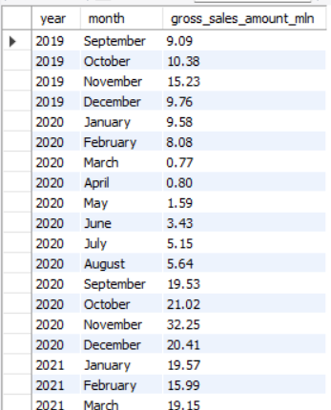
7. Get the complete report of the Gross sales amount for the customer “Atliq Exclusive” for each month. This analysis helps to get an idea of low and high-performing months and take strategic decisions.
The final output should contain these fields
Month
Year
Gross sales Amount
Query Output

Slide 15
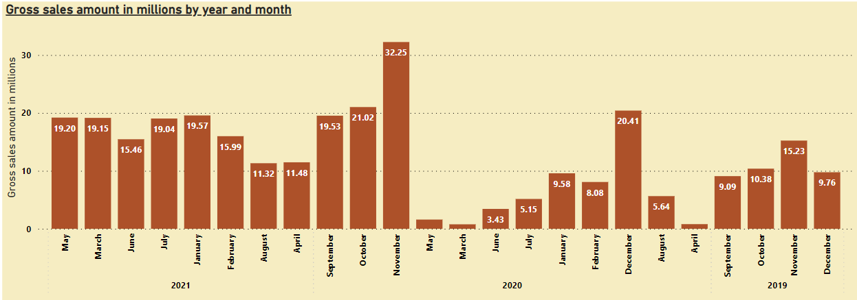
Insight
The highest gross sales is registered for Atliq Hardware is in November 2020 which is 32.25M.
It is evident that March-May 2020 has least gross sales due to pandemic.
However, the sales increases in later months of the year.

Slide 16
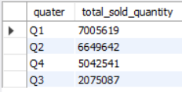
8. In which quarter of 2020, got the maximum total_sold_quantity?
The final output contains these fields sorted by the total_sold_quantity,
Quarter
total_sold_quantity
Query Output

Slide 17
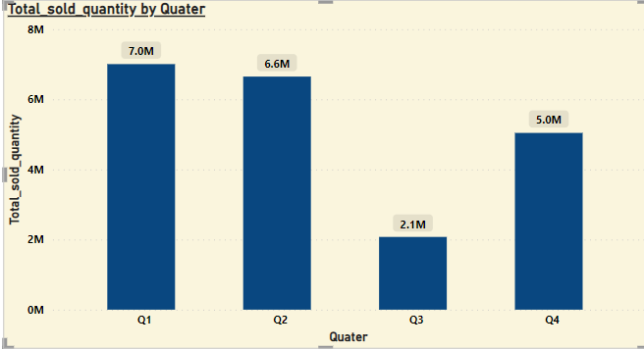
Insight
The chart describes the total sold quantity in each quarter for fiscal year 2021.
The total quantity sold in Q3(March-May) is least which is 2.1M due to covid.
However, there is increase in the sold quantity to 5.0M in next quarter.

Slide 18

9. Which channel helped to bring more gross sales in the fiscal year 2021 and the percentage of contribution?
The final output contains these fields,
channel
gross_sales_mln
Percentage
Query Output

Slide 19
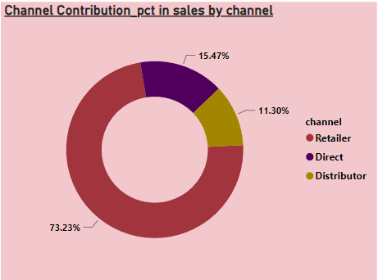
Insight
Retailer with gross sales of $1219.08M has highest contribution(73.23%) followed by Direct with gross sales of $257.53M which contributes to 15.47% in FY-21.
Distributor contributed least with 11.30% with the gross sales of $188.03M.

Slide 20
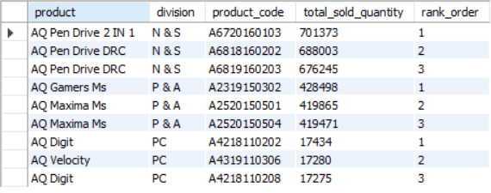
10. Get the Top 3 products in each division that have a high total_sold_quantity in the fiscal_year 2021?
The final output contains these fields,
division
product_code
product
Total_sold_quantity
Rank_order
Query Output

Slide 21
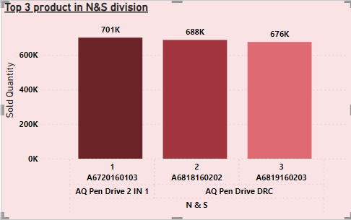
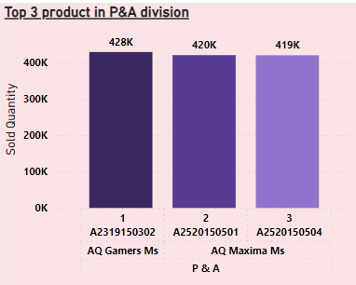
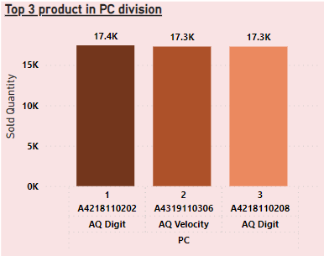
Insight
The top 3 selling products in N&S division are pen drives which is around 7L in quantity.
The top 3 selling products in P&A division are mouses which is around 4L in quantity.
The top 3 selling products in PC division are personal laptops which is around 1.7L in quantity

Slide 22
Thank You

