Slide 1
super_Bech32m
Mikita Valatovich, Illia Kostenko, Kamil Fňukal
https://github.com/NikitaVolotovich/super_bech32m

Slide 2
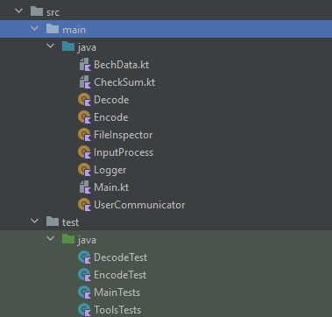
Structure of the project

Slide 3
Encountered obstacles
user friendly and intuitive interface
prevent incorect inputs
creating fuzzer for ArrayList<String> with jazzer

Slide 4
Used analysis tools
Built-in Intellij analyzer
SonarQube
Ktlint
Snyk
YourKit Java Profiler

Slide 5
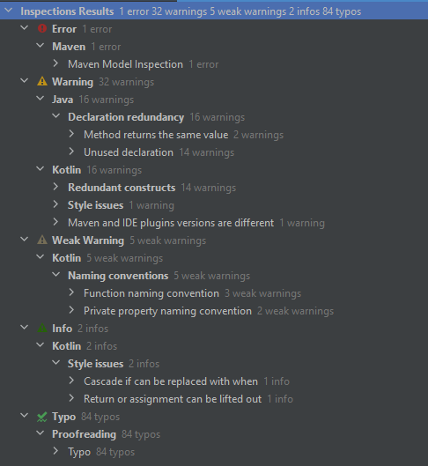
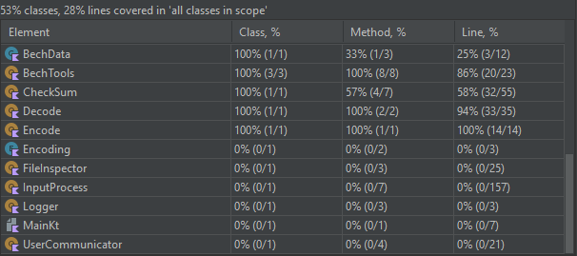
Built-in Intellij analyzer and code coverage
Html export in ./CoverageTest.7z

Slide 6
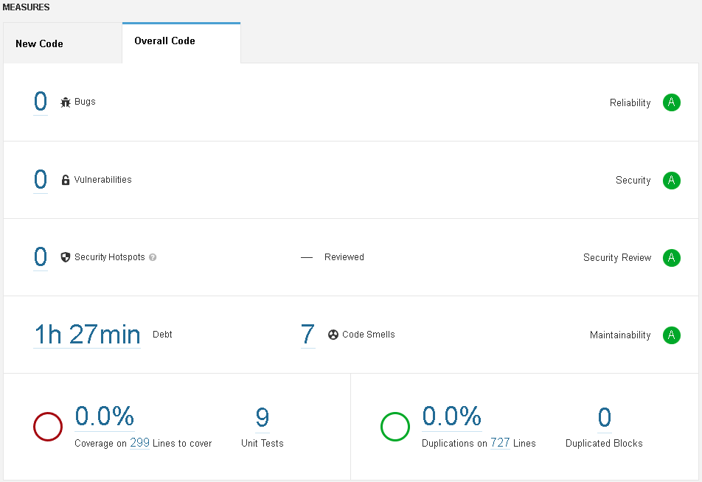
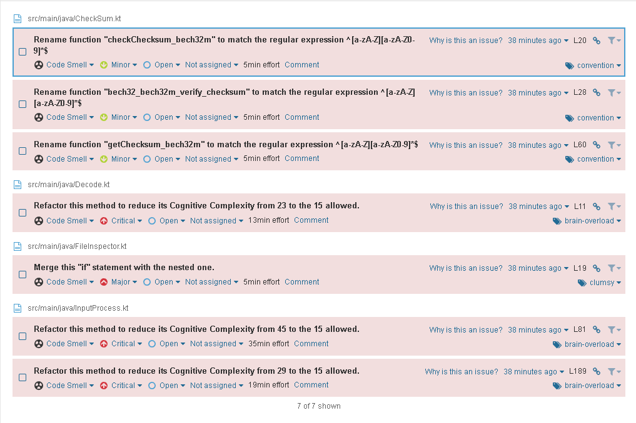
SonarQube

Slide 7
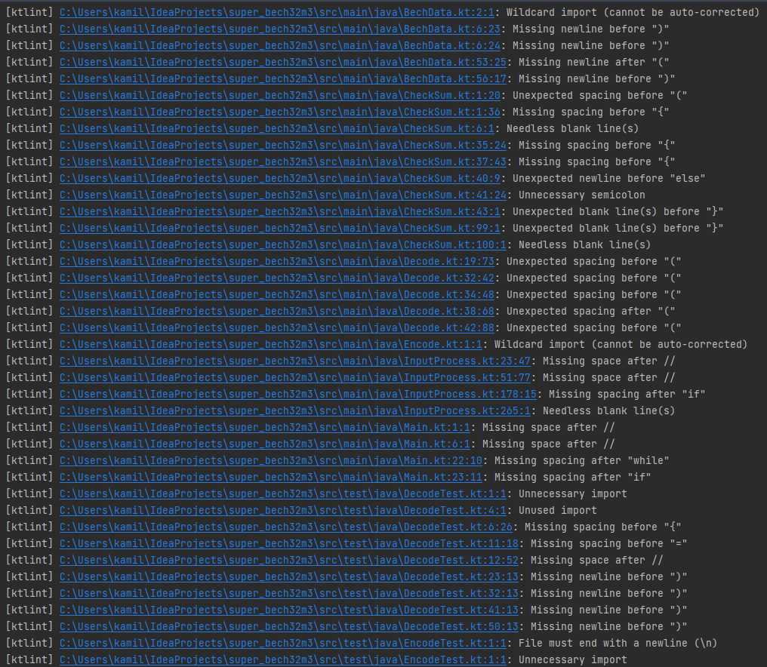
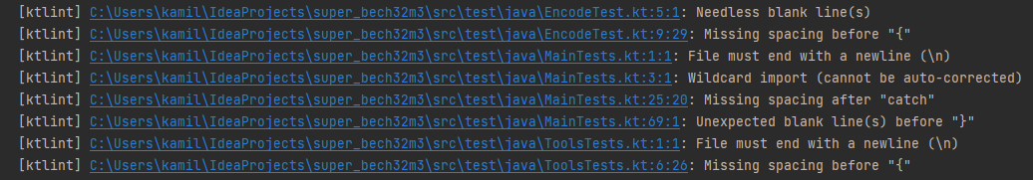
ktlint

Slide 8
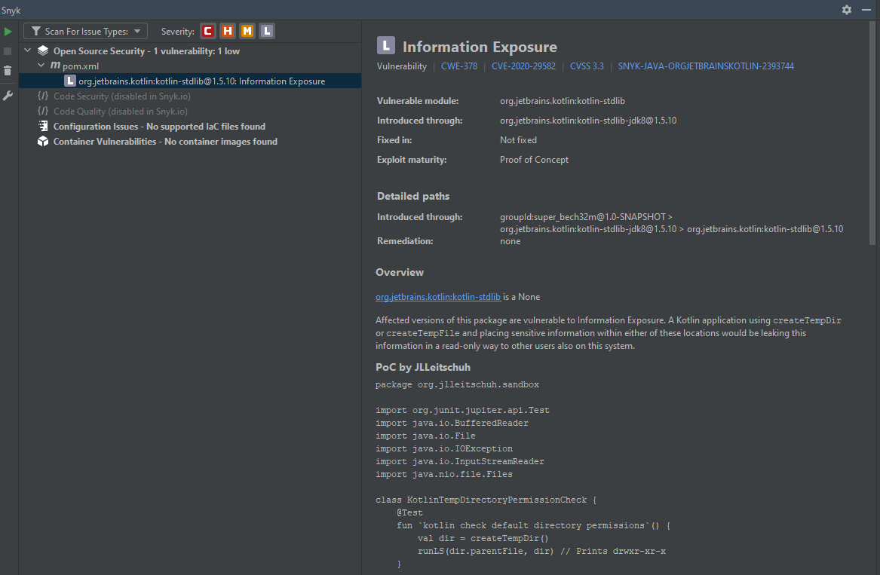
Snyk
Vulnerability:
Opening temporary files without appropriate measures or controls can leave the file, its contents and any function that it impacts vulnerable to attack.

Slide 9
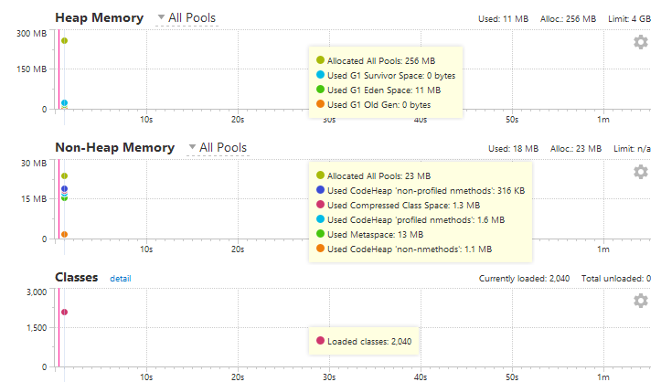
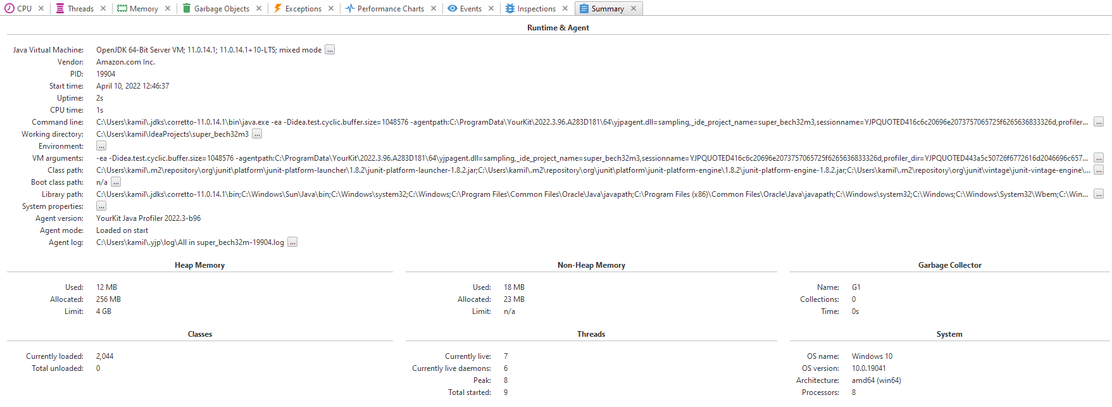
YourKit Java Profiler
Log in ./yourkit.txt

Slide 10
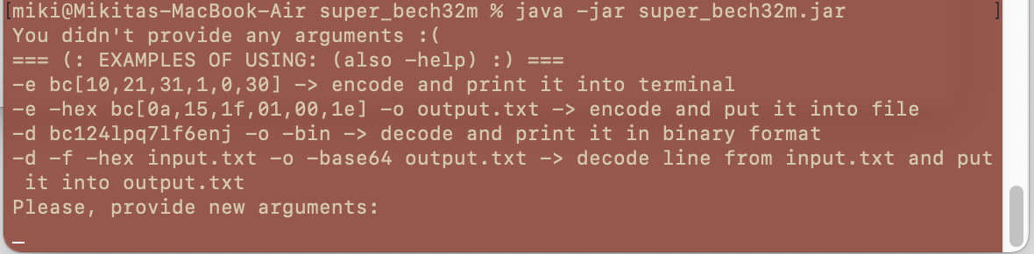
Usage of the tool
Provided file: super_bech32m.jar
It can be executed using terminal:
It can be run also with input arguments (listed with ““):

Slide 11
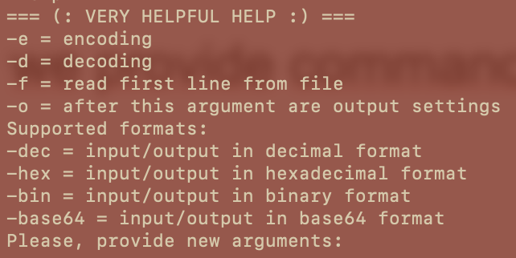
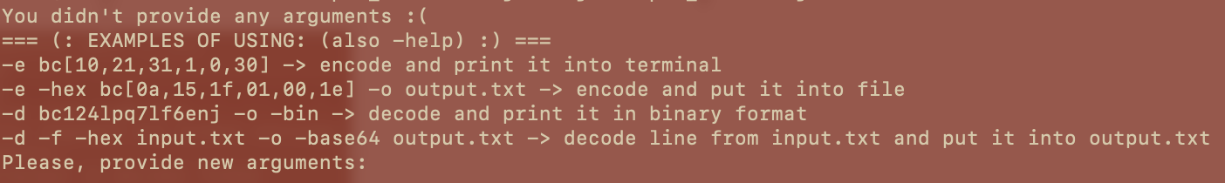
Usage of the tool
In case when no arguments provided program shows examples of usage and if something wrong print this part what is incorrect. And then ask for a new input.
Also we provide command –help which show list of all commands.

Slide 12
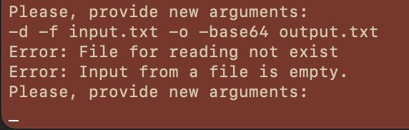
Usage of the tool
Logically program divide input into two parts which corresponds to input part and output part.
For example, first part here:
–d (decode) –f (read first line from a file) input.txt (path to file or input string)
Seconds part (not compulsory):
-o (arguments for output) –base64 (format for output) output.txt (filepath for output)

Slide 13
Usage of the tool
For encoding request should look like:
HRP[data]
Example:
In dec : -e bc[10,20,31,0,1,2,3] (without spaces between data) (can be without flag –dec, because its by default)
In hex: -e -hex bc[0a,15,1f,01,00,1e]
In bin: -e -bin bc[01010,10101,11111,00001,00000,11110]

Slide 14
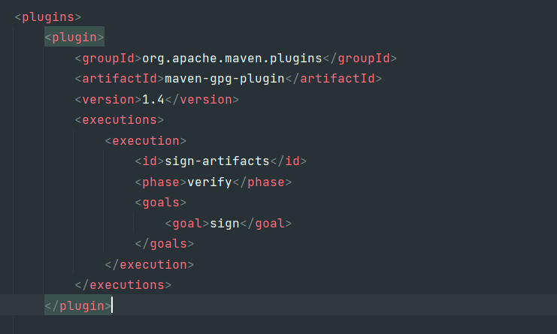
Release build with a GPG signature
For signing final binary build was used maven plugin maven-gpg-plugin. These part has been added to the pom.xml file:

Slide 15
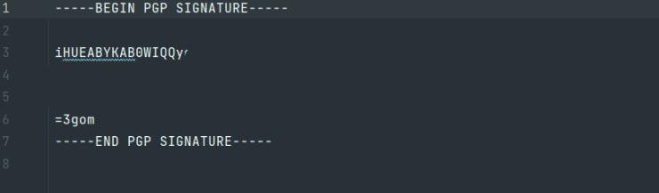
Release build with a GPG signature
For creating signed binary build (.jar) is enough to call:
mvn clean install
Part of created GPG key (in .asc format).

