Slide 1








Patients
Doctors
Hospital Management
System
Admissions
Medications
Billing
Appointments
Rooms

Slide 2
Introduction
Hospital Management System stores hospital data.
Tracks patients, doctors, rooms, appointments, billing, and medicines.
Made in MySQL Workbench.
Helps hospital work become easy and fast.

Slide 3
Objectives of the Project
Keep hospital data organized.
Manage patients, doctors, rooms, appointments, billing, and medicines.
Give quick information to staff (like pending bills or admitted patients).
Make hospital work faster and easier.

Slide 4
Database Overview
Database Name: hospital
Tables and Their Purpose:
1. Patients → Stores patient information
2. Doctors → Stores doctor details and specialization
3. Rooms → Tracks hospital rooms and their status (Available/Occupied)
4. Appointments → Tracks patient appointments with doctors
5. Admissions → Tracks patient admissions, discharge, and room allocation
6. Billing → Stores payment details and status (Paid/Unpaid)
7. Medications → Tracks medicines prescribed to patients
Note: Tables are connected using primary and foreign keys.

Slide 5
ER Diagram
Patients
Doctors
Appointments
Rooms
Medications
Admissions
Billing

Slide 6
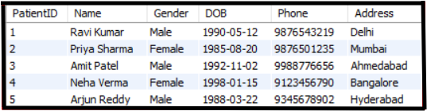
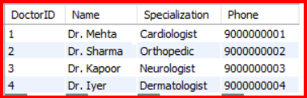
Patients & Doctors
Patients Table
Doctors Table

Slide 7

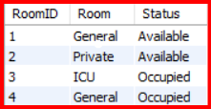
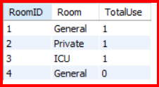
Rooms Status
Show available rooms:
Insight: Check rooms ready for new patients.
Show all rooms and status
Insight: Overview of free and occupied rooms.
Room usage count
Insight: See how many times each room has been used.

Slide 8
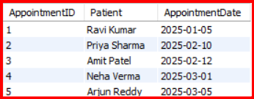
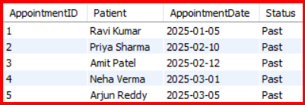

Appointments Tracking
Show all appointments with patient names
Insight: See which patient has an appointment.
Show all appointments and mark upcoming ones
Insight: Identify upcoming vs past appointments
Count total appointments
Insight: Know the total number of appointments in the hospital.

Slide 9
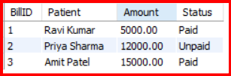

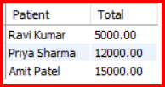
Billing Overview
Show billing info with patient
Insight: Know who has paid and who hasn’t.
Total unpaid amount
Insight: Track pending payments.
Total billing per patient
Insight: See total charges per patient.

Slide 10

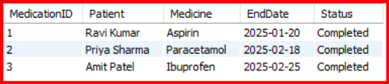

Patient Medications
Show medications with patient
Insight: Track which medicines patients are taking.
Show all medications and highlight ongoing ones
Insight: See which medicines are still being taken.
Most prescribed medicine
Insight: Helps manage medicine stock efficiently.

Slide 11


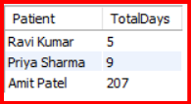
Patient Admissions
Show patients in ICU
Insight: Identify critical patients.
Patients currently admitted
Insight: See which patients are still in the hospital.
Total days each patient admitted
Insight: Track how long patients stayed in the hospital.

Slide 12
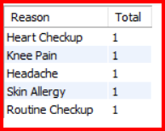


Patient & Payment Insights
Appointments by purpose
Insight: Know why patients visit the hospital most often.
Payments by status
Insight: Compare paid vs unpaid bills.
Unpaid amount per patient
Insight: See which patients owe money.

Slide 13
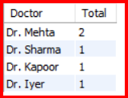


Doctors & Patients
Total appointments per doctor
Insight: See how busy each doctor
Doctors with more than 1 patient
Insight: Identify doctors treating multiple patients.
Doctor treating most distinct patients
Insight: Know the busiest doctor in the hospital.

Slide 14
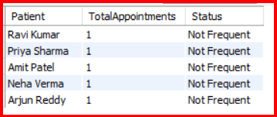


Patient Details & Insights
Show all patients and their appointment count
Insight: Identify frequent visitors.
Patients with no medicine
Insight: See which patients are not taking any medicine.
Patients never admitted
Insight: Patients who only had appointments but no hospital stay.

Slide 15


Summary & Conclusion
Hospital Management System helps store and manage hospital data efficiently.
Provides quick insights on patients, doctors, rooms, appointments, billing, and medications.
Reduces manual work and makes hospital operations faster and easier.
SQL queries give useful reports for decision-making and tracking.

