Slide 1
Load Balancing Strategy for Optimal Peak Hour Performance in Cloud Datacenters
Under the guidance of:
Mrs.Suriya Refai Begum
By
NIKITH.H.A

Slide 2

What is clouding computing ?
Cloud computing is a type of computing that relies on sharing computing resources rather than having local servers or devices to handle applications.

Slide 3
ADVANTAGES OF CLOUD
Scalable
elastic (dynamic resources)
Availability as a resources
based on utility billing (pay for what you use)
On Demand Service

Slide 4
Cloud offerings
Infrastructure-as-a-Service or IaaS
host applications
Platform-as-a-Service or PaaS
build applications
Software-as-a-Service or SaaS
consume applications

Slide 5
What is Load Balancing……..
It is a process of distributing load equally among all the nodes or servers
It improves resource utilization, performance and saves energy by properly assigning/re- assigning computing resources to the incoming requests from users.

Slide 6
EFFICIENT LOAD BALANCING TECHNIQUE
Prevents under utilization and over utilization
Impoves the response time of clients
Balances efficiently during peak hours

Slide 7
SYSTEM ARCHITECTURE

Slide 8
States of nodes during load balancing
Overload
Under load
Idle

Slide 9
^{Virtualization}
Virtualization is a proven software technology that makes it possible to run multiple operating systems and applications on the same server at the same time.
Hardware virtualization or platform virtualization refers to the creation of a virtual machine that acts like a real computer with an operating system.
A virtual machine (VM) is a software implementation of a machine (for example, a computer) that executes programs like a physical machine.

Slide 10
Benefits of Virtualization
Reduce capital and operating costs.
Deliver high application availability.
Minimize or eliminate downtime.
Increase IT productivity, efficiency, agility and responsiveness.
Speed and simplify application and resource provisioning.
Support business continuity and disaster recovery.
Enable centralized management.
Build a true Software-Defined Data Center.

Slide 11
ACTIVE VM ALGORITHM
^{Initialization:}
^{1.for(all VM ids)do}
Set allocation table entries to zero
^{end}
Also get the VM status table for all VMs from data center controller.
2.Data center controller requests for VM id to the active VM
^{load balancer.}
^{Allocation:}
3.if (all VMs are not allocated) then
^{for (for all VM ids) do}
Check for index of allocation statistics table with
zero allocation. If found return VM id.
^{end}
^{end}
4.else if (all VMs are busy) then for (for all VM) do
Find the index of the allocation statistics table with
^{least number and return VM id.}
^{end end}

Slide 12
5.Active vm load balancer recommends a VM id to the data center controller unit.
6. Data center controller assigns the VM id to the request.
7. A notification is sent from data center controller to load balancer about recent allocation for the corresponding VM id.
8. Active VM load balancer increments the count for allocation in the allocation statistics table. De-allocation: 9. When the request completes the processing on VM, data center is notified about completion. 10. Data center then sends the notification to the active VM load balancer to signal VM de-allocation. 11. Active VM load balancer’s allocation statistics table is updated by decrementing the count of requests against the allocated VM id.

Slide 13
Problem with Active VM load balancer

Slide 14
Algorithm: Proposed VM load balancer
^{Initialization:}
^{1. for (all VM ids) do}
Set allocation table entries to zero and reservation table
^{entries to zero end}
Also get the VM status table for all VMs from data center
^{controller.}
2. Data center controller requests for VM id to the active VM
^{load balancer.}
^{Allocation:}
3. if (all VMs are not allocated) then
^{for (for all VM ids) do}
Check for index of allocation statistics table with zero allocation. If found return VM id.
^{end}
^{end}
4. else if (all VMs are busy) then for (for all VM) do
Find the index of the allocation statistics table and reservation table with
min_count(allocation count + reservation count).
^{end}
^{end}

Slide 15
5.Active VM load balancer recommends a VM id to the data center controller unit and updates the reservation table to reflect the allocation against the VM id by incrementing the reservation count.
6.Data center controller assigns the VM id to the request.
7.A notification is sent from data center controller to load balancer about recent allocation for the corresponding VM id.
8.Active VM load balancer increments the count for allocation in the allocation statistics table and decrements the reservation table count for corresponding VM id.
De-allocation:
9. When the request completes the processing on VM, data center is notified about completion. 10. Data center then sends the notification to the active VM load balancer to signal VM de-allocation.
11. Active VM load balancer’s allocation statistics table is updated by decrementing the count of requests against the allocated VM id.

Slide 16
Pseudo code
Integer findLeastLoadedVM(){
for (all VM ids in datacenter) {
next_VM_ID_with_minCoun t = MIN( next_VM_ID_with_minCoun t ,(ALLOC_COUNT(VM_id) + RESERVE_COUNT(VM _id) ));
}
return next_VM_ID_with_minCount;
}

Slide 17
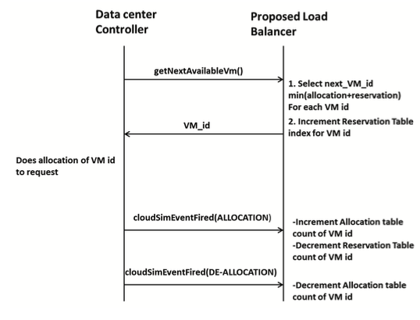
CALL FLOW OF PROPOSED ALGORITHM

Slide 18
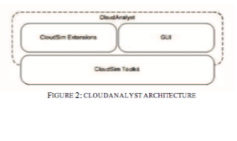
CLOUD ANALYST ARCHITECTURE

Slide 19
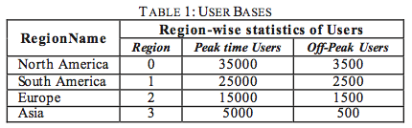
Cloud Analyst Simulation Configuration

Slide 20
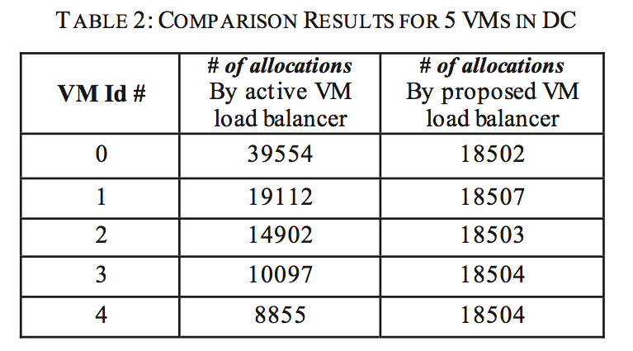
EXPERIMENTAL RESULTS FOR 5 VMs

Slide 21
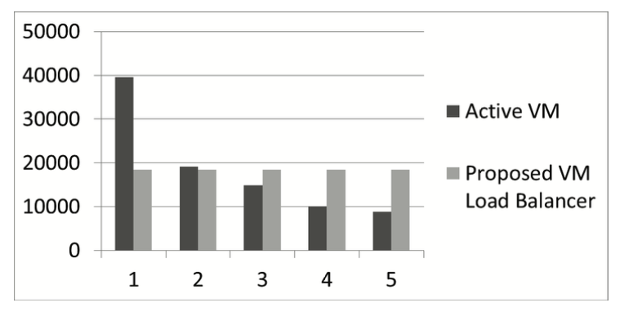

Slide 22
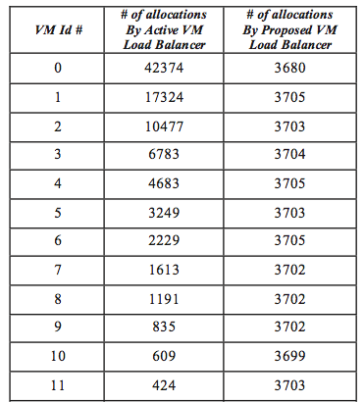
EXPERIMENTAL RESULTS FOR 25VMs

Slide 23
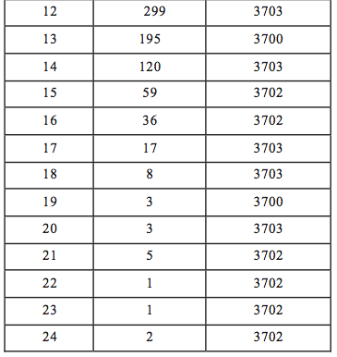

Slide 24
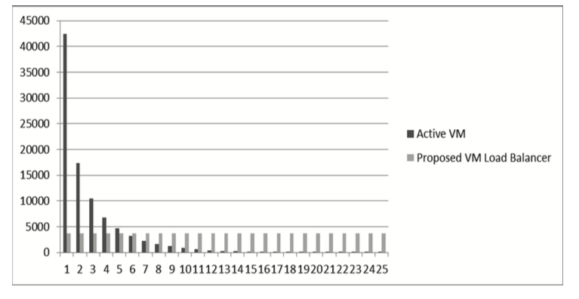
CHART FOR THE RESULTS TABULATED

Slide 25
Conclusion
In this paper, an efficient VM load balancing algorithm is proposed that distributes the load evenly across all VMs in the data center even during peak hours. It is observed from the experimental results that current active VM load balancer heavily loads the first VM with the arriving requests which is at the top of the table where-as the proposed VM Load balancer equally distributes the incoming requests to all VMs ,using a reservation table between the phase of selection and allocation of VMs. Future enhancement of the project is to investigate the efficiency of applying the technique across all data centers to allocate the load uniformly to all VMs situated at different geographical locations.

Slide 26
REFERENCE
Ashwin Kumar Kulkarni1, Annappa .B2 Department of Computer Science & Engineering National Institute of Technology Karnataka Surathkal, Mangalore, India
Load Balancing Strategy for Optimal Peak Hour
Performance in Cloud Data centers

Slide 27

Thank you

