Slide 1
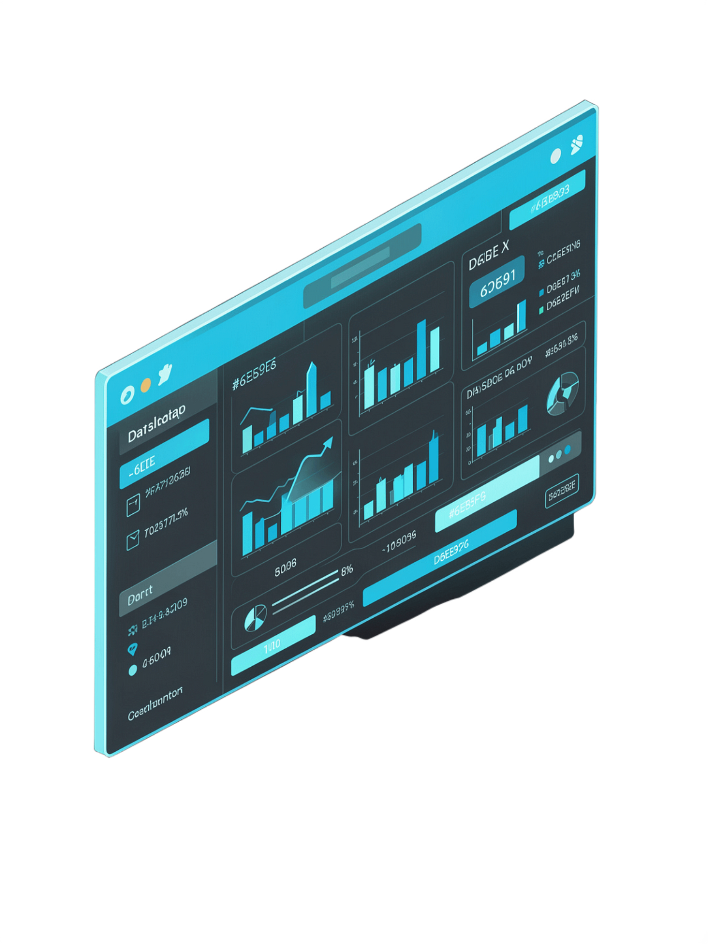

Interactive EDA Dashboard
Data Science (24AD3107) | Academic Year 2026–2027
Team Members
Y. Revanth (2420030605)
G. Rithwik (2420030415)
A. Nikitha (2420030505)
Project Guide
Dr. N. Sunanda

Slide 2
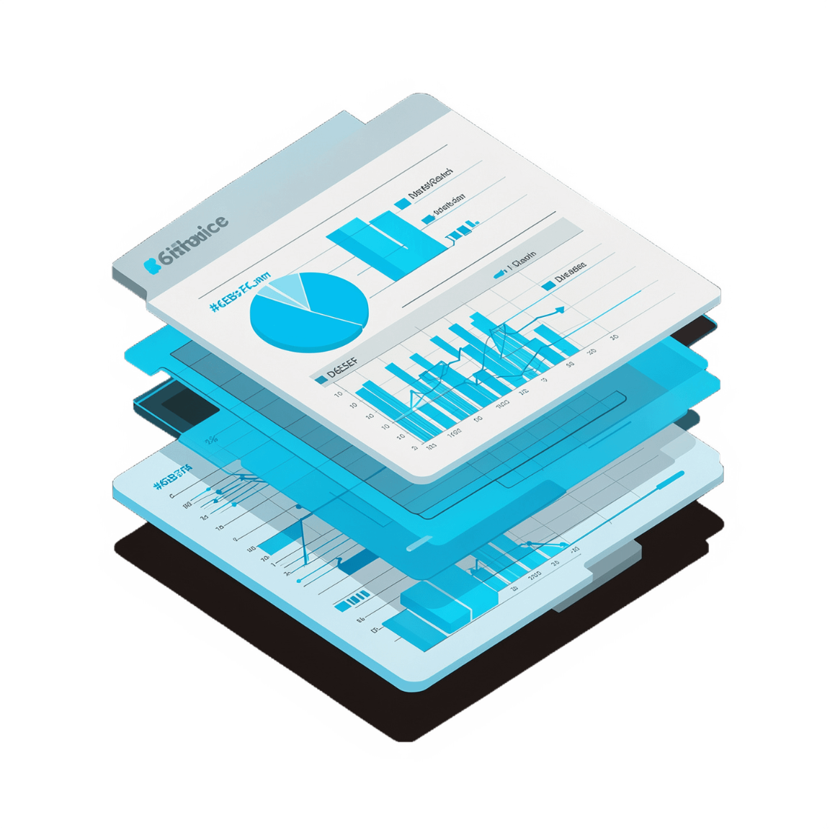
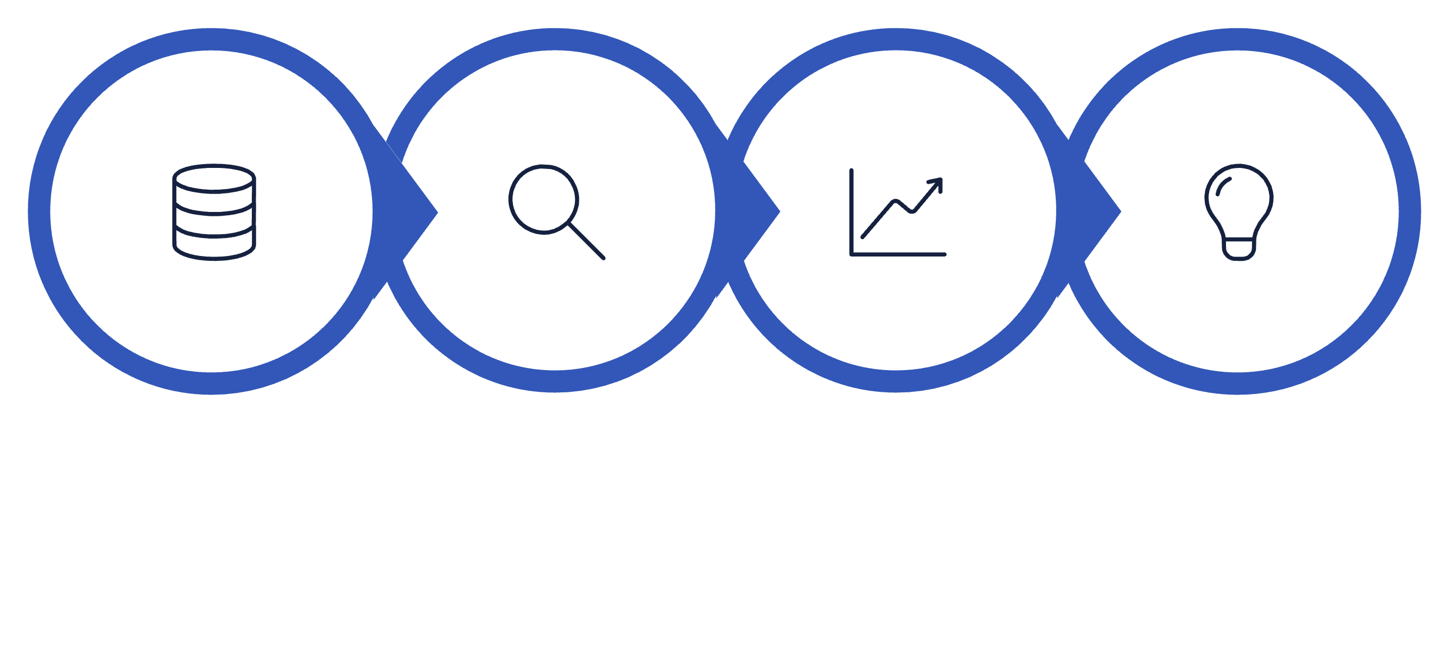
FOUNDATION
What is Exploratory Data Analysis?
EDA is the first critical step in understanding raw datasets before deeper analysis
Raw datasets are often large, unstructured, and difficult to interpret directly
Manual exploration requires multiple steps: inspection, cleaning, visualization, and interpretation
Interactive tools streamline this process and reveal hidden patterns
Data Exploration
Raw Dataset
Visualization
Insights

Slide 3

Problem Statement & Objectives
Challenges
Our Goals
Raw datasets are difficult to understand; manual analysis is time-consuming and error-prone
Identifying missing values, duplicates, and inconsistencies requires significant effort
Creating visualizations manually requires coding expertise
Simplify EDA and make it accessible to all skill levels
Automatically detect data-quality issues and generate visualizations
Enable interactive exploration and pattern discovery in one unified platform

Slide 4
OUR SOLUTION
Proposed Solution
A unified, user-friendly platform automating the entire exploratory data analysis workflow:
Dataset Upload
Auto Preprocessing
Statistical Summary
Simple file upload interface for instant onboarding
Data inspection and quality checks, automatically
Descriptive statistics and data profiling at a glance
Interactive Visualizations
Insight Generation
Multiple chart types generated automatically
Patterns, relationships, and anomalies identified instantly

Slide 5

METHODOLOGY
System Workflow & Methodology
01
Upload Dataset
CSV, Excel, or similar format
02
Inspect Structure
Rows, columns, and data types
Inspect & Clean
Analyze & Discover
03
Upload & Parse
Summarize & Visualize
Check Data Quality
Check structure, missing values, duplicates
Find correlations, outliers, patterns
CSV/Excel upload and dataset reading
Statistical summary, charts, heatmaps
Missing values, duplicates, inconsistencies
04
Statistical Summary
Mean, median, std dev, quartiles
05
Visualize & Analyze
Charts, correlations, outlier detection

Slide 6
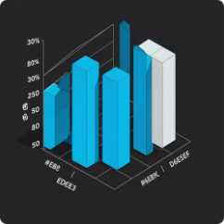
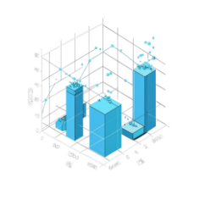
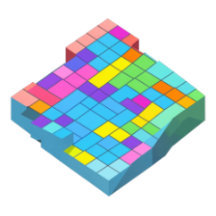
FEATURES
Key Features & Visualizations
Bar Chart & Histogram
Box Plot & Scatter Plot
Correlation Heatmap
Identify outliers and reveal relationships between variables through interactive plots
Visualize feature dependencies across all variables in a single, comprehensive view
Compare categorical values and visualize distribution of numerical data with clarity

Slide 7
IMPLEMENTATION
Dashboard UI Design & Technology Stack
Dashboard Layout
Technology Stack
Top Panel
Left Sidebar
Python
Pandas & NumPy
Upload interface and file information
Navigation controls and filters
Core programming language
Data manipulation and numerical operations
Main Area
Right Panel
Matplotlib & Seaborn
Streamlit
Data preview and interactive visualizations
Statistics summary and correlation heatmap
Statistical visualization
Interactive web-based dashboard interface
Bottom Section
Auto-generated insights and findings

Slide 8

Benefits & Expected Results
Key Benefits
Expected Insights Delivered
Reduces hours of manual analysis to minutes
Enables non-technical users to perform professional-grade EDA
Automatically identifies data-quality issues
Reveals hidden patterns and relationships effortlessly
Dataset structure understanding and profiling
Missing value and duplicate identification
Distribution visualization and outlier detection
Correlation discovery and actionable pattern recognition

Slide 9



LOOKING AHEAD
Future Scope & Enhancements
Expanded Data Sources
ML-Assisted Analysis
Export & Reporting
JSON, SQL databases, and live API integration
Automated anomaly detection, clustering, and hypothesis testing
Exportable PDF, PNG, HTML reports and real-time data streaming
Advanced filtering, interactive drill-down, and automated insight generation are also planned to further elevate the platform's analytical depth.

Slide 10

Conclusion
The Interactive EDA Dashboard transforms exploratory data analysis from a time-consuming, manual process into an efficient, intuitive, and accessible workflow.
By automating data inspection, quality checks, and visualization generation, it empowers users to uncover patterns, identify data-quality issues, and extract meaningful insights — all within a single, unified platform.
Thank You

