Slide 1

SalarySense AI
Batch 5 - Section 4
Team members
Roll No Name
2420030505 A.Nikitha
2420030605 Y.Revanth
Under the guidance of
Garimidi Siva Sree
Department of Computer Science and Engineering
Koneru Lakshmaiah Education Foundation
(Deemed to be University estd. u/s. 3 of the UGC Act, 1956)
Off-Campus: Bachupally-Gandimaisamma Road, Bowrampet, Hyderabad, Telangana - 500 043.
Phone No: 7815926816, www.klh.edu.in

Slide 2
Table of contents
Introduction & Problem Statement
Objectives
Dataset & Features
Methodology
Machine Learning Models
Model Performance & Results
SalarySense AI Web Application
Dashboard & Analysis
Conclusion
Future Scope

Slide 3
Problem Statement
Employee salary varies based on multiple factors such as education, experience, job role, industry, location, and company size.
Traditional salary estimation methods may be time-consuming, inconsistent, and difficult to scale for large datasets.
Proposed Solution
SalarySense AI uses machine learning regression techniques to analyze employee-related attributes and predict an estimated annual salary.
The system provides a faster and data-driven approach to salary estimation through a Flask-based web application.

Slide 4
Objectives
To analyze the major factors that influence employee salary.
To collect and preprocess salary-related employee data.
To transform categorical and numerical features for machine learning.
To develop multiple regression models for salary prediction.
To compare the performance of different regression algorithms.
To select the best-performing model based on evaluation metrics.
To provide salary prediction through an interactive Flask web application.

Slide 5
Dataset & Features
Dataset Used
Dataset: salary_data.csv
Number of Records: 5,000 employees
Target Variable: Annual Salary
Data Type: Employee salary and career-related information
Features Used
Age
Years of Experience
Gender
Education Level
Job Title
Industry
Location
Company Size
Target
Annual Salary — The salary amount that the machine learning models are trained to predict.

Slide 6
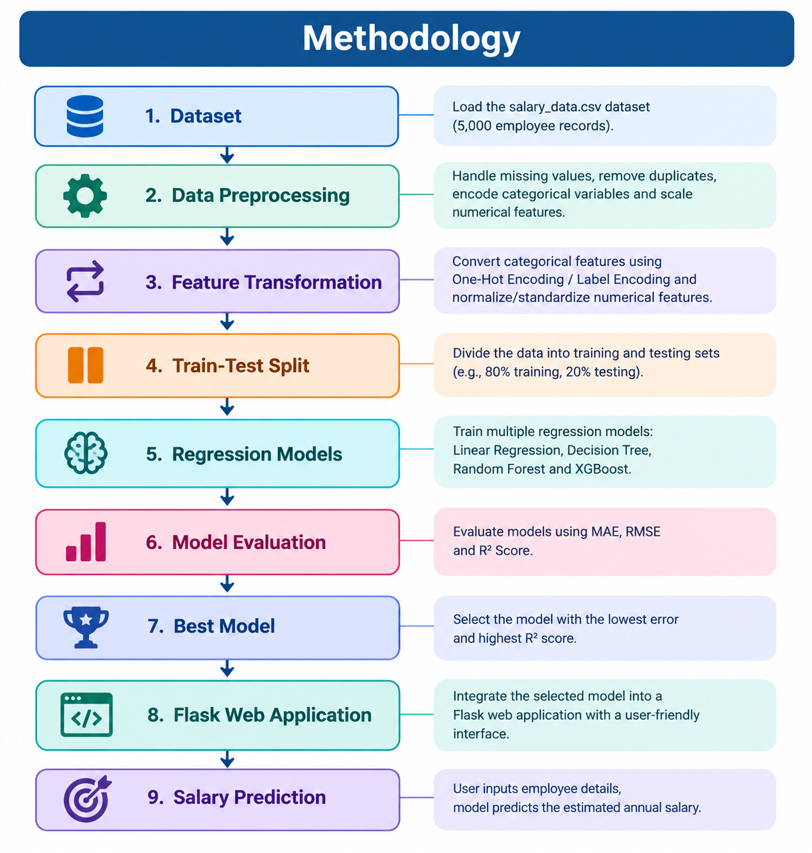
Methodology

Slide 7
Machine Learning Models
Regression Models Used
1. Linear Regression
Used to identify a linear relationship between employee attributes and salary.
2. Decision Tree Regression
Uses decision-based rules to predict salary based on different employee features.
3. Random Forest Regression
Combines multiple decision trees to improve prediction accuracy and reduce overfitting.
4. XGBoost Regression
A powerful boosting algorithm that builds models sequentially to improve prediction performance.
Evaluation Metrics
MAE — Mean Absolute Error
RMSE — Root Mean Squared Error
R² Score — Coefficient of Determination
Lower MAE and RMSE are better, while a higher R² score indicates better model performance.

Slide 8
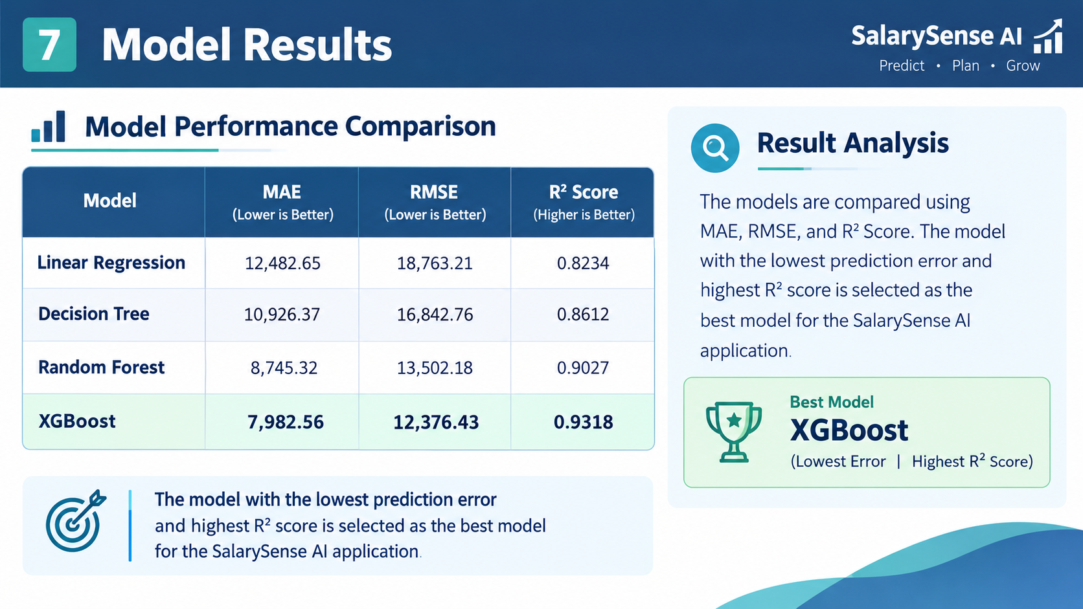
Model Results

Slide 9
Web Application
SalarySense AI Web Application
The trained machine learning model is integrated into a Flask web application.
Main Features
User-friendly salary prediction interface.
Accepts employee details as input.
Processes the entered information.
Uses the trained regression model for prediction.
Displays the estimated annual salary.
Screenshots to Add
Home Page
Prediction/Input Page
Prediction Result Page
Example Prediction Result
Estimated Annual Salary: ₹64,620.00

Slide 10
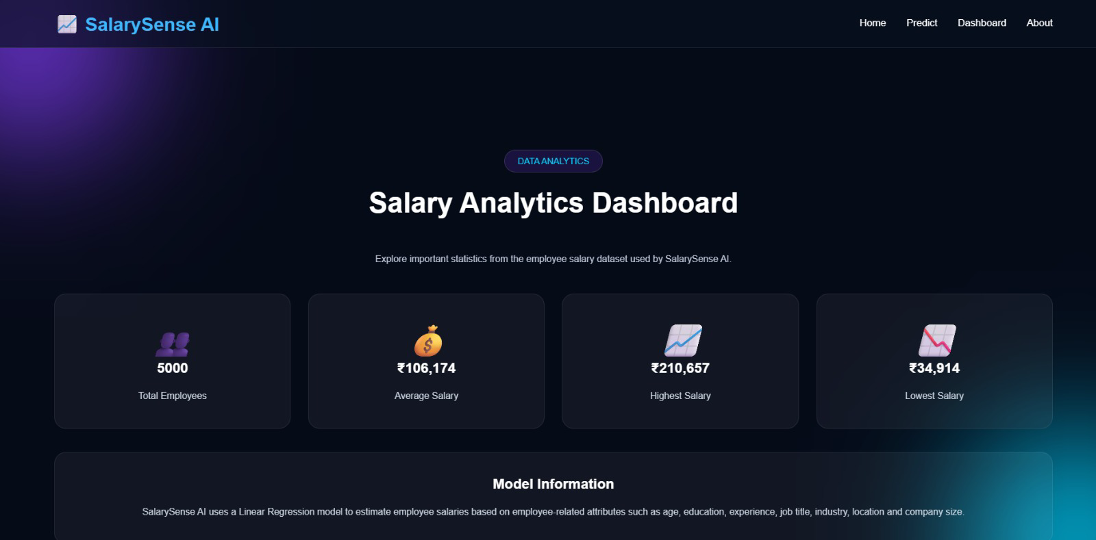
Dashboard

Slide 11
Conclusion
SalarySense AI successfully demonstrates a machine-learning-based approach for employee salary prediction.
The project analyzes employee-related factors, applies different regression algorithms, compares their performance, and integrates the selected model into an interactive Flask web application.
This provides a simple, fast, and data-driven approach to estimating employee salaries.

Slide 12
Future Scope
Real-Time Salary Data Integration
Use continuously updated salary and job-market data.
Explainable AI
Show users which factors have the greatest influence on the predicted salary.
More Datasets and Industries
Expand the system to cover more job roles, industries, and locations.
Cloud Deployment
Deploy the application online for easy access from different devices.
Career Recommendations
Provide suggestions about suitable career paths, skills, and expected salary ranges.

Slide 13
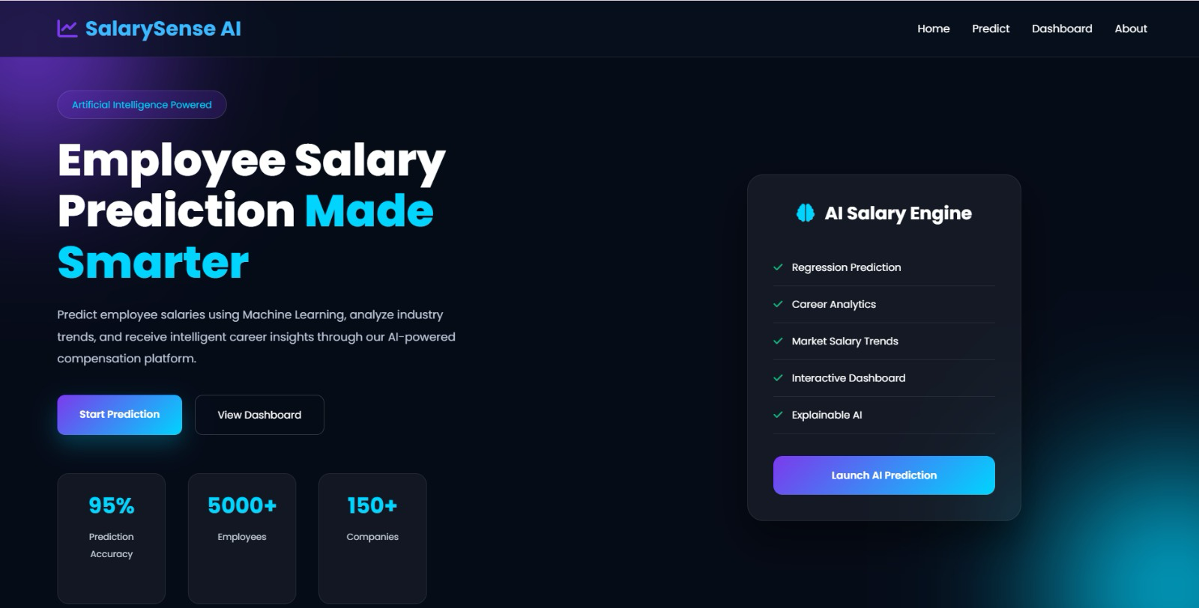

Slide 15
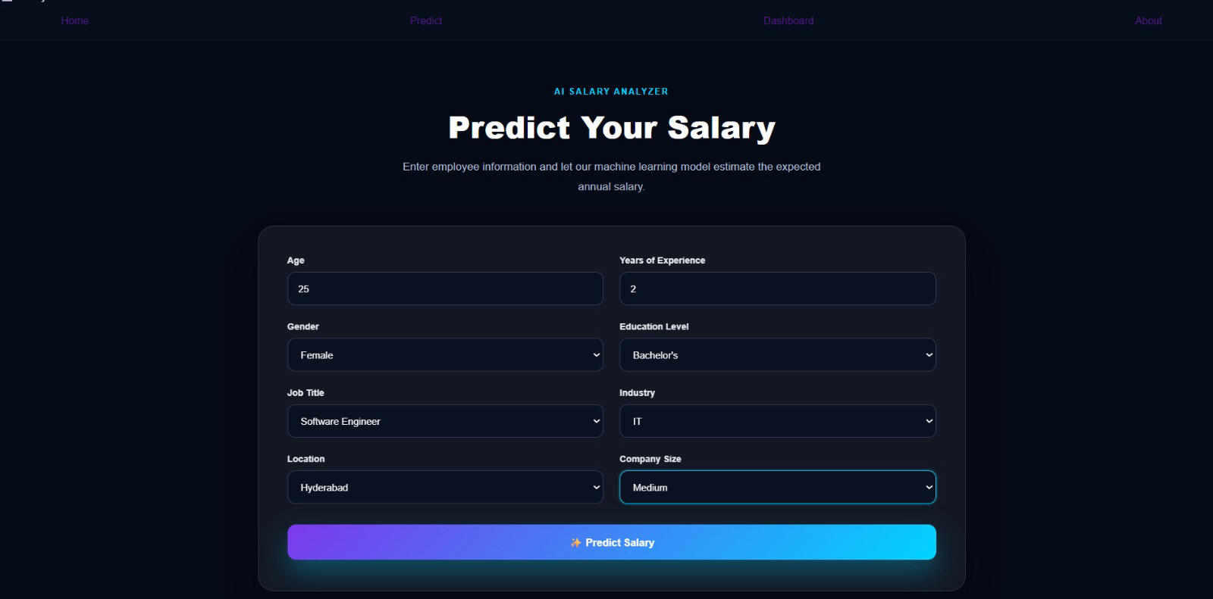

Slide 16
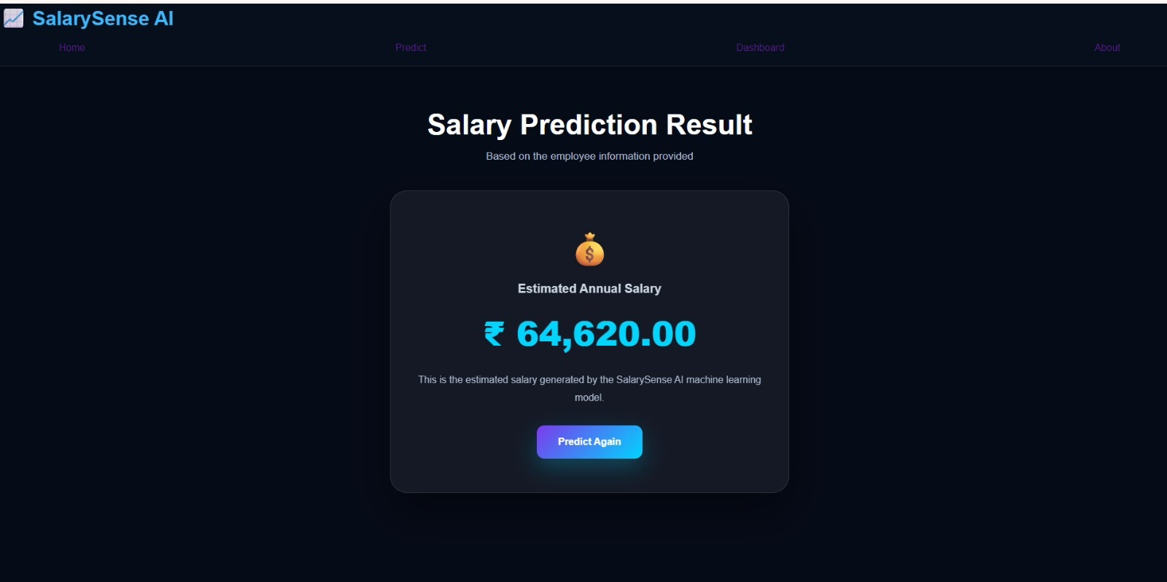

Slide 17
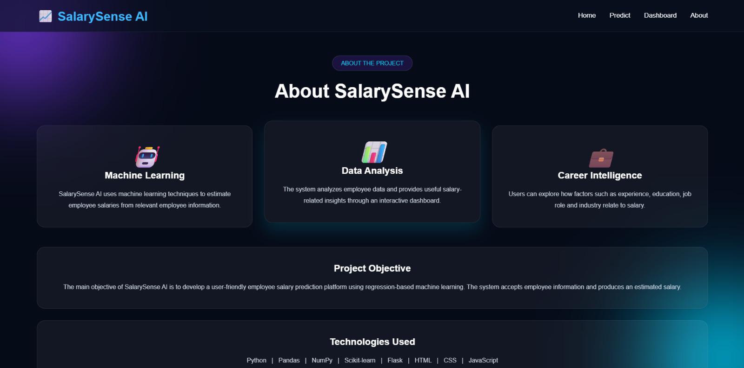

Slide 18
THANK YOU

