Slide 1

Book Verse Retail Analytics
A DATABASE Using MYSQL
Presented By:
NIKITHA SAMANTHULA

Slide 2

About Me
Nikitha Samanthula, M.Sc. Horticulture
Why Data Science?
Data science plays a key role to solve the real-world problems, improves the ability to make better decisions, provides useful insights and even build successful career with high demands, diverse job opportunities.
Work Experience: 3 years in horticulture field
LinkedIn: https://www.linkedin.com/in/nikitha-samanthula-384237430
GitHub Repository: https://github.com/Nikitha-Samanthula

Slide 3
Agenda
Project Overview
Database Structure
ER Diagram
Key Analysis Questions
Experience/challenges
Conclusion

Slide 4
Project overview
The project uses MySQL to analyze orders related to different books and identify important business patterns.
The analysis focuses on:
Sales performances
Orders management
Customer purchasing behavior
Product demand
Revenue generated
Inventory availability
Key Insight
SQL analysis help Book-Verse Retailers to understand operational performance and make data-driven decisions.

Slide 5
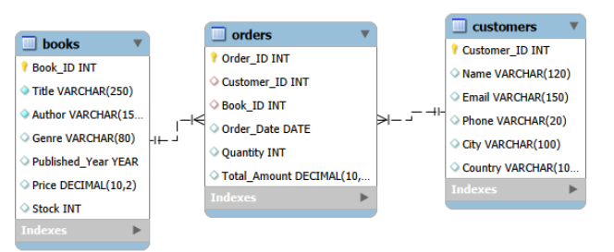
ER Diagram & Database Structure
Database structure:
The project contains 3 interrelated tables:
1. Books:
Primary key – Book_ID
2. Orders:
Primary key – Order_ID
Foreign Keys- Customer_ID, Book_ID
3. Customers:
Primary Key- Customer_ID
These tables are connected using Primary Keys and Foreign Keys to maintain relational database integrity.

Slide 6


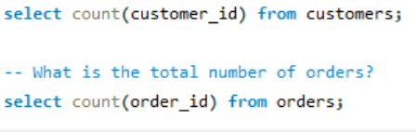

Basic Analysis-Questions
1. What is the total number of books?
2. What is the total number of customers?
3. What is the total number of orders?
This query helps us to understand the basic analysis of data i. e., there are 496 books, 500 customers and 495 orders.

Slide 7



4. What is the total quantity of books sold?
5. What is the total revenue generated?
6. What is the average order value?
These queries will help analyze book sales performance by measuring the total number of books sold, the overall revenue generated, and the average revenue earned per order.

Slide 8
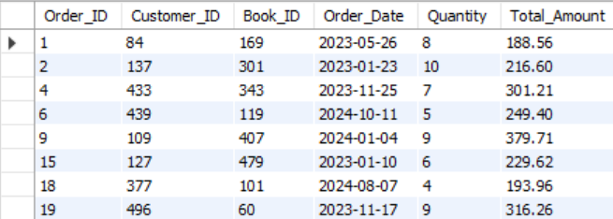
Key Analysis Questions
1. Understand Sales Performance
Which orders have a total amount greater than the average order value?
This query identifies the orders whose total amount is greater than the average order value, helping highlight higher-value orders and analyze customer purchasing patterns

Slide 9
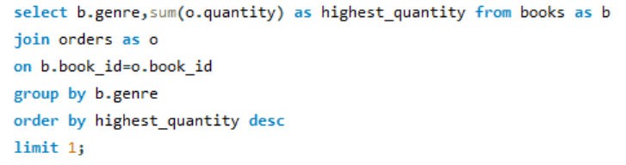

What is the highest-value orders?
Which genre has the highest quantity sold?
These queries identify the highest-value orders and the genre with the highest quantity of books sold, helping analyze top revenue-generating orders and the most popular genre based on sales volume.

Slide 10
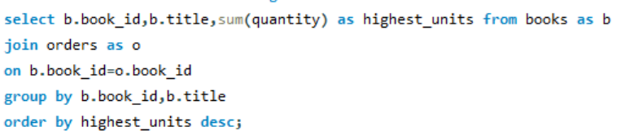
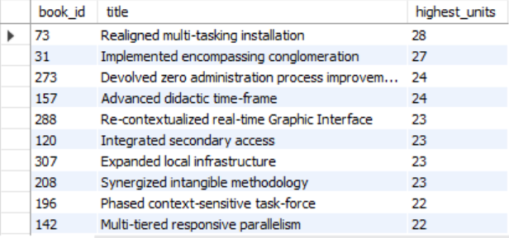
Which books have sold the highest number of units?
This query identifies the books with the highest number of units sold, helping determine the best-selling books based on sales volume.

Slide 11
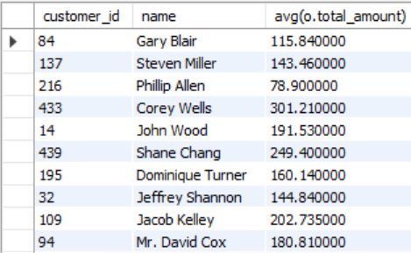
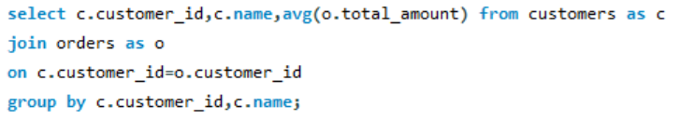
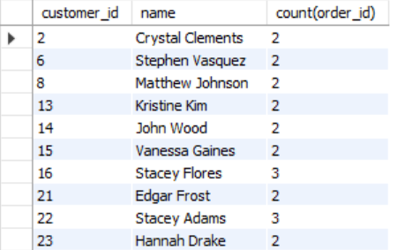
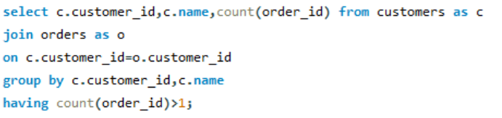
2. Understand Customer Purchasing Behaviour
What is the Average customer spending?
Who are the repeat customers?

Slide 12
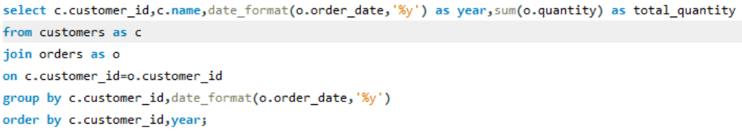
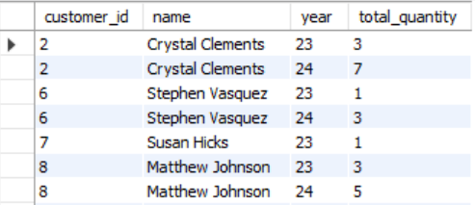
How does customer purchasing behavior change over time?
These queries calculate average customer spending, identify repeat customers, and analyze how customer purchasing behavior changes over time.

Slide 13
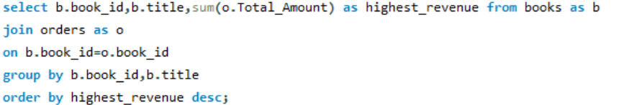
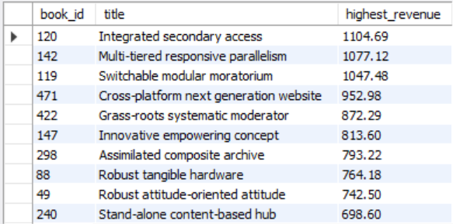
3. Understand Product and Genre Performance
Which books generate the highest revenue?
This query identifies the books that generate the highest revenue, helping determine which books contribute the most to overall sales revenue.

Slide 14
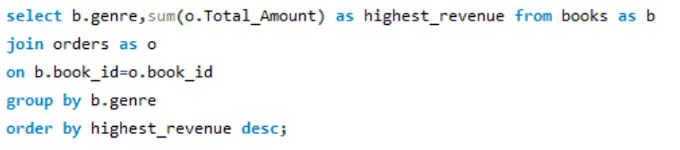
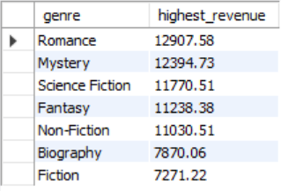
Which genres generate the highest revenue?
This query identifies the genres generating the highest revenue, helping understand which genres contribute most to overall sales and are the most financially successful.

Slide 15

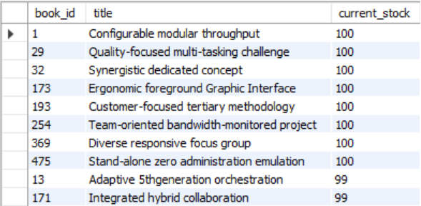
4. Understand Inventory Position
What are the current stock levels of each book?
This query shows the current stock levels of each book, helping monitor inventory, identify low-stock books, and plan restocking efficiently.

Slide 16

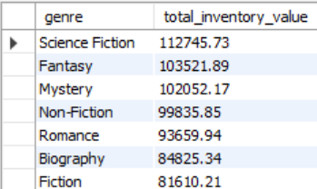
What is the total inventory value by genre?
This query calculates the total value of inventory for each genre, helping compare the financial value of stock across genres and identify which genres hold the most inventory value.

Slide 17
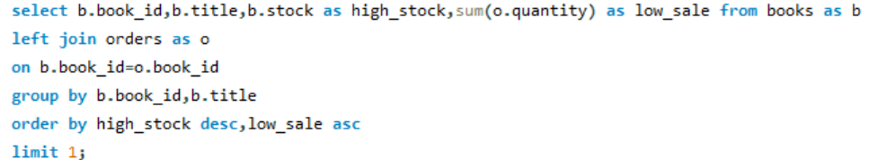

Which books are with high stock but low sales?
This query identifies books with high stock levels but low sales, helping detect slow-moving inventory and improve stock management decisions.

Slide 18
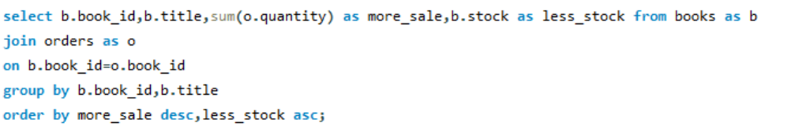
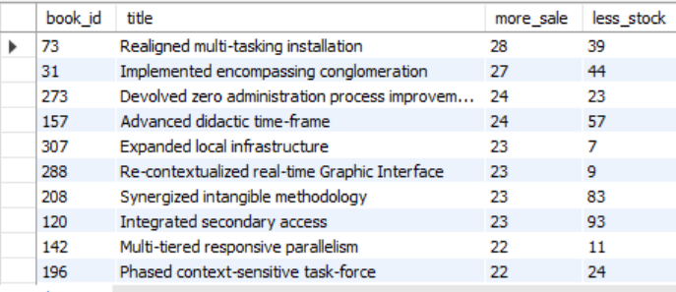
5. Identify Sales and Inventory Opportunities
Which books are with strong demand?
This query helps us to identify the books which are of strong demand as the stock of such books can be maintained and increase the sales.

Slide 19
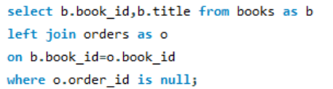
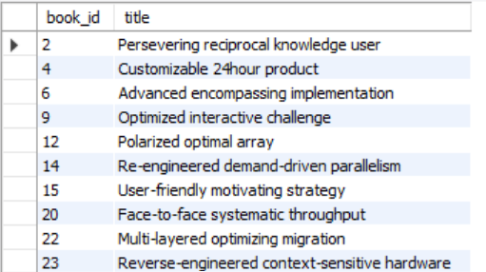
What are the books that have never been ordered?
This query identifies books that have never been ordered, helping detect unsold titles and make better inventory and stocking decisions.

Slide 20
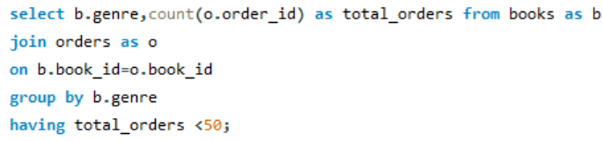

What are the products that may require promotional attention?

Slide 21
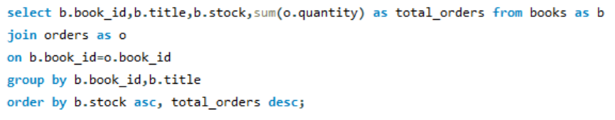
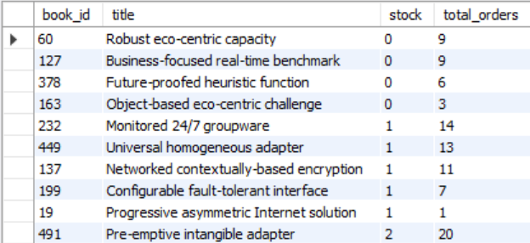
What are the products that may require replenishment?
These queries identify products with low sales that may need promotional attention and products with low stock levels that may require replenishment, helping improve sales and maintain adequate inventory.

Slide 22
Challenges/Experiences
Learned real-time database design
Worked with multiple related tables.
Practiced SQL joins and aggregate queries.
Creating relational database by using foreign keys.
Maintaining data consistency.
Writing complex JOIN queries.
These challenges are solved by using primary keys, foreign keys, aggregate functions like sum(),avg(),count() and clauses like JOIN operations, GROUP BY, ORDER BY.

Slide 23
Conclusion
Successfully designed and implemented an Book Verse Retail Analytics using MySQL.
Managed three interrelated tables for books, customers and orders.
Used SQL queries, joins and aggregate functions to generate meaningful sales and orders insights.
Improved understanding of relational database design, foreign keys, data integrity and SQL-based analysis.
“This project helped me understand how SQL can be used to manage real-world employee data and generate meaningful business insights.”

Slide 24

THANK YOU

