Slide 1

DEPARTMENT OF CSE
Real Time Research Project
A Novel Approach for Disaster Victim Detection Under Debris Environments Using Decision Tree Algorithms With Deep Learning Features
PRESENTED BY(Batch 14):
UNDER THE GUIDANCE OF:
M.Madhusudhan
(Assistant Professor)
Ms.M.Srilekha
Dr.B. Venkateshwarlu Naik
A.Divya Bharati
(Faculty coordinators)
M.NIKITHA | (247R1A05BN)
P.ANJALI | (247R1A05BY)
P.SATHWIKA | (247R1A05CB)

Slide 2
Table of Contents
Abstract
Existing System & Disadvantages
Proposed System & Advantages
Hardware Requirements
Software Requirements
Novelty of project
Project Architecture
Modules
Class Diagram
Use Case Diagram
Sequence Diagram
Collaboration Diagram
Component Diagram
Deployment diagram
Source Code
Results
Conclusion and future enhancement
References
Github Link

Slide 3
Abstract
This project proposes a deep learning based human victim detection system for disaster environments such as collapsed buildings.
The system uses RGB image datasets to identify human body parts like head, hand, leg and upper body.
A Transfer Learning based ResNet-50 model is used to extract features from images.
Machine learning algorithms such as Decision Tree, SVM, Random Forest, MLP and XGBoost are used for classification.
The system improves accuracy, speed and reliability of victim detection, helping rescue teams save lives during disaster situations.

Slide 4
EXISTING SYSTEM
Voice detection
CO₂ sensors
Thermal sensors
Skin color detection
Motion detection
DISADVANTAGES
Slow detection process
Environmental factors affect sensors
Low accuracy in debris environments
Difficulty detecting partially visible victims
High computational complexity

Slide 5
PROPOSED SYSTEM
The proposed system combines:
Deep Learning + Machine Learning
Steps involved:
Dataset collection
Image preprocessing
Feature extraction using ResNet-50
Feature selection using Decision Tree
Classification using ML algorithms
Algorithms used:
SVM
Random Forest
MLP
XGBoost

Slide 6
ADVANTAGES
High detection accuracy
Faster classification
Uses transfer learning for better feature extraction
Works with RGB images
Handles complex debris environments
Supports multiple classification algorithms

Slide 7
NOVELTY OF PROJECT
Combines deep learning (ResNet-50) with machine learning classifiers
Uses decision tree-based feature selection to reduce complexity
Introduces a custom multi-class victim dataset (body parts)
Achieves high accuracy with low computation time
Focuses on fast classification instead of complex detection models
Suitable for real-time disaster rescue applications

Slide 8
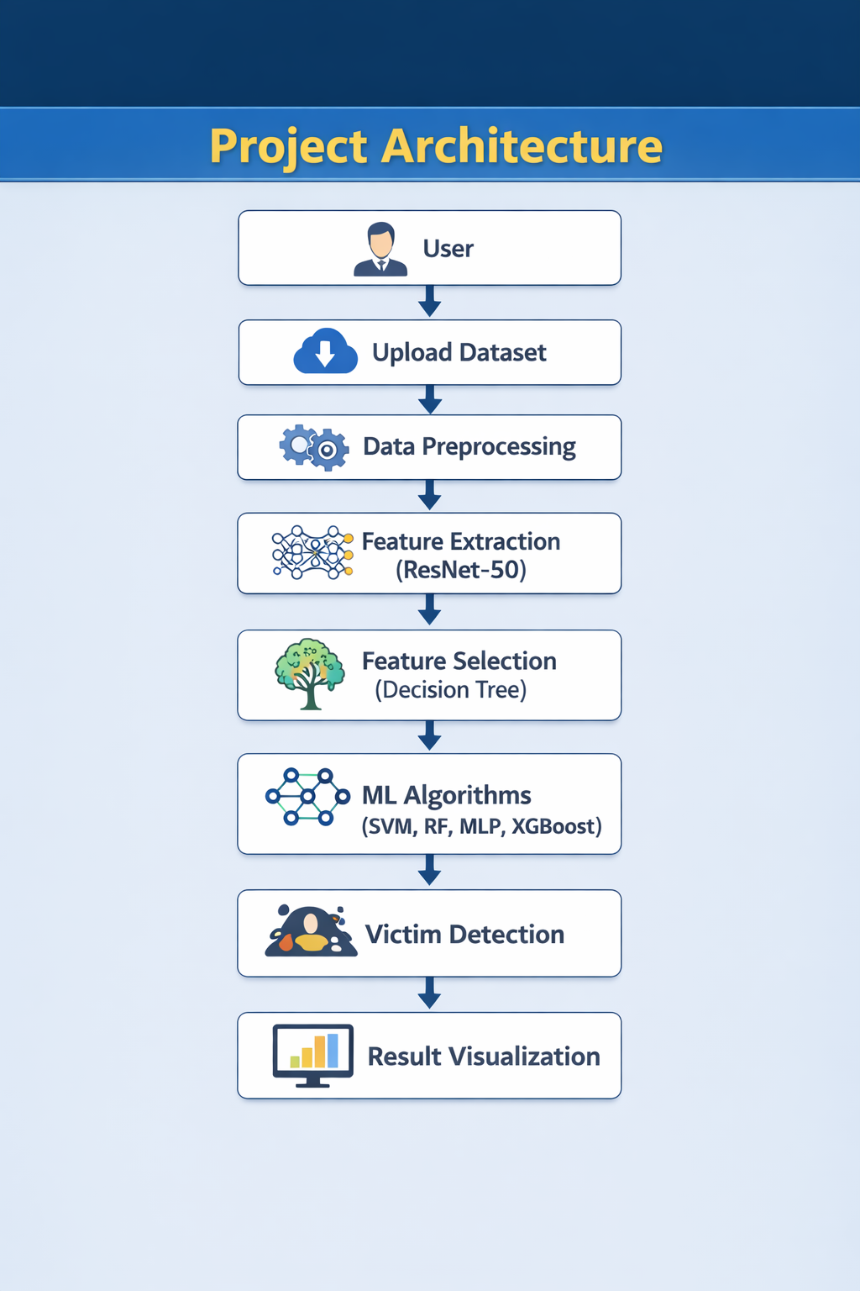
PROJECT ARCHITECTURE

Slide 9
MODULES
1.Data Collection Module
Collects RGB images of human body parts and debris
Creates a custom dataset (head, hand, leg, etc.)
2. Preprocessing Module
Cleans and resizes images
Applies data augmentation (rotation, flipping)
3.Feature Extraction Module
Uses ResNet-50 (Transfer Learning)
Extracts important features from images
4.Feature Selection Module
Uses Decision Tree (J48)
Selects only relevant features to reduce complexity
5.Classification Module
Applies ML algorithms:
SVM
Random Forest
MLP
XGBoost
Classifies the detected body part

Slide 10
CLASS DIAGRAM

Slide 11
Use Case Diagram

Slide 12
Sequence Diagram

Slide 13
CoLLABORATION Diagram

Slide 14
COMPONENT DIAGRAM

Slide 15
DEPLOYMENT DIAGRAM

Slide 16
SAMPLE CODE
from tkinter import *
import tkinter
from tkinter import filedialog
import matplotlib.pyplot as plt
from tkinter.filedialog import askopenfilename
from sklearn.tree import DecisionTreeClassifier
from sklearn.feature_selection import SelectFromModel
import seaborn as sns
import os
from sklearn.metrics import confusion_matrix
import cv2
import numpy as np
from keras.utils.np_utils import to_categorical
from keras.layers import MaxPooling2D
from keras.layers import Dense, Dropout, Activation, Flatten, GlobalAveragePooling2D, BatchNormalization
from keras.layers import Convolution2D
from keras.models import Sequential, load_model, Model
import pickle
from sklearn.metrics import precision_score
from sklearn.metrics import recall_score
from sklearn.metrics import f1_score
from sklearn.metrics import accuracy_score
from sklearn.model_selection import train_test_split
from keras.callbacks import ModelCheckpoint
import keras
from sklearn.metrics import accuracy_score
from sklearn.model_selection import train_test_split
from keras.applications import ResNet50
from sklearn.neural_network import MLPClassifier
from sklearn import svm
from sklearn.ensemble import RandomForestClassifier
import xgboost as xg
import pandas as pd
main = tkinter.Tk()
main.title("A Novel Approach for Disaster Victim Detection Under Debris Environments Using Decision Tree Algorithms With Deep Learning Features")

Slide 17
text.delete('1.0', END)
text.insert(END,filename+" loaded\n\n")
if os.path.exists('model/X.txt.npy'):
X = np.load('model/X.txt.npy')
Y = np.load('model/Y.txt.npy')
else:
X = []
Y = []
for root, dirs, directory in os.walk(path):
for j in range(len(directory)):
name = os.path.basename(root)
if 'Thumbs.db' not in directory[j]:
img = cv2.imread(root+"/"+directory[j])
img = cv2.resize(img, (32, 32))
X.append(img)
label = getLabel(name)
Y.append(label)
main.geometry("1200x1200")
labels = ['Body', 'Hand', 'Leg']
global filename, X, Y, X_train, y_train, X_test, y_test
global resnet_model, accuracy, precision, recall, fscore, resnet_features
global X_train, X_test, y_train, y_test
def getLabel(name):
index = -1
for i in range(len(labels)):
if labels[i] == name:
index = i
break
return index
def uploadDataset():
global filename, X, Y
filename = filedialog.askdirectory(initialdir=".")
pathlabel.config(text=filename)

Slide 18
plt.tight_layout()
plt.show()
def processDataset():
global X, Y
text.delete('1.0', END)
X = X.astype('float32')
X = X/255
indices = np.arange(X.shape[0])
np.random.shuffle(indices)
X = X[indices]
Y = Y[indices]
Y = to_categorical(Y)
text.insert(END,"Images pixels shuffling & normalizations completed\n\n")
text.insert(END,"Total features found in each image = "+str(X.shape[1] * X.shape[2] * X.shape[3])+"\n\n")
def featuresExtraction():
global X, Y, resnet_model, resnet_features
X = np.asarray(X)
Y = np.asarray(Y)
np.save('model/X.txt',X)
np.save('model/Y.txt',Y)
text.insert(END,"Total images loaded = "+str(X.shape[0])+"\n")
text.insert(END,"Victim Parts Found in Dataset : "+str(labels))
unique, count = np.unique(Y, return_counts = True)
height = count
bars = labels
y_pos = np.arange(len(bars))
plt.figure(figsize=(6,3))
plt.bar(y_pos, height)
plt.xticks(y_pos, bars)
plt.xlabel("Victim Dataset Graphs")
plt.ylabel("Count")
plt.title("Dataset Class Label Graph")

Slide 19
resnet_model = ResNet50(input_shape=(X.shape[1], X.shape[2],
X.shape[3]), include_top=False, weights='imagenet')
for layer in resnet_model.layers:
layer.trainable = False
resnet_model = Sequential()
resnet_model.add(Convolution2D(32, (3, 3), input_shape =
(X.shape[1], X.shape[2], X.shape[3]), activation = 'relu'))
resnet_model.add(MaxPooling2D(pool_size = (2, 2)))
resnet_model.add(Convolution2D(32, (3, 3), activation = 'relu'))
resnet_model.add(MaxPooling2D(pool_size = (2, 2)))
resnet_model.add(Flatten())
resnet_model.add(Dense(units = 256, activation = 'relu'))
resnet_model.add(Dense(units = Y.shape[1], activation = 'softmax'))
resnet_model.compile(optimizer = 'adam', loss = 'categorical_cross
entropy', metrics = ['accuracy'])
if os.path.exists("model/resnet_weights.hdf5") == False:
model_check_point
=ModelCheckpoint(filepath='model/resnet_weights.hdf5',verbose=1, save_best_only = True)
hist = resnet_model.fit(X, Y, batch_size = 32, epochs = 20,
validation_data=(X, Y), callbacks=[model_check_point], verbose=1)
f = open('model/resnet_history.pckl', 'wb')
pickle.dump(hist.history, f)
f.close()
else:
resnet_model.load_weights("model/resnet_weights.hdf5")
resnet_features = Model(resnet_model.inputs, resnet_model.layers[-2].output)
#create resnet model
resnet_features = resnet_features.predict(X) #extracting resnet features
Y = np.argmax(Y, axis=1)
text.insert(END,"Total features extracted by ResNet50 from
each Image : "+str(resnet_features.shape[1])+"\n\n")
def featuresSelection():
global resnet_features, Y
global X_train, X_test, y_train, y_test
dt_cls = DecisionTreeClassifier()

Slide 20
selector = SelectFromModel(dt_cls, threshold=0.00000005)
selector.fit(resnet_features, Y)#train algorithm using training features
and target value
selected_features = selector.get_support()
resnet_features = resnet_features[:,selected_features] #extract selected features
text.insert(END,"Total features selected by Decision Tree (J48) Algorithm : "+str(resnet_features.shape[1])+"\n\n")
X_train, X_test, y_train, y_test = train_test_split(resnet_features,
Y, test_size=0.2)
text.insert(END,"Dataset Training & Testing Details\n\n")
text.insert(END,"80% images for training : "+str(X_train.shape[0])+"\n")
text.insert(END,"20% images for testing : "+str(X_test.shape[0])+"\n")
#function to calculate all metrics
def calculateMetrics(algorithm, testY, predict):
global labels
p = precision_score(testY, predict,average='macro') * 100
r = recall_score(testY, predict,average='macro') * 100
f = f1_score(testY, predict,average='macro') * 100
a = accuracy_score(testY,predict)*100
accuracy.append(a)
precision.append(p)
recall.append(r)
fscore.append(f)
text.insert(END,algorithm+" Accuracy : "+str(a)+"\n")
text.insert(END,algorithm+" Precision : "+str(p)+"\n")
text.insert(END,algorithm+" Recall : "+str(r)+"\n")
text.insert(END,algorithm+" FSCORE : "+str(f)+"\n\n")
conf_matrix = confusion_matrix(testY, predict)
plt.figure(figsize =(6, 3))
ax = sns.heatmap(conf_matrix, xticklabels = labels, yticklabels = labels,
annot = True, cmap="viridis" ,fmt ="g");
ax.set_ylim([0,len(labels)])
plt.title(algorithm+" Confusion matrix")
plt.xticks(rotation=90)
plt.ylabel('True class')
plt.xlabel('Predicted class')
plt.show()

Slide 21
def runSVM():
global X_train, X_test, y_train, y_test
global accuracy, precision, recall, fscore
text.delete('1.0', END)
accuracy = []
precision = []
recall = []
fscore = []
svm_cls = svm.SVC(C=102.0, tol=1.9)
svm_cls.fit(X_train, y_train)
predict = svm_cls.predict(X_test)
calculateMetrics("SVM", y_test, predict)
def runRandomForest():
rf_cls = RandomForestClassifier()
rf_cls.fit(X_train, y_train)
predict = rf_cls.predict(X_test)
calculateMetrics("Random Forest", y_test, predict)
def runNaiveBayes():
mlp_cls = MLPClassifier(hidden_layer_sizes=2)
mlp_cls.fit(X_train, y_train)
predict = mlp_cls.predict(X_test)
calculateMetrics("MLP", y_test, predict)
def runExtension():
global accuracy, precision, recall, fscore, X_train, X_test, y_train, y_test
X_train, X_test1, y_train, y_test1 = train_test_split(resnet_features, Y, test_size=0.1)
xg_model = xg.XGBClassifier() #create XGBOost object
xg_model.fit(X_train, y_train)
predict = xg_model.predict(X_test)
calculateMetrics("Extension XGBoost", y_test, predict)
def graph():
global accuracy, precision, recall, fscore, rmse
df = pd.DataFrame([['SVM','Precision',precision[0]],['SVM','Recall',recall[0]],['SVM','F1 Score',fscore[0]],['SVM','Accuracy',accuracy[0]],
['Random Forest','Precision',precision[1]],['Random Forest','Recall',recall[1]],['Random Forest','F1 Score',fscore[1]],['Random Forest','Accuracy',accuracy[1]],

Slide 22
['Naive Bayes','Precision',precision[2]],['Naive Bayes','Recall',recall[2]],['Naive Bayes','F1 Score',fscore[2]],['Naive Bayes','Accuracy',accuracy[2]],['Extension XGBoost','Precision',precision[3]],
['ExtensionXGBoost','Recall',recall[3]],['ExtensionXGBoost','F1Score',fscore[3]],['Extension XGBoost','Accuracy',accuracy[3]],],columns=['Algorithms','Performance Output','Value'])
df.pivot("Algorithms", "Performance Output", "Value").plot(kind='bar')
plt.show()
def predict():
global resnet_model, labels
filename = filedialog.askopenfilename(initialdir="testImages")
pathlabel.config(text=filename)
text.delete('1.0', END)
img = cv2.imread(filename)
img = cv2.resize(img, (32,32))#resize image
im2arr = np.array(img)
im2arr = im2arr.reshape(1,32,32,3)
img = np.asarray(im2arr)
img = img.astype('float32')
img = img/255 #normalizing test image
predict = resnet_model.predict(img)#now using cnn model
to detcet tumor damage
predict = np.argmax(predict)
img = cv2.imread(filename)
img = cv2.resize(img, (600,400))
cv2.putText(img, 'Victim Part Detected : '+labels[predict],
(100, 25), cv2.FONT_HERSHEY_SIMPLEX,0.7, (0, 0, 255), 2)
cv2.imshow("Predicted Output", img)
cv2.waitKey(0)
font = ('times', 15, 'bold')
title = Label(main, text='A Novel Approach for Disaster Victim
Detection Under Debris Environments Using Decision Tree
Algorithms With Deep Learning Features')
title.config(bg='brown', fg='white')
title.config(font=font)

Slide 23
resnetButton = Button(main, text="Extract Features from ResNet50", command=featuresExtraction)
resnetButton.place(x=350,y=150)
resnetButton.config(font=font1)
dtButton.config(font=font1)
svmButton = Button(main, text="Run SVM Algorithm", command=runSVM)
svmButton.place(x=50,y=200)
svmButton.config(font=font1)
rfButton = Button(main, text="Run Random Forest", command=runRandomForest)
rfButton.place(x=350,y=200)
rfButton.config(font=font1)
nbButton = Button(main, text="Run MLP Algorithm", command=runNaiveBayes)
nbButton.place(x=650,y=200)
nbButton.config(font=font1)
graphButton = Button(main, text="Comparison Graph", command=graph)
graphButton.place(x=350,y=250)
graphButton.config(font=font1)
predictButton = Button(main, text="Victim Detection from Test Image", command=predict)
predictButton.place(x=650,y=250)
title.config(height=3, width=120)
title.place(x=30,y=5)
font1 = ('times', 13, 'bold')
upload = Button(main, text="Upload Victim
Detection Dataset", command=uploadDataset)
upload.place(x=50,y=100)
upload.config(font=font1)
pathlabel = Label(main)
pathlabel.config(bg='brown', fg='white')
pathlabel.config(font=font1)
pathlabel.place(x=480,y=100)
processButton = Button(main, text="Features Processing
& Normalizaton", command=processDataset)
processButton.place(x=50,y=150)
processButton.config(font=font1)
dtButton = Button(main, text="Features Selection Decision
Tree", command=featuresSelection)
dtButton.place(x=650,y=150)

Slide 24
predictButton.config(font=font1)
font1 = ('times', 12, 'bold')
text=Text(main,height=20,width=150)
scroll=Scrollbar(text)
text.configure(yscrollcommand=scroll.set)
text.place(x=10,y=300)
text.config(font=font1)
main.config(bg='brown')
main.mainloop()

Slide 25
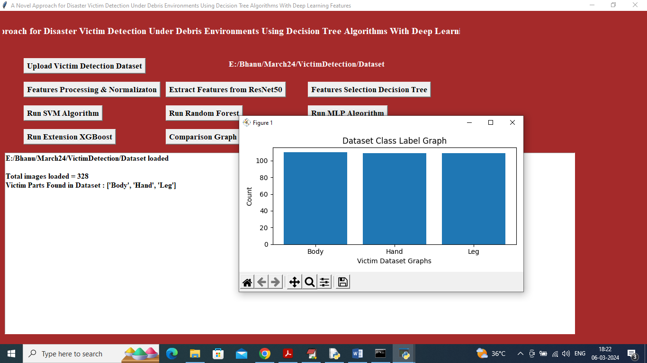
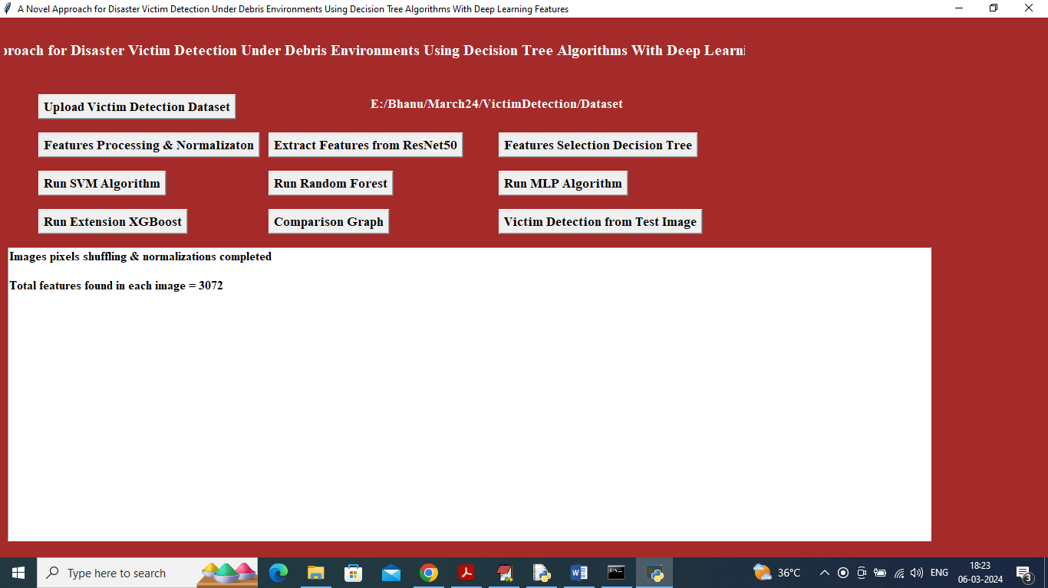
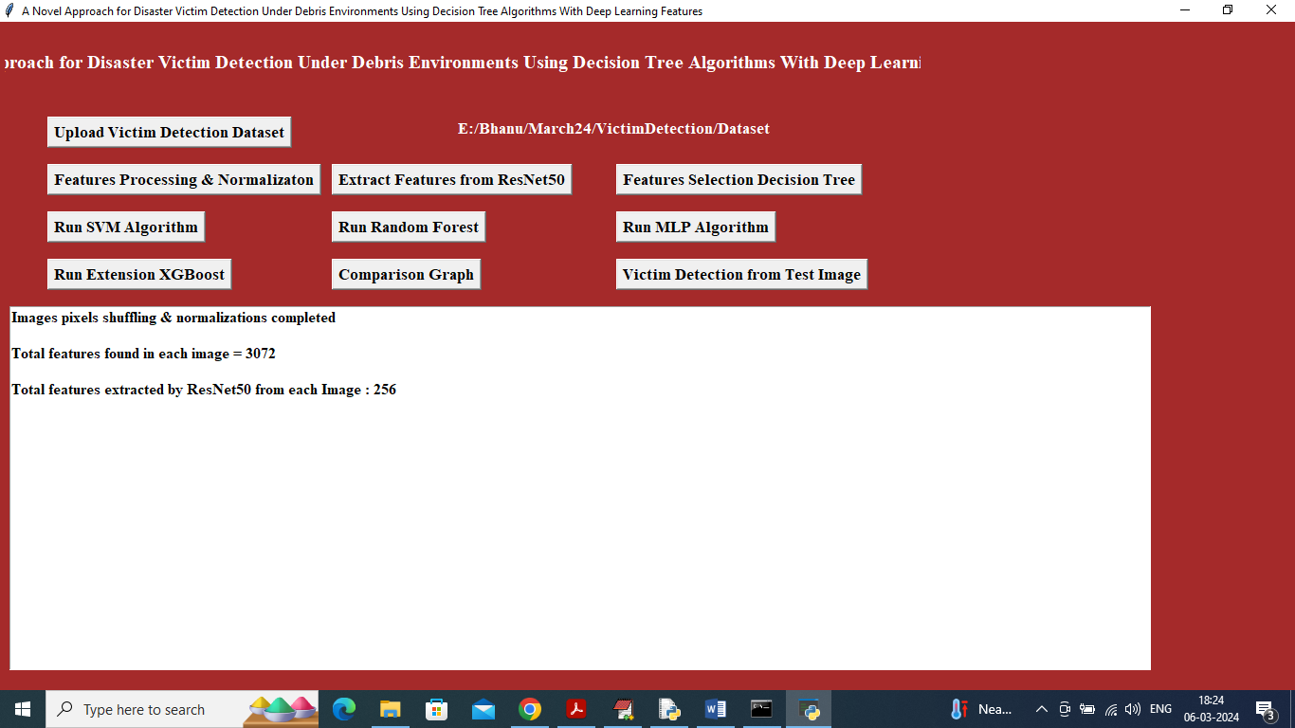

SAMPLE OUTPUT

Slide 26
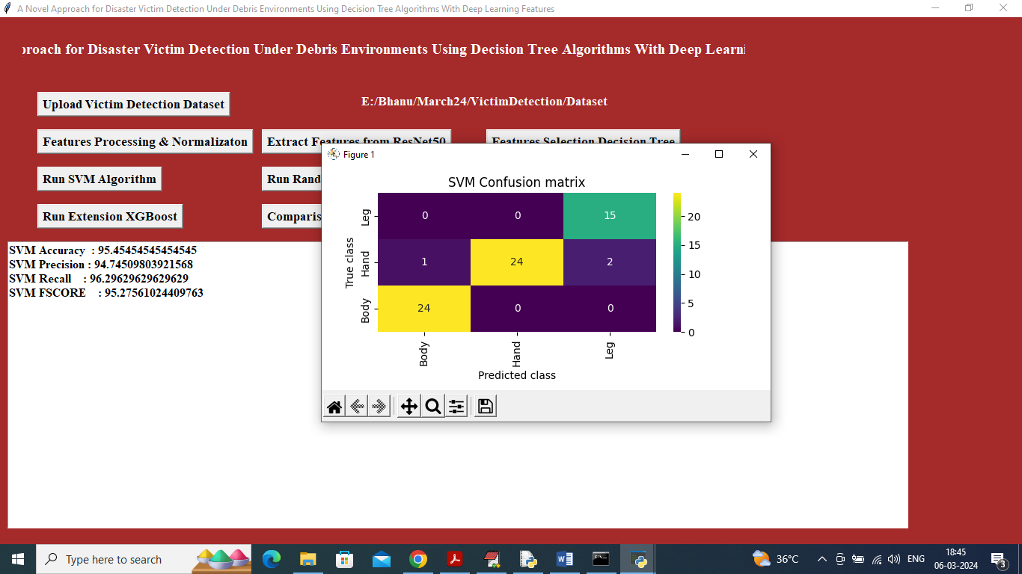
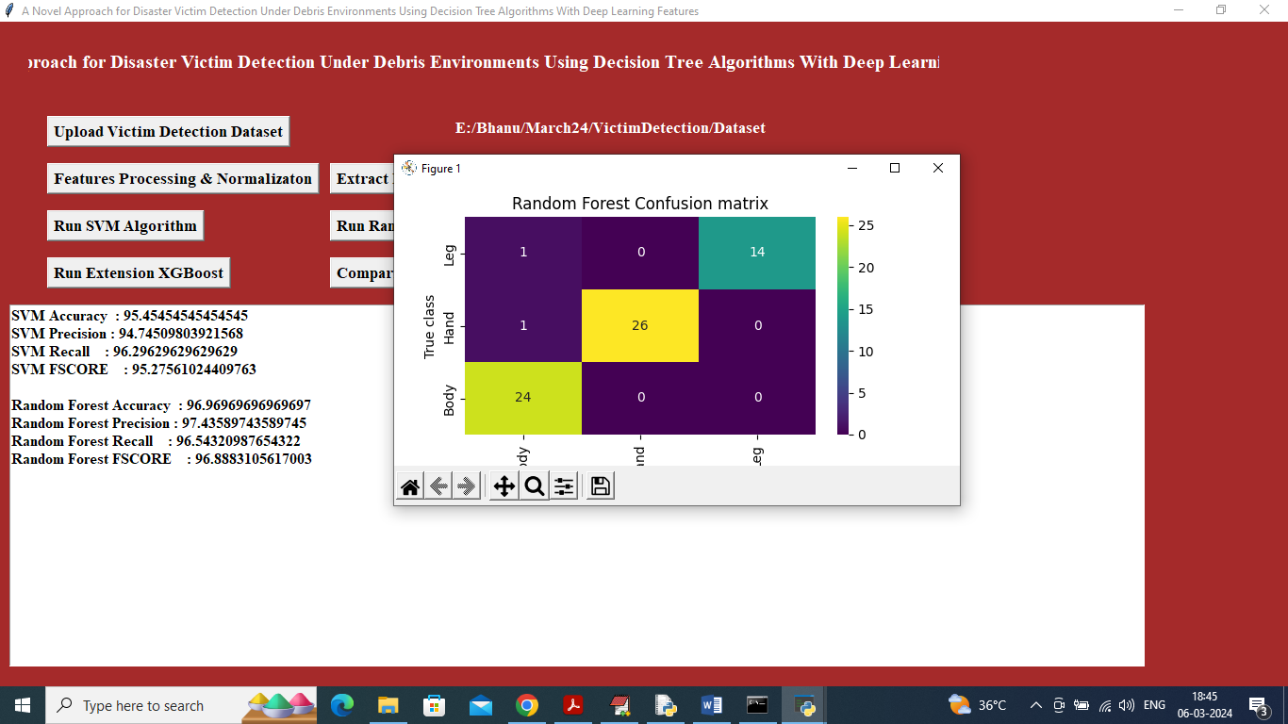
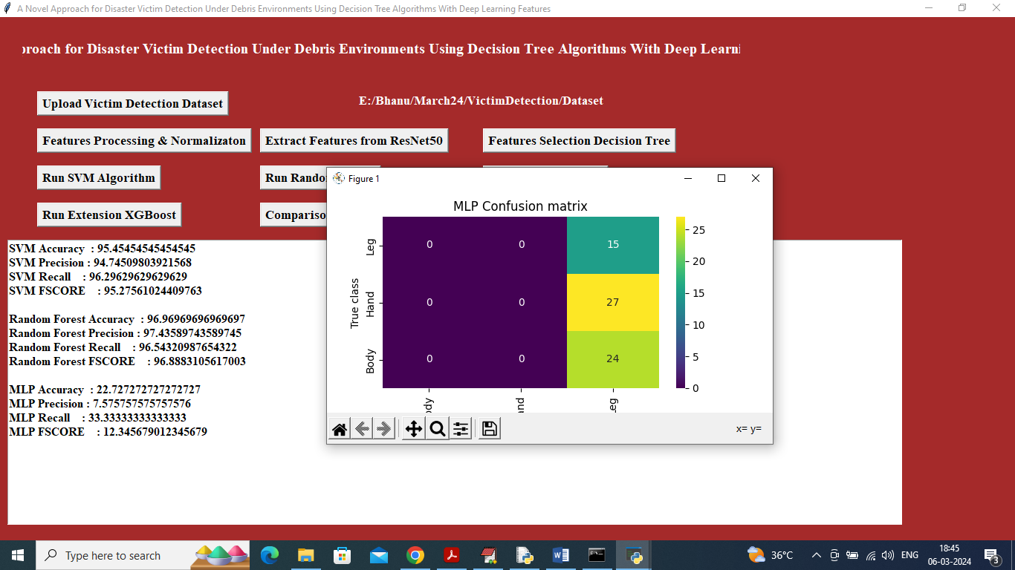
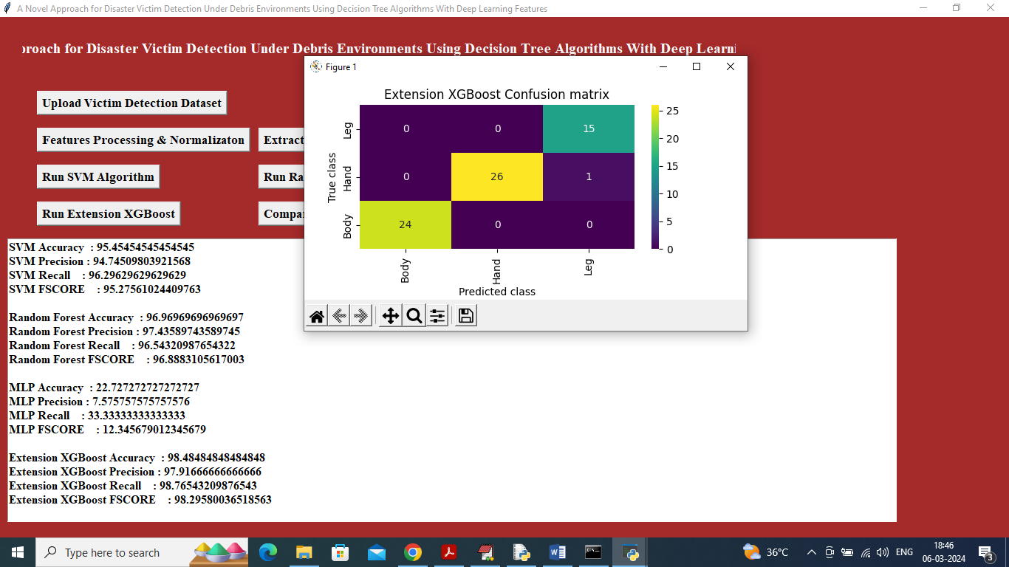

Slide 27
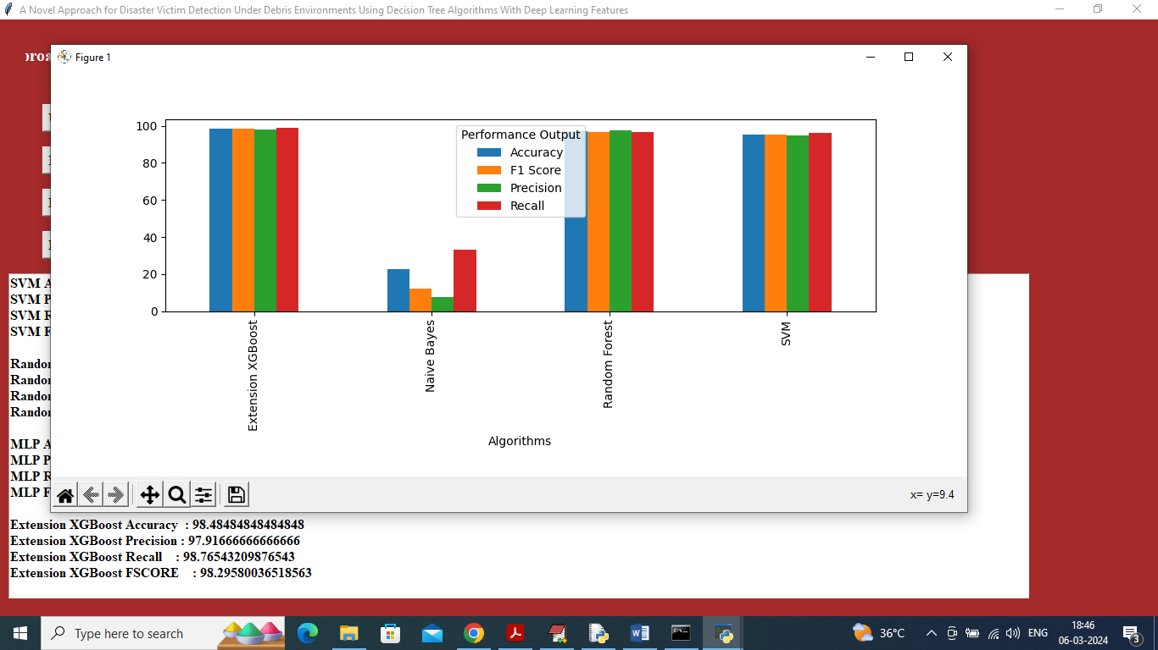
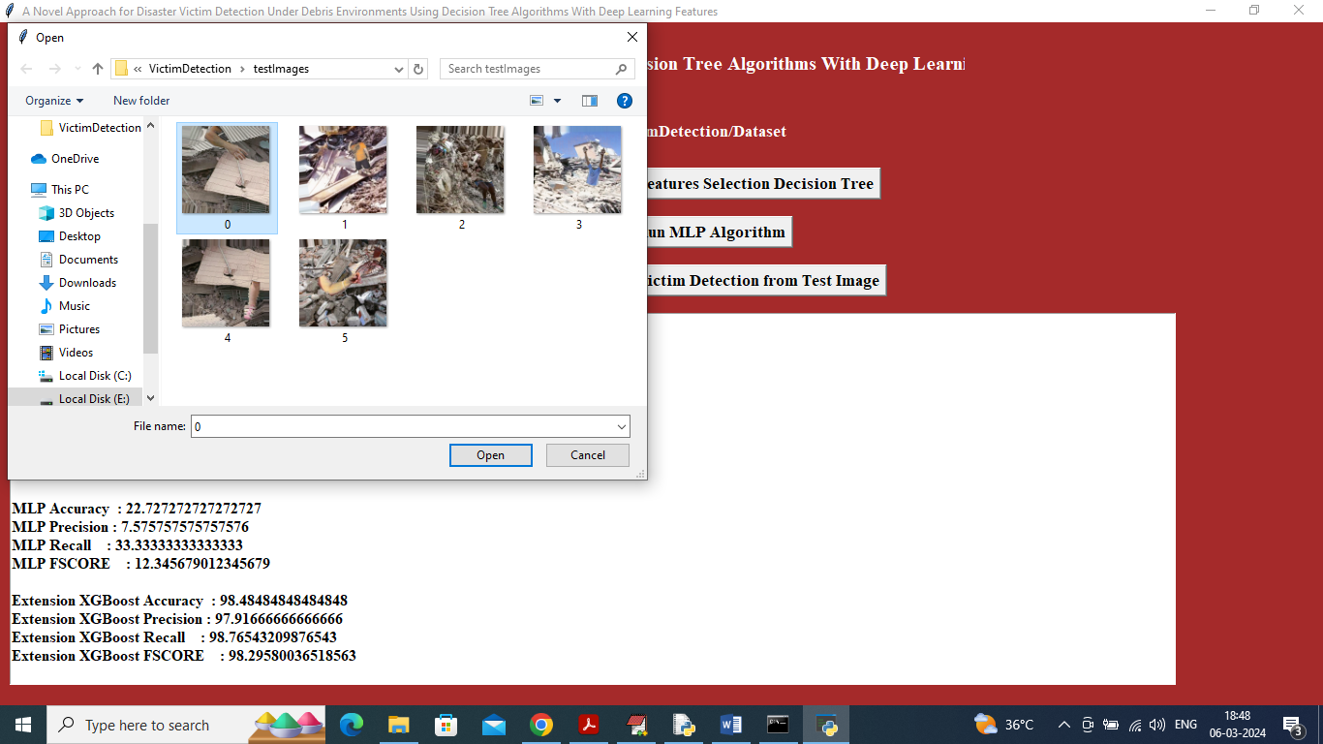
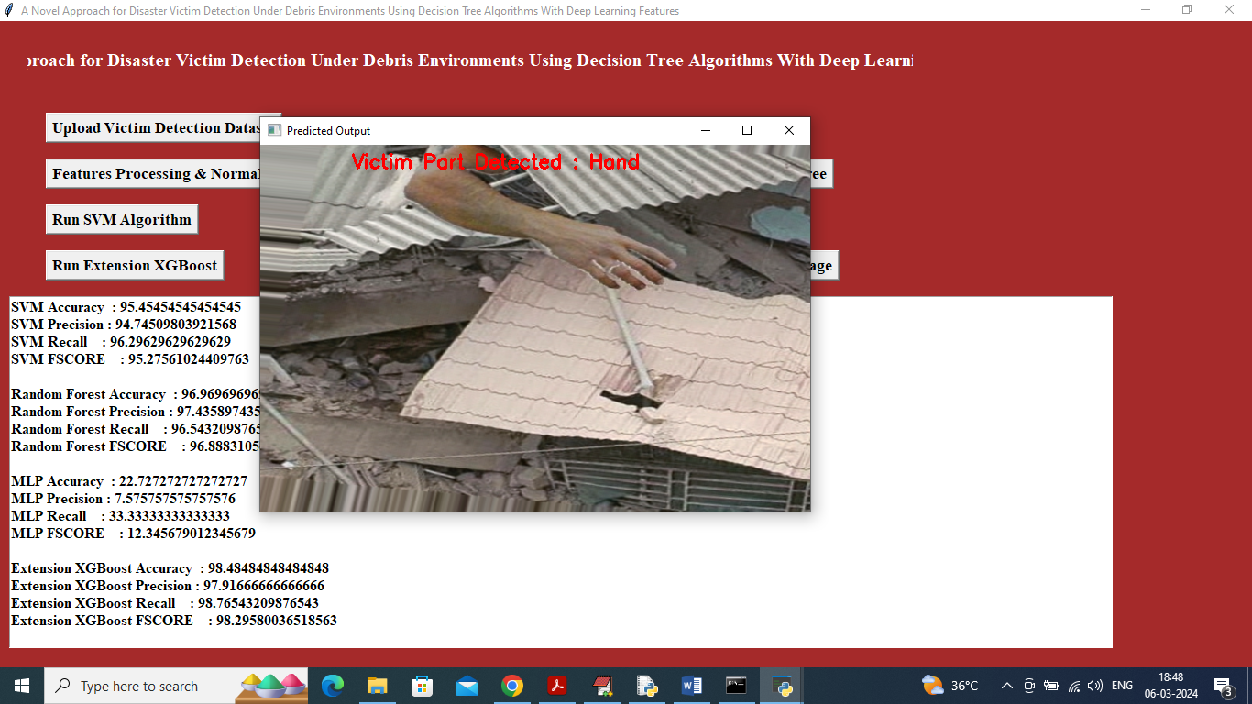

Slide 28
Conclusion AND FUTURE ENHANCEMENT
Improved detection accuracy.
Efficient feature extraction using ResNet50.
Better classification using Random Forest and XGBoost.
Faster identification of victims under debris.
Use thermal and infrared images along with RGB for better detection
Integrate with rescue robots or drones for real-time operations
Add real-time live video detection instead of only images

Slide 29
References
N. Lopac, F. Hržic, I. P. Vuksanovic, and J. Lerga, ‘‘Detection of non-stationary GW signals in high noise from Cohen’s class of timefrequency representations using deep learning,’’ IEEE Access, vol. 10, pp. 2408–2428, 2022.
G. Seeja, A. S. A. Doss, and V. B. Hency, ‘‘A survey on snake robot locomotion,’’ IEEE Access, vol. 10, pp. 112100–112116, 2022.
N. Lopac, F. Hržic, I. P. Vuksanovic, and J. Lerga, ‘‘Detection of non-stationary GW signals in high noise from Cohen’s class of timefrequency representations using deep learning,’’ IEEE Access, vol. 10, pp. 2408–2428, 2022.

Slide 30
GITHUB LINK
https://github.com/Nikitha-mandala/RTRP-project-python-Nikitha.git

Slide 31


