Slide 1
OBE Implementation
Module - 4:School Setting
Submitted By
Peketi Jaswanth Sri Phanidar Reddy - AP22110010304
Yuva Komara - AP22110010327
Katragadda Prudhvi Raju - AP22110010307
USSV Sathwik Naidu - AP22110010293
Nikith Sri Kommalapati - AP22110010351
Vishnu Priya Vayya - AP22110010390

Slide 2
Introduction to Project
Outcome-Based Education (OBE) is a student-centric teaching and learning model that focuses on measuring student performance through outcomes. It emphasizes the achievement of specific competencies at the end of educational experiences. SRM University - Andhra Pradesh has adopted the OBE framework across its academic infrastructure to align its curriculum and evaluation system with international standards.
The purpose of this document is to present a detailed project report on the development of the "Schools" module, which is a part of the comprehensive OBE Implementation System. The Schools module is one of the foundational layers of the system, enabling the management of various schools under the university's administration. Developed using Java and integrated with a MySQL database, this module supports Create, Update, Retrieve, and Delete (CURD) operations for school entities.

Slide 3
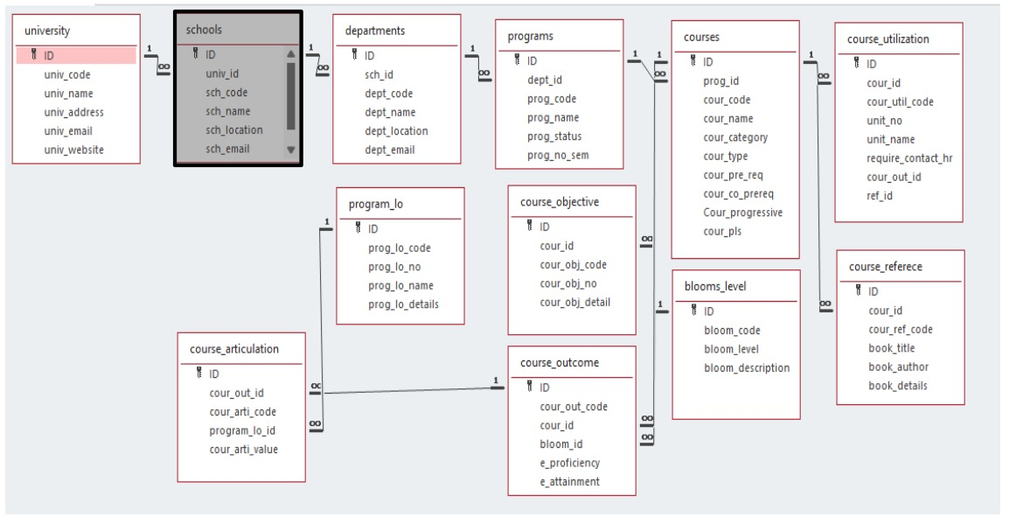
Architecture Diagram

Slide 4
Module Description : School
The Schools Module allows university staff to create, retrieve, update, and delete (CRUD) school information with data such as school code, name, and location linked to the university ID (uni_id).
It depends on the University Module for uni_id linkage and provides data to the Departments Module using the school code (sch_code).
Target users include university administrators, academic coordinators, and IT system administrators.
The module integrates with a MySQL database for storing and managing school data efficiently.
It ensure smooth inter-module communication and accurate data flow between university entities, supporting efficient academic and administrative management.

Slide 5
Table Details: schools
Field Name | Data type
id | integer
uni_id | String
uni_code | String
uni_name | String
uni_location | String
uni_email | String

Slide 6
University Setting : Programming Details
Class/Activity: Schools
Functions:
Create: create.schools()
Update: update.schools()
Retrieve: retrieve.schools()
Delete: delete.schools()

Slide 7
Sample Source Code
private void addSchool() {
try {
String query = "INSERT INTO schools (uni_id, sch_code, sch_name, sch_location, sch_email) VALUES (?, ?, ?, ?, ?)";
pst = con.prepareStatement(query);
pst.setString(1, tfUniID.getText());
pst.setString(2, tfSchCode.getText());
pst.setString(3, tfSchName.getText());
pst.setString(4, tfSchLocation.getText());
pst.setString(5, tfSchEmail.getText());
pst.executeUpdate();
System.out.println("School Added Successfully!");
clearForm();
} catch (SQLException e) {
e.printStackTrace();
}
}

Slide 8
Sample Source Code
private void updateSchool() {
try {
String query = "UPDATE schools SET uni_id = ?, sch_name = ?, sch_location = ?, sch_email = ? WHERE sch_code = ?";
pst = con.prepareStatement(query);
pst.setString(1, tfUniID.getText());
pst.setString(2, tfSchName.getText());
pst.setString(3, tfSchLocation.getText());
pst.setString(4, tfSchEmail.getText());
pst.setString(5, tfSchCode.getText());
int rowsAffected = pst.executeUpdate();
if (rowsAffected > 0) {
System.out.println("School Updated Successfully!");
clearForm();
} else {
System.out.println("No matching school found for update.");
}
}
catch (SQLException e) {
e.printStackTrace();
}
}

Slide 9
Sample Source Code
private void deleteSchool() {
try {
String query = "DELETE FROM schools WHERE sch_code = ?";
pst = con.prepareStatement(query);
pst.setString(1, tfSchCode.getText());
pst.executeUpdate();
System.out.println("School Deleted Successfully!");
clearForm();
} catch (SQLException e) {
e.printStackTrace();
}
}

Slide 10
Sample Source Code
private void retrieveSchool() {
try {
String query = "SELECT * FROM schools WHERE sch_code = ?";
pst = con.prepareStatement(query);
pst.setString(1, tfSchCode.getText());
ResultSet rs = pst.executeQuery();
if (rs.next()) {
tfUniID.setText(rs.getString("uni_id"));
tfSchName.setText(rs.getString("sch_name"));
tfSchLocation.setText(rs.getString("sch_location"));
tfSchEmail.setText(rs.getString("sch_email"));
System.out.println("School Retrieved Successfully!");
} else {
System.out.println("No School Found!");
}
} catch (SQLException e) {
e.printStackTrace();
}
}

Slide 11
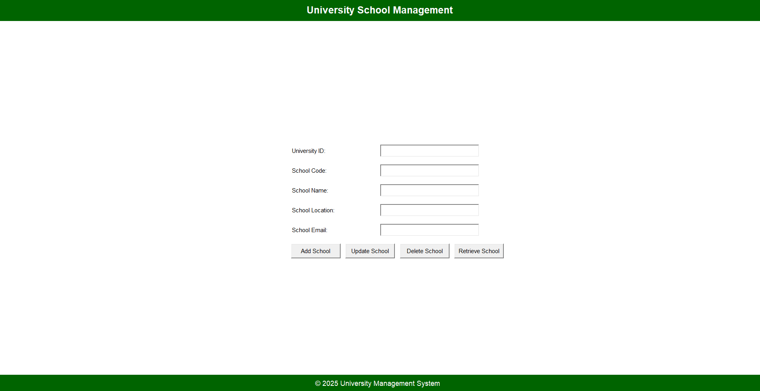
GUI Screenshot

Slide 12
Conclusion
The Schools module is a key component of the OBE Implementation System at SRM-AP, enabling structured management of core academic entities such as school names, codes, and locations. Designed for university administrators, it ensures efficient data handling through secure CRUD operations. Developed using Java for the desktop interface and MySQL for backend data storage, the module offers a reliable, scalable, and user-friendly experience. Its integration within the broader academic ecosystem allows for seamless data flow between related modules, such as University and Departments, supporting smooth academic operations and decision-making within the institution’s outcome-based education framework.

Slide 13
Thank You

