Slide 1
IBM University Engagement Project Submission
“Exploring the Power of Machine Learning with IBM Cloud”

Slide 2
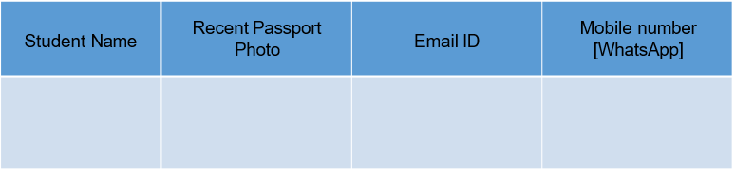

Project Title –
Predictive Maintenance of Industrial Machinery Using IBM watsonx.ai AutoAI
Domain of Project –
Machine Learning / Predictive Maintenance / Industrial AI
Gunda Nikitha
nikithagunda5@gmail.com
7032451345

Slide 3
Problem Statement – Predictive Maintenance of Industrial Machinery Using Machine Learning
Unexpected failures of industrial machinery can lead to costly production downtime, increased maintenance expenses, reduced productivity, and safety risks in manufacturing environments. Traditional maintenance strategies, such as reactive maintenance (repair after failure) and preventive maintenance (scheduled servicing), often fail to identify potential equipment failures in advance, resulting in unnecessary maintenance or unexpected breakdowns. Modern industries generate large amounts of machine sensor data that can be leveraged to predict failures before they occur. The objective of this project is to design, build, and evaluate a multi-class machine learning classification model that accurately predicts different types of machine failures based on operational parameters such as air temperature, process temperature, rotational speed, torque, tool wear, and machine type. The goal is to develop a reliable predictive maintenance solution that assists industries in identifying potential equipment failures early, enabling timely maintenance decisions, minimizing downtime, reducing operational costs, and improving overall equipment reliability and efficiency.

Slide 4
Proposed Solution – (IBM watsonx.ai Studio – AutoAI)
We propose an AI-powered Predictive Maintenance System using IBM watsonx.ai Studio and AutoAI.
Historical machine operational data, including air temperature, process temperature, rotational speed, torque, tool wear, and machine type, was collected and uploaded to IBM watsonx.ai.
AutoAI automatically performs data preprocessing, feature engineering, algorithm selection, model training, and hyperparameter optimization to identify the most suitable machine learning model.
Multiple classification models are generated, trained, and evaluated using performance metrics such as accuracy, precision, recall, and F1-score to determine the best-performing model for machine failure prediction.
The selected model is deployed as an online deployment on IBM Cloud, enabling users to provide new machine sensor values and receive real-time predictions indicating whether the machine is operating normally or is likely to experience a specific failure type. This intelligent solution helps industries perform proactive maintenance, minimize unexpected equipment failures, reduce maintenance costs, and improve overall operational efficiency.

Slide 5
Technology Used
IBM Cloud – It provides the infrastructure to build, train, deploy, and manage the predictive maintenance solution efficiently. IBM Cloud offers a secure, reliable, and scalable platform for machine learning model development and online deployment.
IBM watsonx.ai Studio – Used to build the machine learning solution, manage datasets, perform AutoAI experiments, and evaluate multiple machine learning models.
IBM AutoAI – Automatically performs data preprocessing, feature engineering, algorithm selection, model training, hyperparameter optimization, and identifies the best-performing machine learning model.
ML Algorithm / Model Used: Snap Random Forest Classifier (Best Model selected by IBM AutoAI)
Accuracy Obtained: 99.6% (Holdout Accuracy)
Enhancements and Hyperparameter Tuning: Performed automatically by IBM AutoAI, including automated data preprocessing, feature engineering, algorithm comparison, hyperparameter optimization (HPO), and model ranking to select the optimal model for deployment.

Slide 6
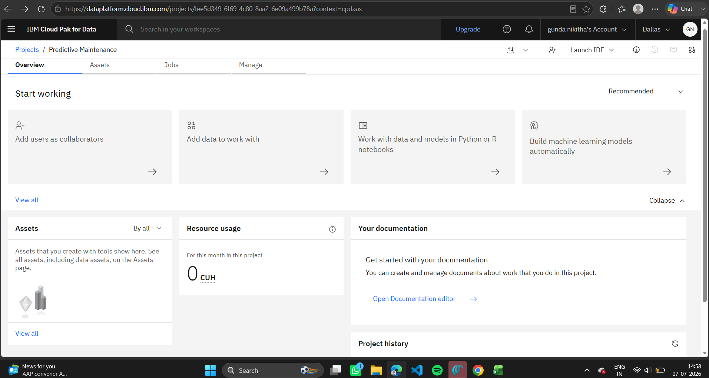
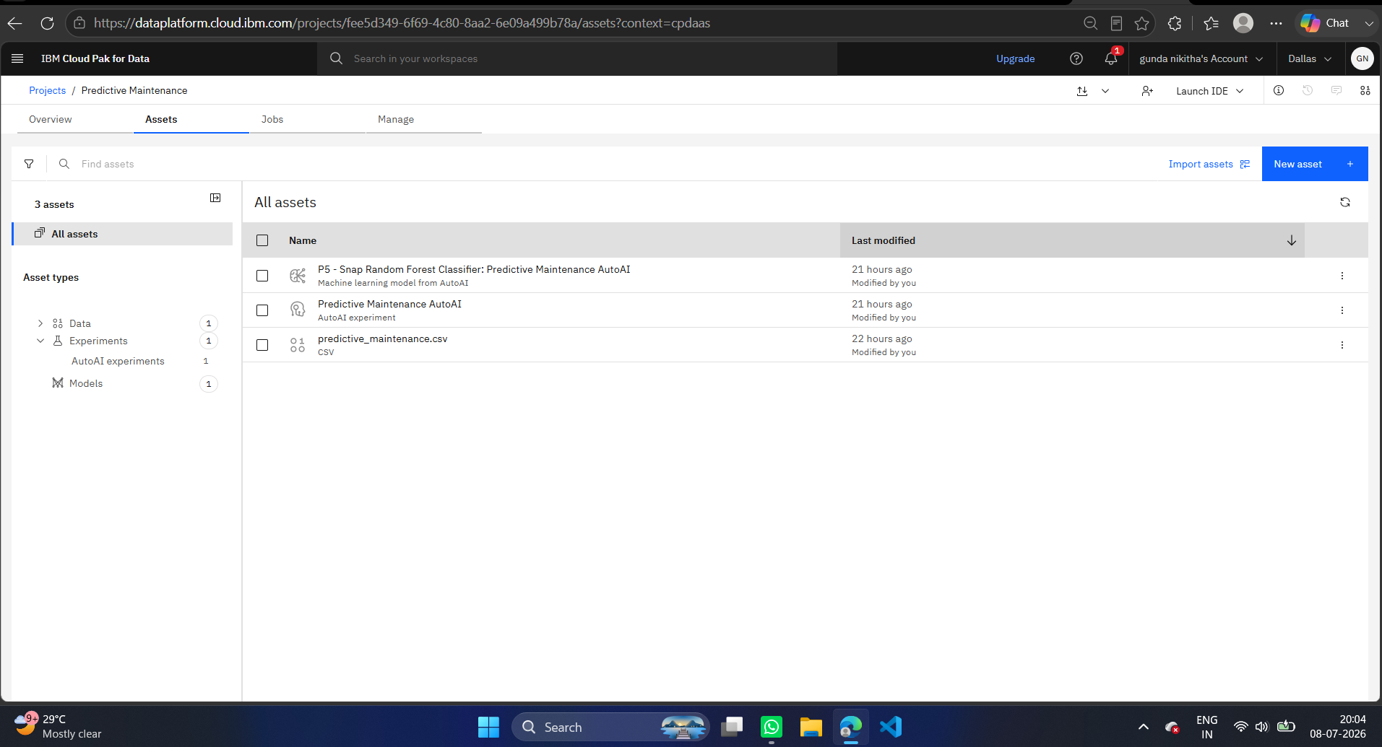

Slide 7
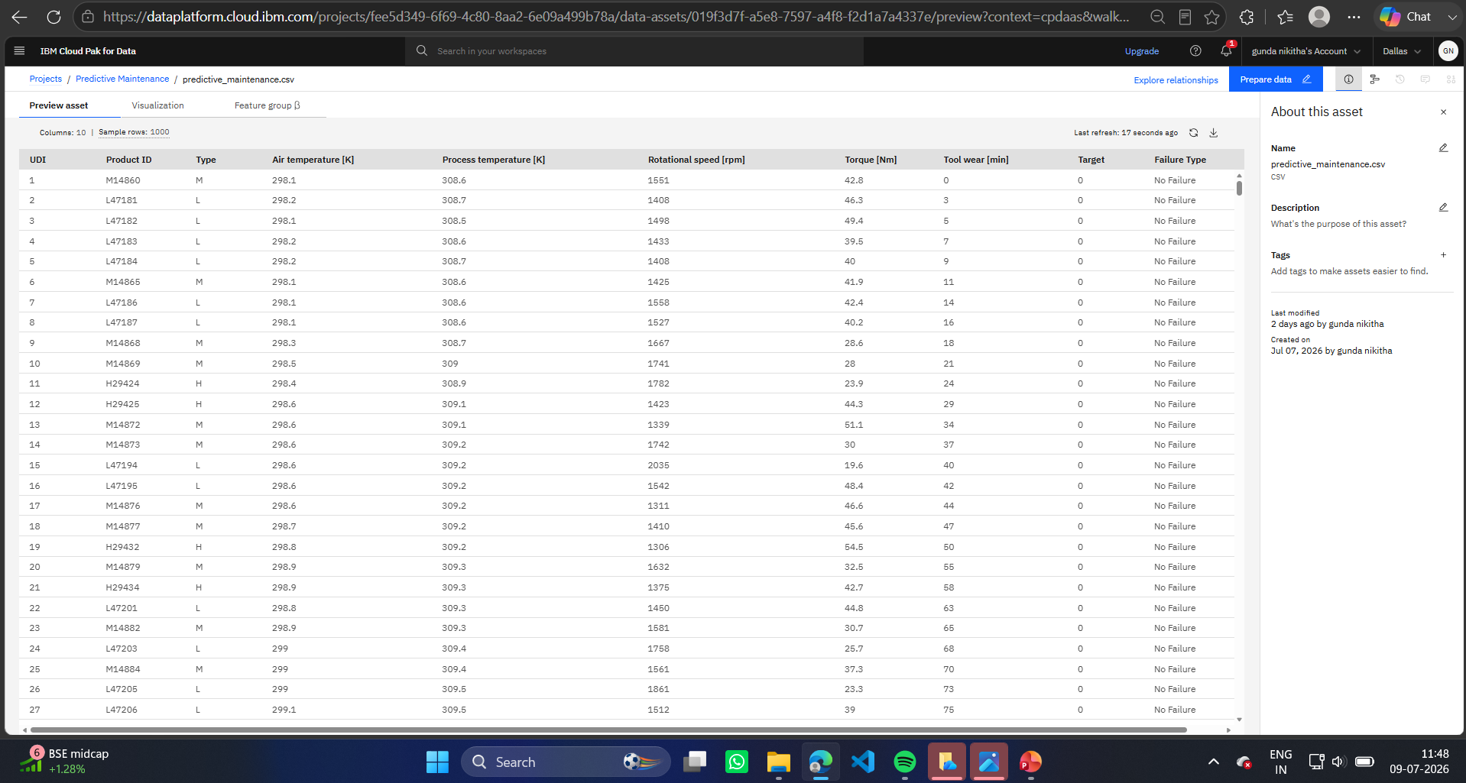

Slide 8
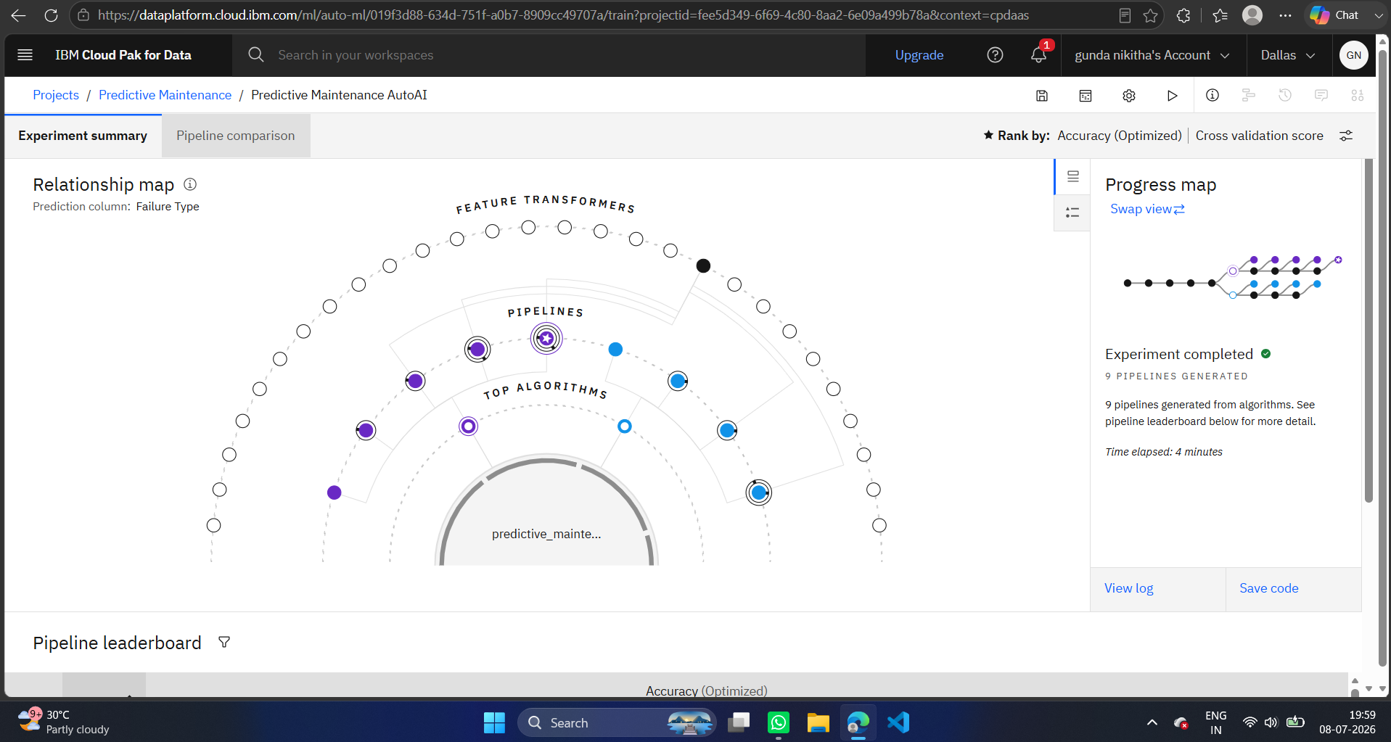

Slide 9
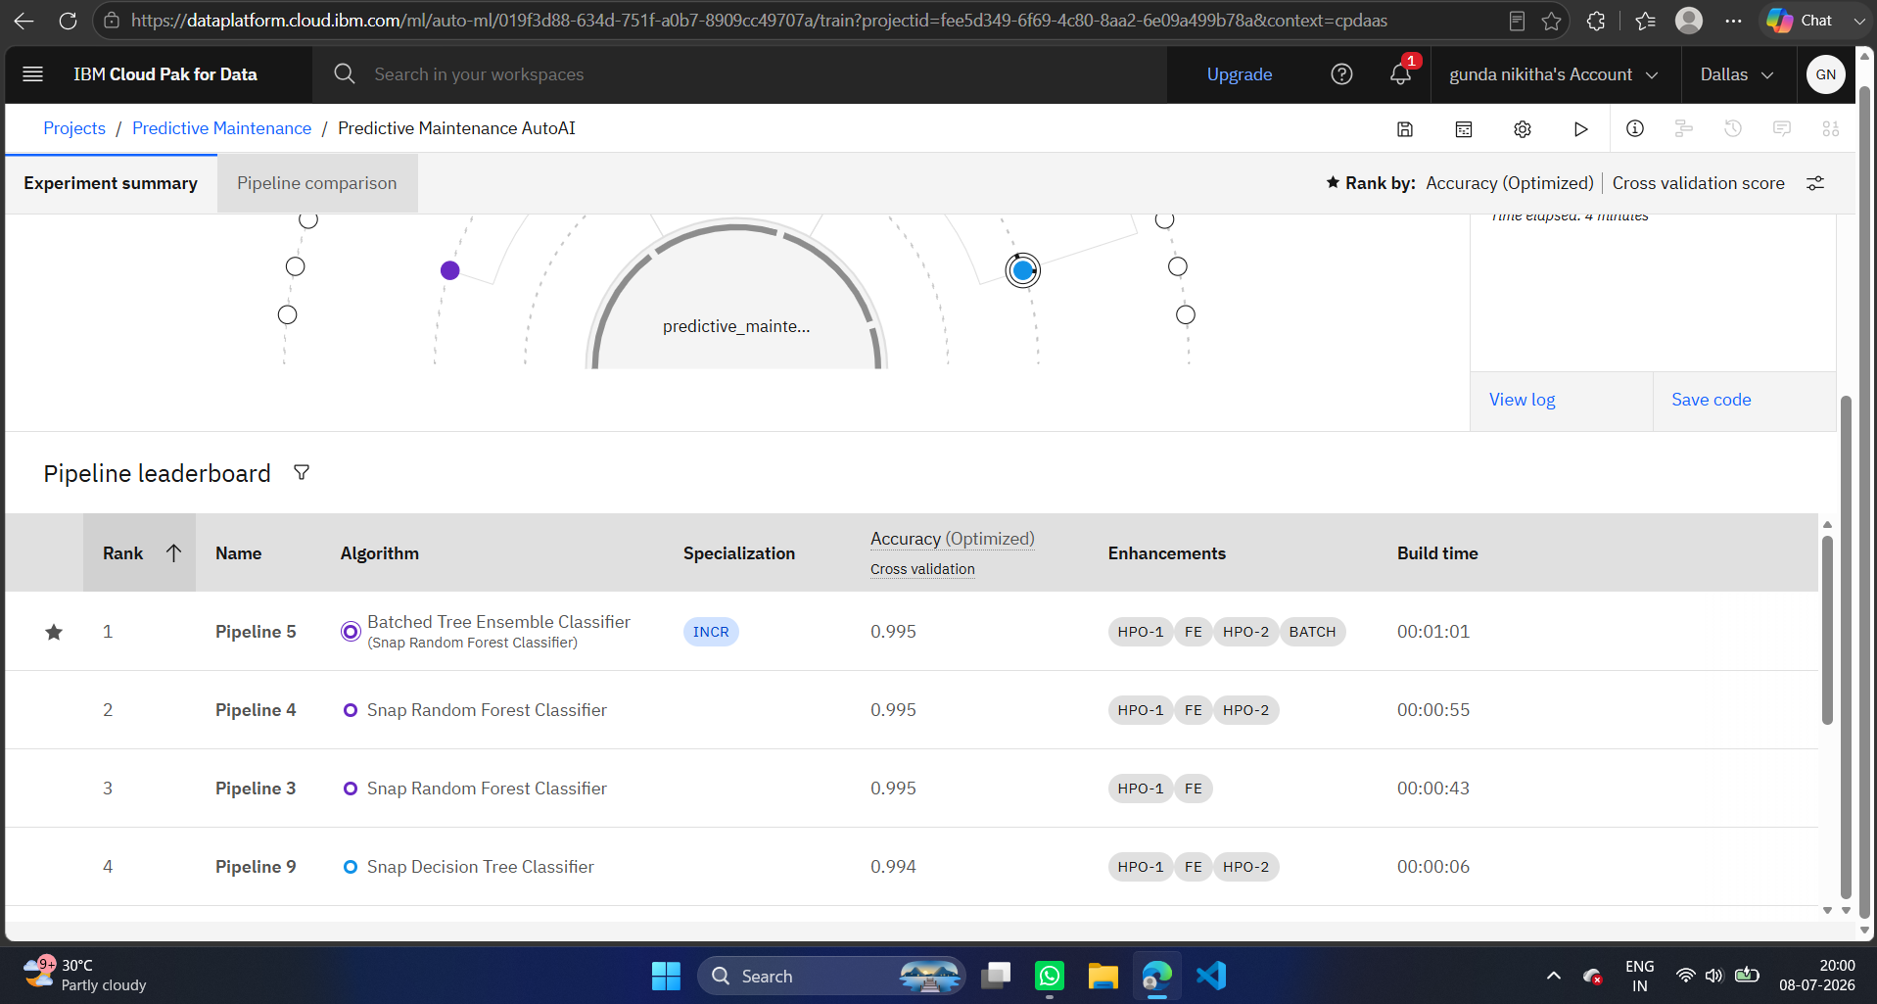

Slide 10
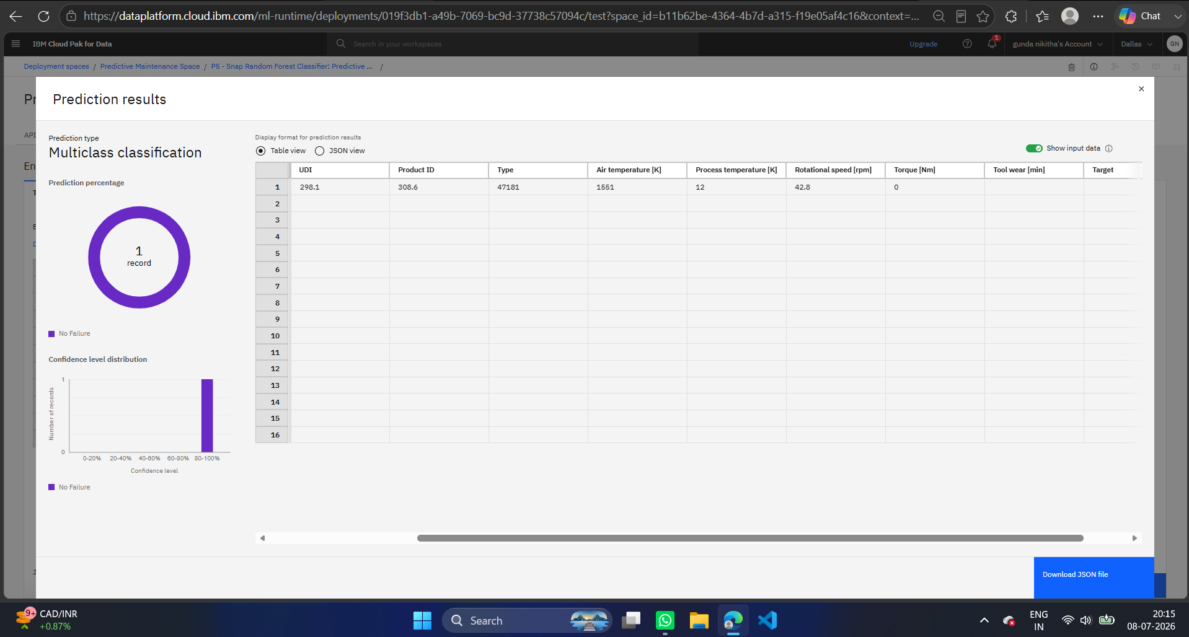

Slide 11
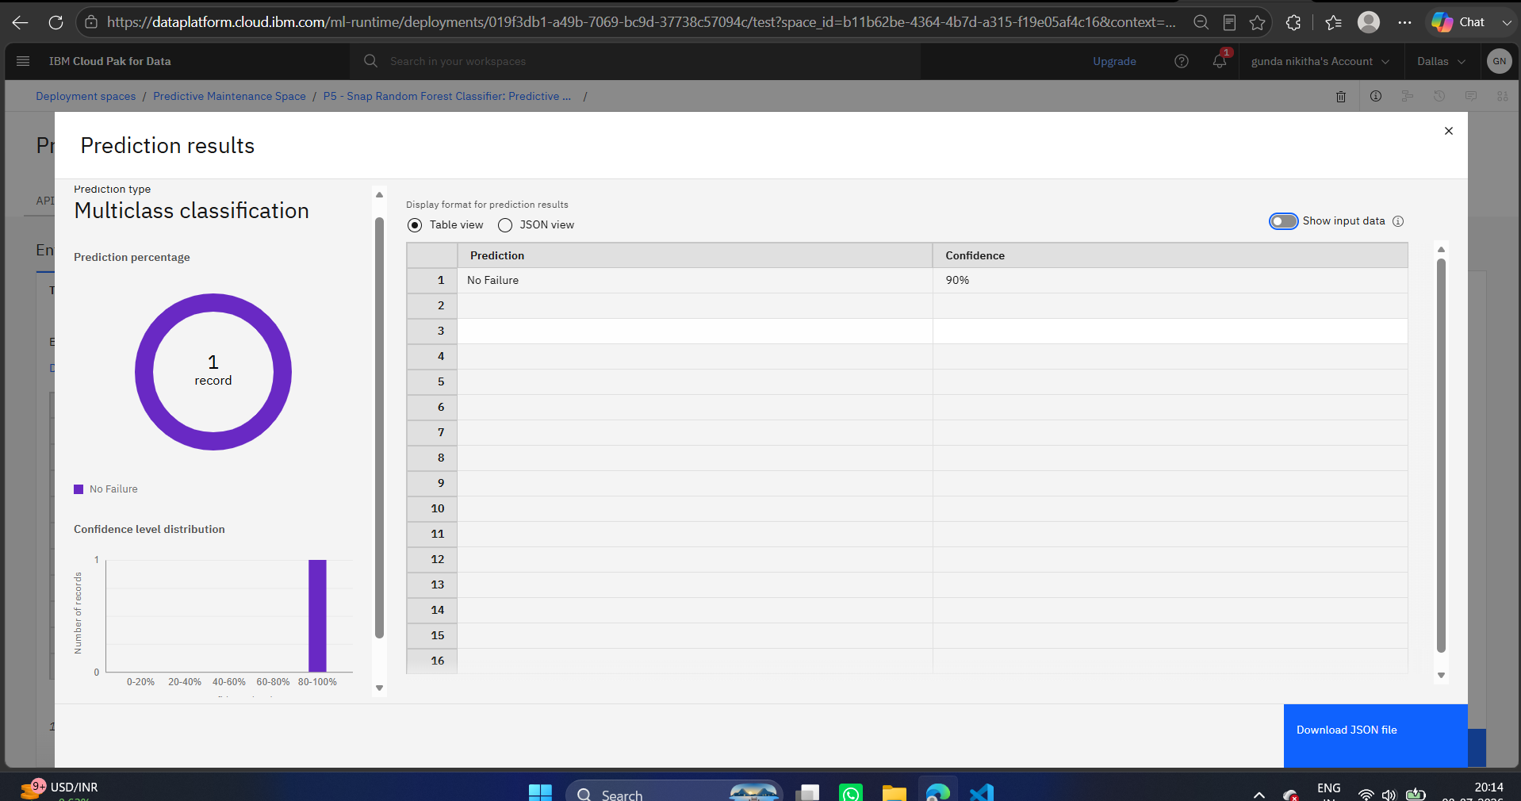

Slide 12
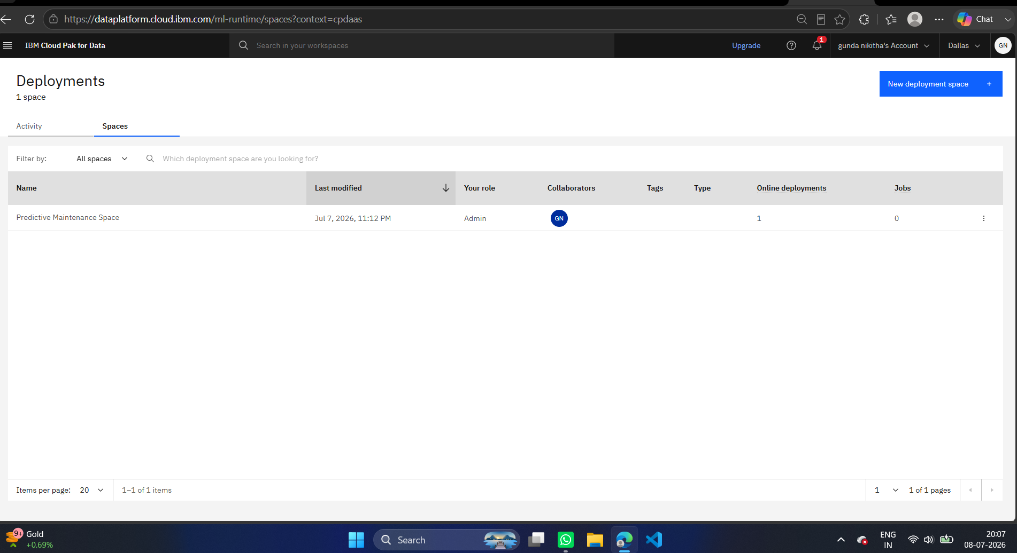

Slide 13
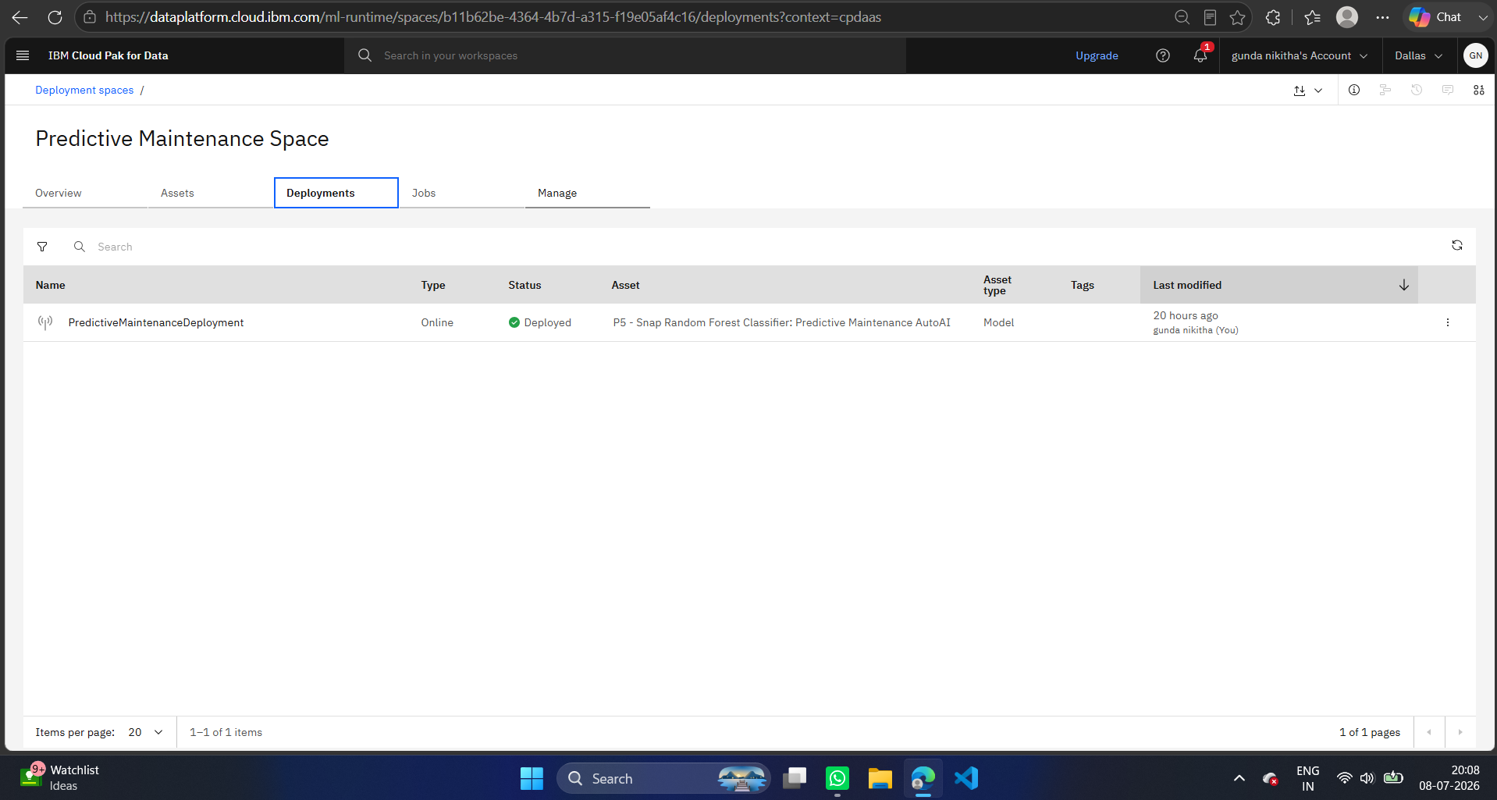

Slide 14
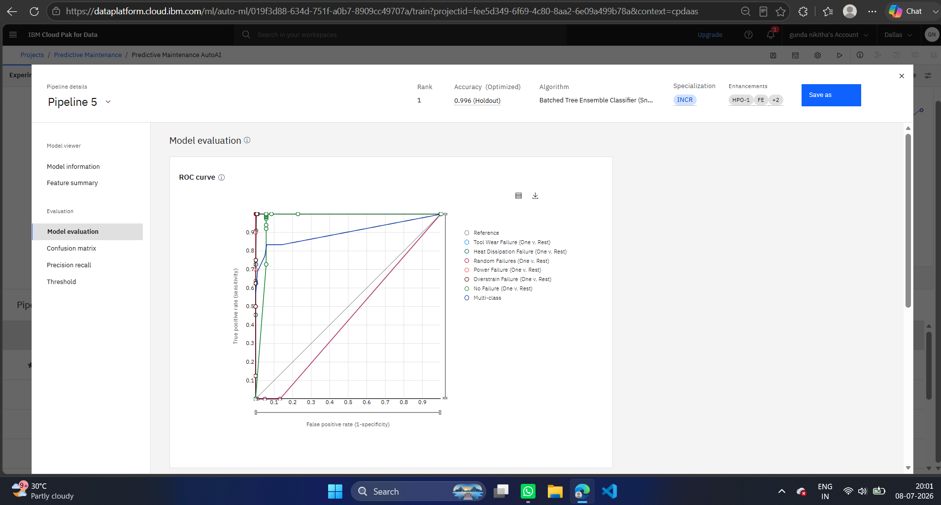

Slide 15
Novelty and Uniqueness
The solution automates industrial machine failure prediction, reducing unexpected equipment breakdowns and minimizing production downtime.
It uses IBM watsonx.ai AutoAI to automatically discover the best-performing machine learning model without requiring extensive manual coding or model selection.
The system accurately classifies machine operating conditions into multiple failure categories or normal operation through a single intelligent predictive maintenance platform.
Automated data preprocessing, feature engineering, and hyperparameter optimization help identify hidden patterns in machine sensor data, improving prediction performance.
The deployed model provides real-time predictions, enabling industries to perform proactive maintenance, reduce maintenance costs, and improve equipment reliability.
The solution supports data-driven maintenance decisions, minimizing human intervention and increasing consistency in failure detection.
The system is scalable and cloud-based, allowing organizations to integrate predictive maintenance into modern Industry 4.0 and IoT-enabled manufacturing environments.

Slide 16
Git Hub
Repository Visibility: Public
working Github URL –
https://github.com/Nikitha2802/Predictive-Maintenance-of-Industrial-Machinery
Repository Contents:
predictive_maintenance.csv
Problem_Statement.pdf
Predictive_Maintenance_of_Industrial_Machinery_Using_IBM_watsonx.ai_AutoAI.pptx
Predictive_Maintenance_AutoAI.ipynb

Slide 17
Future Scope
The system can be integrated with Industrial Internet of Things (IIoT) sensors to collect real-time machine data and continuously monitor equipment health.
Additional machine learning models and deep learning techniques can be incorporated in IBM watsonx.ai to further improve prediction accuracy and identify complex failure patterns.
Real-time alert notifications can be implemented to automatically inform maintenance teams before critical machine failures occur, reducing downtime and maintenance costs.
The solution can be integrated with Enterprise Resource Planning (ERP) and Computerized Maintenance Management Systems (CMMS) to automate maintenance scheduling and spare parts management.
The platform can be scaled across multiple manufacturing plants and industries, enabling centralized monitoring, predictive analytics, and data-driven maintenance decisions for large-scale industrial operations.

Slide 18
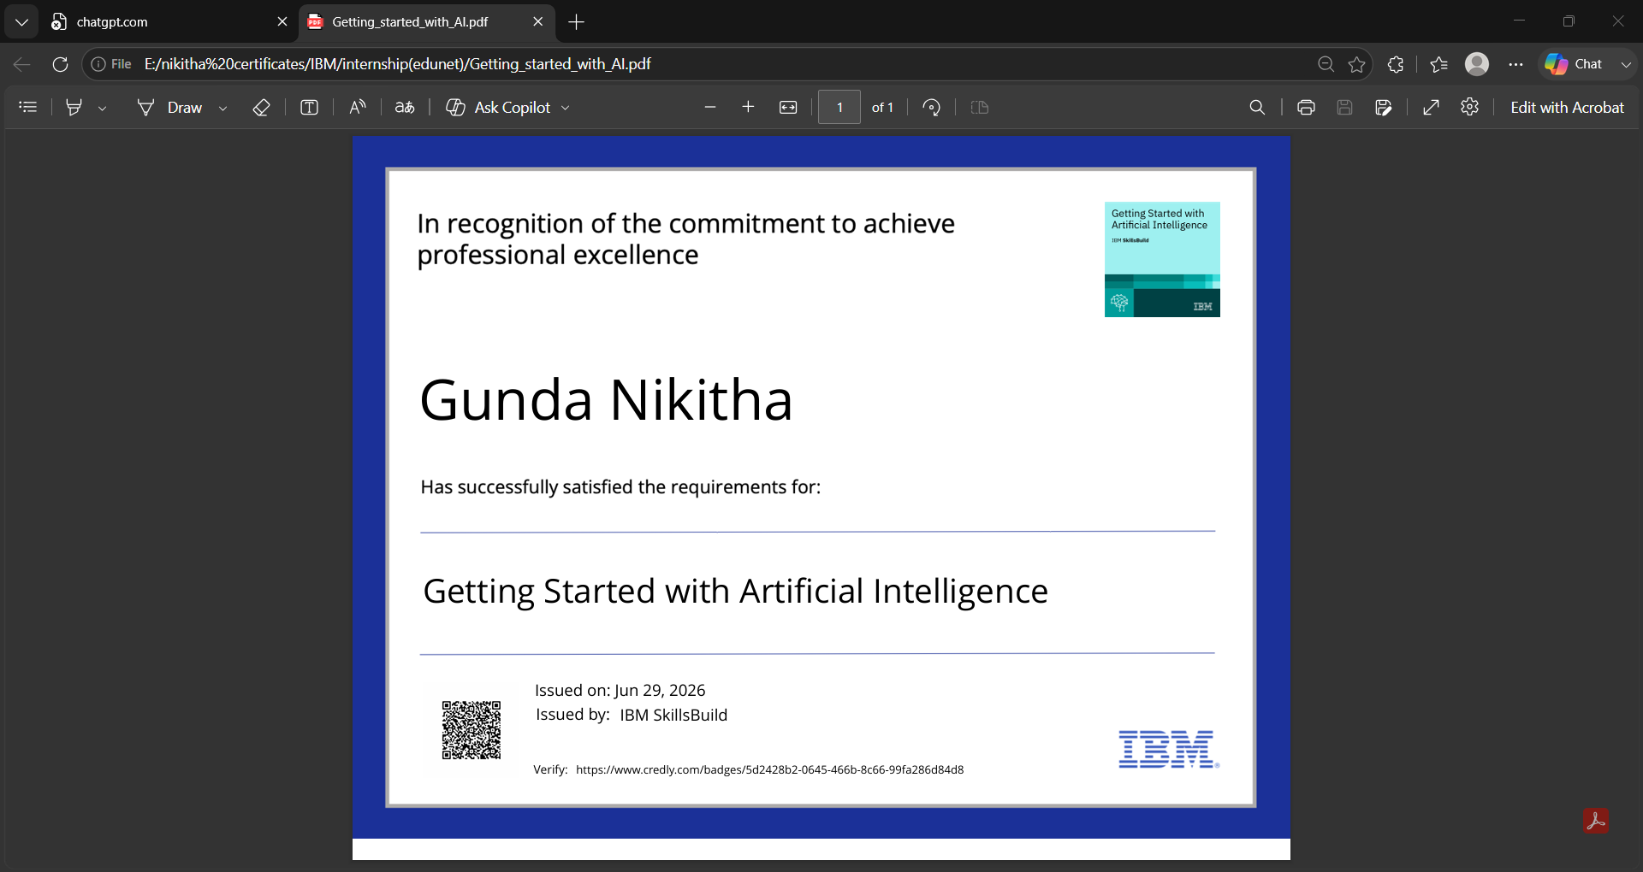
Certificates Earned: Credly Certificate

Slide 19
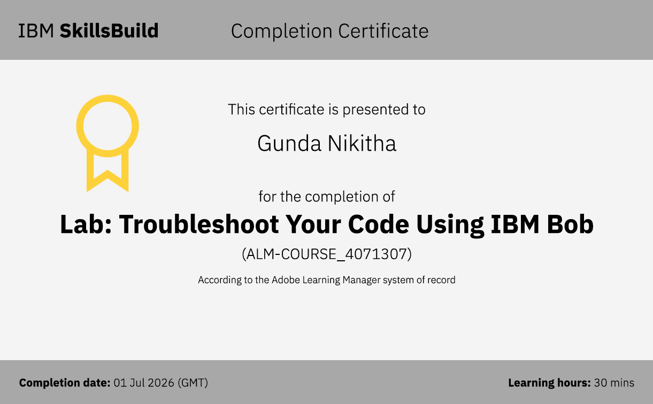
Certificates Earned: IBM BOB Certificate

Slide 20
THANK YOU

