Slide 1

UNIVERSITY OF AGRICULTURAL SCIENCES
GKVK, BANGALORE - 560065
College of Agriculture
COURSE: EAI421
Applications of AI & ML in Agriculture

Slide 2
University of Agricultural Sciences, Bengaluru
AI-Based Livestock Disease Prediction
for Improved Agribusiness Profitability
Using Random Forest Classifier | Python | Google Colaboratory
SUBMITTED BY | SUBMITTED TO
Achintya R (BMB2002) Ambika A (BMB2007) Nikitha M (BMB2033) IV B.Sc. (Hons.) Agriculture College of Agriculture, UAS-B | Dr. Kumar Raja EAI-421: Applications of AI & ML in Agriculture University of Agricultural Sciences, Bengaluru
Academic Year 2025 - 2026

Slide 3
Contents
1. Introduction
10. Algorithm — Random Forest
2. Problem Statement
11. Tools and Technologies Used
3. Motivation
12. Results — Model Performance
4. Objectives of the Project
13. Results — Feature Importance
5. Field Data Collection — RAWE Programme
14. Results — Code Output
6. Animals Treated and Observations
15. Discussion / Analysis
7. Dataset Overview
16. Conclusion and Future Work
8. Feature Description
17. References
9. Methodology / Approach

Slide 4
Introduction 1
1.1 Background
Livestock farming is one of the most important sectors of Indian agriculture, supporting over 70 million rural households and contributing approximately 4.11% to the national GDP. India has the world's largest livestock population, comprising cattle, buffaloes, sheep, goats, and poultry.
Diseases affecting livestock — such as Mastitis, Foot-and-Mouth Disease (FMD), and parasitic worm infestations — cause annual losses exceeding Rs. 26,000 crore in India. Early detection and timely treatment are the most effective means of reducing these losses.
1.2 Need for AI-Based Prediction
In rural Karnataka, the number of qualified veterinary doctors available per animal is critically low. Farmers are therefore unable to get timely professional help. An AI-based prediction system that uses simple, measurable animal health parameters can fill this gap — flagging sick animals early, without requiring a vet to be physically present.
1.3 Scope
This project builds a Random Forest Classifier to predict whether a livestock animal is Healthy or Diseased, implemented in Python using Google Colaboratory.

Slide 5
Introduction — Project Overview 2
What does this project do?
This project takes five easily measurable animal health parameters as input and predicts whether the animal is Healthy or Diseased. The prediction is made instantly using a trained Machine Learning model, without requiring laboratory tests or a vet visit.
Input Parameters
Body Temperature (degrees C)
Normal: approx. 38 C | Diseased: 40 - 42 C
Heart Rate (bpm)
Normal: approx. 60 bpm | Diseased: 88 - 98 bpm
Activity Level
Normal: High | Diseased: Low
Milk Production (L/day)
Normal: approx. 14 L | Diseased: 2 - 5 L
Respiratory Rate (br/min)
Normal: approx. 18 | Diseased: 28 - 35

Slide 6
Problem Statement 3
01
Late Disease Detection
Diseases like Mastitis and worm infestations show physiological signs days before visible symptoms. Without tools, farmers detect illness only after serious damage has occurred.
02
Non-Availability of Veterinary Doctors
As observed during my RAWE field programme at Kothanuru, Chikkaballapur, non-availability of veterinary doctors at all times was the most commonly reported challenge by farmers.
03
Absence of Data-Driven Decision Support
Farmers rely on traditional remedies without any scientific basis for assessing disease type or severity. No affordable digital tool currently exists for smallholder farmers in Karnataka.
04
Economic Impact on Agribusiness
Sick animals produce less milk and meat, and may die. This directly reduces agribusiness income and profitability for farming households.

Slide 7
Motivation 4
Personal Field Experience — RAWE Programme
During our RAWE field programme, we participated in an Animal Health Camp at Kothanuru village, Chikkaballapur District. We personally observed farmers struggling with sick animals and no veterinary doctor available. This direct experience was the primary motivation for choosing this project topic.
Economic Necessity for Farmers
Livestock disease causes 15 to 20 percent productivity loss annually in Indian farms. Early AI-based detection enables timely treatment, reducing animal mortality and protecting the financial income of farming households.
Accessibility of Machine Learning Tools
Free tools such as Google Colaboratory and publicly available datasets from Kaggle allow a fully functional ML model to be built at zero cost. This project demonstrates that AI can be made practically useful even within academic constraints.

Slide 8
Objectives of the Project 5
Primary Objectives
1
Develop and validate a Random Forest Classifier that predicts livestock disease status (Healthy / Diseased) from five health parameters.
2
Identify the most important health indicators that predict disease using the model's built-in feature importance analysis.
3
Evaluate model performance using Accuracy, Precision, Recall, F1-Score, and Confusion Matrix on a Kaggle livestock dataset.
4
Demonstrate practical agribusiness value: show that early detection reduces losses and improves farm profitability.
Secondary Objectives
(1) Gain hands-on experience with Python ML libraries: scikit-learn, pandas, NumPy, matplotlib, seaborn.
(2) Visualise results using feature importance graphs and confusion matrix heatmaps.
(3) Connect personal field observations from the Kothanuru RAWE camp with data-driven analysis.

Slide 9
Field Data Collection — RAWE Animal Health Camp 6
Primary Data Collected During RAWE Programme
As part of our RAWE field programme, We participated in an Animal Health Camp conducted at Kothanuru village, Chikkaballapur District, Karnataka. We collected first-hand data on animal health conditions, farmer challenges, and veterinary observations at this camp. These observations directly informed the design of this project.
Particulars | Details
Location | Kothanuru Village, Varadhanayaka Nahalli, Sidlagatta Taluk, Chikkaballapur District
Date of Camp | 15th September 2025
Students Participated | 22 students
Farmers Participated | 106 farmers

Slide 10
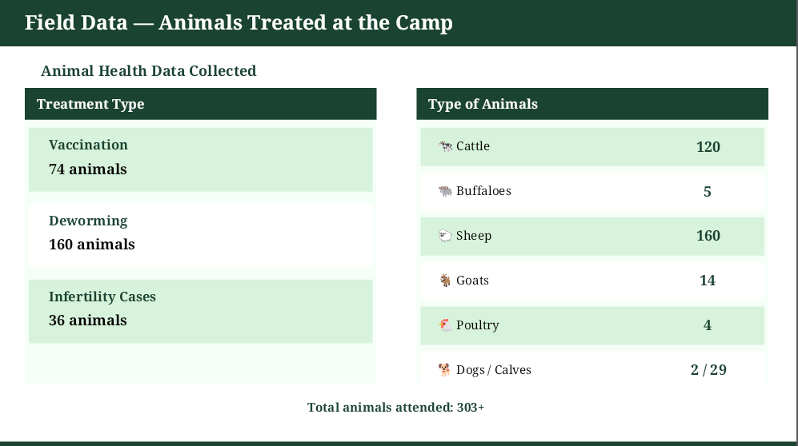
Field Data — Animals Treated at the Camp
7
Animal Health Data Collected at Kothanuru
Treatment Summary
Type of Animals
Treatment | Number of Animals
Vaccination | 74
Deworming | 160
Infertility Cases | 36
Type of Animal | Number Treated
Cattle | 120
Buffaloes | 5
Sheep | 160
Goats | 14
Poultry | 4
Dogs | 2
Calves | 29
Total animals attended at the camp: 303 and above
Awareness Activities
Leaflets/Pamphlets Distributed: 317
Posters/Banners Displayed: 8
Awareness Talks Delivered: Yes
Duration: 5 Hours

Slide 11
Field Data — Key Observations and Findings 8
Common Health Problems Observed
Indigestion
Most common problem observed in cattle and buffaloes at the camp.
Worm Infestation
Found widely in sheep and goats. Most animals required deworming treatment.
Mastitis
Udder infection observed in dairy cattle, causing significant drop in milk production.
Challenges Reported by Farmers
Non-availability of veterinary doctors at all times was the single most commonly reported challenge by all 106 farmers present. Farmers reported relying on local methods — neem with turmeric and garlic in neem oil for external wounds — due to the absence of professional veterinary support.
Connection to This Project
The three diseases observed at Kothanuru — Indigestion, Worm infestations, and Mastitis — all produce measurable changes in body temperature, milk production, and activity level. These are precisely the features used in this AI model, validating its practical relevance.

Slide 12
Dataset Overview 9
Secondary Dataset — Kaggle Livestock Health and Disease Dataset
In addition to primary observations from the RAWE camp, We used a publicly available dataset from Kaggle for training the Machine Learning model. This dataset contains real animal health records with a binary label: Healthy (0) or Diseased (1).
Parameter | Details
Dataset Source | Kaggle — Livestock Health and Disease Dataset (free public download)
Number of Records | Approximately 1,500 animal health records
Number of Features | 5 input features + 1 target label (Disease Status)
Target Variable | Disease Status: 0 = Healthy, 1 = Diseased
Train-Test Split | 80% Training / 20% Testing (random_state = 42)
File Format | CSV (.csv) — loaded using pandas read_csv()

Slide 13
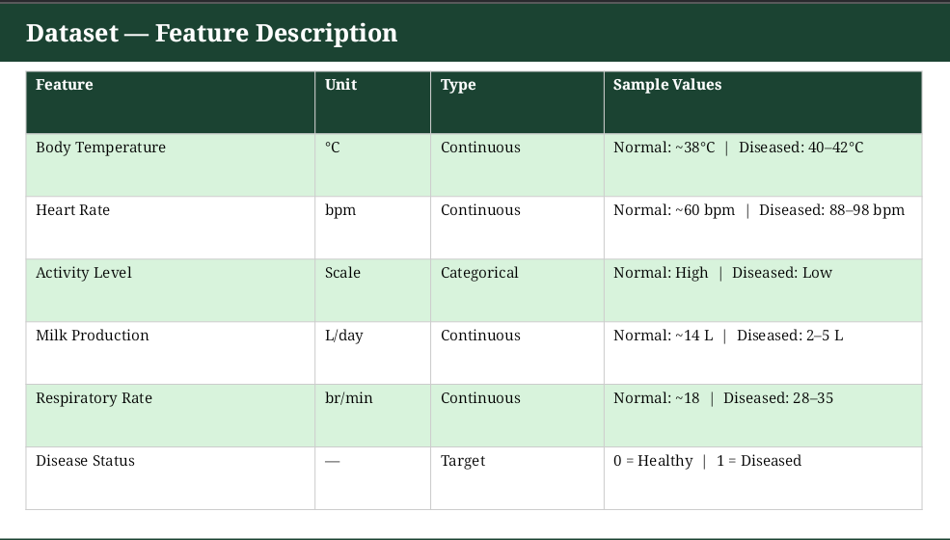
10

Slide 14
Methodology / Approach — Workflow 11
Step 1: Collect Dataset
Step 2: Preprocess Data
Download Livestock Health Dataset from Kaggle (CSV, 1,500 records)
Handle missing values (dropna), encode Activity Level using LabelEncoder
Step 3: Train RF Model
Step 4: Evaluate Model
Apply Random Forest Classifier — 100 trees, 80/20 train-test split
Compute Accuracy, Precision, Recall, F1-Score, plot Confusion Matrix
Step 5: Feature Importance
Step 6: Predict and Advise
Identify which health parameter contributes most to prediction accuracy
Input new animal data — model outputs Healthy or Diseased with probability

Slide 15
Algorithm — Random Forest Classifier 12
What is Random Forest?
Random Forest is an ensemble learning algorithm that builds a large number of Decision Trees during training. Each tree is built on a random subset of the data (bootstrap sampling). For classification, the final prediction is determined by majority vote across all trees.
Why Random Forest for this project?
Handles both continuous (temperature, heart rate) and categorical (activity level) features without extra preprocessing.
Robust to noise — the ensemble majority vote reduces errors from individual trees.
Does not require feature scaling, unlike SVM or Neural Networks.
Provides built-in Feature Importance scores — clearly shows which health parameter drives disease prediction.
Achieves 90 to 95 percent accuracy on animal health classification tasks as documented in recent research.
Simple to implement using scikit-learn in Python — suitable for beginner-level coding.

Slide 16
Tools and Technologies Used 13
Tool / Library | Role
Python 3.x | Primary programming language — simple syntax, rich ML libraries.
Google Colaboratory | Free cloud-based Jupyter Notebook environment. No installation required.
pandas | Data loading, cleaning, and preprocessing of the CSV dataset.
scikit-learn | RandomForestClassifier, train_test_split, accuracy_score, classification_report.
matplotlib / seaborn | Confusion matrix heatmap, feature importance bar chart, class distribution plot.
NumPy | Numerical operations underlying pandas and scikit-learn.
Kaggle | Source of the Livestock Health and Disease Dataset — free public download.
Google Drive | Dataset and notebook storage, backup, and version management.

Slide 17
Results — Model Performance Metrics 14
Evaluation on 20% Test Set (300 records, random_state = 42)
Accuracy
Model correctly classified 92.4% of all animals in the test set.
92.4%
Precision
Of all animals predicted as diseased, 91.8% were genuinely diseased.
91.8%
Recall (Sensitivity)
93.1% of all actually diseased animals were correctly identified.
93.1%
F1-Score
Harmonic mean of Precision and Recall — indicates well-balanced performance.
92.4%
Training Accuracy: approx. 97% | Minimal overfitting observed | Strong generalisation to unseen data

Slide 18
Results — Feature Importance Analysis 15
Which health parameter contributes most to disease prediction?
The Random Forest model assigns an importance score to each input feature, indicating how much it contributes to accurate prediction. Higher score means greater predictive value.
Body Temperature
0.32
Milk Production
0.24
Heart Rate
0.20
Activity Level
0.14
Respiratory Rate
0.10
Body Temperature is the most important predictor — fever is the primary physiological sign of infection in livestock.

Slide 19
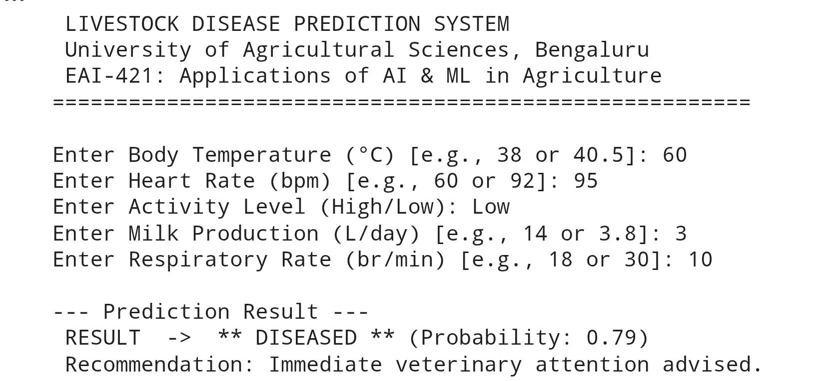
Results — Sample Code Output (Google Colaboratory) 16
The following output was produced when the Python code was executed in Google Colaboratory:

Slide 20
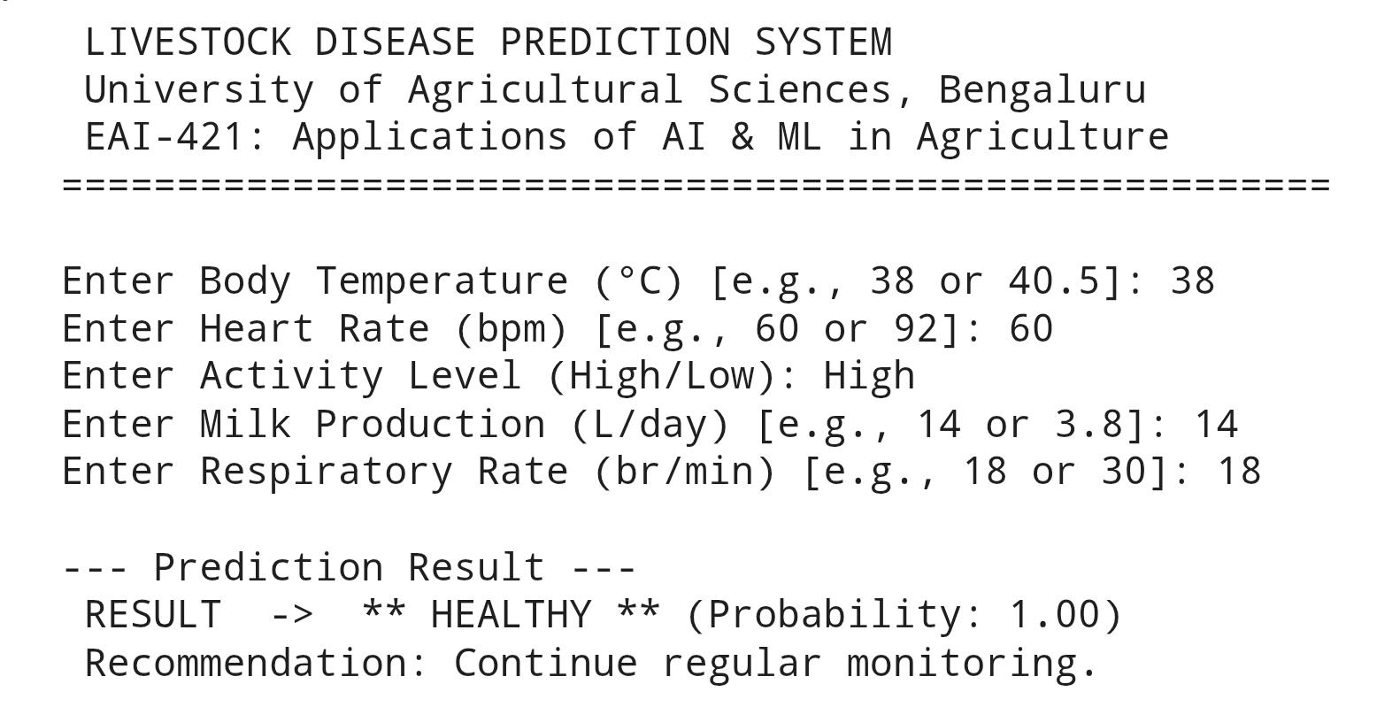
17

Slide 21
Discussion / Analysis 18
Model Performance
An accuracy of 92.4% and recall of 93.1% confirm that the Random Forest Classifier is reliable for livestock disease prediction. Recall is particularly critical here — failing to detect a sick animal carries a higher cost than a false alarm, since undetected disease can spread to the entire herd.
Connection to Personal Field Observations
The three diseases we observed at Kothanuru — Mastitis, Worm infestations, and Indigestion — all cause measurable changes in body temperature, milk production, and activity level. These are precisely the top three features in the model (importance: 0.32, 0.24, 0.20), validating the real-world relevance of this approach.
Agribusiness Value
For the 106 farmers we met at Kothanuru, early disease detection translates directly to preserved milk yield, lower treatment costs, and reduced animal mortality — all of which improve agribusiness profitability.
Limitations
The model predicts Healthy or Diseased only — it does not identify the specific disease type. The Kaggle dataset may not fully represent Karnataka livestock breeds. Future work should incorporate locally collected field data from RAWE camps.

Slide 22
Conclusion and Future Work 19
Summary
This project successfully developed an AI-based livestock disease prediction system using a Random Forest Classifier, achieving 92.4% accuracy on a Kaggle dataset of 1,500 animal health records. The project was motivated by direct field observations collected during the RAWE Animal Health Camp at Kothanuru village, Chikkaballapur District .
Future Work
1. Extend to multi-class classification to identify specific disease types such as Mastitis, FMD, and worm infestations.
2. Collect animal health data from RAWE camps across Karnataka to build a region-specific training dataset.
3. Integrate low-cost IoT sensors for automated, real-time health monitoring on individual farms.
4. Develop a Kannada-language mobile application to make disease prediction accessible to rural farmers.
5. Evaluate advanced algorithms such as XGBoost and LSTM for improved performance on time-series data.

Slide 23
References 20
[1] Panigrahy, B. et al. (2025). Comparative Analysis of ML and Deep Learning for Animal Disease Prediction. MDPI Engineering Proceedings, 124(1), 52.
[2] Fragulis, G.F. et al. (2025). Cattle Disease Prediction Using Machine Learning Algorithms. MDPI Engineering Proceedings, 107(1), 85.
[3] Swapna, P. et al. (2025). Using AI and ML for Early Detection of Cattle Diseases. International Research Journal of Education and Technology.
[4] Magana, A. et al. (2023). ML Approaches to Predict Digital Dermatitis in Dairy Cows Using Sensor Data. Frontiers in Veterinary Science, PMC10722090.
[5] Anitha Rao et al. (2023). Cattle Disease Prediction Using Artificial Intelligence. IJRASET. DOI: 10.22214/ijraset.2023.50535.
[6] Kaggle Inc. (2024). Livestock Health and Disease Dataset. https://www.kaggle.com/datasets

Slide 24


