Slide 1
Fraud Detection in Healthcare Transactions

Slide 2
Team
Aasrita Emani
Nikitha Ravella
Niharika polu
Sirisha Panuganti
Priyanka Godugunuri

Slide 3
Agenda
Introduction
Tools & Technologies
Goals
Results on PySpark
Conclusion

Slide 4
Introduction
Healthcare fraud detection is vital for preventing financial losses and ensuring patient care.
These systems rely on advanced analytics, machine learning, and data mining for real-time analysis.
They identify patterns and anomalies to mitigate risks and protect financial integrity.
Our project leveraged PySpark's distributed computing for efficient processing of large healthcare datasets.
Implementation of robust fraud detection algorithms enhances security and reliability in healthcare transactions.

Slide 5
Tools & Technologies
PySpark
Apache Hadoop
Apache Spark SQL
Jupyter Notebook

Slide 6
Goals
What is the average Medicare allowed amount for each HCPCS code?
Average difference between the submitted charge amount and the Medicare payment amount for each provider?
What is the average Medicare allowed amount for each state?
How many providers are there in each city?
Identify the top five most common HCPCS codes used by providers?
Can we identify the most common HCPCS codes used by providers in a specific state?

Slide 7
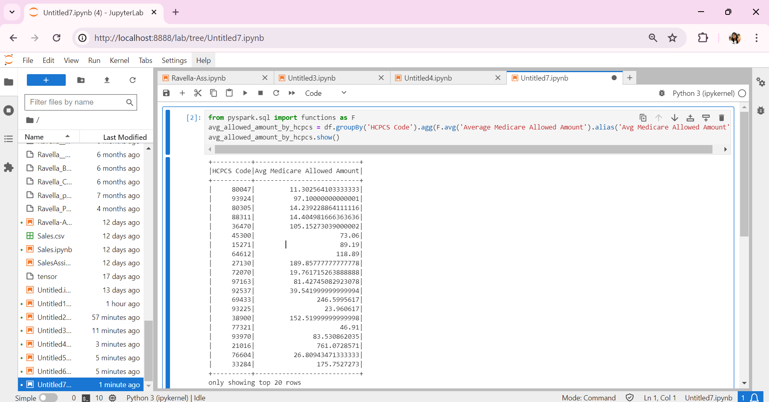
What is the average Medicare allowed amount for each HCPCS code?
Results

Slide 8
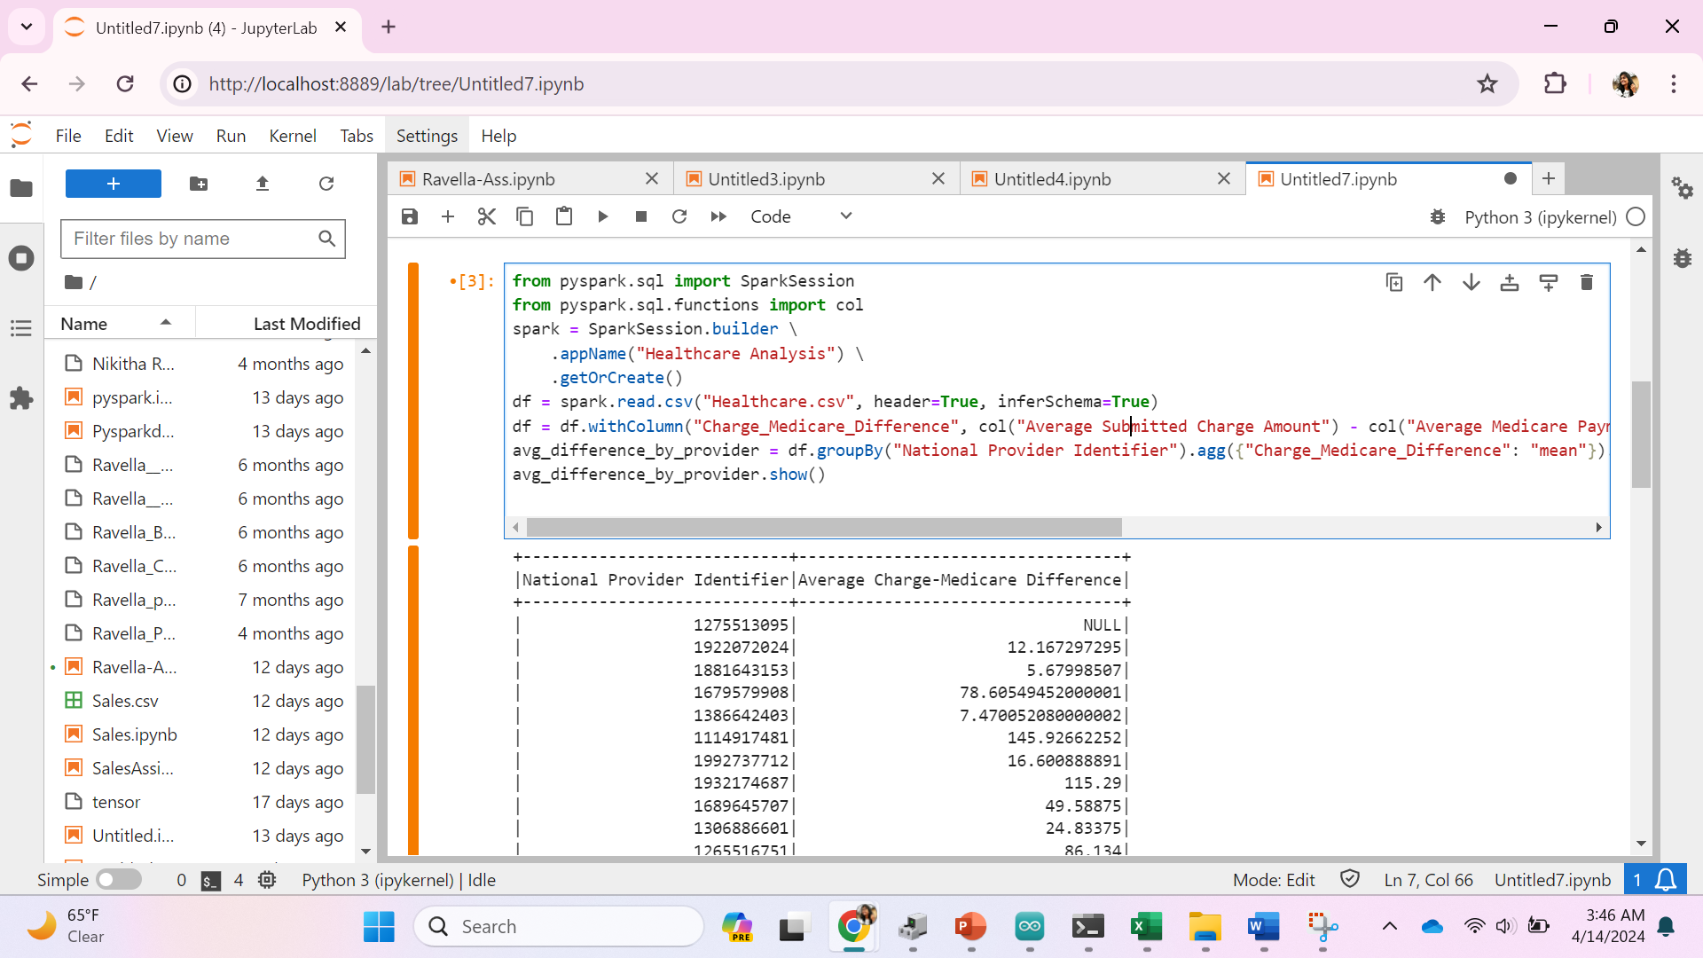
Average difference between the submitted charge amount and the Medicare payment amount for each provider?
Results

Slide 9
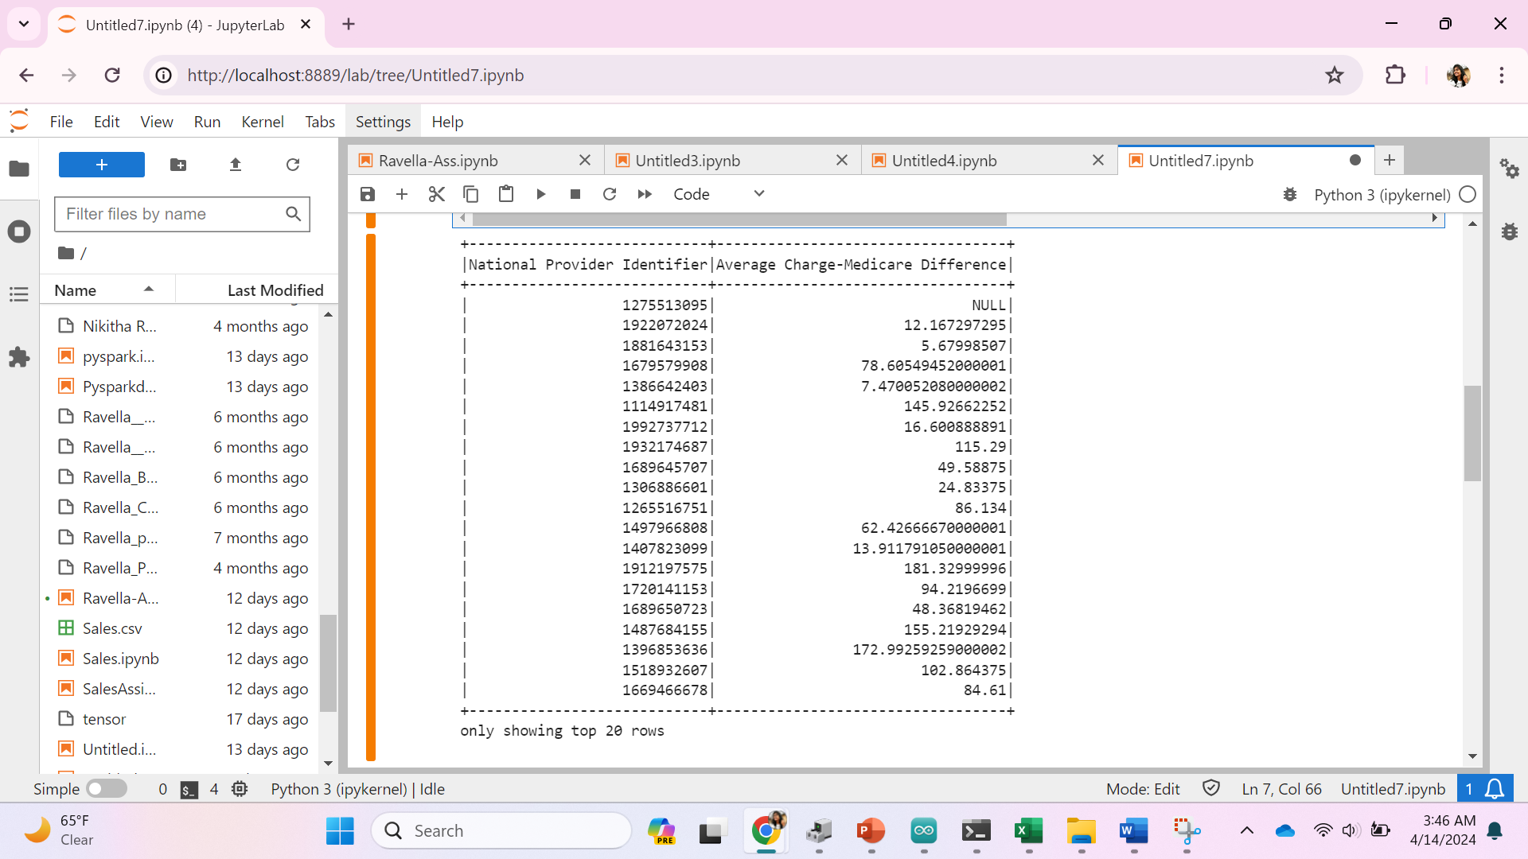
Average difference between the submitted charge amount and the Medicare payment amount for each provider?
Results

Slide 10
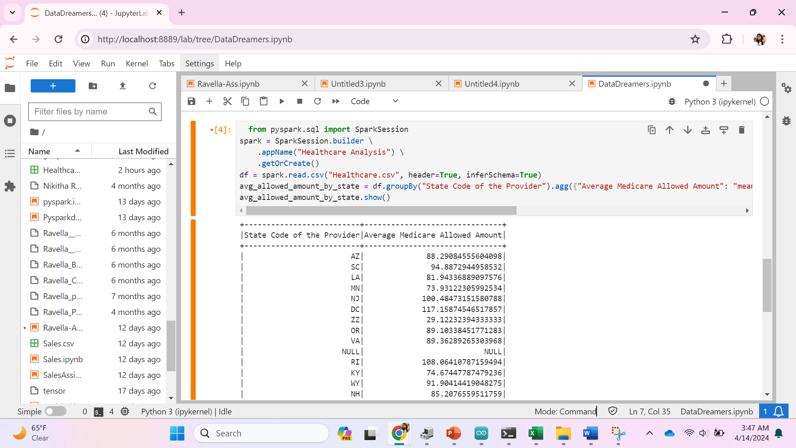
What is the average Medicare allowed amount for each state?
Results

Slide 11
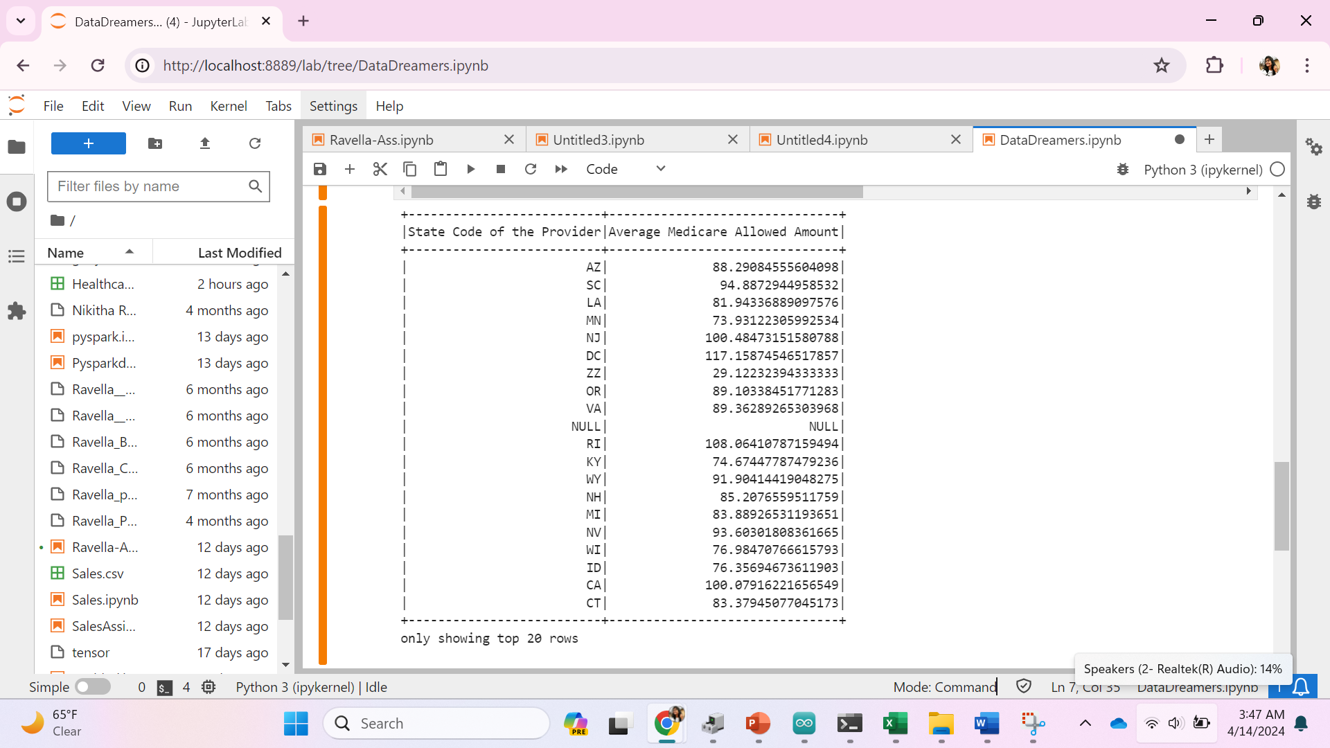
What is the average Medicare allowed amount for each state?
Results

Slide 12
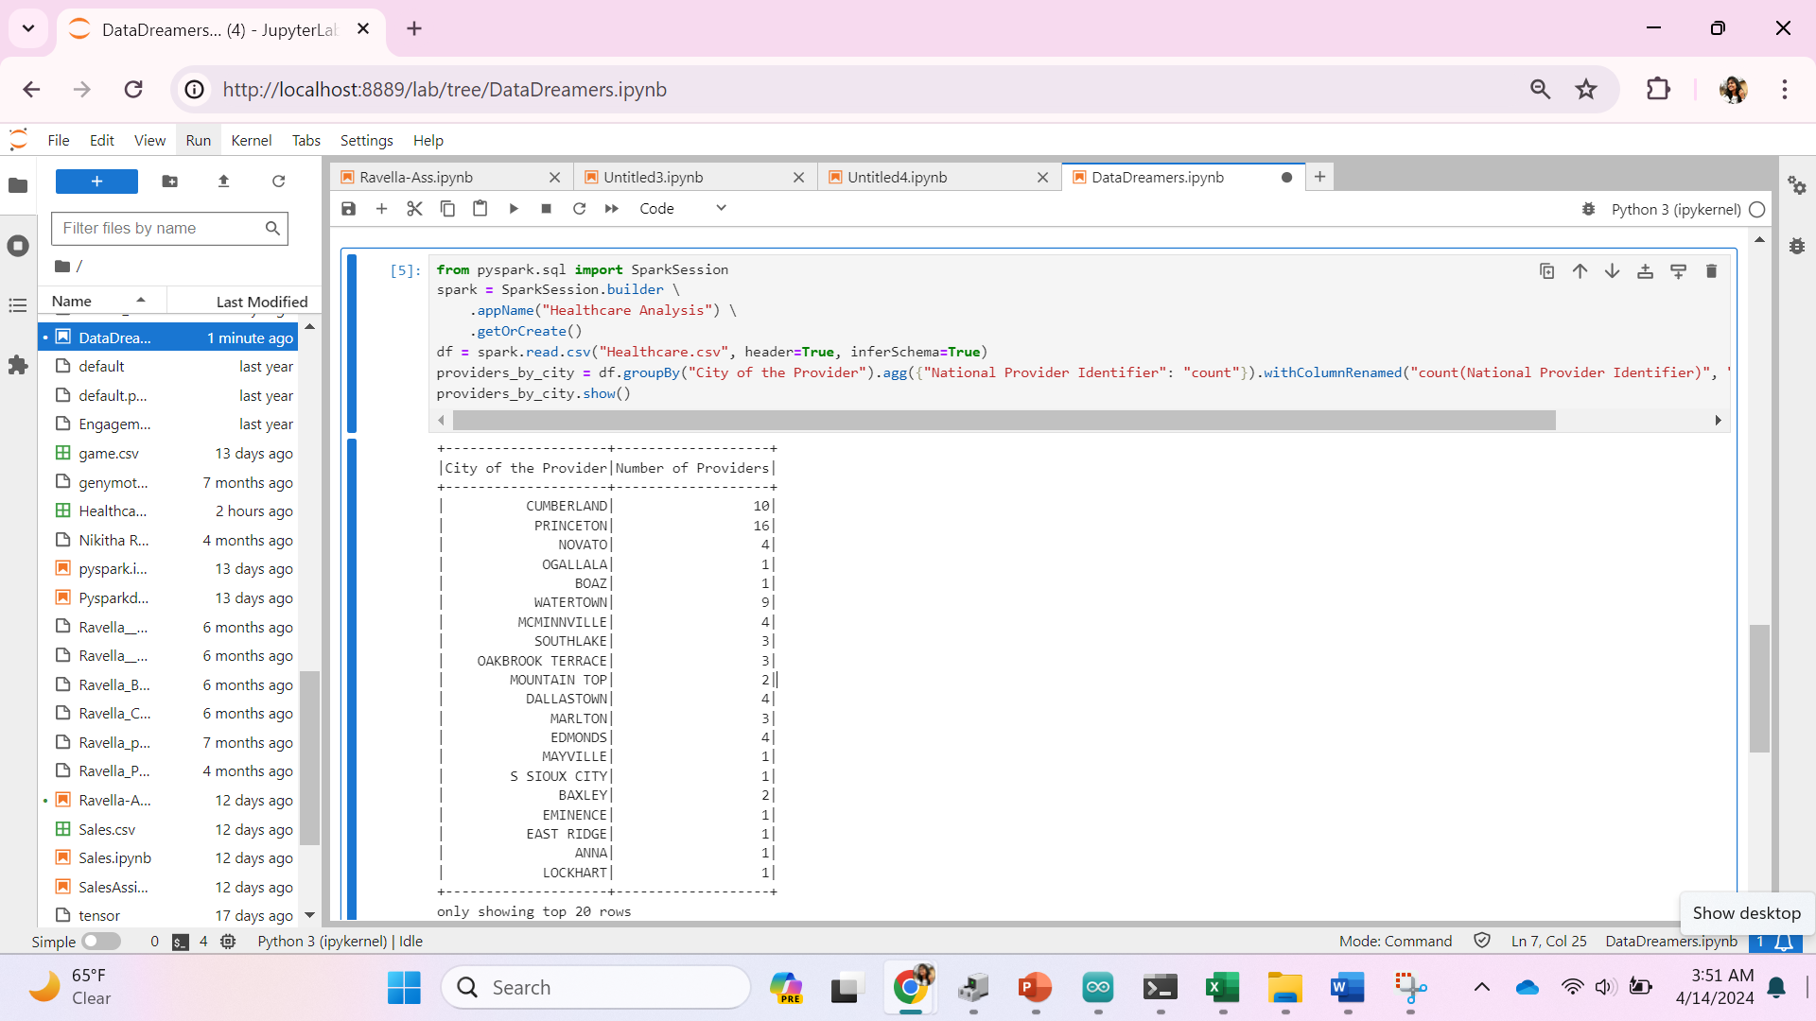
How many providers are there in each city?
Results

Slide 13
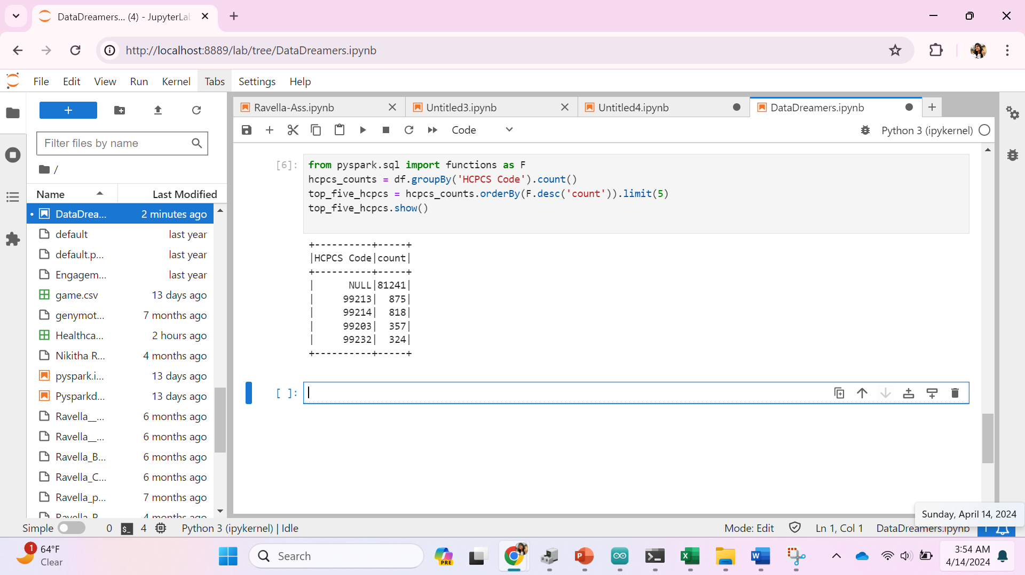
Identify the top five most common HCPCS codes used by providers?
Results

Slide 14
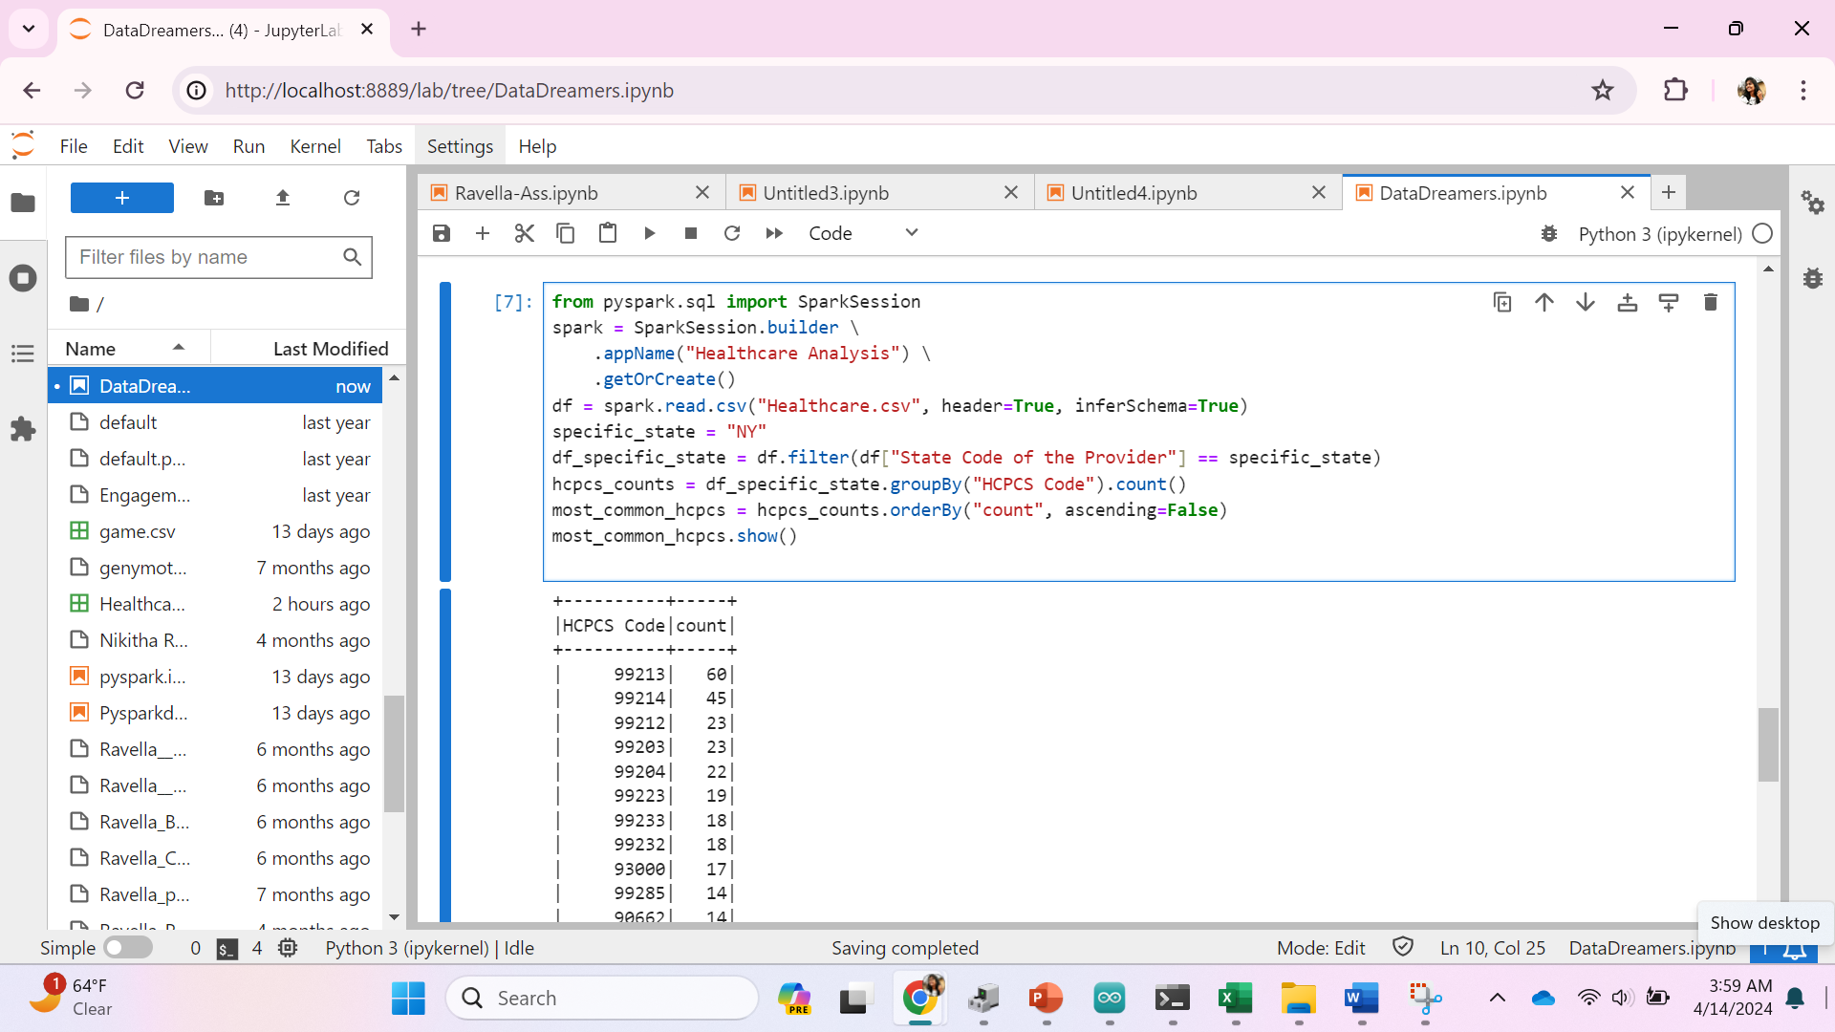
Can we identify the most common HCPCS codes used by providers in a specific state? NY:
Results

Slide 15
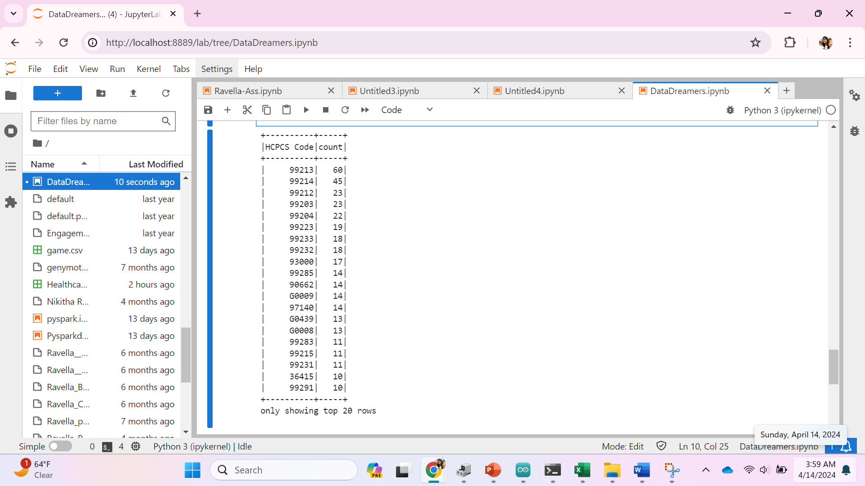
Can we identify the most common HCPCS codes used by providers in a specific state? NY:
Results

Slide 16
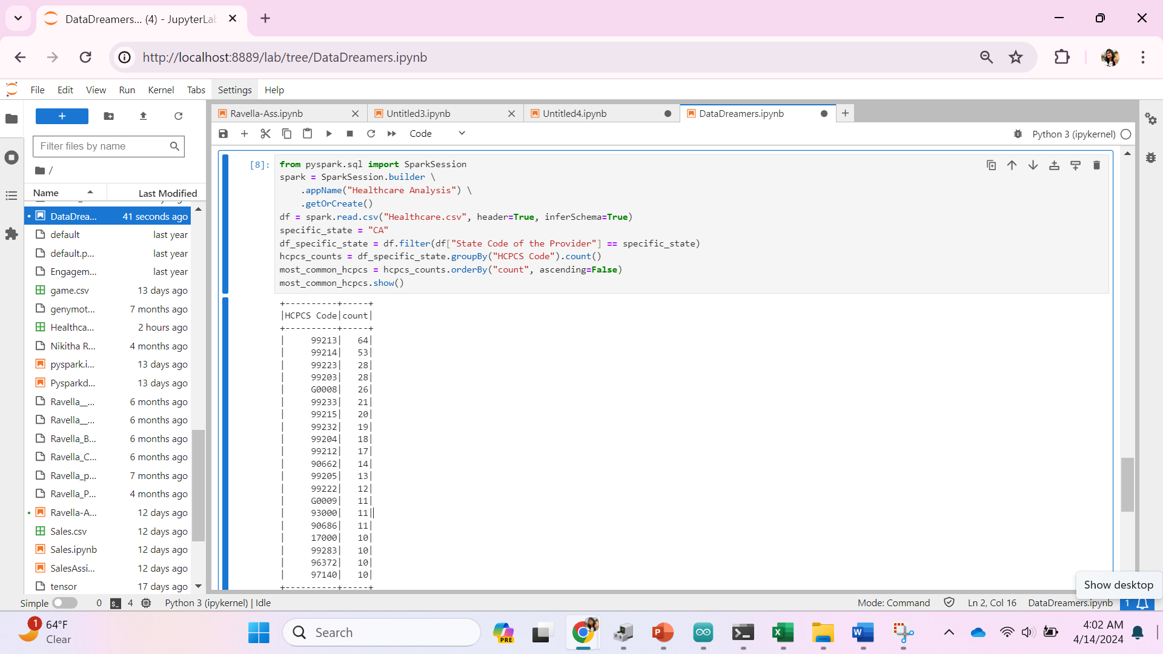
Can we identify the most common HCPCS codes used by providers in a specific state? CA:
Results

Slide 17
Conclusion
Identifying Most Common HCPCS Codes by State reveals frequently used codes in each state, aiding resource allocation.
Identifying Top Five Most Common HCPCS Codes highlights prevalent medical procedures for administrators and policymakers.
Counting Providers in Each City provides insights into healthcare service distribution & accessibility.
Average Medicare Allowed Amount by State shows reimbursement trends and cost variations across states.
Average Difference Between Submitted Charge and Medicare Payment detects billing discrepancies and potential fraud in charge amounts.
Average Medicare Allowed Amount for Each HCPCS Code illuminates reimbursement rates for specific medical procedures.

Slide 18
Thank you

