Slide 1
Introduction
What : Maven is a project management tool, which includes build system and other management tasks.
It is used for projects build, dependency and documentation, mailing tasks etc.
Current version : 3
Tasks done by maven : Automatic Builds, Documentation, Reporting, SCM, Releases, Distribution.

Slide 2
Problems without maven ?
Adding set of Jars/Dependencies in each project manually:
Creating the right project structure manually each time.
Building and Deploying the project manually again and again.

Slide 3
What is a build tool
A build tool is a software that takes care of everything for building a process. It does following:
*Generates source code (if auto-generated code is used).
*Generates documentation from source code
Compiles source code.
* Packages compiled code into JAR of ZIP file.
* Installs the packaged code in local repositories.

Slide 4
What is a Repository
A place where things are or may be stored.
A software repository is a central place to keep resources that users can pull from when necessary.
One example is software repositories for Linux distributions
Serve the general purpose of promoting collaborative use by offering remote access to code modules and software packages.
Also often known as repo.
Maven also provides access to repositories.

Slide 5
Maven Installation
Prerequisites : It needs jdk 1.8 pre installed.
Download the packaged version from
http://maven.apache.org/download.cgi.
Unzip the zip and set the environment.
Verify and ready to use( verify by checking its version./ mvn --version).

Slide 6
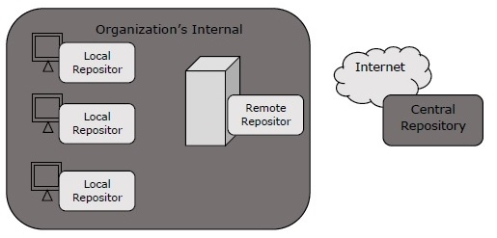
Maven Repositories
There are 3 types of maven repositories :
Local Repositories : Available on local machine.
Default Location : USER_HOME/.m2
To change its location , set the path of local repo in settings.xml file.(settings.xml is present in MAVEN_HOME/conf/settings.xml).

Slide 7
Maven Repositories
2. Central Repository : Available on web.
If a resource is not present/hosted at local repo, it will be searched on central repo.
Created by the apache maven community.
Location : http://repo1.maven.org/maven2/
Central repo is useful to find a lot of dependencies of libraries that can be
viewed on http://search.maven.org/#browse
3. Remote Repository :
Apart from central repository, you may have needed artifacts deployed on other remote locations. For example, in your corporate office there may be projects or modules specific to organization only. In this cases, organization can create remote repository and deploy these private artifacts. This remote repository will be accessible only inside organization.

Slide 8
Maven Repositories
These maven remote repository work exactly same way as maven’s central repository. Whenever an artifact is needed from these repositories, it is first downloaded to developer’s local repository and then it is used.
We can configure a remote repository in the POM file or super POM file in remote repository itself.
<repositories>
<repository>
<id>org.source.repo</id>
<url>http://maven.orgName.com/maven2/</url>
</repository>
</repositories>

Slide 9
Sample Example
Command : archetype:generate
Syntax :
mvn archetype:generate - DgroupId=groupid DartifactId=artifactid
-DarchetypeArtifactId=maven-archetype-quickstart -DinteractiveMode=booleanValue
Example : mvn archetype:generate -DgroupId=com.dxc -DartifactId=sample -DarchetypeArtifactId=maven-archetype-quickstart -DinteractiveMode=false

Slide 10
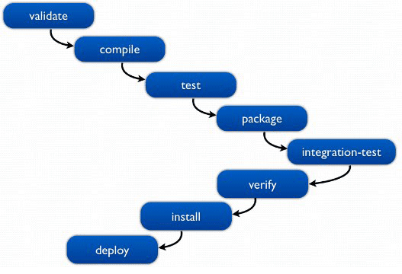
Build Lifecycle

Slide 11
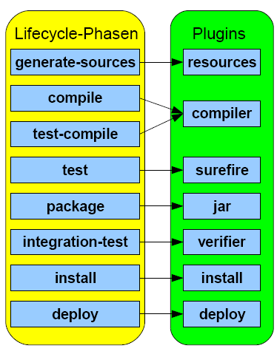
Build Cycle Plugins

Slide 12
Build Cycle Plugins
After creating the maven project , just cd into the project folder and issue any of the maven build cycle command.
For example
mvn install
This will execute all the commands before install build cycle and will copy the generated jar in the local repository

Slide 13
What is POM ?
*POM stands for "Project Object Model“.
*It is an XML representation of a Maven project held in a file named pom.xml.
We might think that a project is just of set of files containing some code.
But a project is beyond that .
A project contains
configuration files.
developers involved and the roles they play.
the defect tracking system.
the organization and licenses.
the URL of where the project lives.
the project's dependencies.
pom is a one-stop-shop for all things concerning the project . In maven project, a project need not contain any code at all, merely a pom.xml.

Slide 14
Elements of POM
project : The root element of pom.xml file.
modelVersion : It is the sub element of project.
Specifies the modelVersion.
It should be set to 4.0.0.
groupId : Sub element of project.
Specifies the id for the project group.
artifactId : Sub element of project.
It specifies the id for the artifact (project).
An artifact is something that is either produced or used by a project. Examples of artifacts produced by Maven for a project include: JARs, source and binary distributions, and WARs.
version : It is the sub element of project.
It specifies the version of the artifact under given group.

Slide 15
Sample POM : Screenshot
<project xmlns="http://maven.apache.org/POM/4.0.0"
xmlns:xsi="http://www.w3.org/2001/XMLSchema-instance"
xsi:schemaLocation="http://maven.apache.org/POM/4.0.0
http://maven.apache.org/xsd/maven-4.0.0.xsd">
<modelVersion>4.0.0</modelVersion>
<groupId>com.dxc.app1</groupId>
<artifactId>sample-app</artifactId>
<version>1</version>
</project>

Slide 16
Additional elements
More elements in pom.xml file can be added:
packaging : defines packaging type such as jar, war etc.
name : defines name of the maven project.
url : defines url of the project.
dependencies : defines dependencies for this project.
dependency :defines a dependency. It is used inside dependencies.
scope : defines scope for this maven project. It can be compile, provided, runtime, test and system.

Slide 17
Another Screenshot : POM.xml
<project xmlns="http://maven.apache.org/POM/4.0.0"
xmlns:xsi="http://www.w3.org/2001/XMLSchema-instance"
xsi:schemaLocation="http://maven.apache.org/POM/4.0.0
http://maven.apache.org/xsd/maven-4.0.0.xsd">
<modelVersion>4.0.0</modelVersion>
<groupId>com.dxc.appl1</groupId>
<artifactId>my-application1</artifactId>
<version>1.0</version>
<packaging>jar</packaging>
<name>Maven Quick Start Archetype</name>
<url>http://maven.apache.org</url>
<dependencies>
<dependency>
<groupId>junit</groupId>
<artifactId>junit</artifactId>
<version>4.8.2</version>
<scope>test</scope>
</dependency>
</dependencies>
</project>

