Slide 1

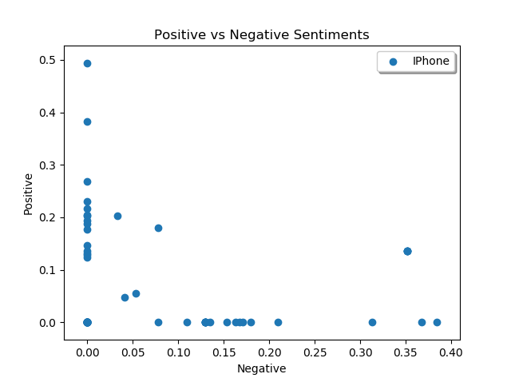
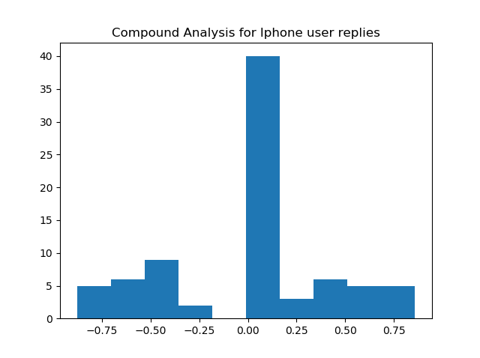

IPhone Users reaction towards Android Tweets
Nikitha Lakmarapu
School of Computer Science and Information Systems, Northwest Missouri State University
Introduction
Results
Conclusions
The goal of this project is to find the reactions of IPhone users for the tweets related to Android.
Finding Compound sentiment analysis for IPhone Users Reply done to Android Tweets.
Based on the results from this analysis, It is clear that IPhone users are more negative towards the tweets of android.
They less agree to the statements done and less satisfied to the tweets of android.
Replies from IPhone users where mostly negative and neutral to the tweets.
Looking back to the Question:” Are IPhone users positive when tweeting about the android event/tweet?” Based on the results I can make some assertions.
IPhone users are not so satisfied with the tweets done by the Android.
85% of IPhone users are negative and neutral when there is a tweet or event about Android.
Methods
I used Python Tweepy module to grab tweets for Android Account.
I also used Twitter API for cursor which is used to grab information through redirected pages.
I grabbed information from 2 pages which contains about 200 replies for tweets of Android.
Additional Resources
Poster Repository
API module: http://docs.tweepy.org/en/v3.5.0/cursor_tutorial.html
Tweepy documentation: http:// bit.ly/tweAPI
https://github.com/NikithaLakmarapu/posterDraftLakmarapu

