Slide 1

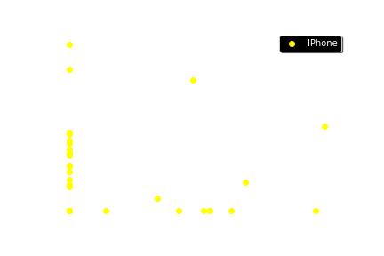

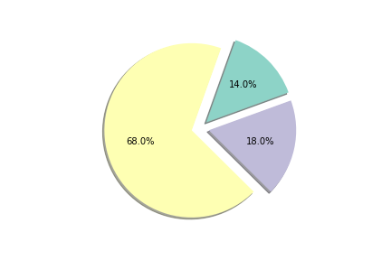

IPhone Users reaction towards Android Tweets
Nikitha Lakmarapu
School of Computer Science and Information Systems, Northwest Missouri State University
Introduction
Results
Conclusions
The goal of this project is to find the reactions of IPhone users for the tweets related to Android account.
Finding Compound sentiment analysis for IPhone Users Reply done to Android account Tweets.
Looking back to the Question:” Are IPhone users positive when tweeting about the android event/tweet?” Based on the results I can make some assertions.
IPhone users are not so positive towards tweets done in Android account which resembles that they are not much satisfied with tweets.
Approximately 85% of IPhone users are neutral and negative when there is a tweet in Android account.
Methods
I used Python Tweepy module to grab tweets for Android Account.
I also used Twitter API for cursor which is used to grab information through redirected pages.
I grabbed information from 2 pages which contains about 200 replies for tweets of Android account.
Positive
Neutral
Negative
Additional Resources
Poster Repository
API module: http://docs.tweepy.org/en/v3.5.0/cursor_tutorial.html
Tweepy documentation: http://docs.tweepy.org/en/v3.5.0/
https://github.com/NikithaLakmarapu/posterDraftLakmarapu

