Slide 1
TALKING FINGERS
PIP2001 Capstone Project
Final Review
Batch Number: GRP-12
Under the Supervision of,
Mr. Sheik Jamil Ahmed
School of Computer Science and Engineering
Presidency University
Roll Number | Student Name
20211ISR0023 | Naga Nikhitha P
20211ISR0086 | Sarthak Mishra
20211ISR0073 | Darshan.S
Name of the Program: B. TECH
Name of the HoD: ZAFAR ALI
Name of the Program Project Coordinator: Mr. Sheik Jamil Ahmed
Name of the School Project Coordinators: Dr. Sampath A K / Dr. Abdul Khadar A / Mr. Md Ziaur Rahman

Slide 2
Introduction
Sign language is the only way to communicate who are unable to speak and hear and also it is a good way for sharing ideas emotions and feelings. Sign language is the preferred method among the deaf and dumb community for communication.
Hence in this project report, we introduced a web application that converts text input into the form of sign language gifs and also sign language gestures in the form of text to communicate easily between deaf-dumb and normal people.
As we know communication is an important part of everyone's life because it helps us to bond with the world so that it is everyone's right to commune that we thought about Talking fingers because it's a great initiative towards deaf and dumb people.

Slide 3
Literature Review
Title of the Paper | Key Findings
Bridging Communication Gaps: Real-Time Translation of Audio/Text to Sign Language | The application demonstrated high accuracy in gesture recognition, improved communication effectiveness, and received positive user feedback for its educational resources and usability.
Sign Language Recognition Application Systems for Deaf-Mute People: A Review Based on Input-Process-Output | Various methods exist for sign language recognition, but they face challenges like high costs and limitations in commercialization, with neural networks and other advanced models showing the most promise​
Continuous Indian Sign Language Gesture Recognition and Sentence Formation | the purpose is to develop a framework for recognizing and translating continuous Indian Sign Language gestures into meaningful sentences using key-frame extraction and classification, with key findings showing that Euclidean distance and correlation classifiers provide the highest accuracy in gesture recognition​

Slide 4
Multi-Modal Deep Hand Sign Language Recognition in Still Images Using Restricted Boltzmann Machine | the objective is to use multi-modal deep learning for hand sign language recognition, and the key finding is that the proposed model achieves state-of-the-art accuracy by fusing RGB and depth modalities while being robust against noise​

Slide 5
Proposed Method
Real-Time Translation: Instant conversion of spoken or typed inputs to sign language and vice versa.
Input Recognition:
Allow text entry through a user-friendly interface.
Capture sign language gestures using a webcam and process them with computer vision techniques.
Data Processing:
Analyze text for keywords and phrases using Natural Language Processing (NLP) techniques.
Convert recognized gestures to text using gesture recognition algorithms (e.g., OpenCV).
Gesture Mapping:
Use machine learning models (e.g., TensorFlow) to map text to sign language gestures and vice versa.
GIF Generation:
Retrieve corresponding sign language GIFs from a pre-built library.
Output Generation:
Display sign language GIFs and optional text output for clarity.

Slide 6
Objectives
The main objective of this project is to design a possible sign language translator for deaf and dumb people. While sign language is very important to deaf-dumb people, to communicate both with normal people and with them, is still get them little attention from the normal people.
To help normal people to interact easily with deaf-dumb people.
Deaf-dumb people will also easily communicate with new technologies.
To teach normal people sign language in their comfort.
To be able to understand deaf and dumb people feeling.

Slide 7
Methodology/Modules
Input Recognition:
Text Input: Provide a text box for direct user input.
Sign Language Input: Capture gestures via webcam using computer vision techniques.
Data Processing:
Text Analysis: Apply Natural Language Processing (NLP) for keyword identification.
Gesture Recognition: Use OpenCV to convert gestures into text.

Slide 8
Methodology/Modules
Gesture Mapping:
Machine Learning Models: Train models to map text to sign language and vice versa.
Mapping Process: Match keywords to gestures for text-to-sign; use models for sign-to-text.
Output Generation:
GIF Library: Maintain a library of sign language GIFs for visual representation.
Dynamic Display: Show GIFs alongside generated text.

Slide 9
Architecture
Modular Design:
The app is built using a modular architecture, allowing for flexibility and scalability. Each module (e.g., text-to-sign translation, offline database) functions independently, making it easier to update, maintain, and improve specific features without disrupting the entire system.
Text-to-Sign Language Translation Module:
Converts recognized text into corresponding sign language gestures. This module interfaces with the local sign language database and maps each word to a predefined gesture or animation. If a word is not available in the database, it falls back on spelling-based gestures or requests user input for expansion.
Sign Language Rendering Engine:
The rendering engine visualizes the signs. It either displays animated sign language gestures using pre-recorded videos or 3D avatars. This module needs to be highly optimized for smooth performance on mobile devices, ensuring quick access and rendering of sign gestures, even in offline mode.

Slide 10
Hardware/software components
Hardware: Smartphone (Android/iOS) for accessability
Software:
Frontend:
HTML/CSS/JavaScript for building the user interface.
React.js or Vue.js for dynamic UI components.
Backend:
Node.js or Python (Flask/Django) for server-side logic.
Express.js for handling API requests.
APIs:
Natural Language Processing (NLP) Libraries (e.g., NLTK, spaCy) for text analysis.
Machine Learning:
TensorFlow for training and deploying gesture recognition models.
Computer Vision:
OpenCV for processing sign language gestures.
Database:
MongoDB or PostgreSQL for storing user data and GIFs.

Slide 11
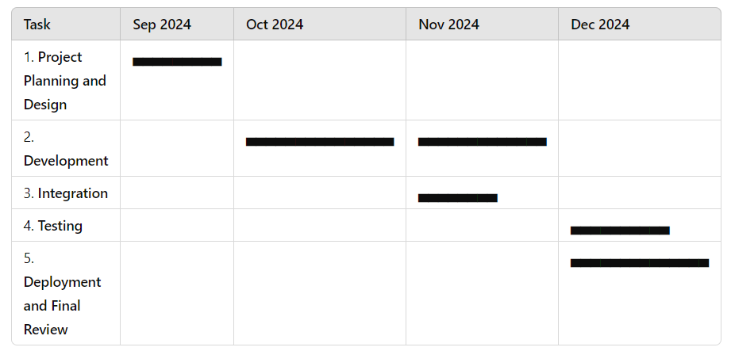
Timeline of Project

Slide 12
Expected Outcomes
A fully functional mobile app capable of real-time translation from text into sign language and vise versa.
An offline mode to ensure functionality without internet access.
The application aims for high accuracy in gesture recognition, ensuring effective communication. Deployed on a cloud platform, it will support multiple users simultaneously and feature a comprehensive database of sign language GIFs and phrases.
The project will offer insights into linguistics, computer vision, and human-computer interaction.

Slide 13
Conclusion
In conclusion, this project aims to bridge communication gaps by developing a web application that facilitates real-time translation between audio/text and sign language. By leveraging advanced technologies in speech recognition, natural language processing, and gesture recognition, the application will enhance accessibility for deaf and hard-of-hearing individuals. The incorporation of user feedback will ensure continuous improvement in translation accuracy, while educational resources will empower users to learn sign language effectively. With its scalable architecture and comprehensive database of sign language GIFs, the application is poised to foster inclusivity and community engagement. Ultimately, this project not only addresses a critical need in communication but also contributes valuable insights to the fields of linguistics, computer vision, and human-computer interaction.

Slide 14
Github Link
The Github link provided should have public access permission.
Github Link
https://github.com/NikithaPeddisetty

Slide 15
References
Mohammad Inshal Pinjari, Ketaki Patil, Achal Patil, Madhuri Hivarale ,”Talking Fingers”, International Research Journal of Modernization in Engineering Technology and Science .
Mais Yasen and Shaidah Jusoh ,” A systematic review on hand gestures recognitiontechniques,challengesand applications”, International Research Journal of Engineering and Technology (IRJET)
P.R. Futane, R.V. Dharaskar, in “hasta mudra”: An Interpretation of Indian Sign Hand Gestures. 2011 3rd International Conference on Electronics Computer Technology, vol. 2 (2011)
Suharjito,Ricky Anderson,fanny wiryana,meita Chandra ariesta,gede putra Kusuma,”Sign language recognition application systems for Dear-mute people: A review Based on input-process-output”
Disha Gangadia,varsha chamaria,vidhi doshi ,Jigyasa gandhi,” Indian Sign Language Interpretation and Sentence Formation”

Slide 16
References
Shanmukha swamy,chethan m p,mahantesh gatwadi,” Indian Sign Language Interpreter with Android Implementation”
https://github.com/Talking-Fingers-Using-TensorFlow/talking-fingers/blob/master/LICENSE
https://github.com/Talking-Fingers-Using-TensorFlow/talking-fingers/blob/master/LICENSE
Kumud Tripathi,neha baranwal,gc nandi ,” Continuous dynamic Indian Sign Language gesture recognition with invariant backgrounds”
Anuja v.nair, bindu v,” A Review on Indian Sign Language Recognition”, International Journal of Computer Applications (0975 – 8887) Volume 73– No.22, July 2013

Slide 17
Thank You

