Slide 1
SUPERCAPACITOR
By
S.Nikitha
17R21A04H3
IV-ECE-C

Slide 2
CONTENTS
INTRODUCTION
LITERATURE SURVEY
HISTORY
DESIGN
WORKING
CONSTRUCTION
TYPES
ADVANTAGES
DISADVANTAGES
APPLICATIONS

Slide 3
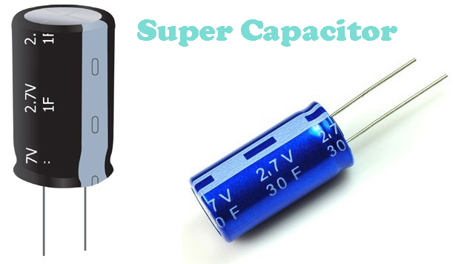
INTRODUCTION
A supercapacitor (SC), also called an ultra capacitor, is a high-capacity capacitor with a capacitance value much higher than other capacitors, but with lower voltage limits, that bridges the gap between electrolytic capacitors and rechargeable batteries. It typically stores 10 to 100 times more energy per unit volume or mass than electrolytic capacitors, can accept and deliver charge much faster than batteries, and tolerates many more charge and discharge cycles than rechargeable batteries.

Slide 4
LITERATURE SURVEY
Bockris, J. O'M.; Devanathan, M. A. V.; Muller, K. (1963). "On the Structure of Charged Interfaces". Proc. R. Soc. A. 274 (1356): 55–79. Bibcode:1963RSPSA.274...55B. doi:10.1098/rspa.1963.0114. S2CID 94958336.
Béguin, Francois; Raymundo-Piñeiro, E.; Frackowiak, Elzbieta (2009). "8. Electrical Double-Layer Capacitors and Pseudocapacitors". Carbons for Electrochemical Energy Storage and Conversion Systems. CRC Press. pp. 329–375. doi:10.1201/9781420055405-c8. ISBN 978-1-4200-5540-5.
Conway, Brian Evans (1999). Electrochemical Supercapacitors: Scientific Fundamentals and Technological Applications. Springer. doi:10.1007/978-1-4757-3058-6. ISBN 978-0306457364.

Slide 5
HISTORY
In 1957 the first supercapacitor was created by General Electric, but there aren’t any known commercial applications.
In 1996, Standard Oil accidentally discovered-double layer capacitor while working on fuel cells.
But it wasn’t until the 1970’s that the Japanese company, NEC, began commercially offering the first “supercapacitor” for computer for memory backup.

Slide 6
DESIGN
Electrochemical capacitors (super capacitors) consist of two electrodes separated by an ion-permeable membrane (separator), and an electrolyte ionically connecting both electrodes. When the electrodes are polarized by an applied voltage, ions in the electrolyte form electric double layers of opposite polarity to the electrode's polarity.
For example, positively polarized electrodes will have a layer of negative ions at the electrode/electrolyte interface along with a charge-balancing layer of positive ions adsorbing onto the negative layer. The opposite is true for the negatively polarized electrode.

Slide 7
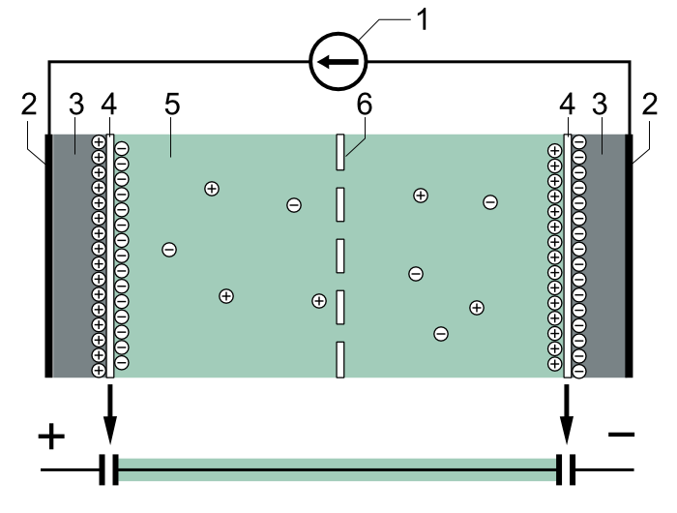
Typical construction of a supercapacitor:
(1) power source
(2) collector
(3) polarized electrode
(4) Helmholtz double layer
(5) electrolyte having positive and negative ions
(6) separator.

Slide 8
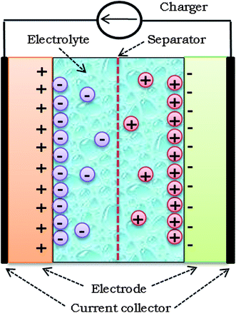
WORKING
Similar to a normal capacitor, the supercapacitor also has two parallel plates with a bigger area. But the difference is, the distance between the plates is small. The plates are made up of metals and soaked in electrolytes. The plates are separated by a thin layer called an insulator.

Slide 9
CONSTRUCTION
Supercapacitors are constructed with two metal foils (current collectors), each coated with an electrode material such as activated carbon, which serve as the power connection between the electrode material and the external terminals of the capacitor. Specifically to the electrode material is a very large surface area.

Slide 10
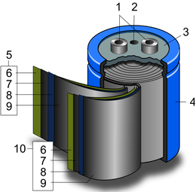
Schematic construction of a wound supercapacitor: 1. terminals
2. safety vent
3. sealing disc
4. aluminum can
5. positive pole
6. separator
7. carbon electrode
8. collector
9. carbon electrode
10. negative pole

Slide 11
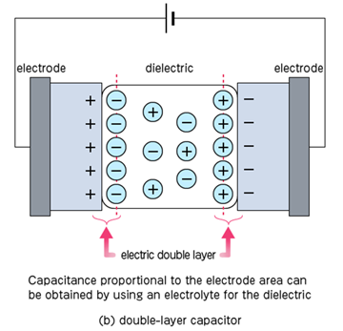
TYPES
There are three types of super capacitors based on storage principle
Double-layer capacitors (EDLCs) — with activated carbon electrodes or derivatives with much higher electrostatic double-layer capacitance than electrochemical pseudo capacitance

Slide 12
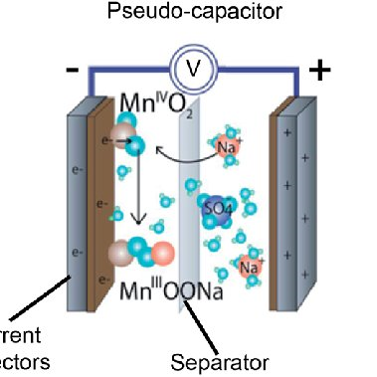
Pseudo capacitors — with transition metal oxide or conducting polymer electrodes with a high electrochemical pseudo capacitance

Slide 13
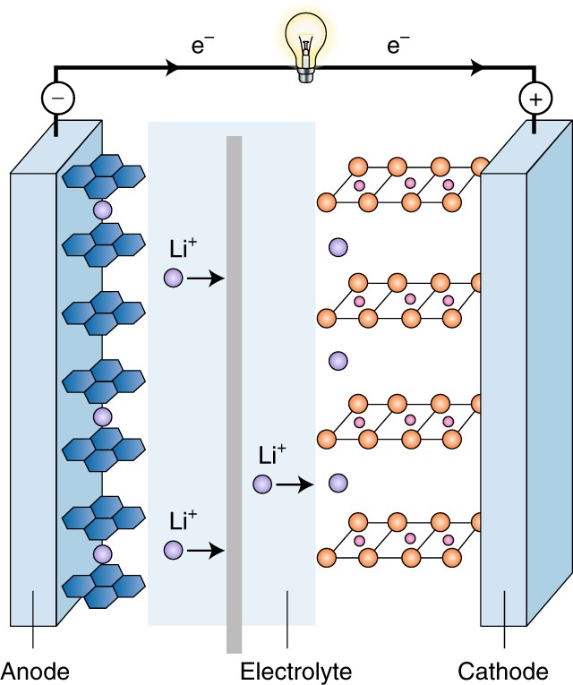
Hybrid capacitors — with asymmetric electrodes, one of which exhibits mostly electrostatic and the other mostly electrochemical capacitance, such as lithium-ion capacitors

Slide 14
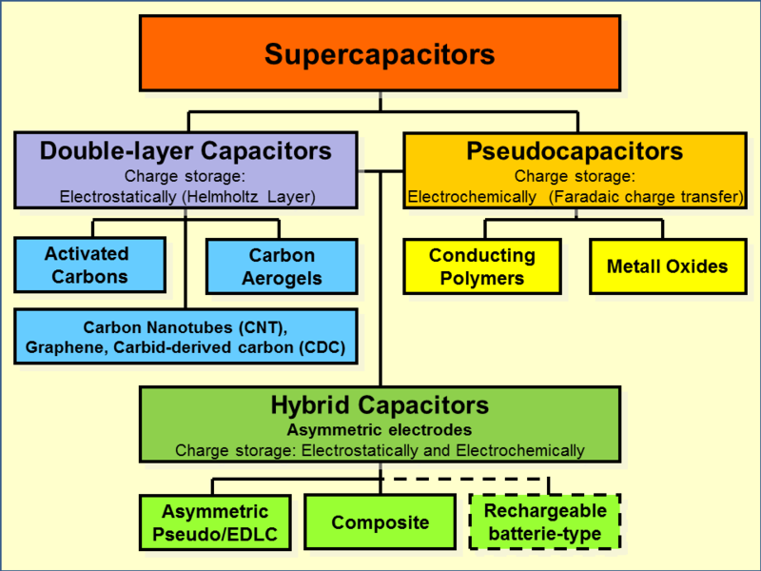
Family tree of supercapacitor types. Double-layer capacitors and pseudocapacitors as well as hybrid capacitors are defined over their electrode designs.

Slide 15
ADVANTAGES
High energy storage
Wide Working temperature
Eco-friendly
Quick charging time
Maximum life cycle
Safe

Slide 16
DISADVANTAGES
Low energy density
Cannot be used in AC and high frequency circuits
The voltage varies with the energy stored
High cost

Slide 17
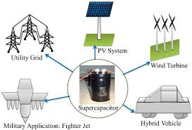
APPLICATIONS
Consumer electronics
Tools
Low-power equipment power buffer
Voltage stabilizer
Street lights

Slide 18


