Slide 1

SCHOOL OF COMPUTING
DEPARTMENT OF COMPUTER SCIENCE & ENGINEERING
WINTER SEMESTER 2024-2025
10214CS701- MAJOR PROJECT INTERNSHIP THROUGH PLACEMENT
BNP PARIBAS
“CERVICAL CANCER DETECTION USING MACHINE LEARNING”
REVIEW-1
BNP PARIBAS
PRESENTED BY
SUPERVISED BY
1. B. Rajeswari (VTU 20548)(21UECS0073)
2. K. Lakshmi Nikitha (VTU 19521)(21UECS0254)
Dr. G. Prabaharan / Associate Professor
BATCH NO : 15 DEPARTMENT OF COMPUTER SCIENCE & ENGINEERING

Slide 2
Institute/Industry Details
BNP PARIBAS
Duration of Internship (From February – To August)
Duration of Internship in Months:(6)
Industry Location(Place/State/Country): Chennai
Industry Guide Name & Designation: NA
Industry Guide Mobile Number: NA
Industry Guide Mail ID: NA
BATCH NO : 15 DEPARTMENT OF COMPUTER SCIENCE & ENGINEERING

Slide 3
AGENDA
Plagiarism Report of Presentation
Introduction & Problem Statement
Project Goals & Objectives
Literature Review & Background
Proposed System Architecture
Methodology & Implementation Plan
Technology Stack & Tools
Expected Outcomes & Deliverables
Progress & Milestones Achieved (For Review-1)
Future Work & Next Steps
Preparation of Article for Publication ( Project the completion status of article)
References
BATCH NO : 15 DEPARTMENT OF COMPUTER SCIENCE & ENGINEERING

Slide 4
Introduction & Problem Statement
Introduction: Cervical cancer is a significant health concern, particularly among women in developing countries, where access to early diagnostic tools is often limited. The Pap smear test is a widely adopted screening technique used to detect precancerous and cancerous cells in the cervix by examining cytological samples under a microscope. However, manual analysis of Pap smear slides is labor-intensive, prone to human error, and requires specialized expertise. With the advent of artificial intelligence and deep learning, there is a growing opportunity to automate and enhance the accuracy of cervical cancer detection. This project aims to leverage Convolutional Neural Networks (CNNs) to classify cervical cell images into four categories—Dyskeratotic, Koilocytotic, Metaplastic, and Parabasal using the Pap smear dataset. By automating this process, the system seeks to improve diagnostic efficiency, reduce the burden on medical professionals, and enable early detection of cervical cancer.
Problem Statement: Cervical cancer remains a major health concern due to delays in diagnosis and the limitations of manual Pap smear analysis, which is time-consuming and error-prone. This project addresses these challenges by developing a CNN-based automated system to classify cervical cell images, improving accuracy and efficiency in early detection.
BATCH NO 15: DEPARTMENT OF COMPUTER SCIENCE & ENGINEERING

Slide 5
Project Goals & Objectives
Overall Goal:To develop an automated cervical cancer detection system using CNNs that classifies cervical cell images into four categories: Dyskeratotic, Koilocytotic, Metaplastic, and Parabasal, thereby improving diagnostic efficiency and reducing human error.
Specific Objectives:
  Classify cervical cell images accurately using CNNs.
  Reduce diagnostic delays and improve early detection.
  Assist medical professionals in making informed decisions.
  Ensure the system is user-friendly and integrates seamlessly into clinical workflows.
BATCH NO : 15 DEPARTMENT OF COMPUTER SCIENCE & ENGINEERING

Slide 6
Literature Review & Background
Research Article | Authors | Methods and Findings | Remarks and Challenges
Privacy Preserved Cervical Cancer Detection Using Convolutional Neural Networks | Shtwai Alsubai et al.,2021 | This study explored the use of a regularized CNN to classify different types of cervical cancer images, aiming to improve detection accuracy. | Regularization techniques are crucial for preventing overfitting, especially in medical image analysis with limited data. Challenges include selecting appropriate regularization
A Lightweight Deep Learning Method to Identify Different Types of Cervical Cancer | Md Humaion Kabir Mehedi et al., 2024 | This study focuses on detecting cervical cancer types efficiently using a novel lightweight deep learning model named CCanNet, which combines squeeze block, residual blocks, and skip layer connections, outperforming other models.. | The proposed model demonstrates high efficiency and accuracy. Future work could explore its application in real-world clinical settings and address potential limitations in generalizability.
CVM-Cervix: A Hybrid Cervical Pap-Smear Image Classification Framework Using CNN, Visual Transformer, and Multilayer Perceptron | Wanli Liu et al., 2022 | This paper proposes a framework called CVM-Cervix based on deep learning to perform cervical cell classification tasks. It combines a Convolutional Neural Network module and a Visual Transformer module | The proposed framework shows effectiveness in cervical Pap smear image classification. Challenges include the need for large-scale annotated datasets and computational resources for training complex models
BATCH NO : DEPARTMENT OF COMPUTER SCIENCE & ENGINEERING

Slide 7
Research Article | Authors | Methods and Findings | Remarks and Challenges
Deep Convolutional Neural Networks Using an Active Learning Strategy for Cervical Cancer Screening and Diagnosis | Xueguang Li, et al.,2020 | The researchers developed a robust Deep Convolutional Neural Network (DCNN) for cervical cancer screening using whole-slide images from ThinPrep cytologic test slides. An active learning strategy was employed to improve labeling efficiency. | The study demonstrates the potential of DCNNs combined with active learning in medical diagnostics. Challenges include the need for large annotated datasets and computational resources.
Enhancing Cervical Cancer Detection and Robust Classification Through a Fusion of Deep Learning Models | Sandeep Kumar Mathivanan et.al., 2024 | This study introduced a methodology leveraging pre-trained deep neural network models, including AlexNet, ResNet-101, ResNet-152,for cervical cancer detection. | The use of pre-trained models facilitates transfer learning, beneficial when dealing with limited datasets
Privacy Preserved Cervical Cancer Detection Using Convolutional Neural Networks Applied to Pap Smear Images | Abdullah Alqahtani et,al,, 2023 | The study proposes a hybrid optimization method combining Quantum-inspired Clustering Algorithm (QCA), Deep Reinforcement Learning (DRL), and Quantum Genetic Algorithm with Ant Colony Optimization (QGA-ACO) to enhance 6G IoT traffic management and multi-routing strategies. | Scalability and latency, which can impact the efficiency of traffic management in large-scale IoT networks.
BATCH NO : DEPARTMENT OF COMPUTER SCIENCE & ENGINEERING

Slide 8
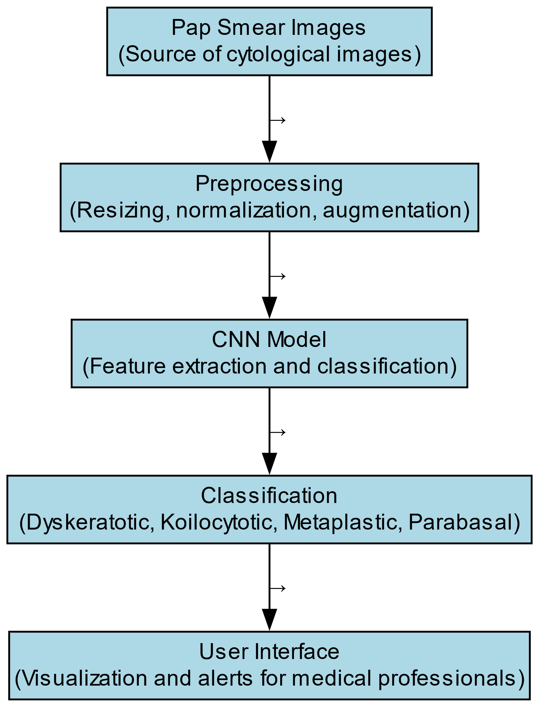
Proposed System Architecture
Concept In Business
The flow diagram illustrates the entire process of cervical cancer detection using CNNs, from image acquisition and preprocessing to classification and presentation of results. Each step is crucial in ensuring the accuracy and efficiency of the system, ultimately aiding medical professionals in making informed decisions for early detection and treatment of cervical cancer.
BATCH NO : 15 DEPARTMENT OF COMPUTER SCIENCE & ENGINEERING

Slide 9
Methodology & Implementation Plan
Methodology:
Agile development methodology to ensure flexibility and iterative improvements.
Implementation Plan:
Phase 1 (Weeks 1-4): Data collection and preprocessing
Phase 2 (Weeks 5-8):CNN model design and training.
Phase 3 (Weeks 9-12):System integration and testing.
Phase 4 (Weeks 13-16):Performance evaluation and optimization.
BATCH NO :15 DEPARTMENT OF COMPUTER SCIENCE & ENGINEERING

Slide 10
Technology Stack & Tools
Hardware:
Microscopes: High-resolution digital microscopes for capturing cervical cell images
Image Scanners: High-quality scanners for digitizing existing Pap smear slides.
Software:
Programming Languages:
Python: Primary language for developing the CNN model, preprocessing scripts, and data analysis.
  TensorFlow/PyTorch: Deep learning frameworks for building and training the CNN model.
  Keras: High-level neural networks API, running on top of TensorFlow, for easier model development.
User Interface Development:
  React Native/Flutter: Frameworks for developing cross-platform mobile applications for displaying classification results and alerts.
  HTML/CSS/JavaScript: For developing web-based user interfaces if needed.
BATCH NO : 15 DEPARTMENT OF COMPUTER SCIENCE & ENGINEERING

Slide 11
Expected Outcomes & Deliverables
The project is expected to deliver an advanced cervical cancer detection system based on Convolutional Neural Networks (CNNs). This system will classify Pap smear images into four categories: Dyskeratotic, Koilocytotic, Metaplastic, and Parabasal, providing a reliable and efficient diagnostic tool for medical professionals. The deliverables include a fully trained and validated CNN model capable of high accuracy, a user-friendly interface for easy interaction, and comprehensive documentation that outlines the methodology, implementation, and potential applications. These outcomes will not only improve the accuracy and speed of cervical cancer diagnosis but also make the technology accessible for integration into clinical workflows, potentially reducing the global burden of cervical cancer.
BATCH NO : 15 DEPARTMENT OF COMPUTER SCIENCE & ENGINEERING

Slide 12
Progress & Milestones Achieved (For Review-1)
Completed Tasks:
  Data collection and preprocessing.
  Initial CNN model design.
  Preliminary testing of the model.
Milestones Reached:
  Prototype of the preprocessing pipeline.
  Basic classification functionality.
Current Status: Ongoing model training and optimization.
BATCH NO : 15 DEPARTMENT OF COMPUTER SCIENCE & ENGINEERING

Slide 13
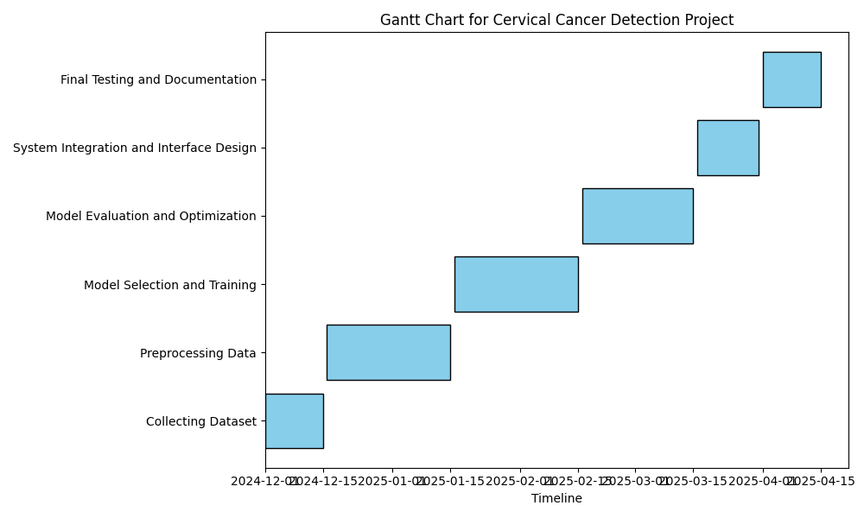
Future Work & Next Steps
Planned Activities:
Dataset Expansion: Incorporate larger and more diverse datasets from multiple sources to enhance model robustness.
Advanced Architectures: Explore hybrid models combining CNNs with transformers or recurrent neural networks for improved performance.
Real-World Validation: Conduct longitudinal studies and real-world clinical validations to assess long-term performance and practical applicability.
Timeline for Next Steps:
BATCH NO : 15 DEPARTMENT OF COMPUTER SCIENCE & ENGINEERING

Slide 14
Publication Status
Publication Status :
Manuscript Completed – The IEEE paper has been fully written and finalized.
Publication Pending – The paper has not yet been officially published but is in the final stages of the process.
BATCH NO : 15 DEPARTMENT OF COMPUTER SCIENCE & ENGINEERING

Slide 15
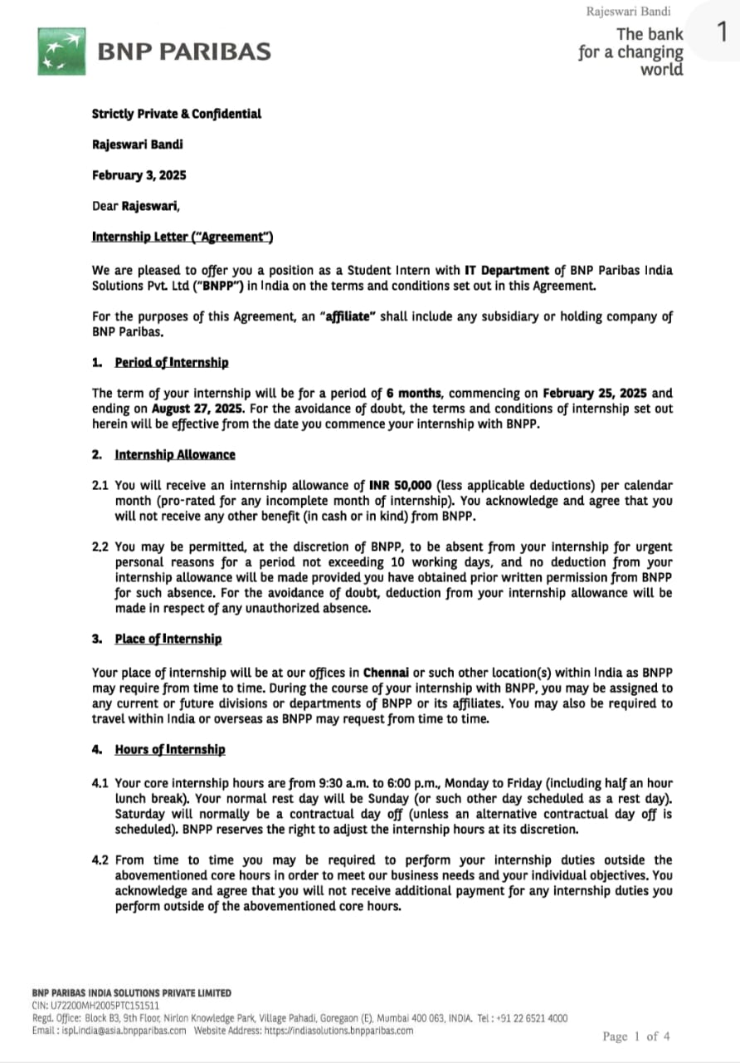
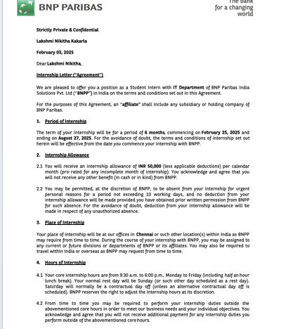
ATTACH OFFER LETTER
BATCH NO : 15 DEPARTMENT OF COMPUTER SCIENCE & ENGINEERING

Slide 16
References(as per IEEE format only)
R. Kavitha and S. Ravi, "Comparison of machine learning techniques for cervical cancer screening", Journal of Medical Systems, vol. 42, no. 6, pp. 103, 2018.
J. M. Ferreira, E. Santos, M. Correia and A. Nunes, "Cervical cancer screening by convolutional neural networks", Compuers in Biology and Medicine, vol. 113, pp. 103392, 2019.
R. Arunachalam, S. Suresh and S. Rajendran, "A novel ensemble model for the detection of cervical intraepithelial neoplasia using machine learning techniques", Journal of Medical Systems, vol. 43, no. 9, pp. 281, 2019.
W. Zhang, W. Li, G. Li, W. Li, J. Zhu and Y. Li, "Deep learning model for predicting risk of cervical cancer using clinical data and cervical images", Frontiers in Oncology, vol. 11, pp. 634784, 2021.
S. M. Zolhavarieh, M. Mohammadzadeh and S. B. Mashohor, "Classification of cervical cancer histopathology images using a combination of GLCM and fractal features", Journal of Medical Systems, vol. 43, no. 9, pp. 280, 2019.
M. A. Alim, A. Talukder, F. Khatun and M. S. Rahman, "A decision support system for cervical cancer diagnosis using machine learning algorithms", Journal of Medical Systems, vol. 45, no. 5, pp. 70, 2021.
X. Dong, J. Hu and Z. Xu, "Predicting survival of patients with cervical cancer using machine learning algorithms", Frontiers in Public Health, vol. 9, pp. 603729, 2021.
X. Wang, L. Li, S. Li, X. Zhao and X. Li, "A decision support system for high-risk HPV infection detection using machine learning algorithms", Frontiers in Microbiology, vol. 10, pp. 2307, 2019.
J. Jia, Z. Wei and Q. Li, "Identification of cervical cancer based on gene expression characteristics using machine learning techniques", Frontiers in Genetics, vol. 11, pp. 5, 2020.

Slide 17
THANK YOU!
BATCH NO : DEPARTMENT OF COMPUTER SCIENCE & ENGINEERING

